Slide 1
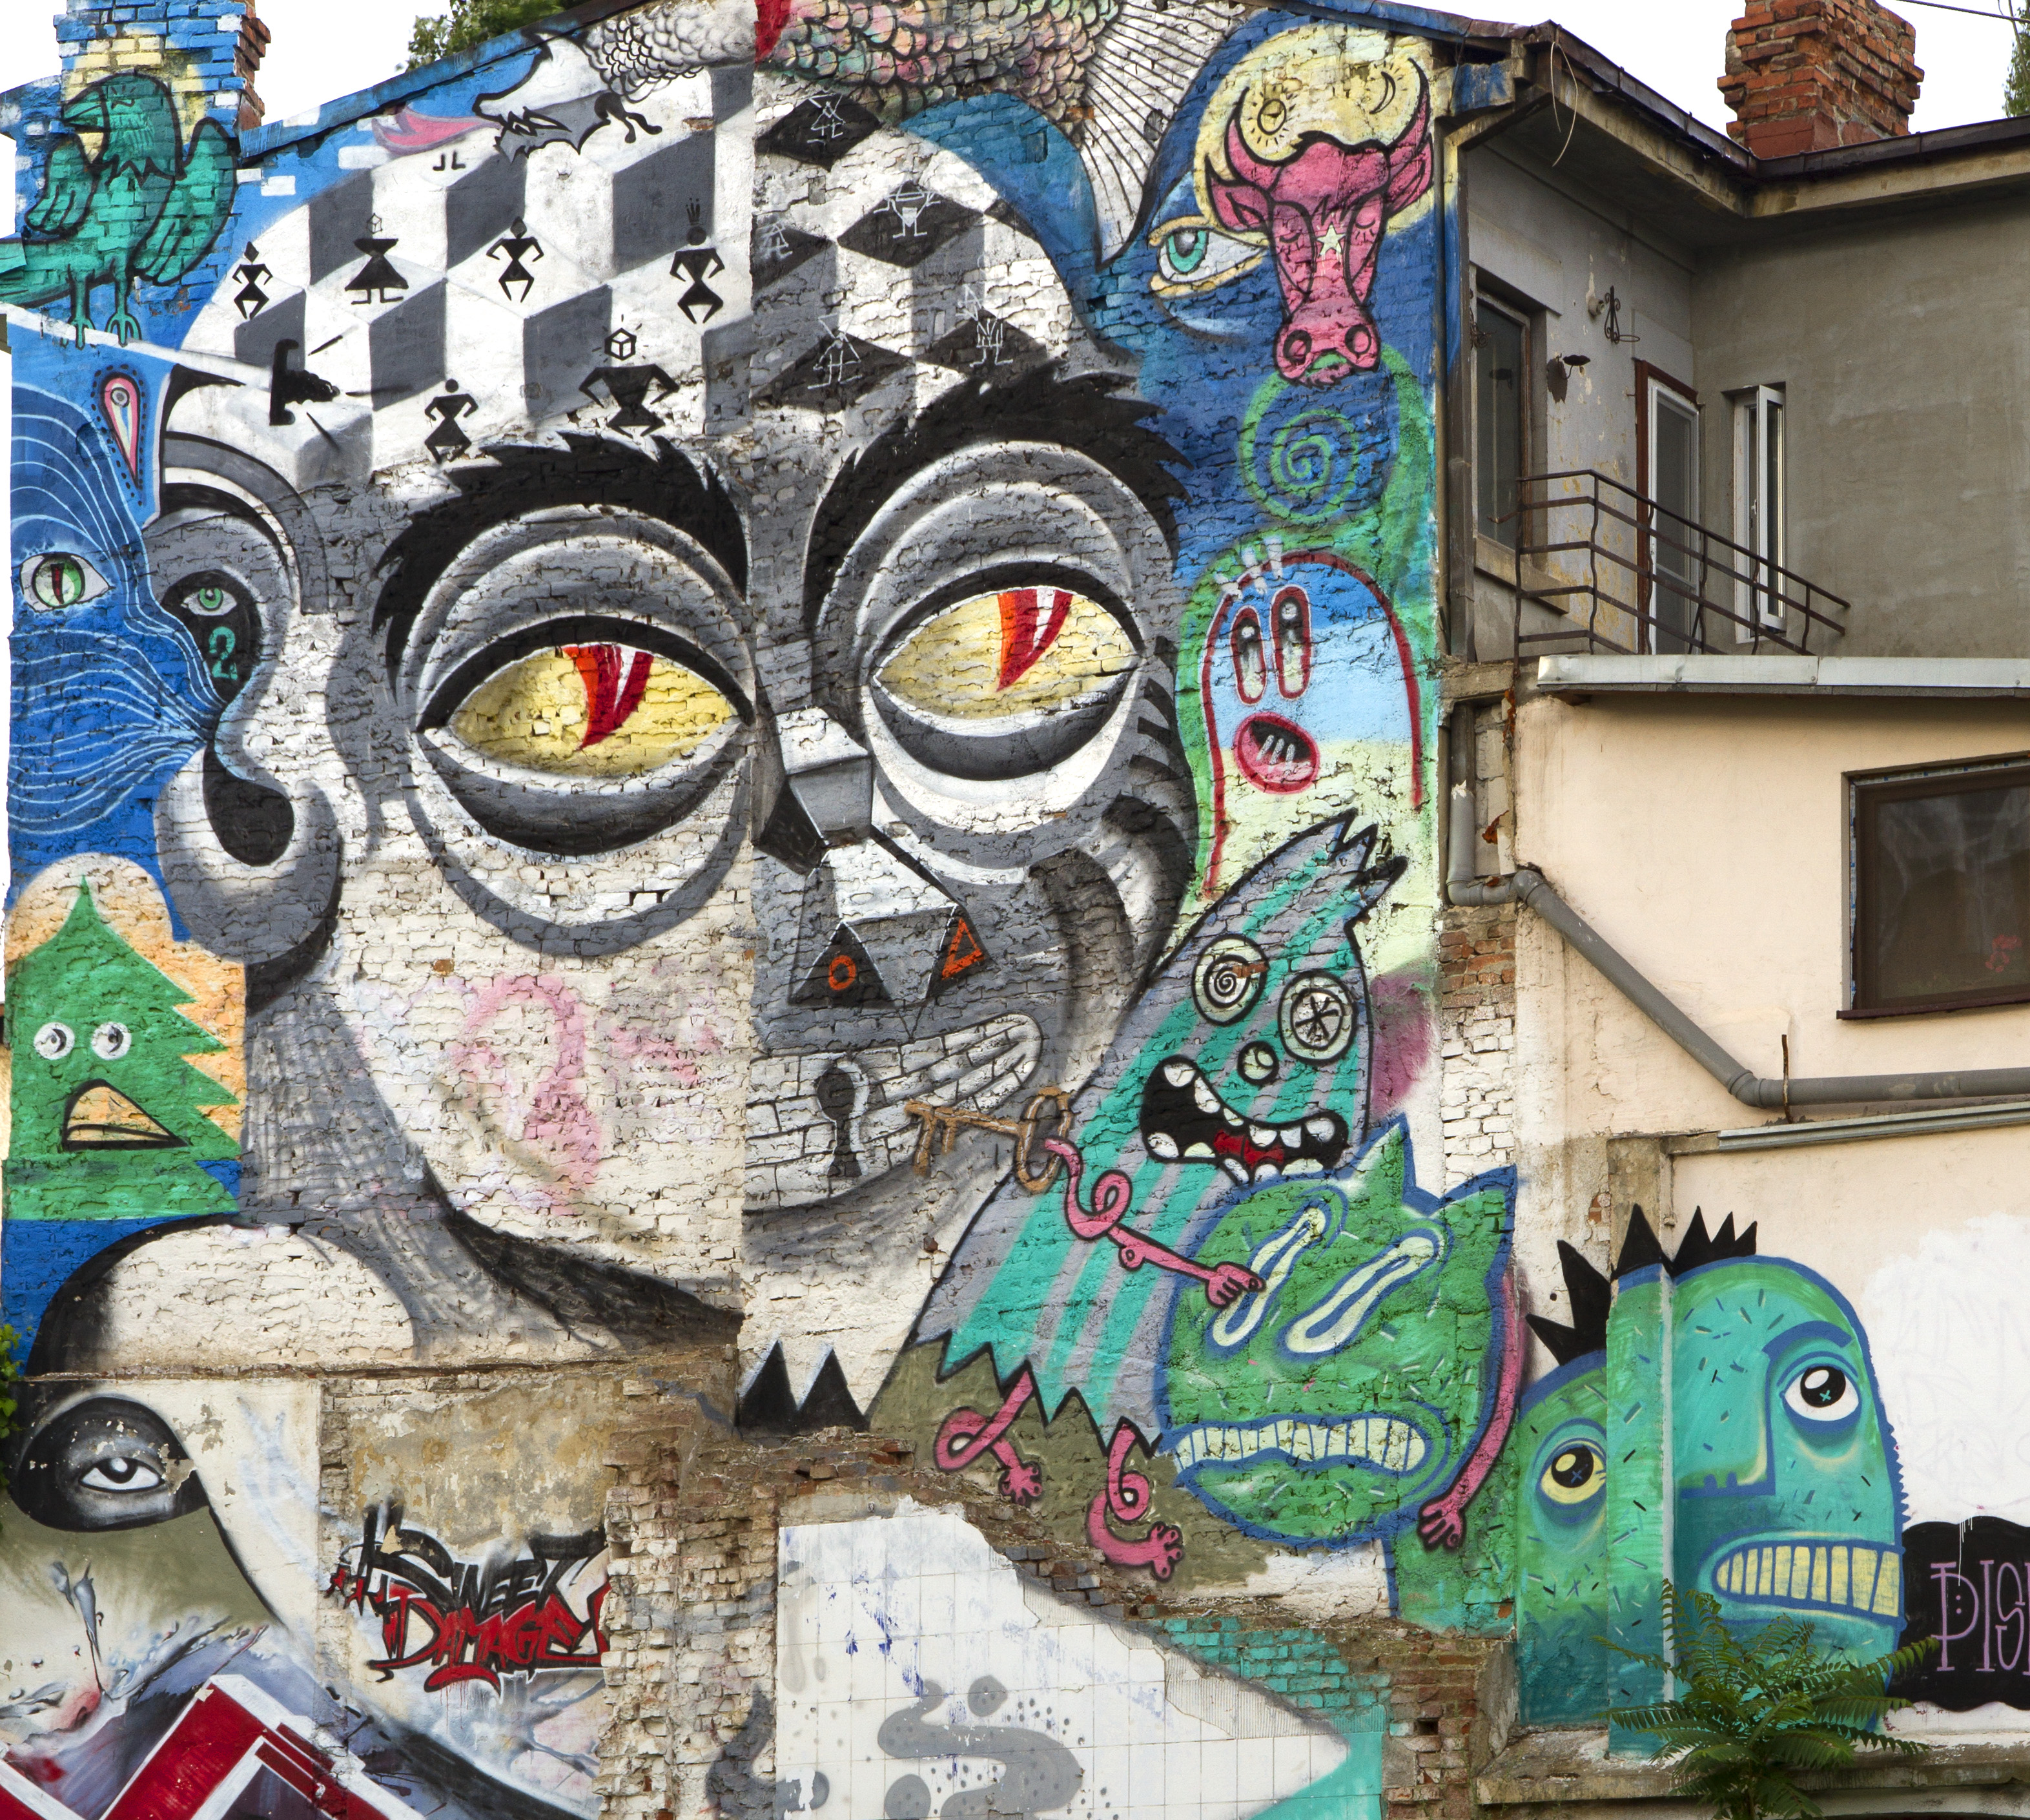

Vadim Makarov
Image: street mural in Bucharest (fragment)
© 2013 Obie Platon, Irlo, Pisica Pătrată, Last, Spesh, Lumin
Quantum cryptography
Lecture 2 in Quantum communications (continuing education) course, 30 Nov 2021

Slide 2
Communication security you enjoy daily
Paying by credit card in a supermarket
Cell phone conversations, SMS
Email, chat, online calls
Secure browsing, shopping online, content delivery
Cloud storage and communication between your devices
Software updates on your computer, phone, tablet
Online banking
Off-line banking: the bank needs to communicate internally
Electricity, water: the utility needs to communicate internally
Car keys, electronic door keys, access control
Government services (online or off-line)
Medical records at your doctor, hospital
Bypassing government surveillance and censorship
CCTV, industrial automation, military, spies...

Slide 3
A (very) brief history of cryptography
 |  |  |  |  | Broken?
Monoalphabetic cipher |  | invented ~50 BC (J. Caesar) |  |  | ~850 (Al-Kindi)
Nomenclators (code books) |  | ~1400 – ~1800 |  |  | ✓
Polyalphabetic (Vigenère) |  | 1553 – ~1900 |  |  | 1863 (F. W. Kasiski)
···
Polyalphabetic electromechanical (Enigma, Purple, etc.) |  | 1920s – 1970s |  |  | ✓
···
DES |  | 1977 – 2005 |  |  | 1998: 56 h (EFF)
Public-key crypto (RSA, elliptic-curve) |  |  | 1977 – |  | will be once we have q. computer (P. Shor 1994)
AES |  | 2001 – |  |  | ?
Public-key crypto (‘quantum-safe’) |  | in development |  |  | ?

Slide 4
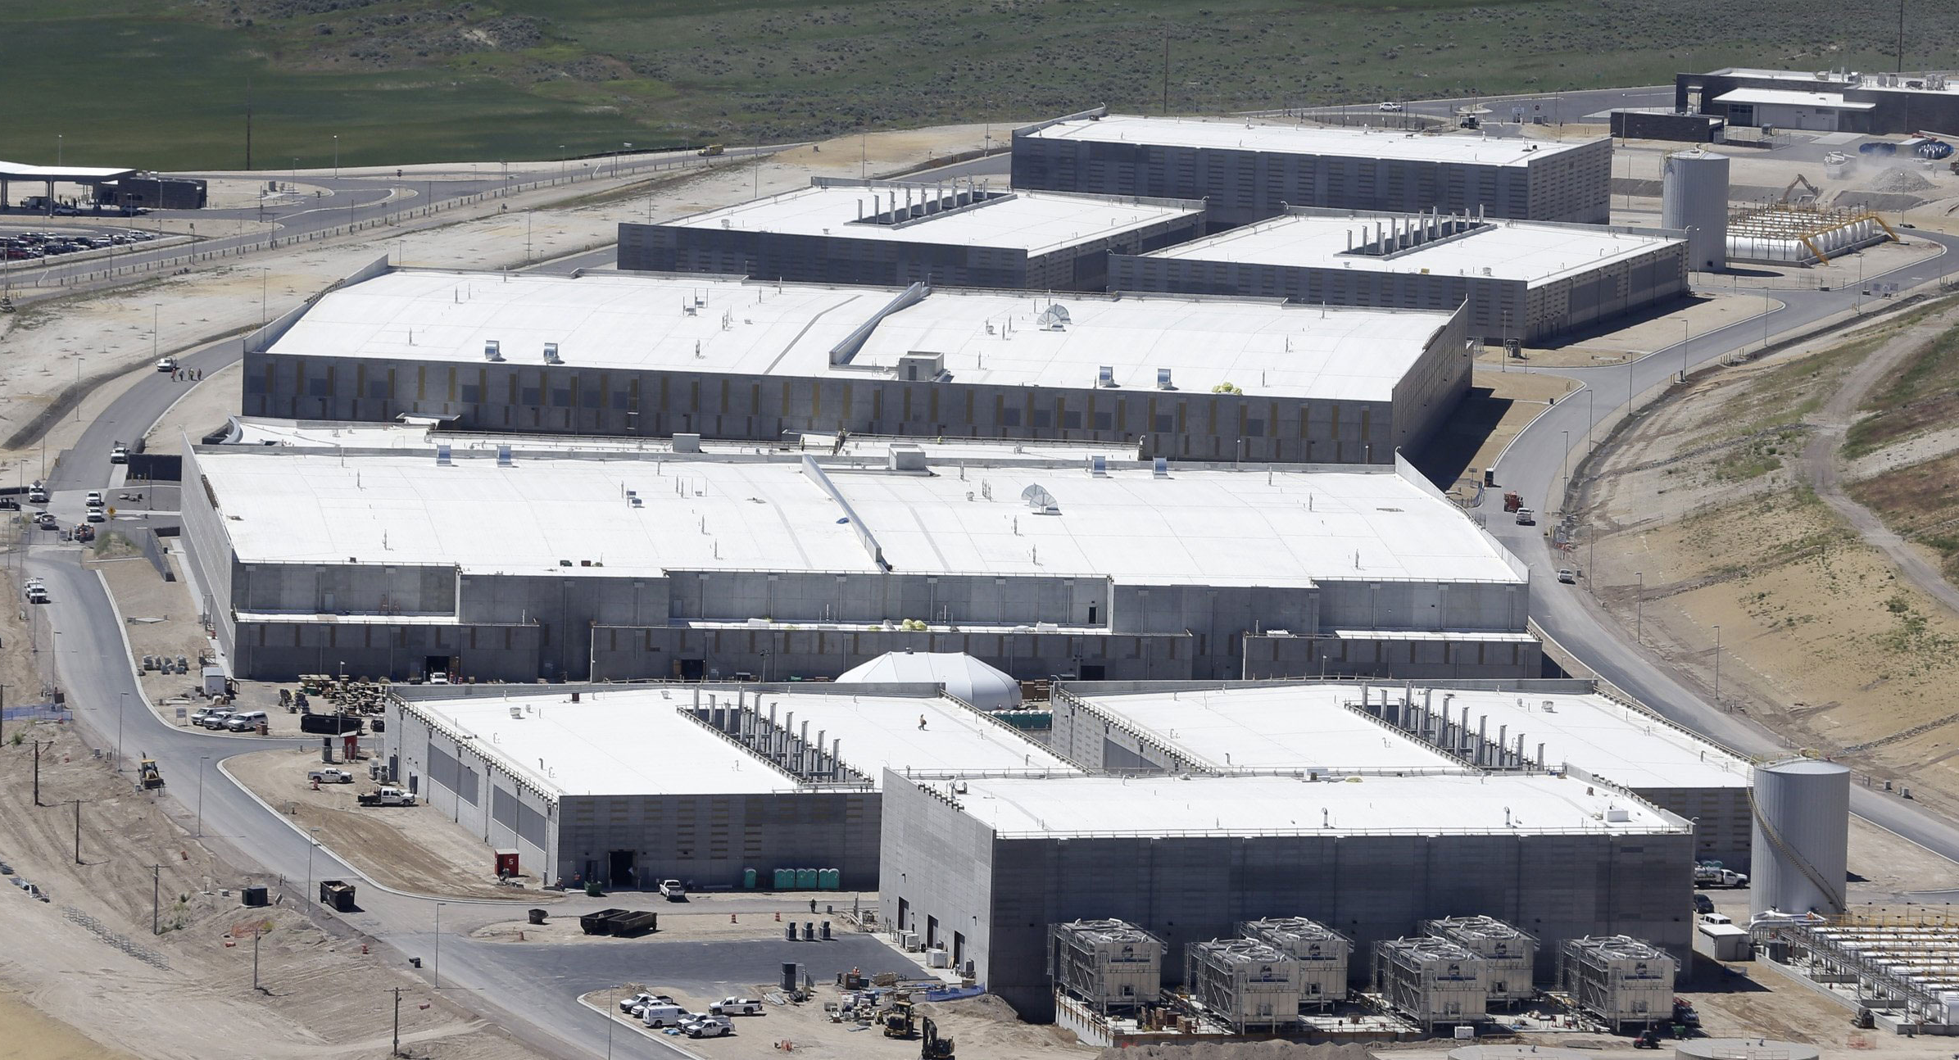
Breaking cryptography retroactively
Encrypt
In future:
Decrypt
Store copy
Decrypt
Photo © 2013 AP / Rick Bowmer
Mosca theorem
y (re-tool infrastructure)
x (encryption needs be secure)
z (time to build large quantum computer)
Time
If x + y > z, then worry.
M. Mosca, http://eprint.iacr.org/2015/1075

Slide 5
A (very) brief history of cryptography
 |  |  |  |  | Broken?
Monoalphabetic cipher |  | invented ~50 BC (J. Caesar) |  |  | ~850 (Al-Kindi)
Nomenclators (code books) |  | ~1400 – ~1800 |  |  | ✓
Polyalphabetic (Vigenère) |  | 1553 – ~1900 |  |  | 1863 (F. W. Kasiski)
···
One-time pad |  | invented 1918 (G. Vernam) |  |  | impossible (C. Shannon 1949)
Polyalphabetic electromechanical (Enigma, Purple, etc.) |  | 1920s – 1970s |  |  | ✓
···
DES |  | 1977 – 2005 |  |  | 1998: 56 h (EFF)
Public-key crypto (RSA, elliptic-curve) |  |  | 1977 – |  | will be once we have q. computer (P. Shor 1994)
AES |  | 2001 – |  |  | ?
Quantum cryptography | invented 1984, in development |  |  |  |  | impossible
Public-key crypto (‘quantum-safe’) |  | in development |  |  | ?
 |  |  |  |  | Broken?
Monoalphabetic cipher |  | invented ~50 BC (J. Caesar) |  |  | ~850 (Al-Kindi)
Nomenclators (code books) |  | ~1400 – ~1800 |  |  | ✓
Polyalphabetic (Vigenère) |  | 1553 – ~1900 |  |  | 1863 (F. W. Kasiski)
···
Polyalphabetic electromechanical (Enigma, Purple, etc.) |  | 1920s – 1970s |  |  | ✓
···
DES |  | 1977 – 2005 |  |  | 1998: 56 h (EFF)
Public-key crypto (RSA, elliptic-curve) |  |  | 1977 – |  | will be once we have q. computer (P. Shor 1994)
AES |  | 2001 – |  |  | ?
Public-key crypto (‘quantum-safe’) |  | in development |  |  | ?


Slide 6
One-time pad
Alice
Bob
Random
secret key
of same length as message
Random
secret key
Message
Message
α | β | α ⊕ β
0 | 0 | 0
0 | 1 | 1
1 | 0 | 1
1 | 1 | 0
G. Vernam, U.S. patent 1310719 (filed in 1918, granted 1919)
C. E. Shannon, Bell Syst. Tech. J. 28, 656 (1949)

Slide 7
A (very) brief history of cryptography
 |  |  |  |  | Broken?
Monoalphabetic cipher |  | invented ~50 BC (J. Caesar) |  |  | ~850 (Al-Kindi)
Nomenclators (code books) |  | ~1400 – ~1800 |  |  | ✓
Polyalphabetic (Vigenère) |  | 1553 – ~1900 |  |  | 1863 (F. W. Kasiski)
···
One-time pad |  | invented 1918 (G. Vernam) |  |  | impossible (C. Shannon 1949)
Polyalphabetic electromechanical (Enigma, Purple, etc.) |  | 1920s – 1970s |  |  | ✓
···
DES |  | 1977 – 2005 |  |  | 1998: 56 h (EFF)
Public-key crypto (RSA, elliptic-curve) |  |  | 1977 – |  | will be once we have q. computer (P. Shor 1994)
AES |  | 2001 – |  |  | ?
Quantum cryptography | invented 1984, in development |  |  |  |  | impossible
Public-key crypto (‘quantum-safe’) |  | in development |  |  | ?


Slide 8
Quantum communication primitives
 | Advantages over classical primitives:
 | Unconditionally secure? | Less resources? | Other quantum advantages?
Money | 
Key distribution | 
Secret sharing | 
Digital signatures |  | 
Superdense coding |  | 
Fingerprinting |  | 
Oblivious transfer | Impossible |  | 
Bit commitment | Impossible |  | 
Coin-tossing | 
Cloud computing | 
Software leasing | 
Bitcoin |  | 
Bell inequality testing | (no classical equivalent)
Teleportation
Entanglement swapping
Interaction-free measurement
Random number generators | 

Slide 9
Quantum communication primitives
 | Advantages over classical primitives:
 | Unconditionally secure? | Less resources? | Other quantum advantages?
Money
Key distribution | idquantique.com, quantum-info.com, qasky.com, goqrate.com
Secret sharing | W. P. Grice et al., Opt. Express 23, 7300 (2015).
Digital signatures | R. Collins et al., Phys. Rev. Lett. 113, 040502 (2014)
Superdense coding | C. H. Bennett, S. J. Wiesner, Phys. Rev. Lett. 69, 2881 (1992)
Fingerprinting | J.-Y. Guan et al., Phys. Rev. Lett. 116, 240502 (2016)
Oblivious transfer | C. Erven et al., Nat. Commun. 5, 3418 (2014)
Bit commitment | T. Lunghi et al., Phys. Rev. Lett. 111, 180504 (2013)
Coin-tossing | A. Pappa et al., Nat. Commun. 5, 3717 (2014)
Cloud computing | S. Barz et al., Science 335, 303 (2012)
Software leasing | A. Broadbent et al., arXiv:2101.12739
Bitcoin | J. Jogenfors, Proc. IEEE ICBC 2019, 245 (2019)
Bell inequality testing | B. Hensen et al., Nature 526, 682 (2015)
Teleportation | X.-S. Ma et al., Nature 489, 269 (2012)
Entanglement swapping | M. Żukowski et al., Phys. Rev. Lett. 71, 4287 (1993)
Interaction-free measurement | A. C. Elitzur, L. Vaidman, Found. Phys. 23, 987 (1993)
Random number generators | idquantique.com, picoquant.com
S. Wiesner, unpublished circa 1970, Sigact News 15, 78 (1983);
S. Aaronson, P. Christiano, Proc. STOC’12, 41 (2012)

Slide 10
Key distribution for encryption
Alice
Bob
Secure channel
RNG
Secret key
Public (insecure) channel
Symmetric
cipher
Symmetric
cipher
Encrypted messages
Messages
Messages
Quantum key distribution transmits secret key
by sending quantum states over open channel.

Slide 11


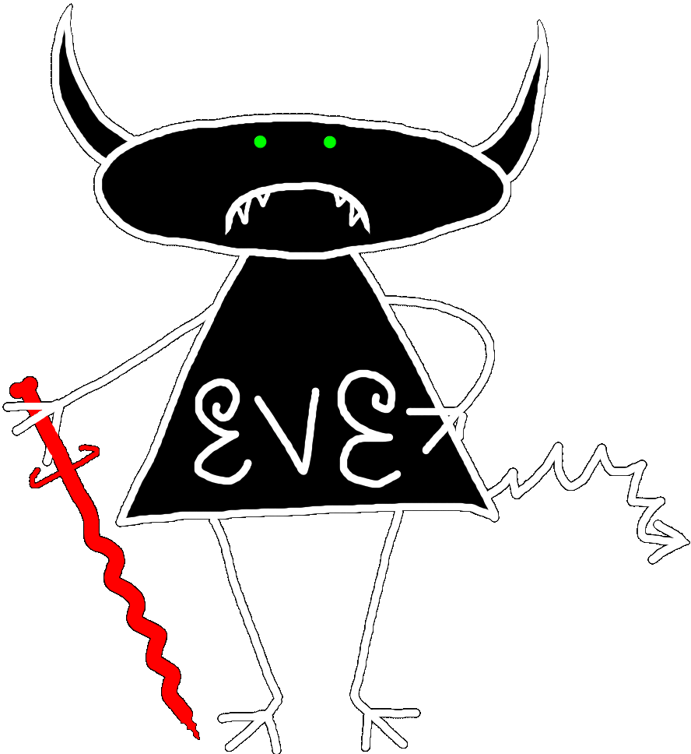
Quantum key distribution (QKD)
Alice
Bob
or ?
Prepares
photons
Measures
photons
(0), (1)
(0), (1)
Eavesdropping
introduces errors
C. H. Bennett, G. Brassard (1984)

Slide 12
Post-processing in QKD
Classical channel (e.g., internet)
Alice
Bob
Raw photon detection data
Sifting (discard bits Bob failed to detect or detected in incompatible basis)
Error correction
1
error rate
R
Secret key rate estimation
R
0
0
0.11
error rate
Privacy amplification (compress key using a hash function)
Authentication Alice–Bob
1st time: initial short key, or
public-key infrastructure
Secret key
small fraction
C. H. Bennett et al., J. Cryptology 5, 3 (1992); N. Lütkenhaus, Phys. Rev. A 59, 3301 (1999)

Slide 13
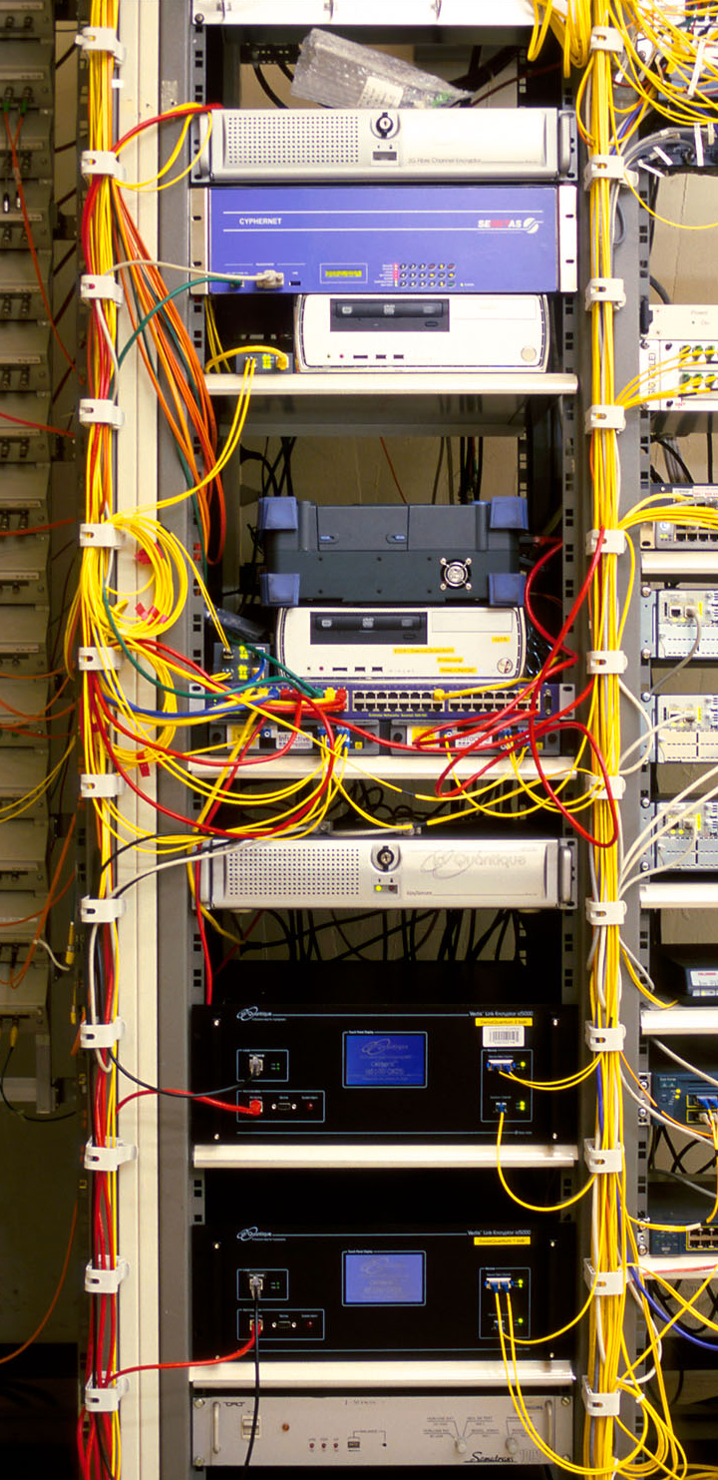
Commercial QKD
Classical encryptors:
L2, 2 Gbit/s
L2, 10 Gbit/s
L3 VPN, 100 Mbit/s
WDMs
17 km (fiber length)
Key manager
14 km
QKD to another node
(4 km)
QKD to another node
(14 km)
4 km
Photo © 2010 Vadim Makarov
www.swissquantum.com
ID Quantique Cerberis system (2010)

Slide 14
Today: trusted-node repeater
User
Trusted node
User
QKD 1
QKD 2
K1
K1
K2
K2
K1⊕K2
K1
K1⊕K2⊕K2 = K1
Future: quantum repeater
User
Untrusted node
Untrusted node
User
K1
Entanglement swapping
Entanglement swapping
K1

Slide 15
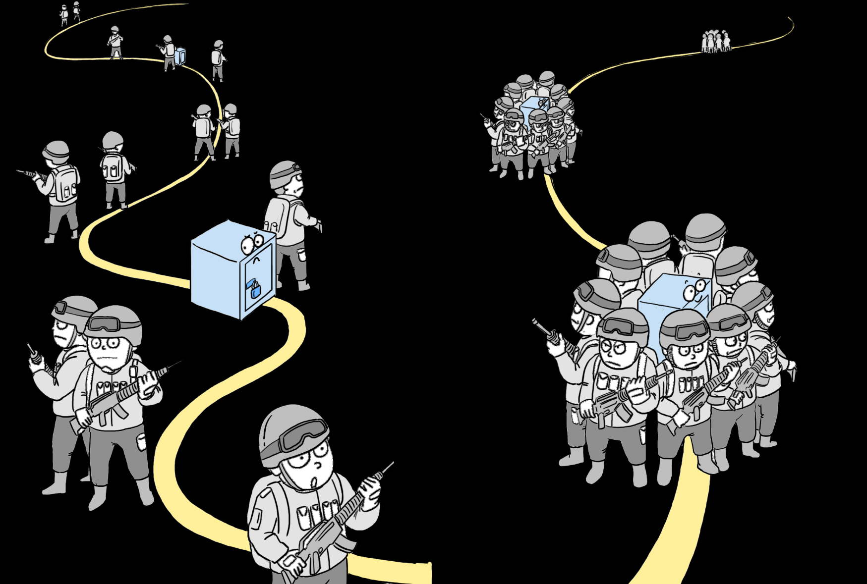
Slide courtesy Y.-A. Chen (2018)

Slide 16
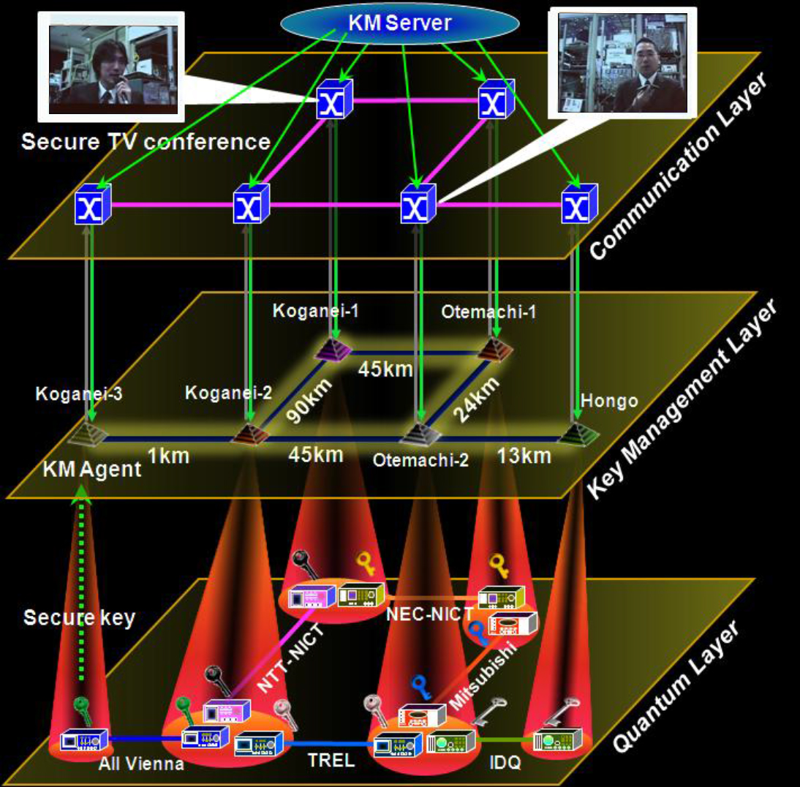
Trusted-node network
M. Sasaki et al., Opt. Express 19, 10387 (2011)

Slide 17
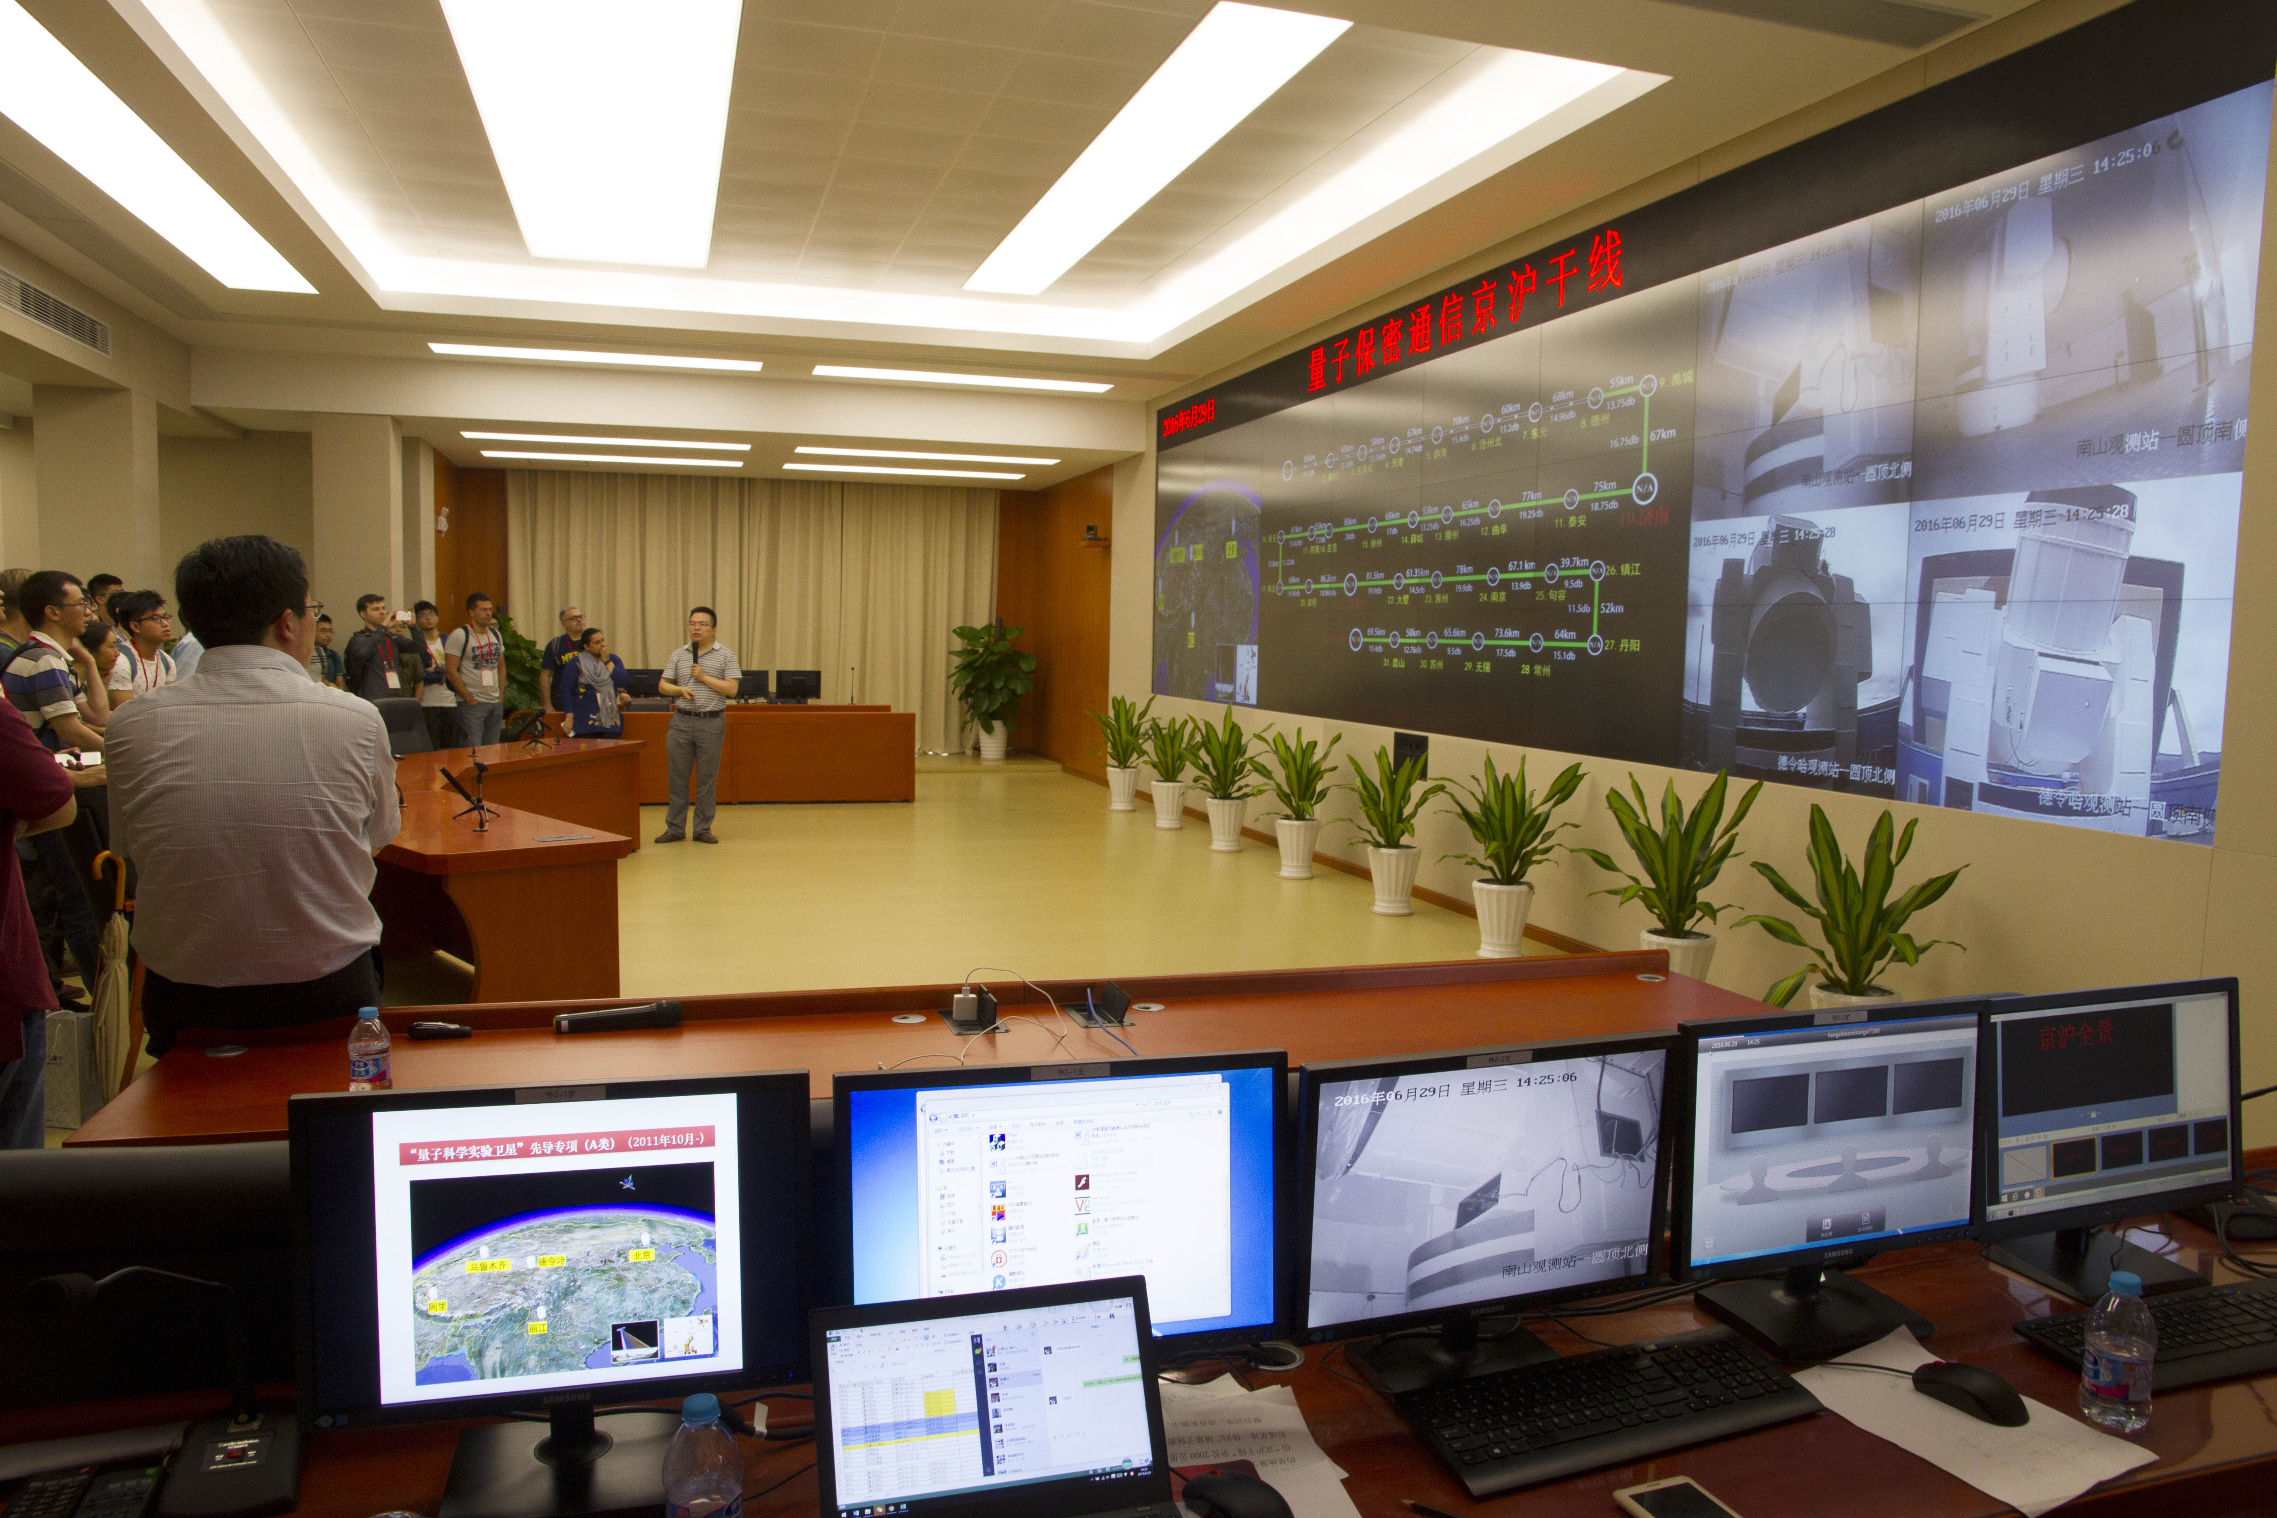
Shanghai control center of the Chinese quantum key distribution network and satellite
Photo © 2016 Vadim Makarov

Slide 18
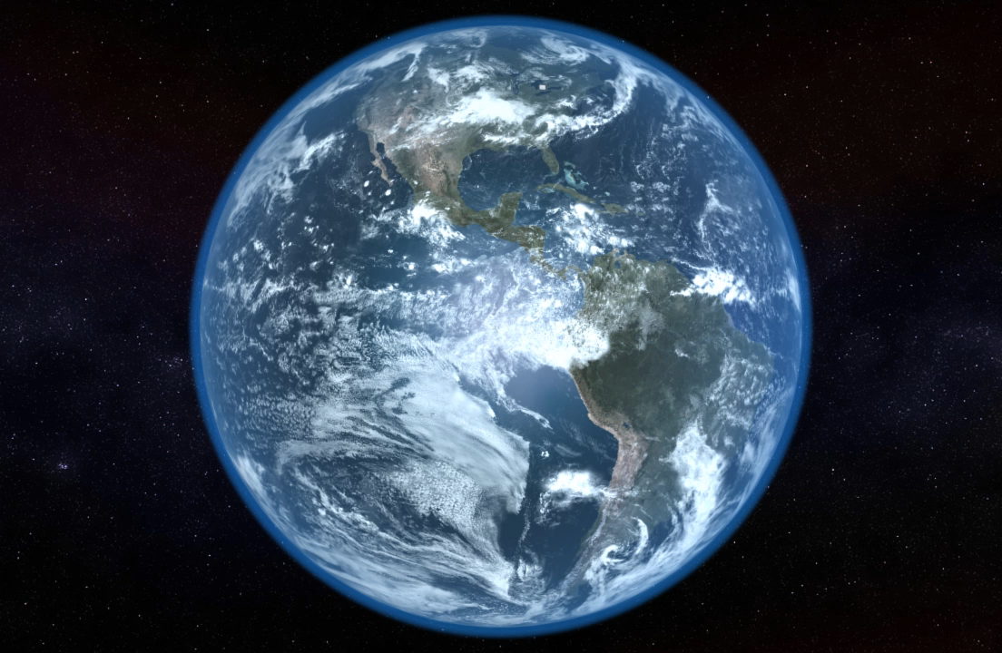
Global
quantum key distribution
Video ©2012 IQC / group of T. Jennewein

Slide 19
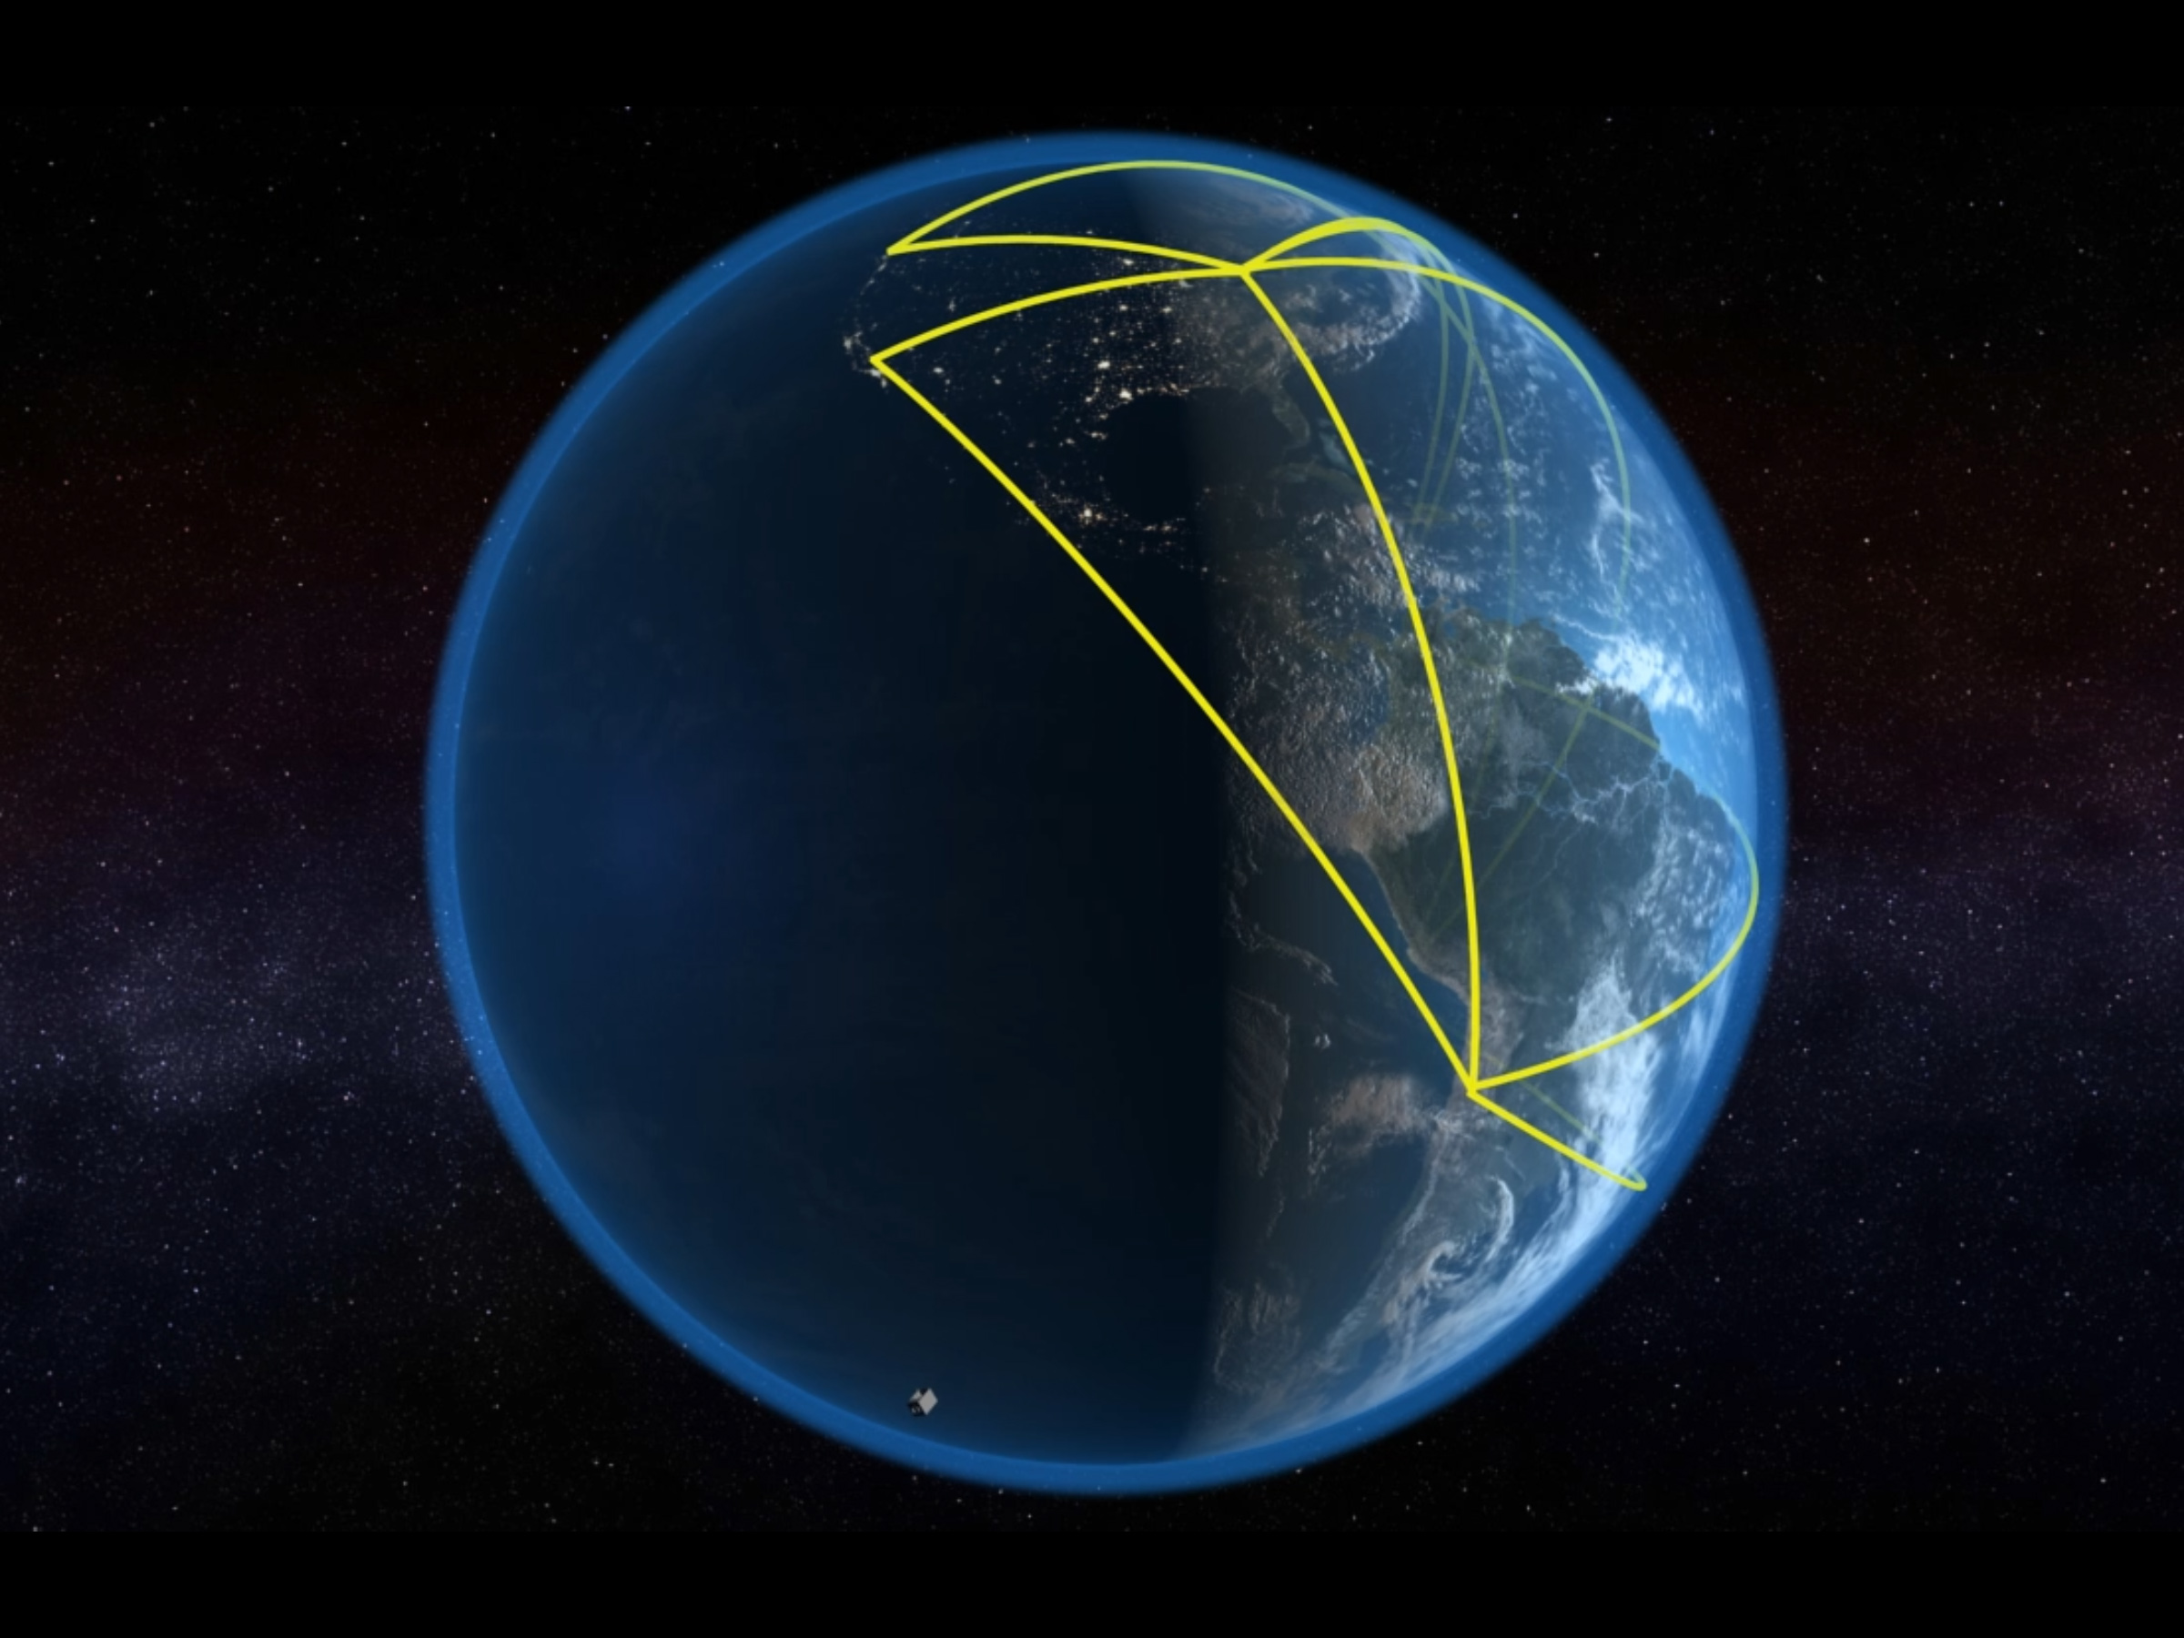
Video ©2012 IQC / group of T. Jennewein

Slide 20
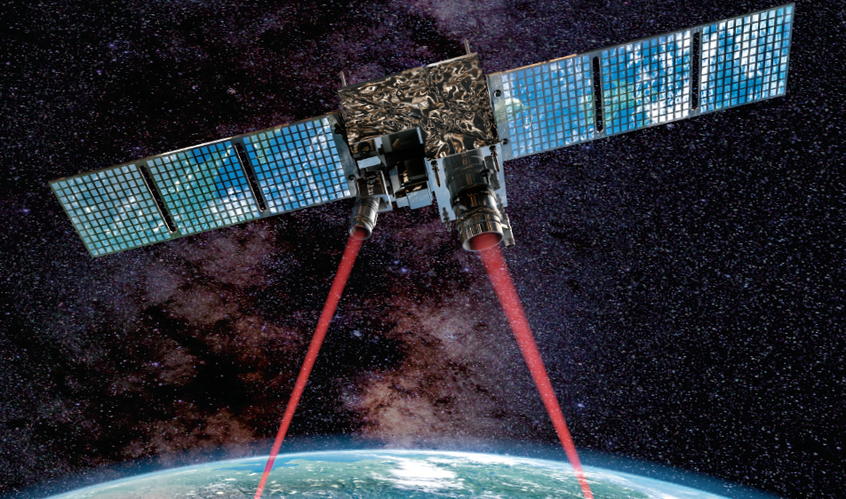
Chinese quantum satellite Micius (launched 2016)
J. Yin et al., Science 356, 1140 (2017)
S.-K. Liao et al., Nature 549, 43 (2017)
J.-G. Ren et al., Nature 549, 70 (2017)
P. Xu et al., Science 366, 132 (2019)
J. Yin et al., Nature 582, 501 (2020)
Bell test over 1200 km
Satellite-to-ground QKD at 1 kbit/s
Quantum teleportation over 1400 km
Test of a quantum gravity theory
Entangled-pair QKD over 1120 km
Graphics © 2017 C. Bickel / Science

Slide 21

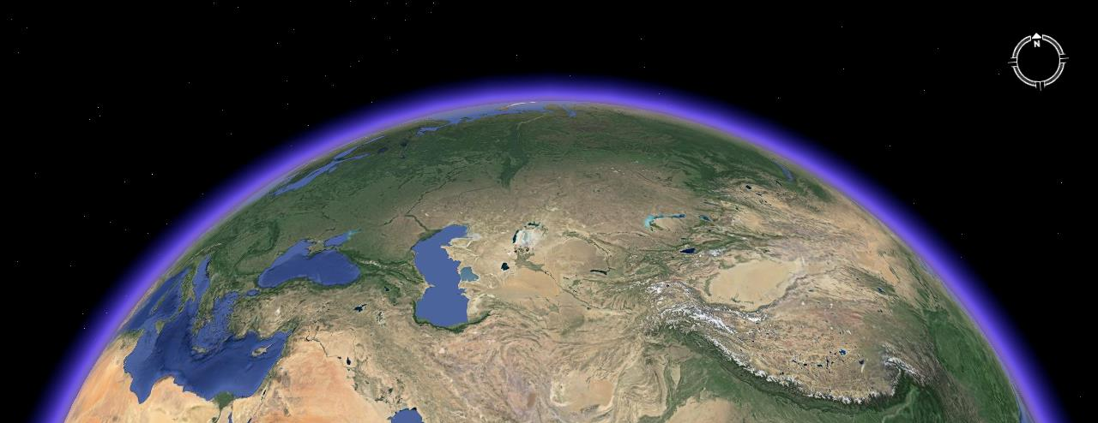

CAS Strategic Priority Research Program: Quantum Satellite
Intercontinental quantum key distribution
Vienna
Beijing
Presentation by Jian-Wei Pan at TyQI conference, Shanghai, June 27–30, 2016

Slide 22
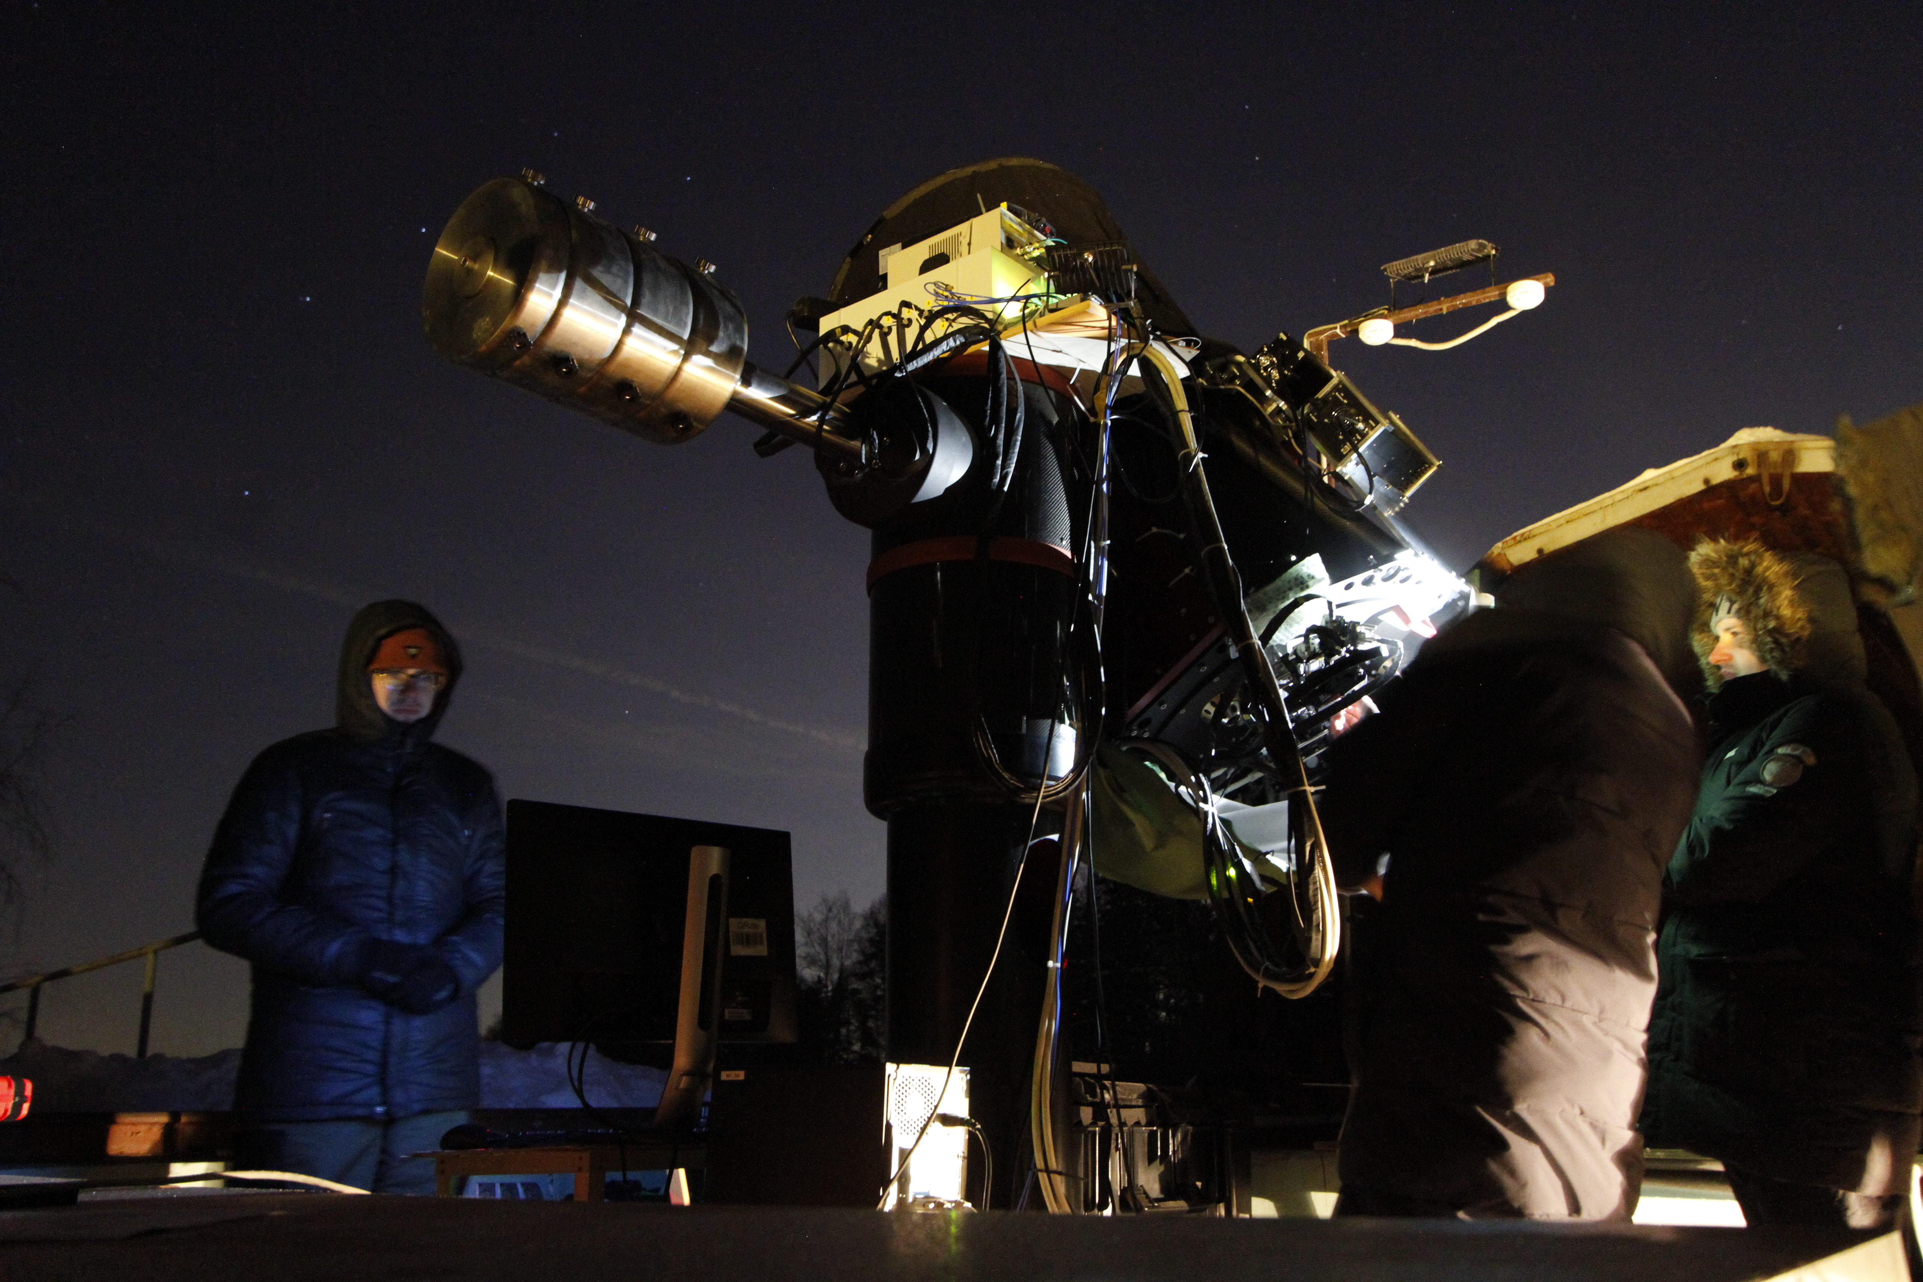

Photo © 2021 Vadim Makarov / RQC
Ground station in Zvenigorod communicates with Micius satellite (18 Jan 2021)

Slide 23
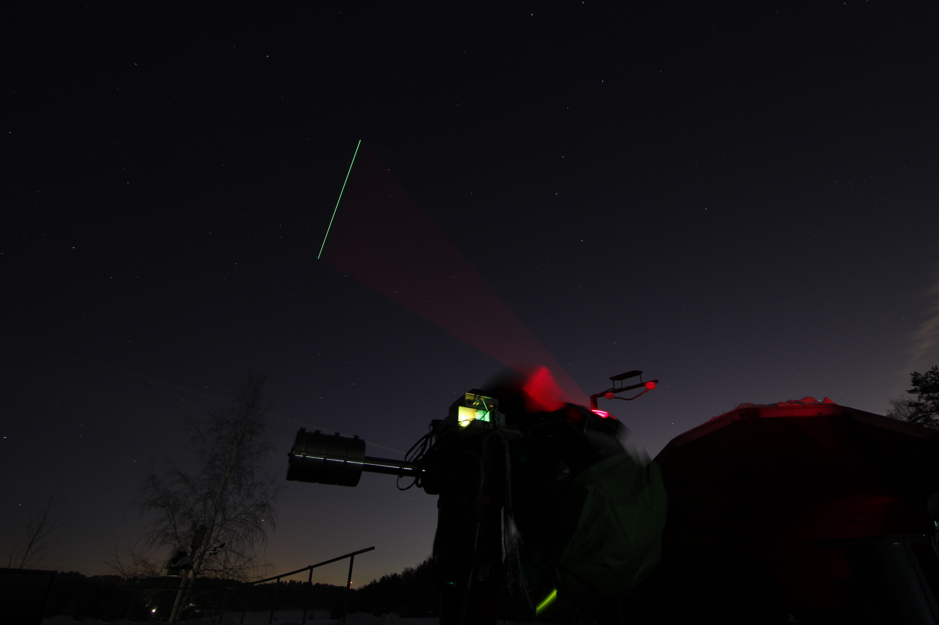
Photo © 2021 Vadim Makarov / RQC
Ground station in Zvenigorod communicates with Micius satellite (18 Jan 2021)

