Slide 1
Components of quantum-optical systems
Lecture 3 in Quantum communications (continuing education) course, 1 Dec 2021
Photon sources
Transmission channels
“Processing” elements
Photon detectors

Slide 2









Attenuated laser source
Laser diode
Attenuator
$$P_{n}\left(μ\right)=\frac{μ^{n}e^{−μ}}{n!}$$
$$μ$$
$$I$$
G
$$μ=0.2$$
$$μ=0.02$$
$$P$$
$$P$$
1
1
0.1
0.1
0.01
0.01
0.001
0.001
0 1 2 3 $n$
0 1 2 3 $n$
S. J. van Enk, C. A. Fuchs, arXiv:quant-ph/0111157

Slide 3
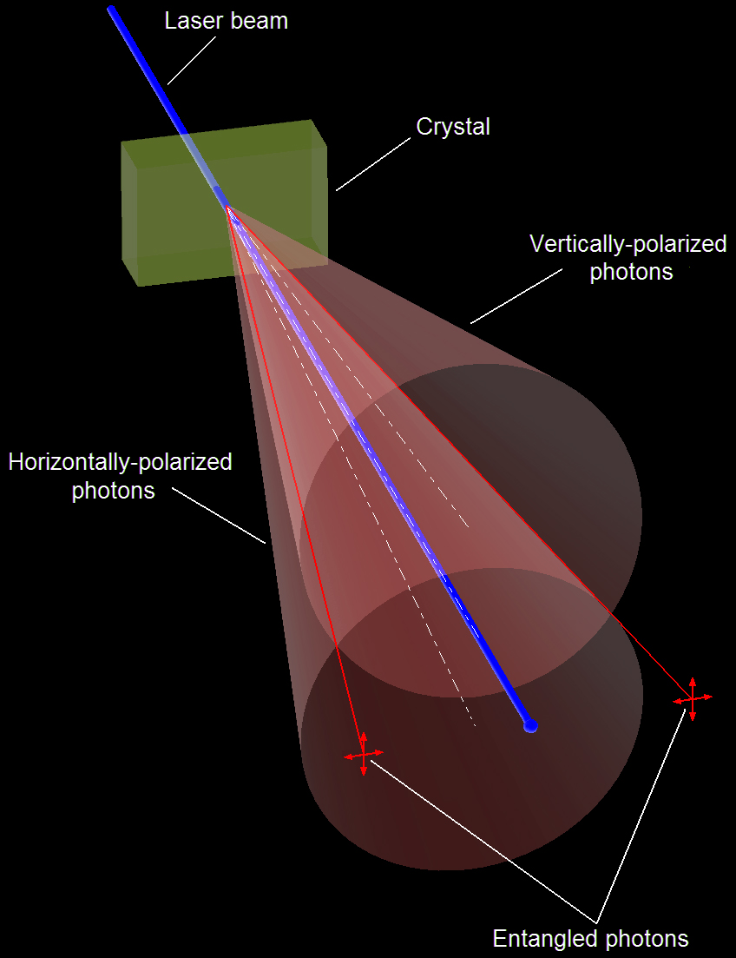

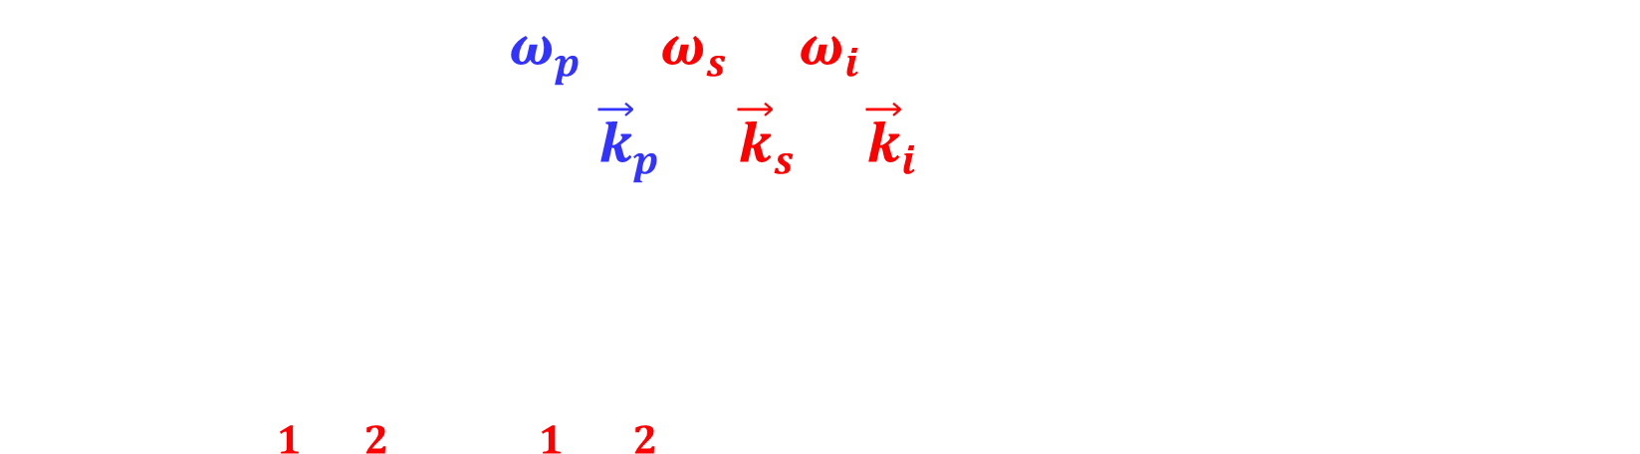




Spontaneous parametric down-conversion
Type II
$$p$$
Energy conservation: $ω_{p}=ω_{s}+ω_{i}$
Momentum conservation: ${\vec{k}}_{p}={\vec{k}}_{s}+{\vec{k}}_{i}$
$$|\left.ψ\right\rangle ={\left(|\left.H_{1},V_{2}\right\rangle +|\left.V_{1},H_{2}\right\rangle \right)}/{\sqrt{2}}$$
(BBO, etc.)
$$i$$
$$s$$
$$2$$
$$1$$
Heralded photon source
Pump
laser
Heralding detector
P. G. Kwiat et al., Phys. Rev. Lett. 75, 4337 (1995)
Image reprinted from: Wikipedia

Slide 4
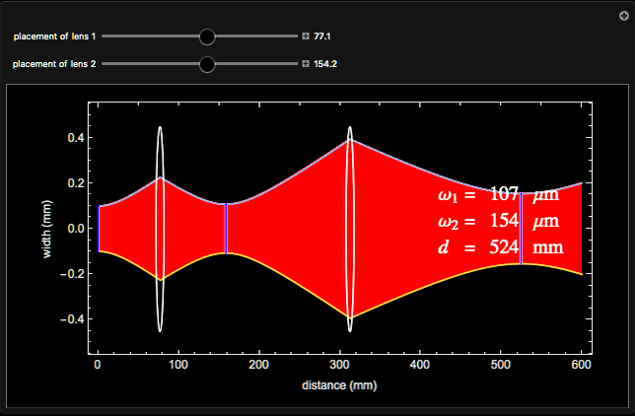
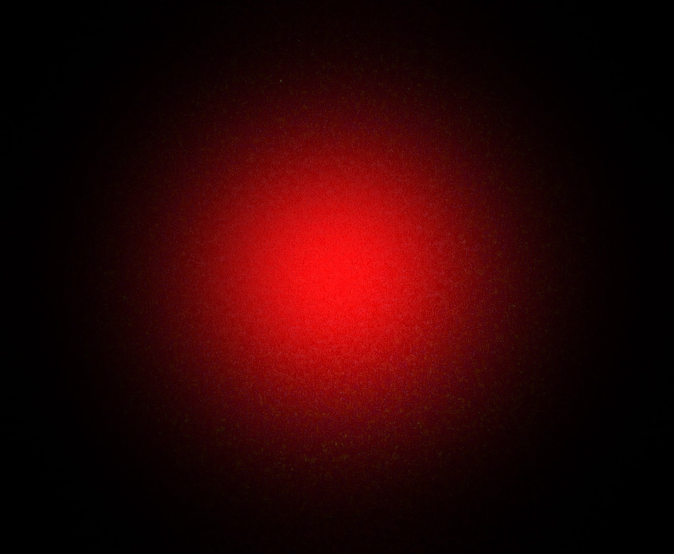
Transmission in free space
Vacuum:
Gaussian optics
Atmosphere: loss, turbulence
Images reprinted from: https://demonstrations.wolfram.com/GaussianBeamPropagationThroughTwoLenses/; Wikipedia;
J.-P. Bourgoin et al., New J. Phys. 15, 023006 (2013); R. Ursin et al., Nat. Phys. 3, 481 (2007)

Slide 5
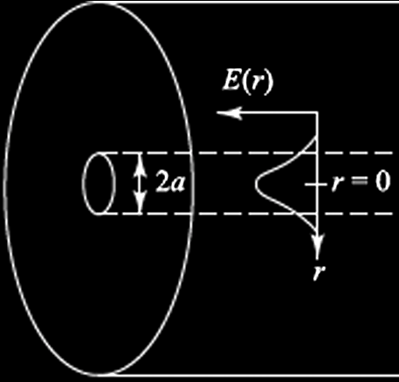
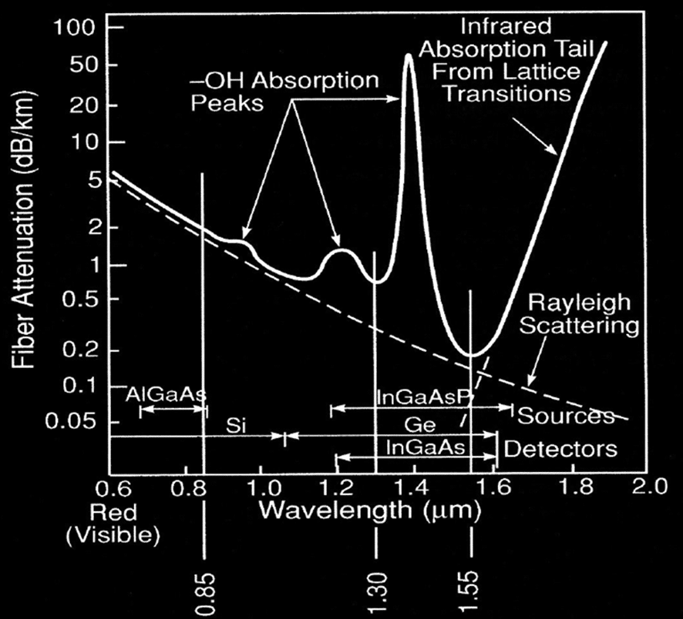
Transmission in optical fiber
Single-mode fiber
125 μm diameter cladding
fused quartz, n₁ = 1.45
8 μm diameter core
n₂ > n₁
≈ 22°
Images reprinted from: G. Keiser et al., J. Biomed. Opt. 19, 080902 (2014); ViaLite

Slide 6




Fiber vs. beam in vacuum: loss scaling
$$L$$
$$T∝e^{−αL}$$
$$L$$
$$T∝L^{−2}$$

Slide 7
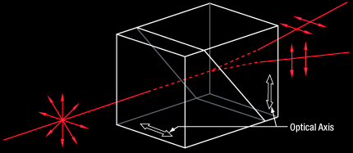
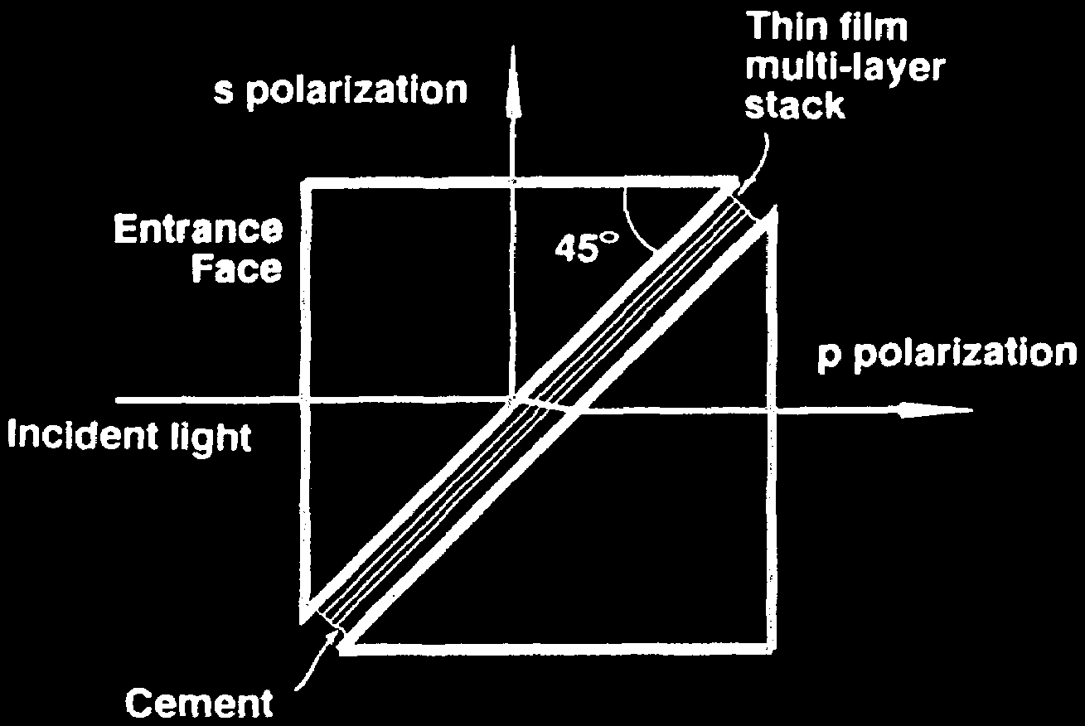
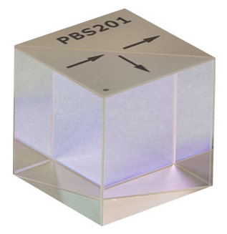
Polarizers
Laser
Birefringent polarizing beamsplitter
Wollaston prism
Polarizing beamsplitter cube
Images reprinted from: Thorlabs; J. L. Pezzaniti, R. A. Chipman, Appl. Opt. 33, 1916 (1994)

Slide 8
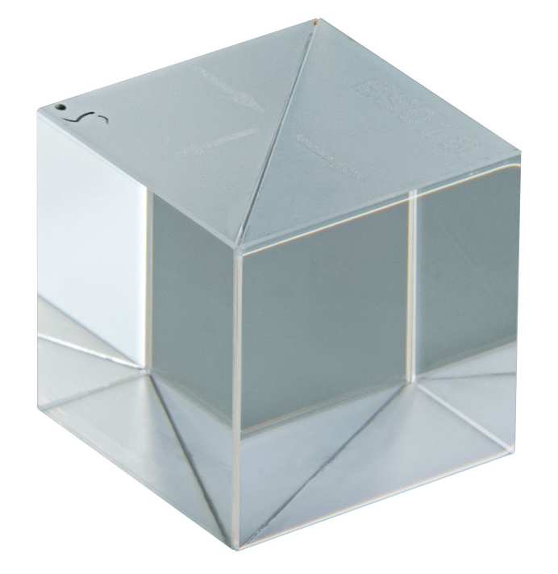
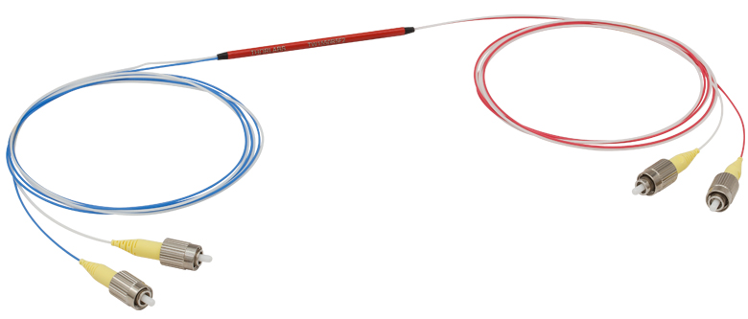
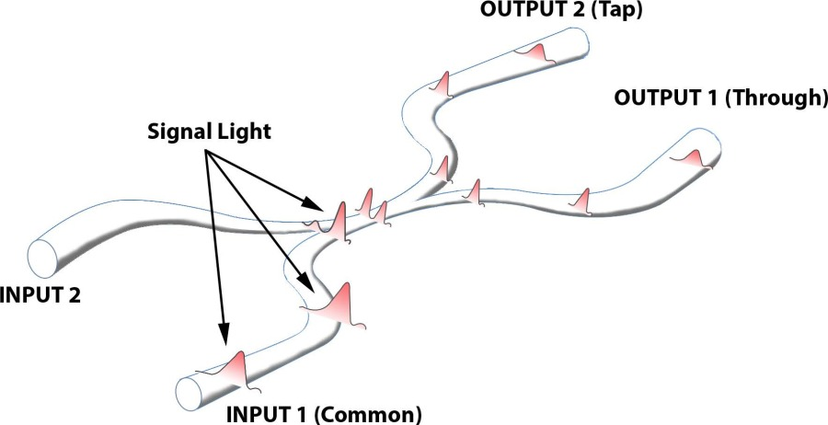
Beamsplitters
50:50
10:90
1:99
Fiber-optic fused beamsplitter (or coupler)
Images reprinted from: Thorlabs; Go!Foton

Slide 9
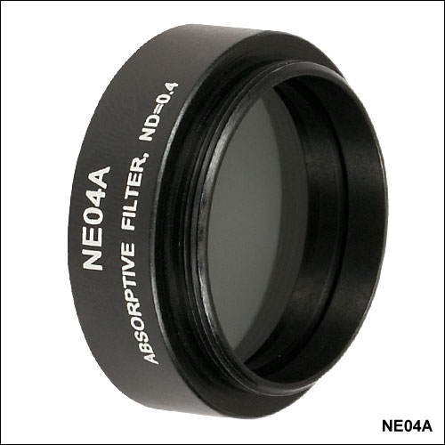
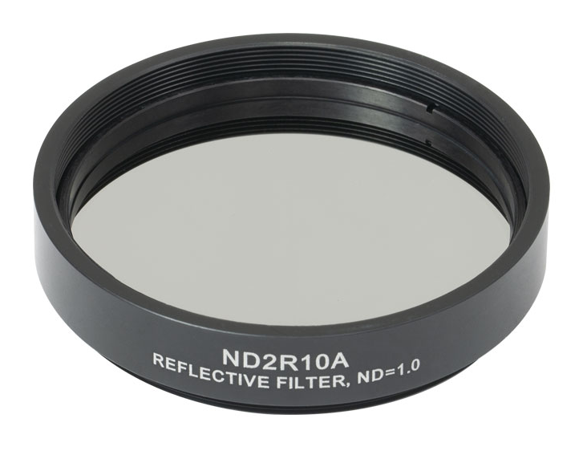
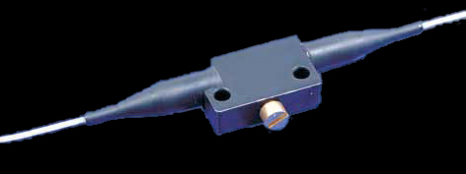
Attenuators
Absorbing or partially reflecting coated glass
Variable
2–60 dB
Images reprinted from: Thorlabs; OZ Optics

Slide 10
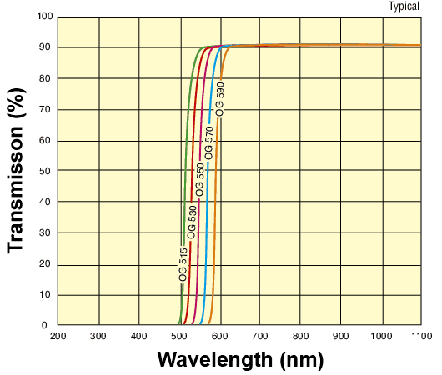

Wavelength filters
Colored glass
Image reprinted from: Newport

Slide 11
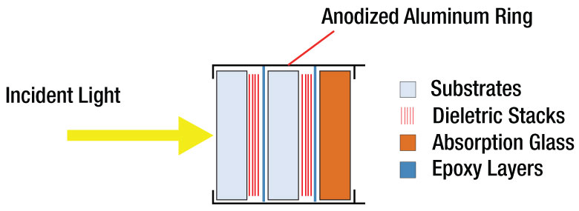
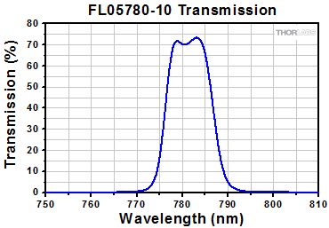
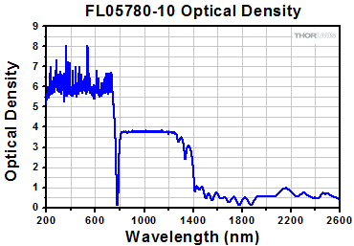
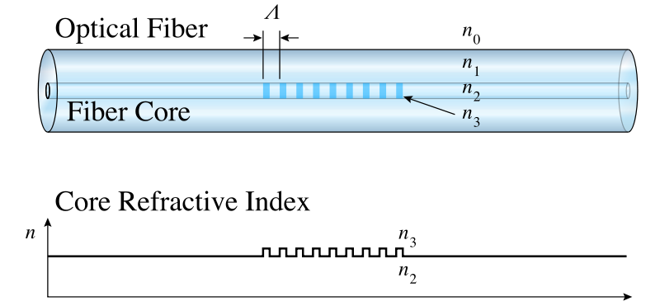
Wavelength filters
Interference filter
Fiber Bragg grating
Images reprinted from: Thorlabs; Wikipedia; F. Seng et al., Appl. Opt. 55, 7179 (2016)

Slide 12
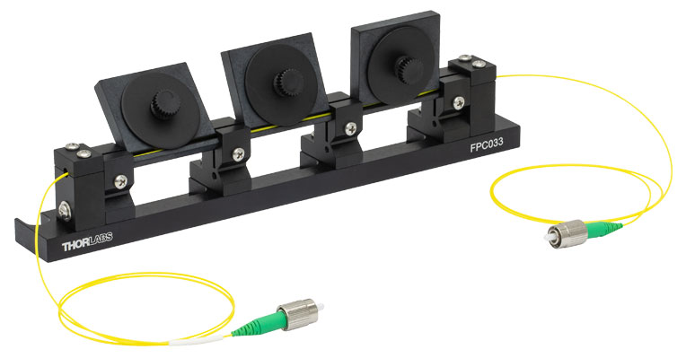



Polarization controller (slow)
$$λ/4$$
$$λ/2$$
$$λ/4$$
www.thorlabs.com/NewGroupPage9.cfm?ObjectGroup_ID=343

Slide 13


Polarization modulator (fast)
E.g., lithium niobate
$$Δλ\sim V$$
$$0 \text{or} V_{π}$$
Pockels cell

Slide 14
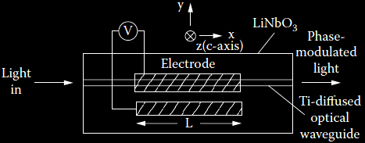
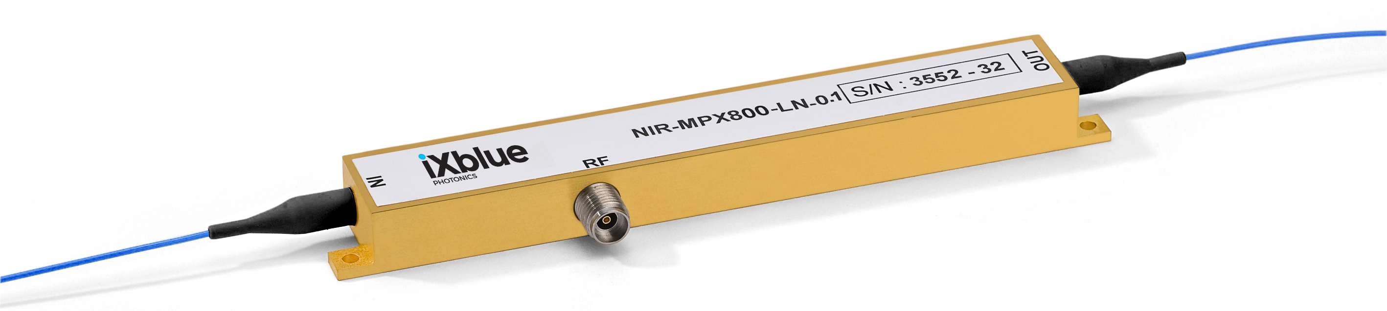


Phase modulator
$$Δφ\sim V$$
$$V$$
Images reprinted from: A. E.-N. A. Mohamed et al., Int. J. Multidiscip. Sci. Eng. 2, 13 (2011); iXblue Photonics

Slide 15
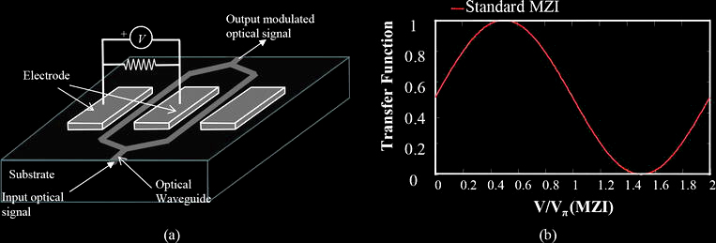
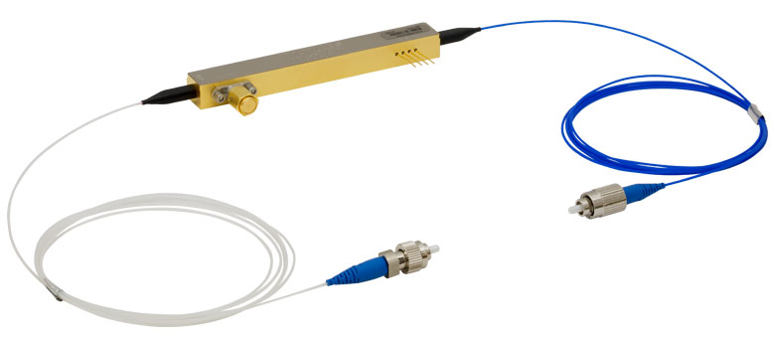
Intensity modulator
Mach-Zehnder interferometer
Images reprinted from: Optical Communication Technology, P. Pinho, ed., IntechOpen (2017); Thorlabs

Slide 16
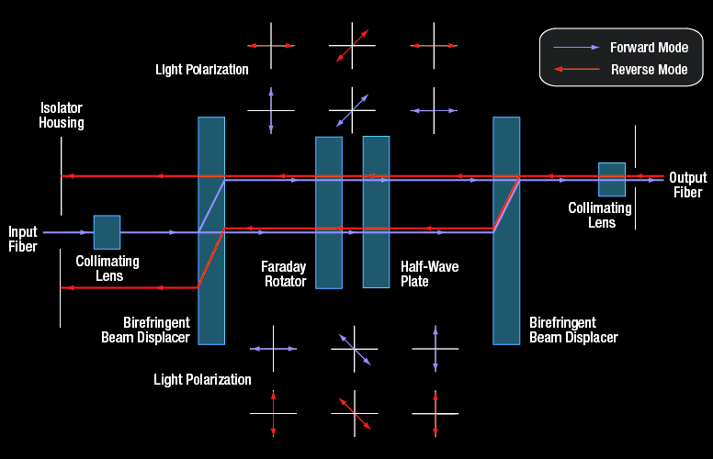
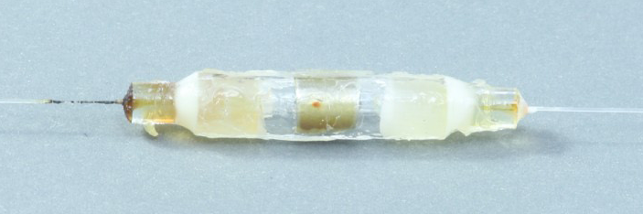
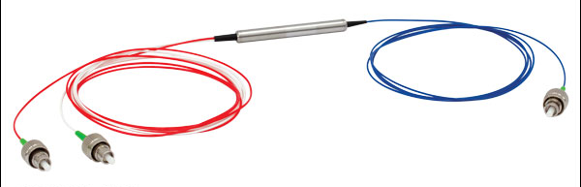
Directional elements
Isolator (an “optical diode”)

Circulator
1
2
1 → 2
2 → 3
3
Images reprinted from: Thorlabs

Slide 17
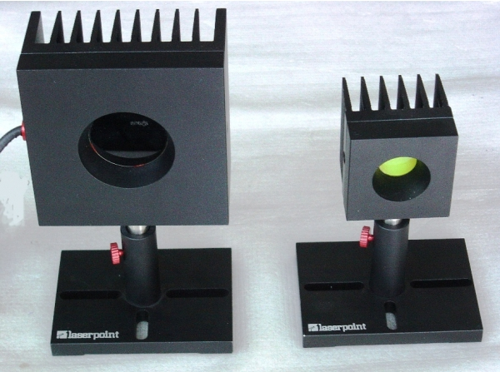
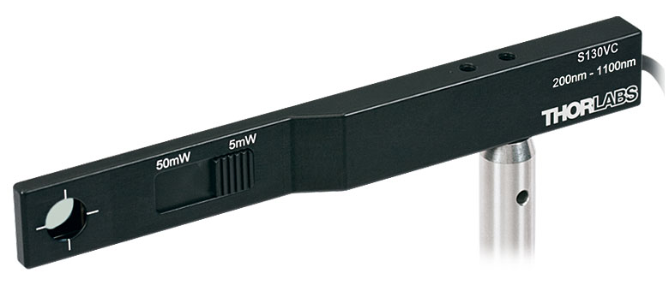
Optical power meters
Thermal
> 10 μW
Photodiode
> 0.1 nW
t°
I

Slide 18
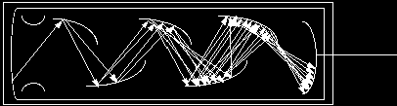


Single-photon detectors
Photon energy
$$E=\frac{hc}{λ}=\frac{19.9×{10}^{−26}}{1.55×{10}^{−6}}=1.28×{10}^{−19} \text{J}$$

Need a gain mechanism
Photomultiplier tube
$$ℏω$$
e
Photocathode
Dynodes
Image reprinted from: http://www.frankswebspace.org.uk/ScienceAndMaths/physics/physicsGCE/D1-5.htm

Slide 19
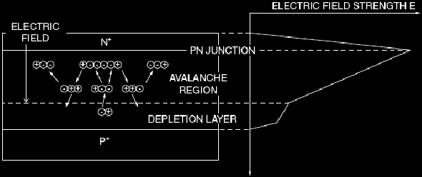
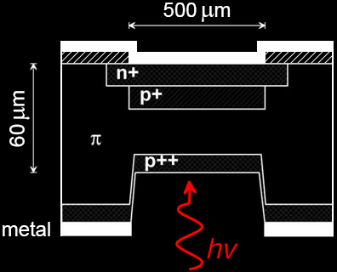


Single-photon avalanche photodiode
I
Linear mode
Geiger mode
Quenching
Single photon
I_{th}
V
$$ℏω$$
Breakdown
voltage V_{br}
+V_{bias} > V_{br}
Output
$$ℏω$$
Images reprinted from: https://www.photonicsonline.com/doc/avalanche-photodiodes-theory-and-applications-0001; S. Cova et al., J. Mod. Opt. 51, 1267 (2004)

Slide 20
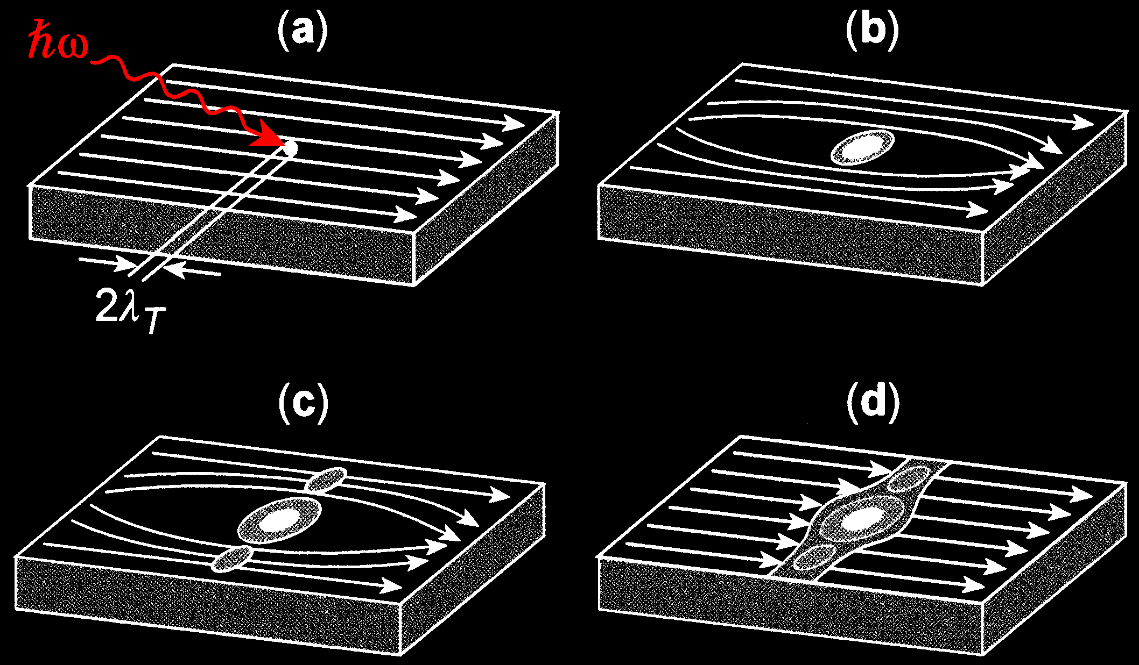
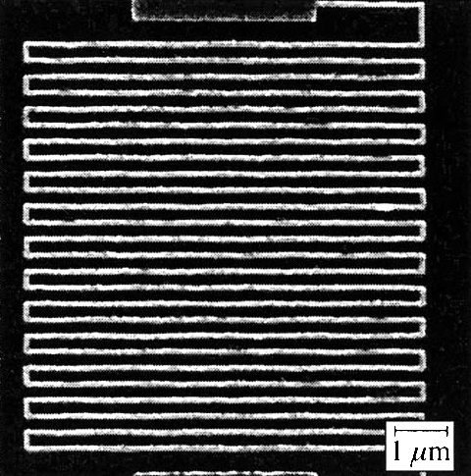
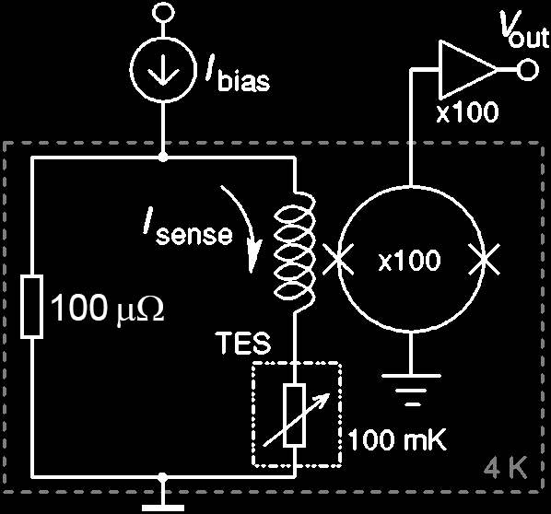
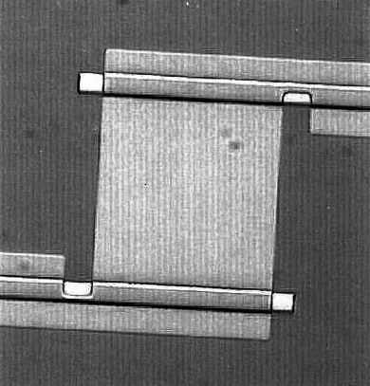

Superconducting single-photon detectors
Superconducting nanowire
Images reprinted from: R. Sobolewski et al., IEEE Trans. Appl. Supercond. 13, 1151 (2003)
Transition-edge sensor
Al lead
W sensor
$$ℏω$$
10 µm
Images reprinted from: B. Cabrera et al., Appl. Phys. Lett. 73, 735 (1998); A.J. Miller et al., Appl. Phys. Lett. 83, 791 (2003)

Slide 21
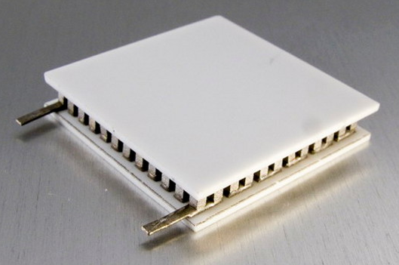
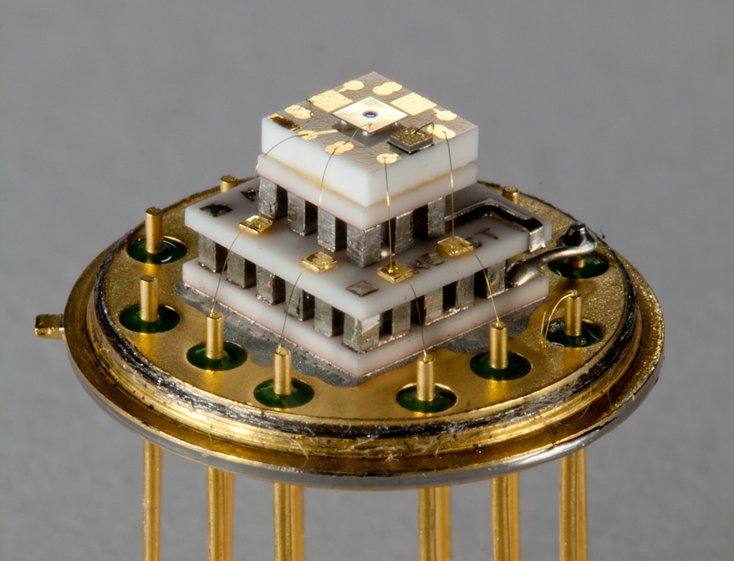
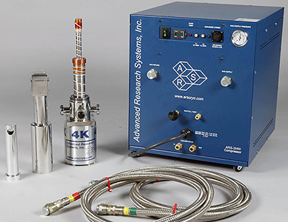
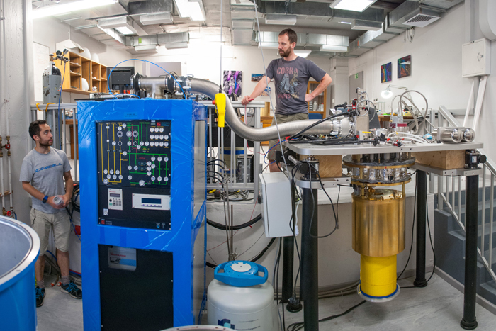
Cooling requirements
Photomultiplier: room temperature Avalanche photodiode: −50 °C
Thermoelectric cooling
Superconducting nanowire: 4 K Transition-edge sensor: 100 mK
0
5 mm
Images reprinted from: Kryotherm; S. Sauge et al., Opt. Express 19, 23590 (2011); Advanced Research Systems; University of Cape Town

Slide 22
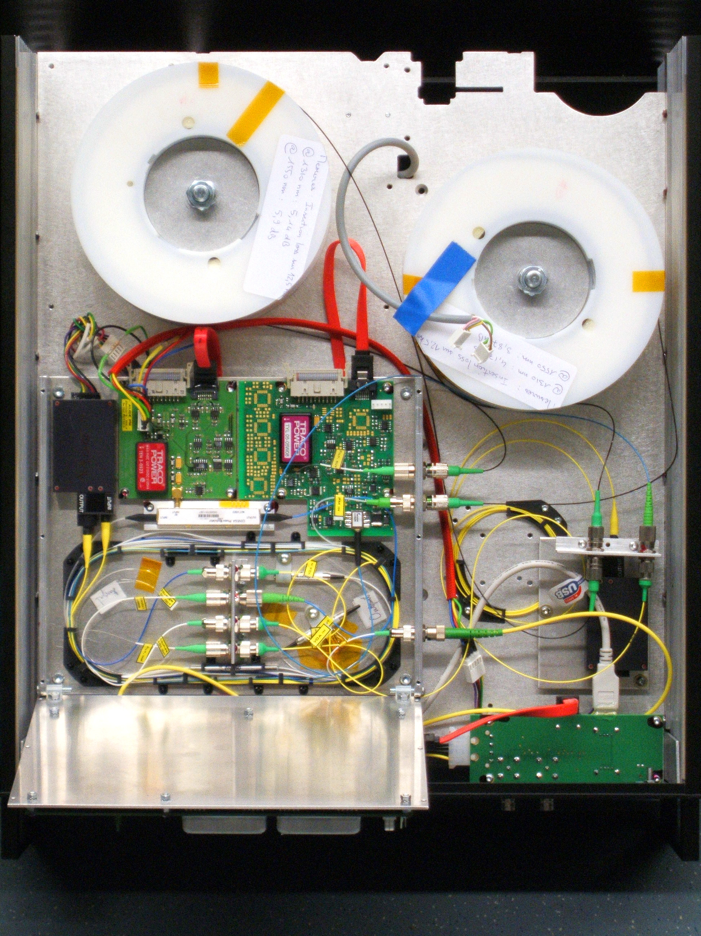
Assembled fiber optics
Quantum key distribution unit Alice (ID Quantique Clavis2)
0
100 mm

Slide 23
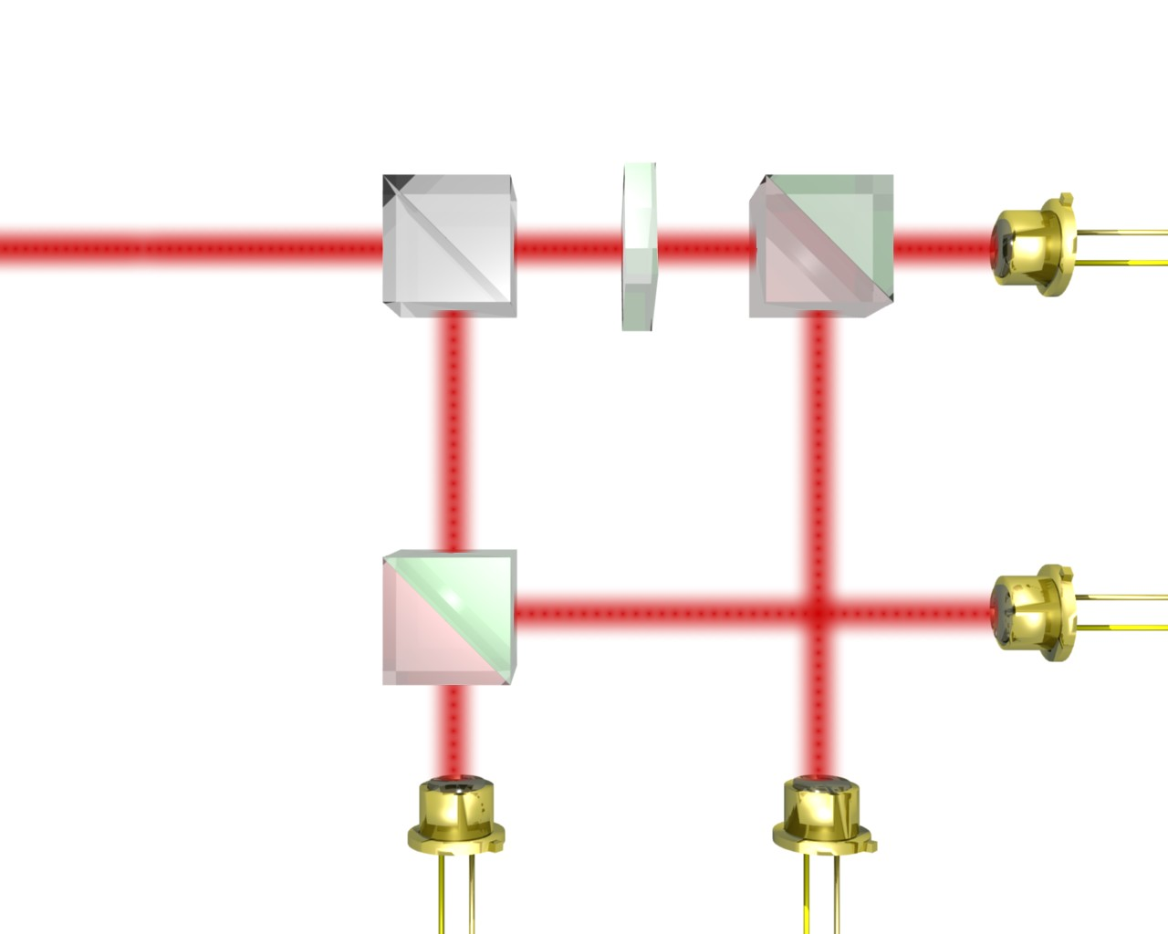
Assembled free-space optics
Bob’s polarization analyzer with single-photon detectors
λ/2
22.5°
50:50
PBS
APD,
+45°
V
PBS
H
-45°
J. G. Rarity, P. C. M. Owens, P. R. Tapster, J. Mod. Opt. 41, 2435 (1994)

Slide 24
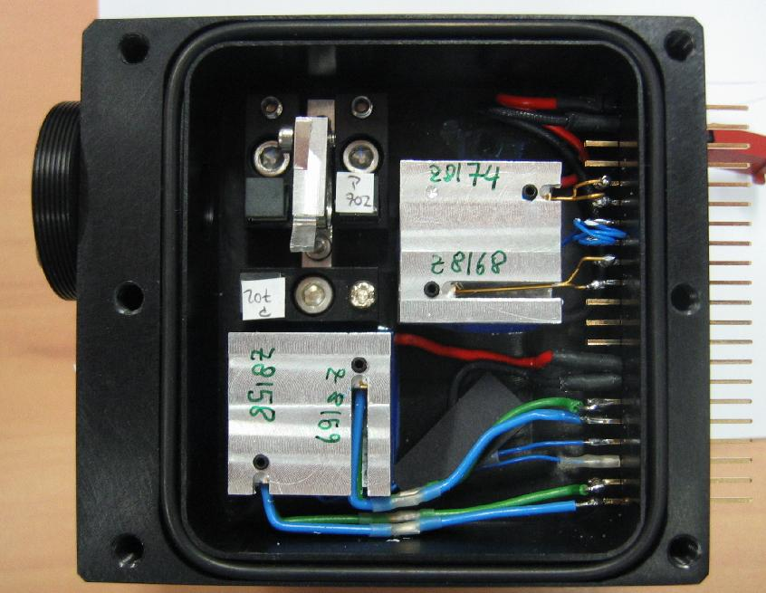
Assembled free-space optics
Bob’s polarization analyzer with single-photon detectors
λ/2
22.5°
50:50
PBS
APD,
+45°
V
PBS
H
-45°
0
10 mm
J. G. Rarity, P. C. M. Owens, P. R. Tapster, J. Mod. Opt. 41, 2435 (1994)

Slide 25
Emerging: integrated optics
Quantum key distribution system
2 mm
P. Sibson et al., Nat. Commun. 8, 13984 (2017)
A. W. Elshaari et al., Nat. Photonics 14, 285 (2020)

