Slide 1
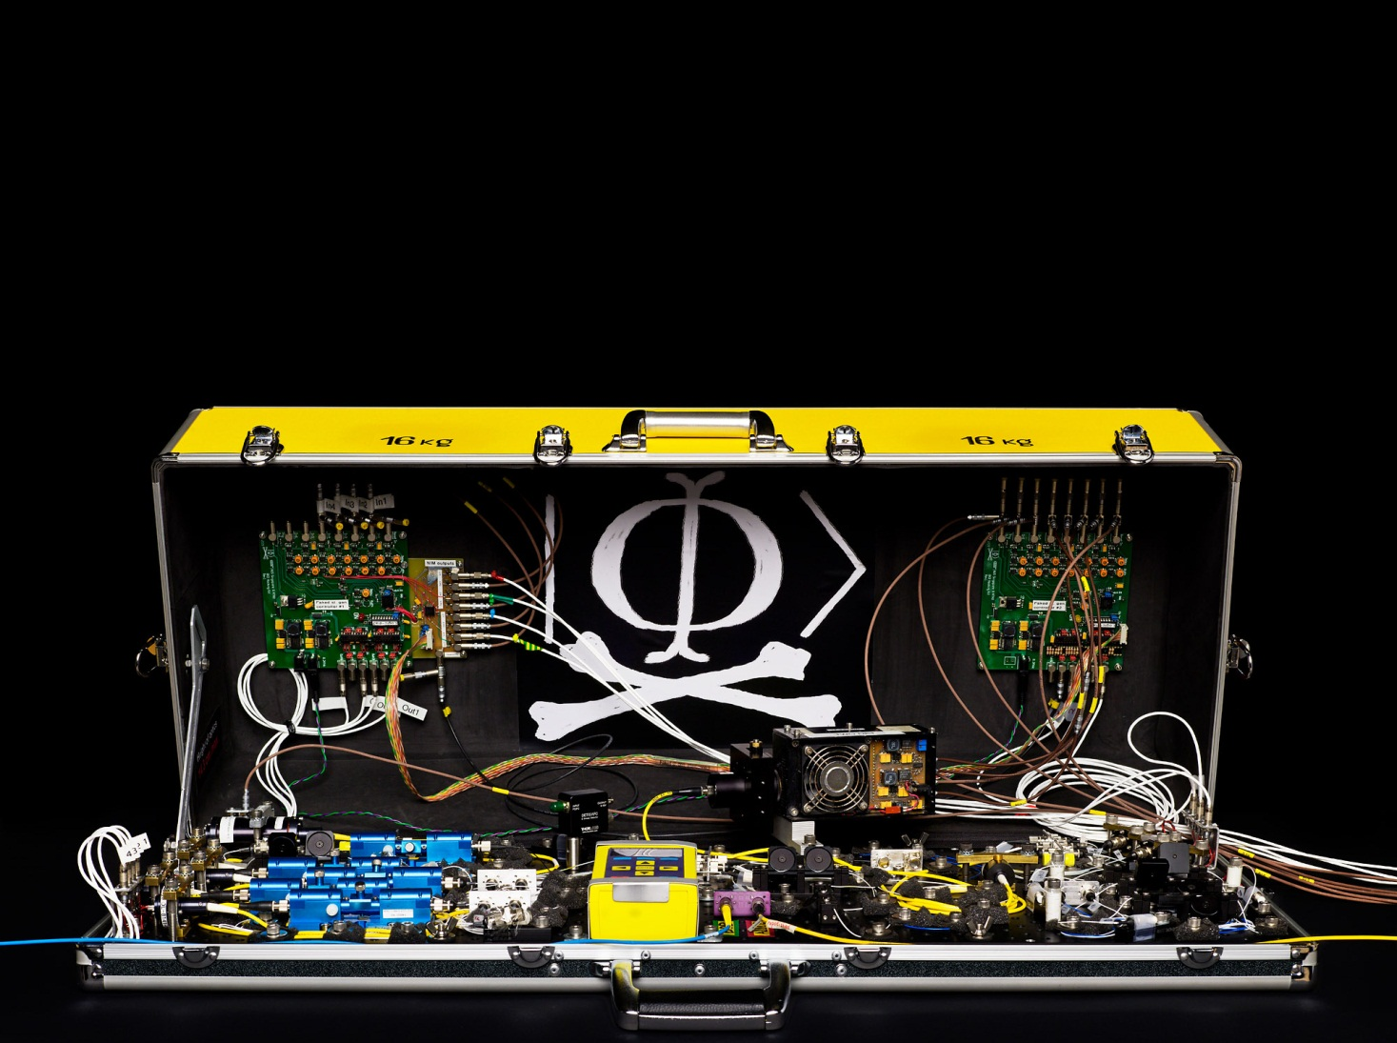

Lecture 12 in Quantum optics and communications (continuing education) course, 7 Dec 2022
Quantum hacking
Vadim Makarov
vad1.com/lab
Photo © 2010 NTNU Info / Geir Mogen

Slide 2
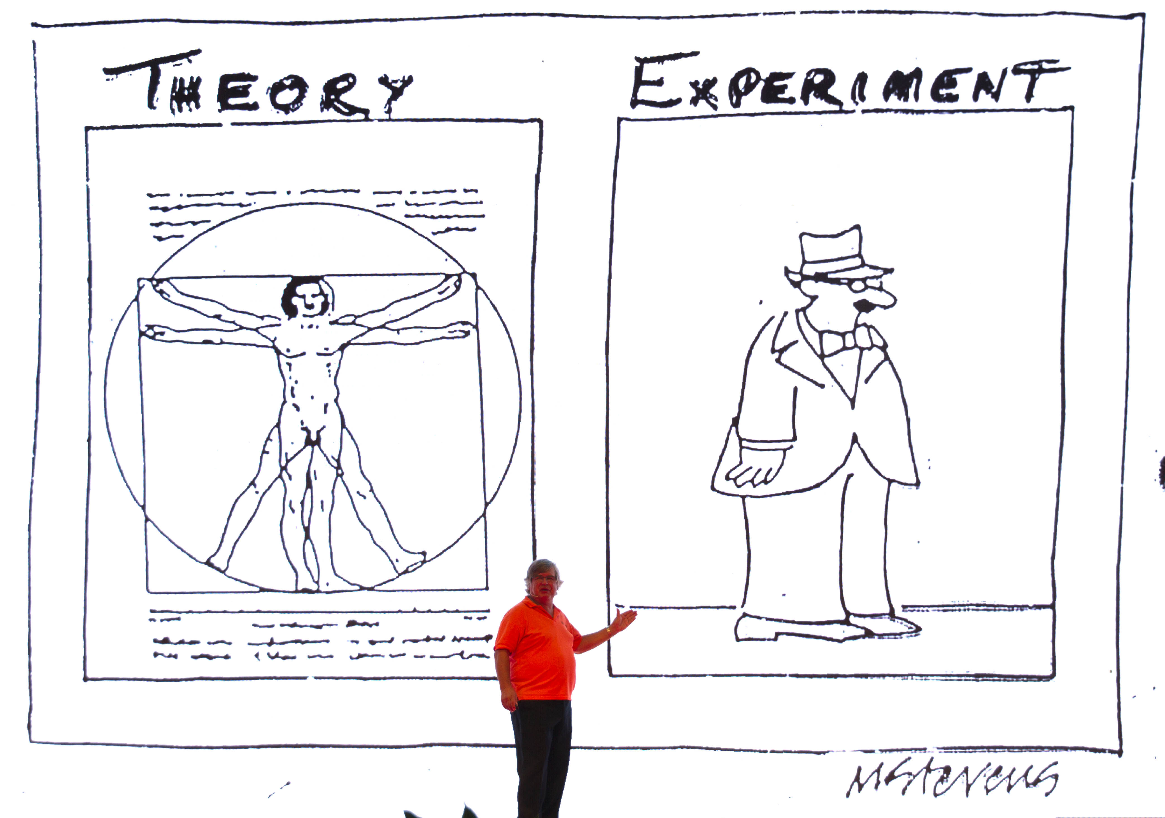

Slide 3
Implementation security of quantum communications
Security proof
.Laws of physics & Model of equipment
Integrate imperfection into security model
Hack
Formal certification: we need
standards and labs ecosystem

Slide 4

Threat model
Alice
Future technology
Bob
physically secure,
characteristics known
physically secure,
characteristics known
Kerckhoffs’ principle:
Il faut qu’il n’exige pas le secret, et qu’il puisse sans inconvénient tomber entre les mains de l’ennemi
A. Kerckhoffs, J. des Sciences Militaires 9, 5 (1883)
Everything about the system that is not explicitly secret is known to the enemy

Slide 5
Attack | Target component | Tested system
Distinguishability of decoy states | laser in Alice | 3 research systems
A. Huang et al., Phys. Rev. A 98, 012330 (2018)
Intersymbol interference | intensity modulator in Alice | research system
K. Yoshino et al., poster at QCrypt (2016)
Laser damage | any | 5 commercial & 1 research systems
V. Makarov et al., Phys. Rev. A 94, 030302 (2016); A. Huang et al., poster at QCrypt (2018)
Spatial efficiency mismatch | receiver optics | 2 research systems
M. Rau et al., IEEE J. Sel. Top. Quantum Electron. 21, 6600905 (2015); S. Sajeed et al., Phys. Rev. A 91, 062301 (2015)
Pulse energy calibration | classical watchdog detector | ID Quantique
S. Sajeed et al., Phys. Rev. A 91, 032326 (2015)
Trojan-horse | phase modulator in Alice | SeQureNet
I. Khan et al., presentation at QCrypt (2014)
Trojan-horse | phase modulator in Bob | ID Quantique
N. Jain et al., New J. Phys. 16, 123030 (2014); S. Sajeed et al., Sci. Rep. 7, 8403 (2017)
Detector saturation | homodyne detector | SeQureNet
H. Qin, R. Kumar, R. Alleaume, Proc. SPIE 88990N (2013)
Shot-noise calibration | classical sync detector | SeQureNet
P. Jouguet, S. Kunz-Jacques, E. Diamanti, Phys. Rev. A 87, 062313 (2013)
Wavelength-selected PNS | intensity modulator | (theory)
M.-S. Jiang, S.-H. Sun, C.-Y. Li, L.-M. Liang, Phys. Rev. A 86, 032310 (2012)
Multi-wavelength | beamsplitter | research system
H.-W. Li et al., Phys. Rev. A 84, 062308 (2011)
Deadtime | single-photon detector | research system
H. Weier et al., New J. Phys. 13, 073024 (2011)
Channel calibration | single-photon detector | ID Quantique
N. Jain et al., Phys. Rev. Lett. 107, 110501 (2011)
Faraday-mirror | Faraday mirror | (theory)
S.-H. Sun, M.-S. Jiang, L.-M. Liang, Phys. Rev. A 83, 062331 (2011)
Detector control | single-photon detector | ID Quantique, MagiQ, research systems
I. Gerhardt et al., Nat. Commun. 2, 349 (2011); L. Lydersen et al., Nat. Photonics 4, 686 (2010)

Slide 6
Example of vulnerability and countermeasures
Photon-number-splitting attack
C. Bennett, F. Bessette, G. Brassard, L. Salvail, J. Smolin, J. Cryptology 5, 3 (1992)
G. Brassard, N. Lütkenhaus, T. Mor, B. C. Sanders, Phys. Rev. Lett. 85, 1330 (2000)
N. Lütkenhaus, Phys. Rev. A 61, 052304 (2000)
S. Félix, N. Gisin, A. Stefanov, H. Zbinden, J. Mod. Opt. 48, 2009 (2001)
N. Lütkenhaus, M. Jahma, New J. Phys. 4, 44 (2002)
Decoy-state protocol
W.-Y. Hwang, Phys. Rev. Lett. 91, 057901 (2003)
SARG04 protocol
V. Scarani, A. Acín, G. Ribordy, N. Gisin, Phys. Rev. Lett. 92, 057901 (2004)
Distributed-phase-reference protocols
K. Inoue, E. Waks, Y. Yamamoto, Phys. Rev. Lett. 89, 037902 (2002)
K. Inoue, E. Waks, Y. Yamamoto, Phys. Rev. A. 68, 022317 (2003)
N. Gisin, G. Ribordy, H. Zbinden, D. Stucki, N. Brunner, V. Scarani, arXiv:quant-ph/0411022v1 (2004)
Laser
Attenuator

Slide 7









Attenuated laser source
Laser diode
Attenuator
$$P_{n}\left(μ\right)=\frac{μ^{n}e^{−μ}}{n!}$$
$$μ$$
$$I$$
G
$$μ=0.2$$
$$μ=0.02$$
$$P$$
$$P$$
1
1
0.1
0.1
0.01
0.01
0.001
0.001
0 1 2 3 $n$
0 1 2 3 $n$
S. J. van Enk, C. A. Fuchs, arXiv:quant-ph/0111157

Slide 8
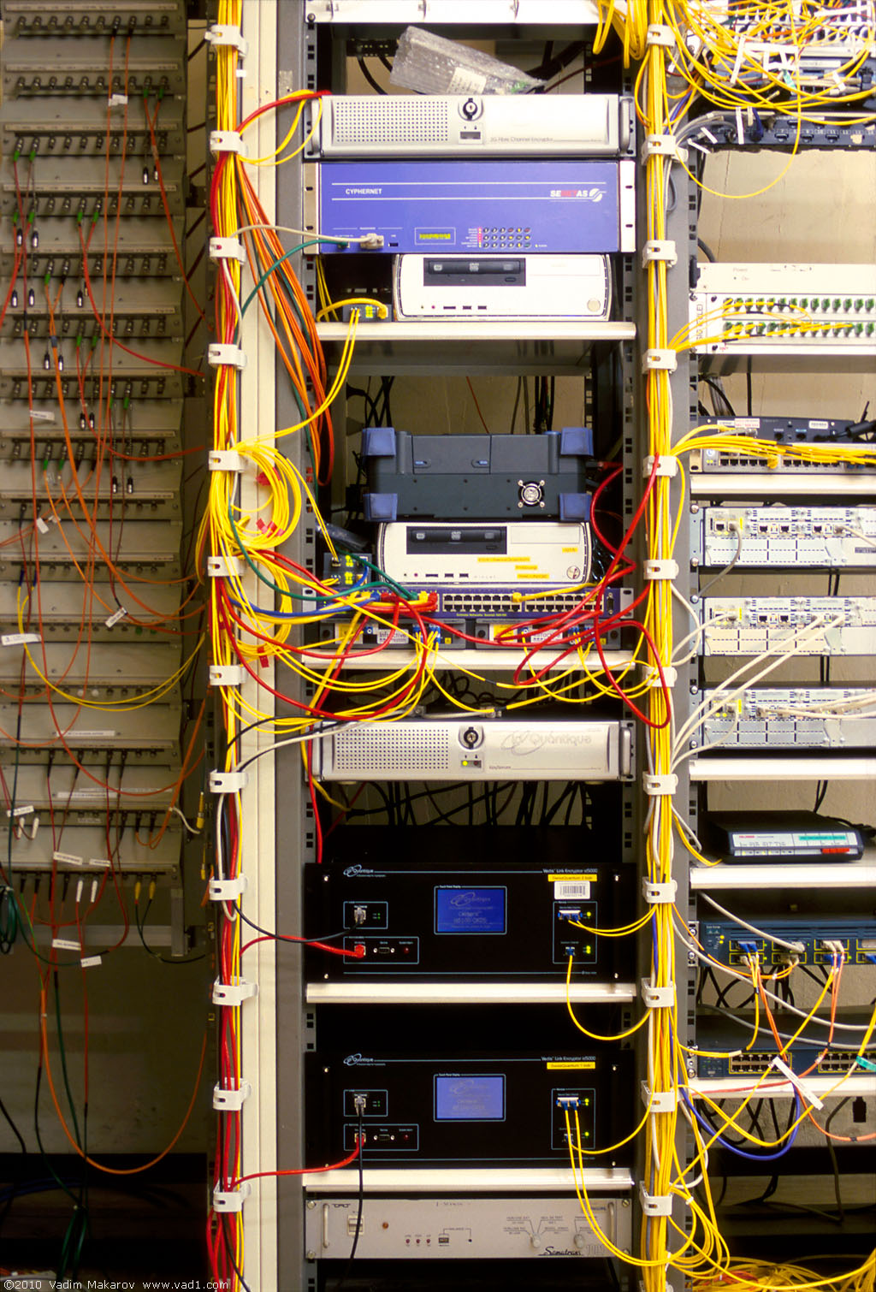
Commercial QKD
1st generation (circa 2008)
ID Quantique Cerberis system
Classical encryptors:
L2, 2 Gbit/s
L2, 10 Gbit/s
L3 VPN, 100 Mbit/s
WDMs
Key manager
QKD to another node (4 km)
QKD to another node (14 km)
Photo © 2010 Vadim Makarov
www.swissquantum.com

Slide 9
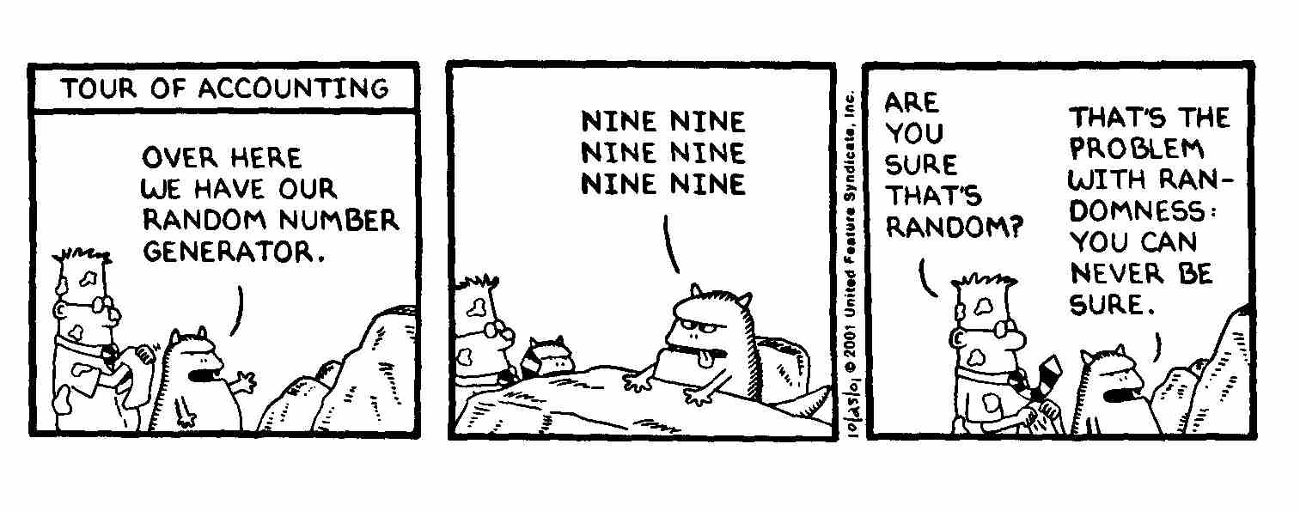
True randomness?
Quantis
RNG
FPGA
Phase modulator in Bob
id Quantique Clavis2 (2008)
OK
V_{π}/2
0
ONE ONE ONE
ONE ONE ONE
ONE ONE ONE

Slide 10
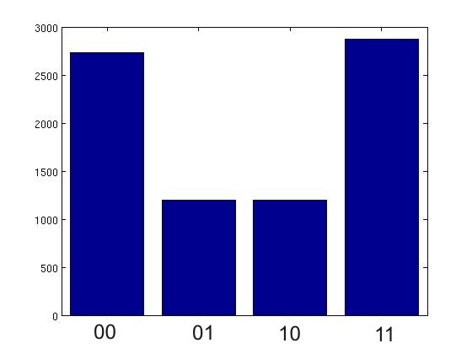
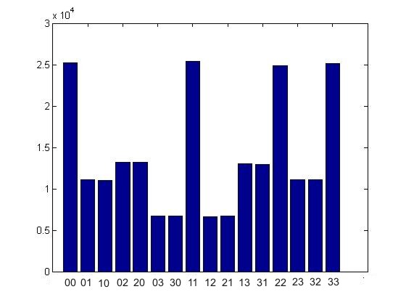
True randomness?
Quantis
RNG
FPGA
Phase modulator in Bob
id Quantique Clavis2 (2008)
V_{π}/2
0
Bob:
Alice:
Issue reported patched in 2010

Slide 11
Do we trust the manufacturer?
Quantis RNG
Quantis RNG, Trojan-horsed :)
*
*
Memory with
pre-recorded
random
sequence
Clicks
processed
Clicks
processed
Random
stream
Random
stream
Switch
Many components in QKD system can be Trojan-horsed:
– access to secret information
– electrical power
– way to communicate outside or compromise security

Slide 12
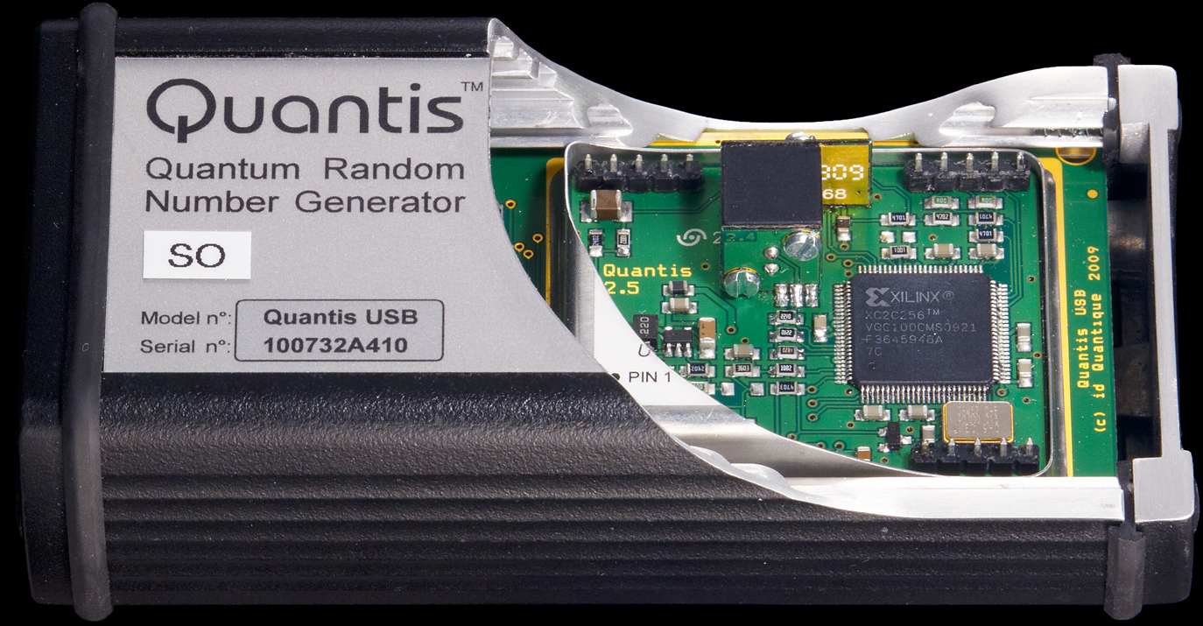
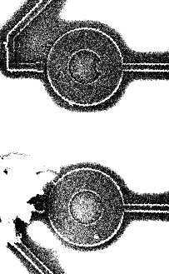
Quantis RNG: what’s inside?
G
20 MHz
Debiasing
LED
820 nm
(40 nm FWHM)
Output
4 Mbit/s
20 µm
G. Ribordy, O. Guinnard, US patent appl. US 2007/0127718 A1 (filed in 2006)
M. Petrov, I. Radchenko et al., EPJ Quantum Technol. 9, 17 (2022)

Slide 13
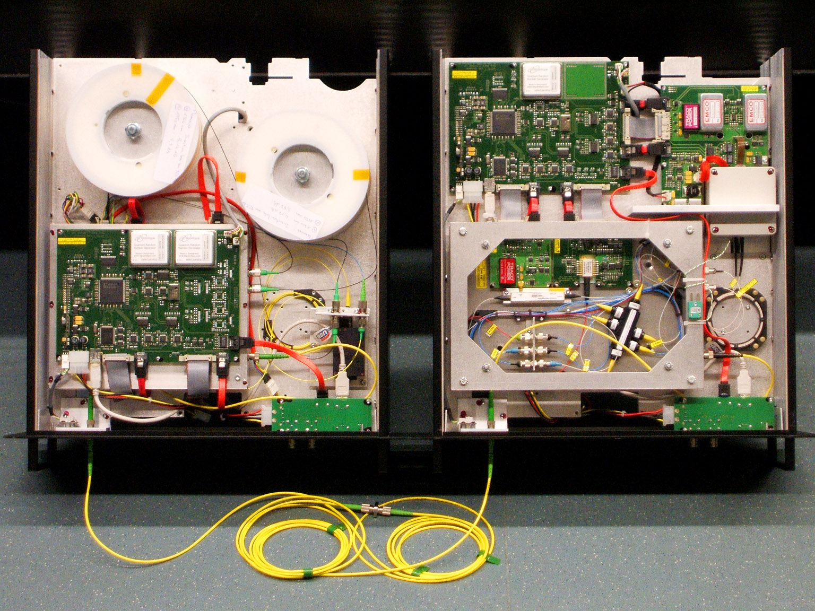
ID Quantique Clavis2 QKD system
Alice
Bob
Photo © 2008 Vadim Makarov. Published with approval of ID Qiantique

Slide 14
Double clicks
– occur naturally because of detector dark counts, multi-photon pulses...
Discard them?
Intercept-resend attack... with a twist:
Bob:
Detects in
Eve’s basis:
single click
Eve
100
photons
Alice
Bob´
Alice´
Detects in
conjugate basis:
double click,
discarded
Proper treatment for double clicks: assign a random bit value.
N. Lütkenhaus, Phys. Rev. A 59, 3301 (1999)
T. Tsurumaru & K. Tamaki, Phys. Rev. A 78, 032302 (2008)

Slide 15
Trojan-horse attack
Alice
Phase modulator
Attenuator
Alice’s
PC
Line
Eve’s equipment
– interrogating Alice’s phase modulator with powerful
external pulses (can give Eve bit values directly)

Slide 16
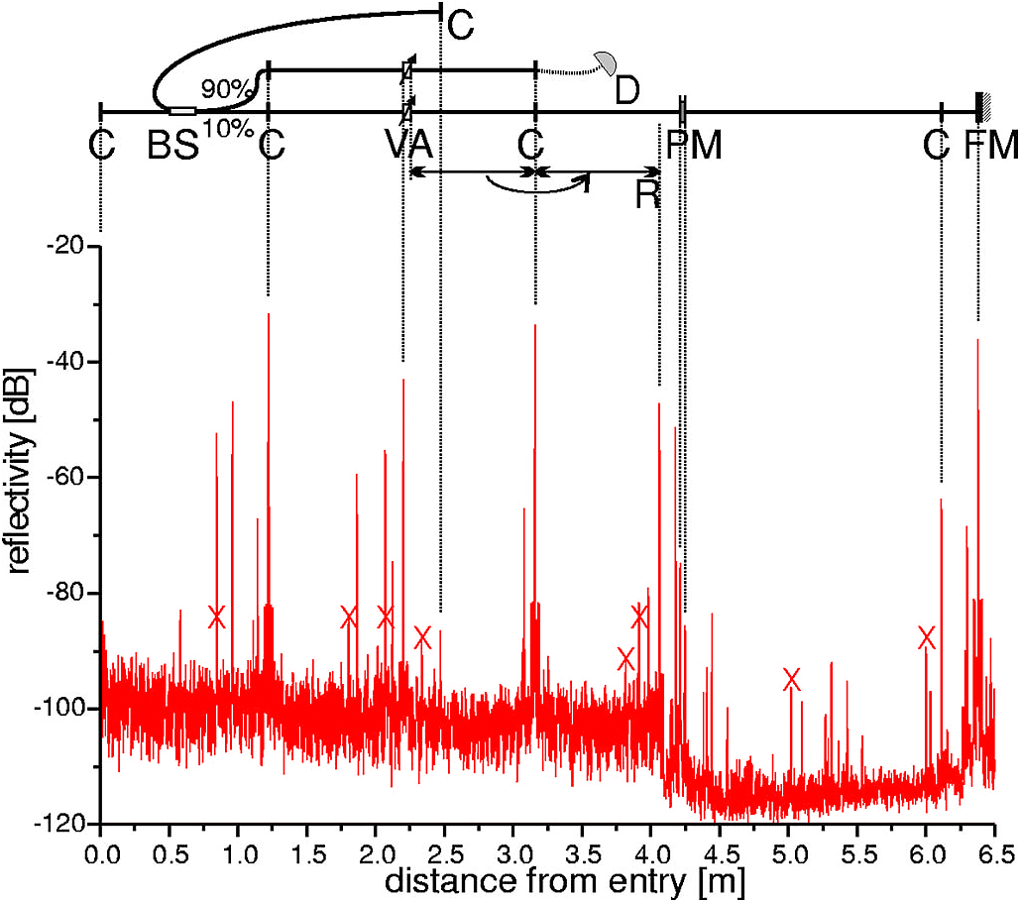
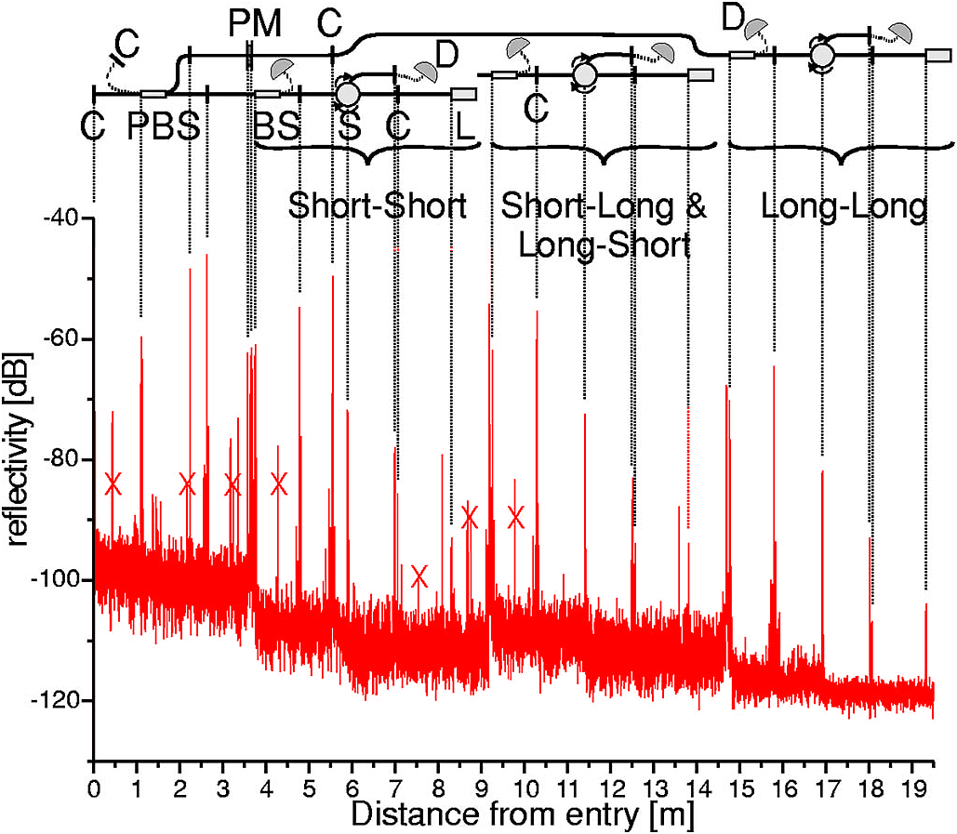
Trojan-horse attack for plug-and-play system
Alice
Bob
Eve gets back one photon → in principle, extracts 100% information
N. Gisin et al., Phys. Rev. A 73, 022320 (2006)

Slide 17
Trojan-horse attack experiment
Alice
4% reflection
Phase modulator
Laser
V_{mod}
Eve
L₁
OTDR
Out
Received OTDR pulse
Variable attenuator
In
L₂
Fine length adjustment
to get L₁ = L₂
0
4.1
8.2
V_{mod}, V
A. Vakhitov et al., J. Mod. Opt. 48, 2023 (2001)

Slide 18
Draft security standard @ ETSI:
Trojan-horse in one-way system
Alice
Isolator(s)
BPF
Att.


M. Lucamarini et al., Phys. Rev. X 5, 031030 (2015)

Slide 19
Attack example: avalanche photodetectors (APDs)
I
Linear mode
Geiger mode
I
I_{th}
P_{th}
P_{opt}
Quenching
I_{th}
Single photon
V
Breakdown
voltage V_{br}

Slide 20
Faked-state attack in APD linear mode
Identical bases & bit values
Eve
Bright
state
Alice
.Bob´
.Alice´
Bob
Listen, do same,
get same final key
Classical post-processing
Bob chooses same basis as Eve:
Bob chooses different basis:
“0”
I
0
“0
”
I
0
I
th
I
th
Click!
t
t
“1
”
I
1
“1
”
I
1
I
th
I
th
t
t
L. Lydersen, C. Wiechers, C. Wittmann, D. Elser, J. Skaar, V. Makarov, Nat. Photonics 4, 686 (2010)

Slide 21

Blinding APD with bright light
Eve applies CW light
Bias to APD
(V_{bias})
No light
V_{APD}
V_{br}
Detector blind!
Zero dark count rate
V_{bias}
R_{bias}
V_{HV} ≈ 40 V
0
t
2
t
647 μW
t
808 μW
Input
illumination
(mW)
1
0
Logic 1
(never clicks)
(always clicks)
Detector
output
ID Quantique
Clavis2
Logic 0
−10
0
10
20
30
−10
0
10
20
30
Time (ns)
L. Lydersen, C. Wiechers, C. Wittmann, D. Elser, J. Skaar, V. Makarov, Nat. Photonics 4, 686 (2010)

Slide 22
Proposed full eavesdropper
Eve
Optical
Alice
Bob´
Alice´
amplifier
Bob
Basis
Basis
Detection result
Bit in
Blinding laser
Note: Intercept-resend always breaks QKD security
M. Curty, M. Lewenstein, N. Lütkenhaus, Phys. Rev. Lett. 92, 217903 (2004)

Slide 23
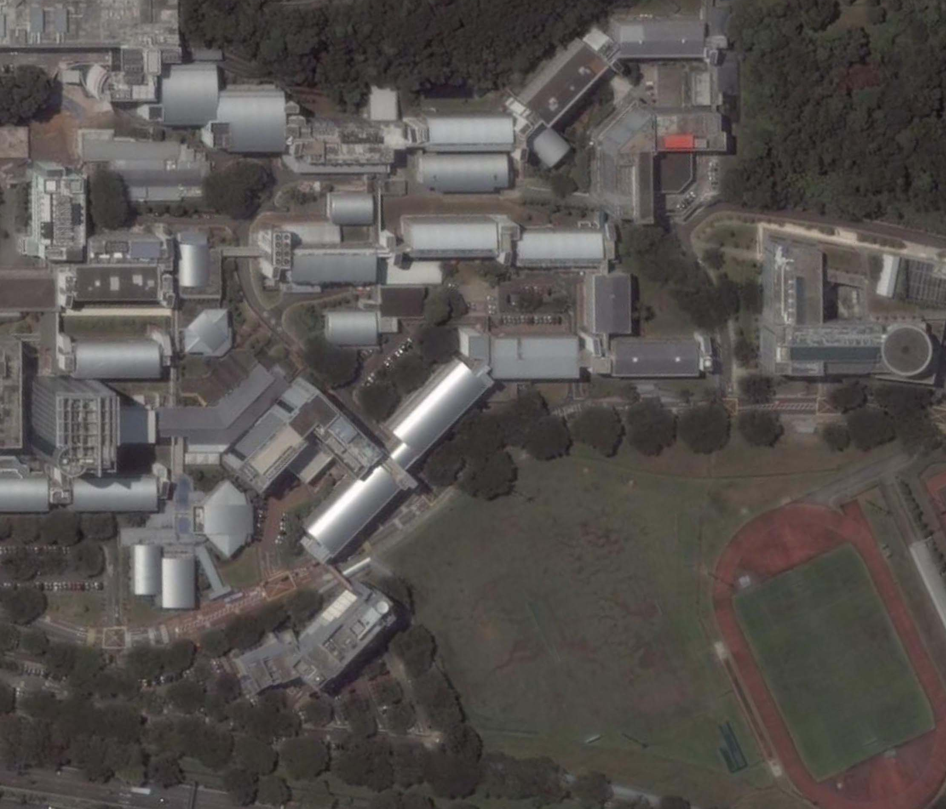
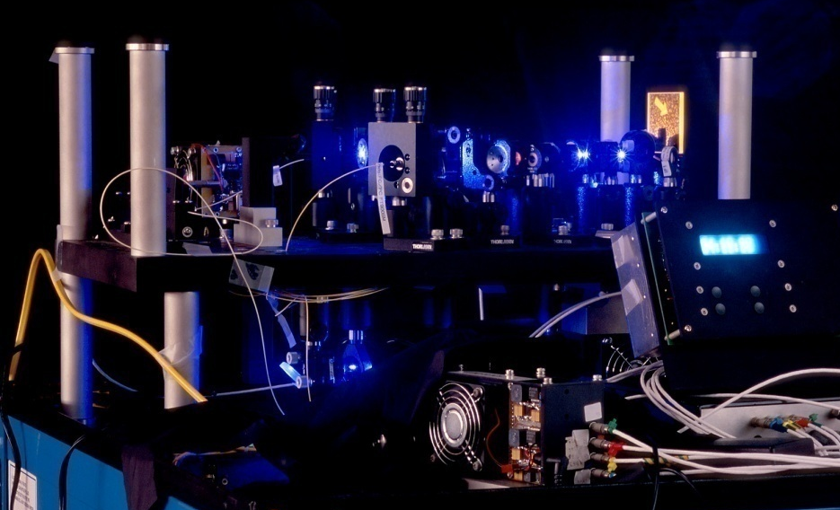
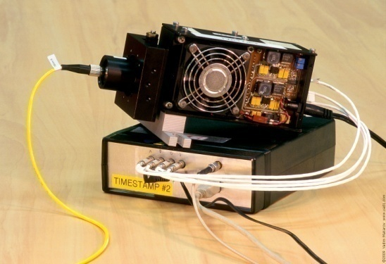
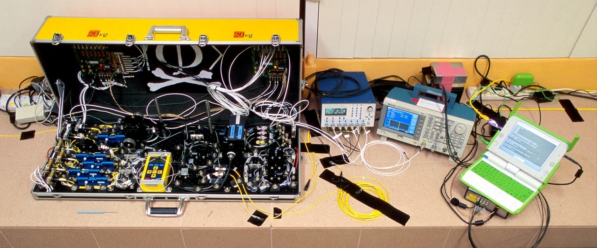
Eavesdropping 100% key on installed QKD line on campus of the National University of Singapore, July 4–5, 2009
290 m of fiber
Eve
S14
S13
Bob
Alice
S12
S15
Image © 2009 DigitalGlobe
I. Gerhardt, Q. Liu et al.,
Nat. Commun. 2, 349 (2011)

Slide 24
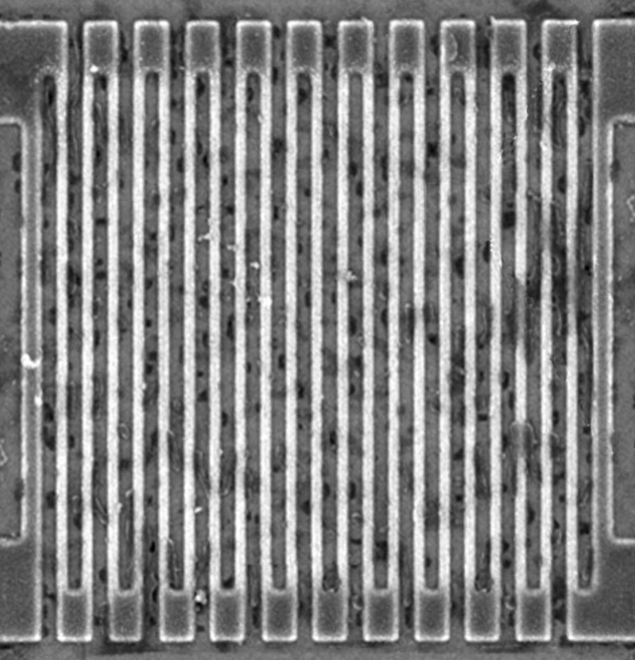
Controlling superconducting nanowire single-photon detectors
Comparator input
voltage (arb. units)
1. Blind (latch)
0
2. Control
0
1
0
2
0
3
0
Time (ns)
Normal single-
photon click
14 mW pulse
7 mW pulse
L. Lydersen, M. K. Akhlaghi, A. H. Majedi, J. Skaar, V. Makarov, New J. Phys. 13, 113042 (2011)
M. G. Tanner, V. Makarov, R. H. Hadfield, Opt. Express 22, 6734 (2014)

Slide 25
Countermeasures to detector attacks?

Slide 26
Alice
Charlie (untrusted)
Bob
EPR
A. Ekert, Phys. Rev. Lett. 67, 661 (1991); C. H. Bennett et al., Phys. Rev. Lett. 68, 557 (1992)
EPR
BSM
EPR
Photon
source
Photon
source
Mod.
BSM
Mod.
RNG
RNG
Measurement-device-independent QKD
H.-K. Lo, M. Curty, B. Qi, Phys. Rev. Lett. 108, 130503 (2012)

Slide 27
3 ways to deal with an imperfection
Technical countermeasure that attempts to stop the attack
Make a scheme intrinsically insensitive to imperfection
Characterise imperfection, upper-bound partial information leakage, eliminate it by privacy amplification

Slide 28
Distinguishability of source states
S. Nauerth et al., New J. Phys. 11, 065001 (2009)
A. Huang, S.-H. Sun, Z. Liu, V. Makarov, Phys. Rev. A 98, 012330 (2018)

Slide 29
Distinguishability of source states
A. Huang, S.-H. Sun, Z. Liu, V. Makarov, Phys. Rev. A 98, 012330 (2018)

Slide 30
Distinguishability of source states
A. Huang, S.-H. Sun, Z. Liu, V. Makarov, Phys. Rev. A 98, 012330 (2018)

Slide 31
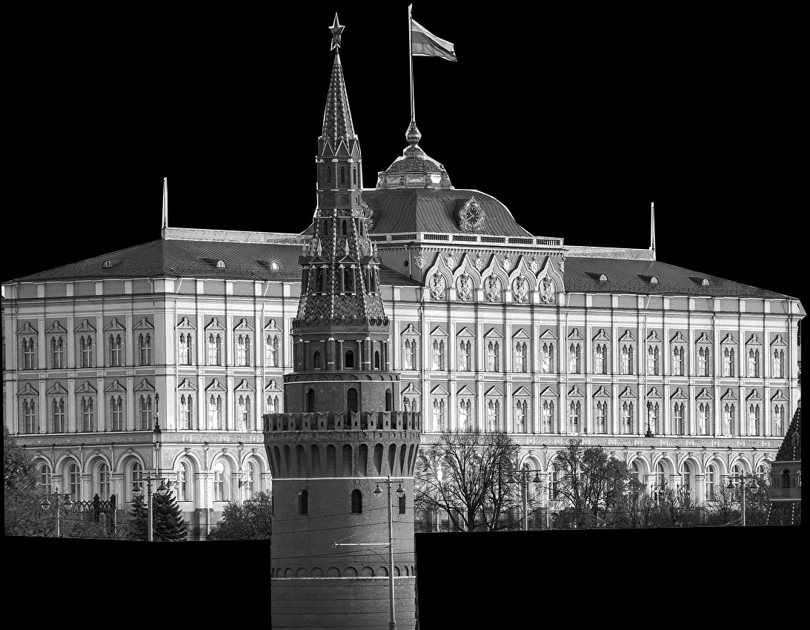
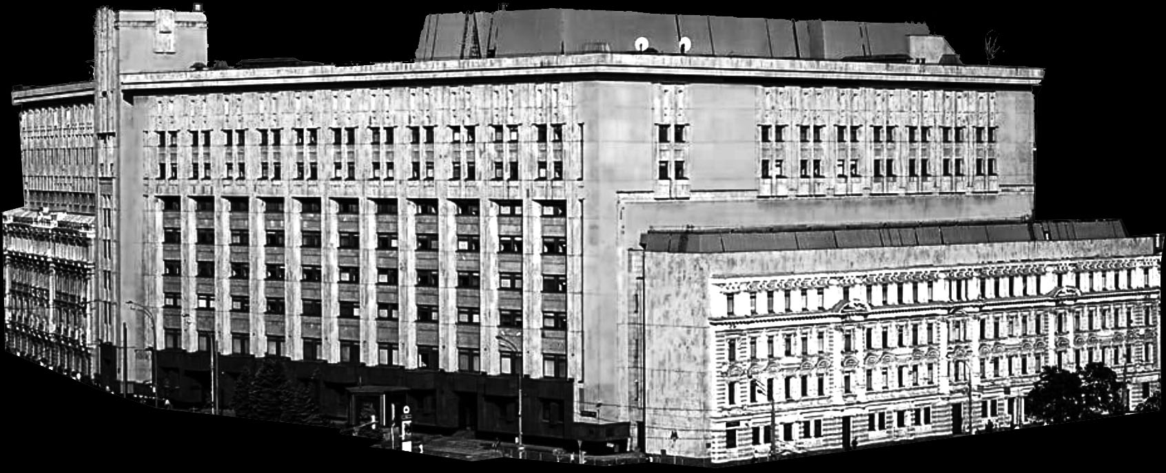
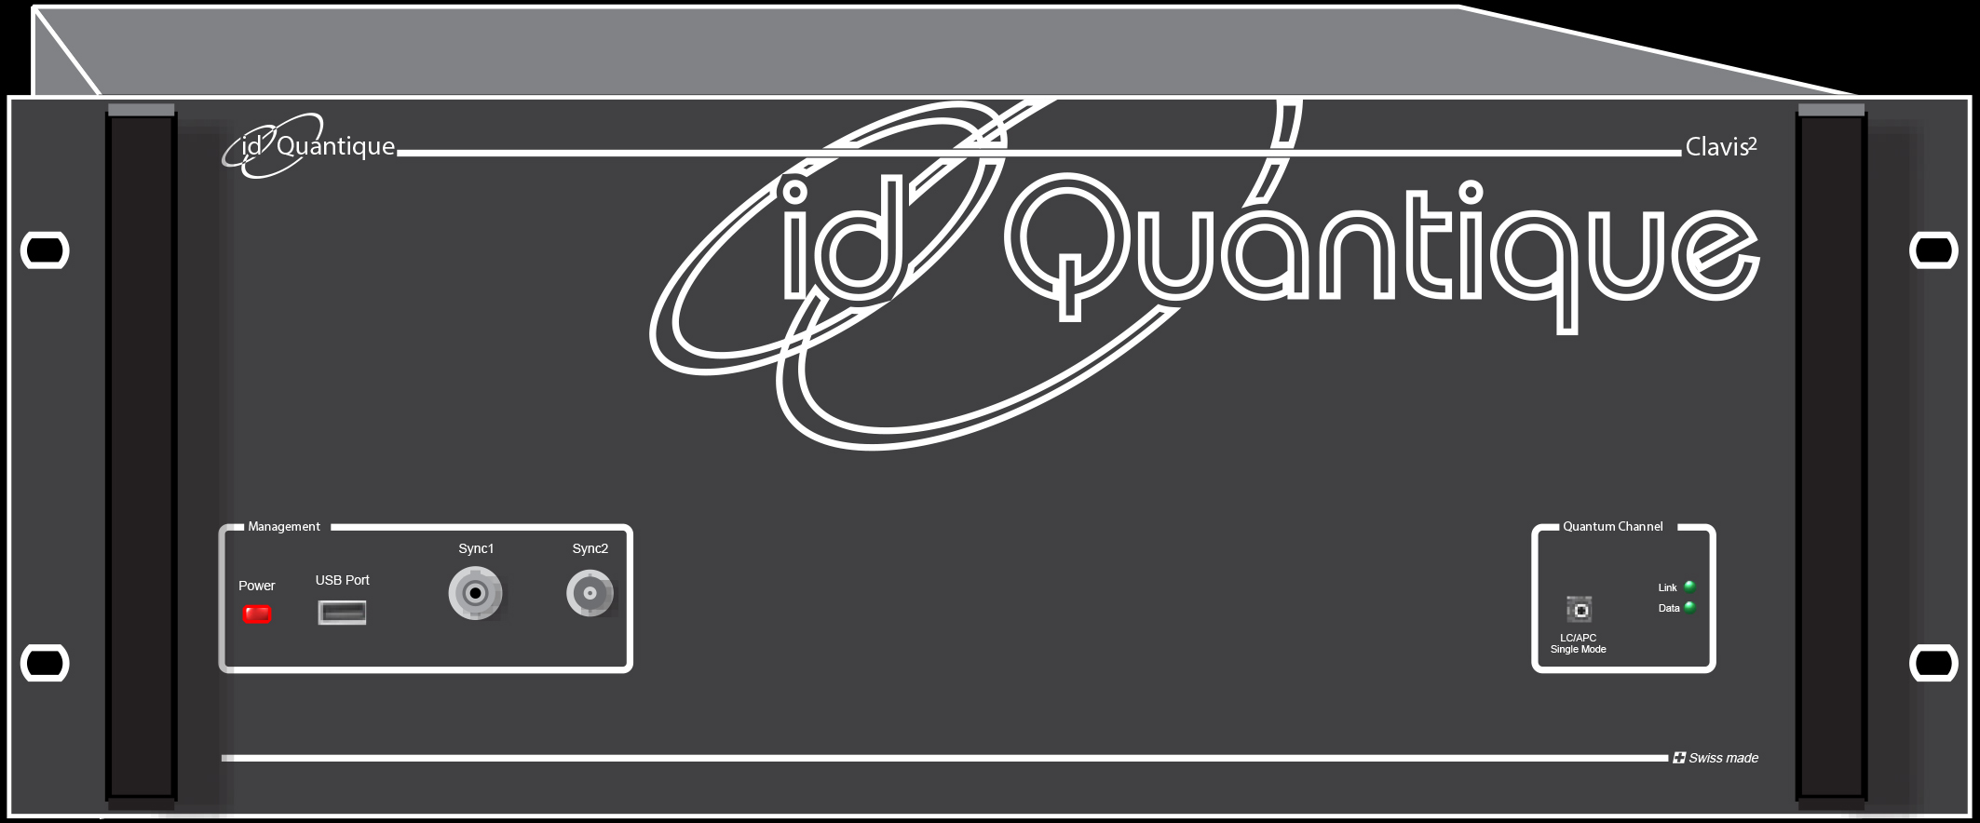
Certification of cryptographic tools
National security agency
Government
Legal requirements
Approval
Accredited lab
System
Certificate
Engineering documentation
Sale
Manufacturer
Customer

Slide 32
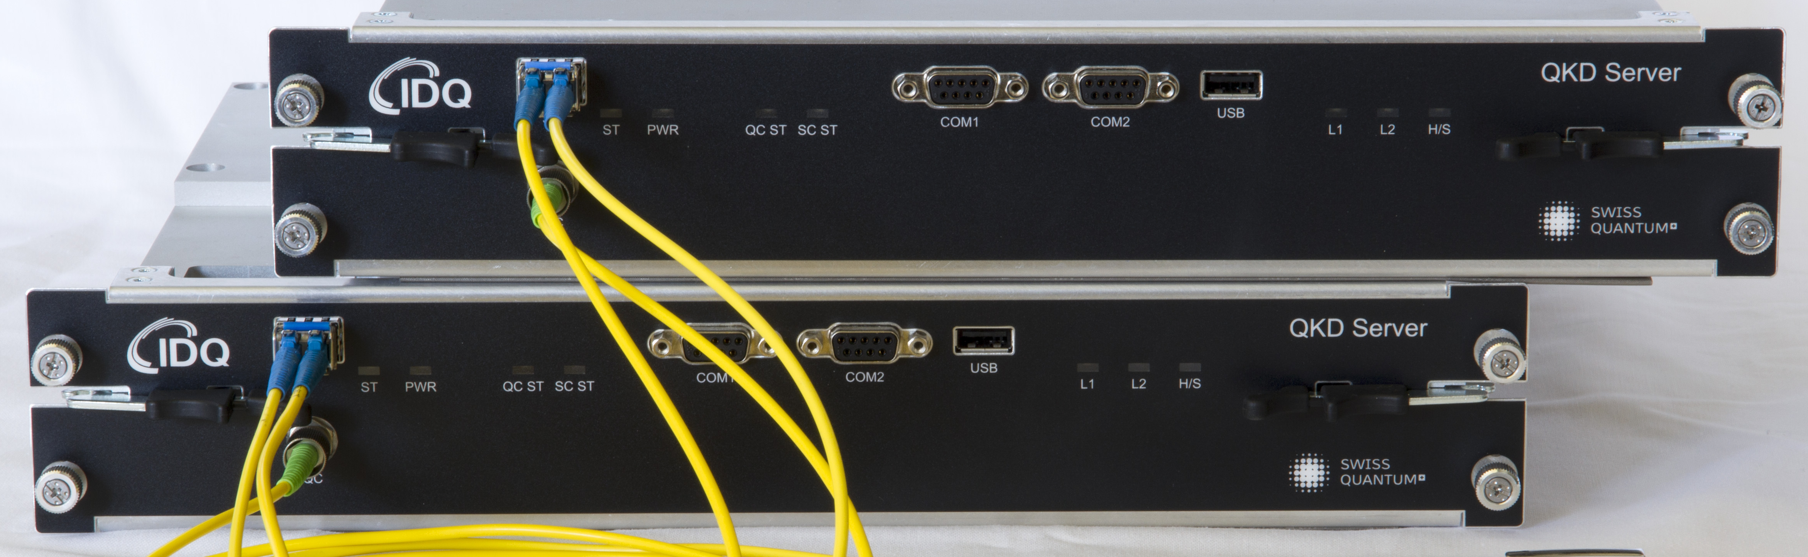
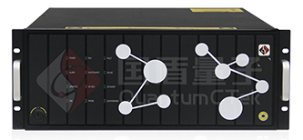




Security audit
 | System | Report | Tests
 | Clavis3 | 2016 | –2018 interrupted
 | 40 MHz | 2016, 2018–19 | ongoing
(ООО Квантовые коммуникации) | Subcarrier scheme | 2018 | –2021
S. Sajeed et al., Sci. Rep. 11, 5110 (2021)
 | 312.5 MHz | 2022 | ongoing
Certification standards are being drafted since 2019 in
Industry standards group in QKD

Slide 33
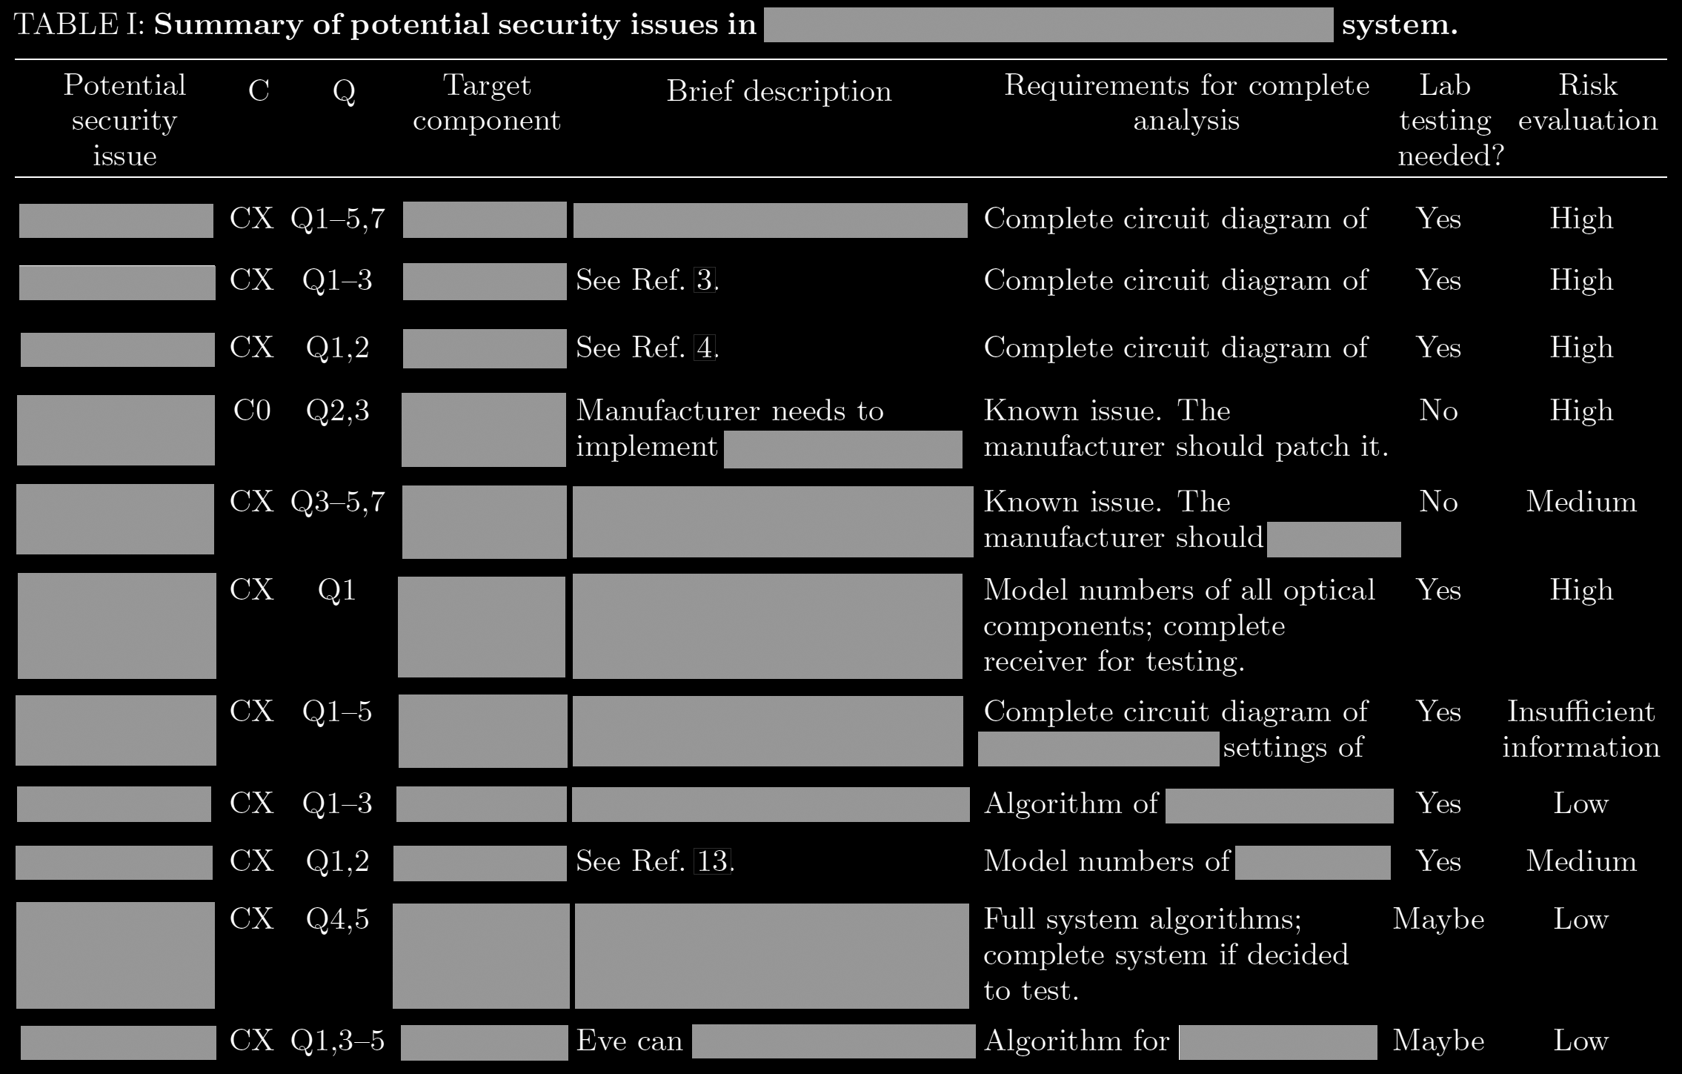
Example of initial analysis report
Missing a single security proof

Slide 34


vad1.com/lab
Quantum hacking lab

