Slide 1
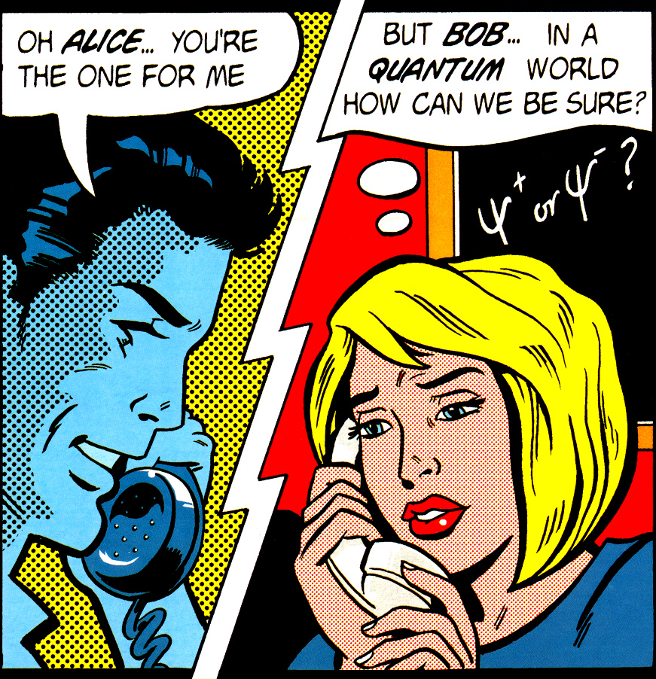
Lecture for CryptoWorks21, IQC, August 1, 2014
Quantum cryptography
Quantum hacking lab
www.vad1.com/lab
Vadim Makarov
Image from cover of
Physics World, March 1998

Slide 2
Communication security you enjoy daily
Paying by credit card in a supermarket
Cell phone conversations, SMS
Email, chat, online calls
Secure browsing, shopping online
Cloud storage and communication between your devices
Software updates on your computer, phone, tablet
Online banking
Off-line banking: the bank needs to communicate internally
Electricity, water: the utility needs to communicate internally
Car keys
Electronic door keys
Government services (online or off-line)
Medical records at your doctor, hospital
Bypassing government surveillance and censorship

Slide 3
Encryption and key distribution
Alice
Bob
Secure channel
RNG
Secret key
Public (insecure) channel
Symmetric
cipher
Symmetric
cipher
Encrypted messages
Messages
Messages
Quantum key distribution transmits secret key
by sending quantum states over open channel.

Slide 4
Public key cryptography
E.g., RSA (Rivest-Shamir-Adleman)
Elliptic-curve
Based on hypothesized one-way functions
Unexpected advances in classical cryptanalysis
Shor’s factorization algorithm for quantum computer
P. W. Shor, SIAM J. Comput. 26, 1484 (1997)
Time to build large quantum computer
Re-tool infrastructure
Encryption needs be secure
What do we do here?
here?
Time
Diagram courtesy M. Mosca

Slide 5
Encryption and key distribution
Alice
Bob
Secure channel
RNG
Secret key
Public (insecure) channel
Symmetric
cipher
Symmetric
cipher
Encrypted messages
Messages
Messages
Quantum key distribution transmits secret key
by sending quantum states over open channel.

Slide 6
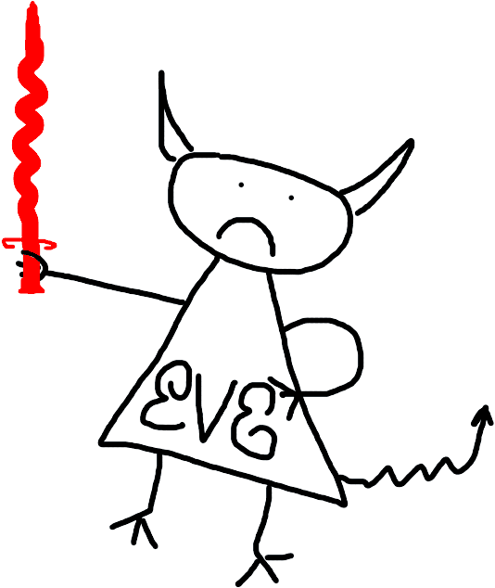
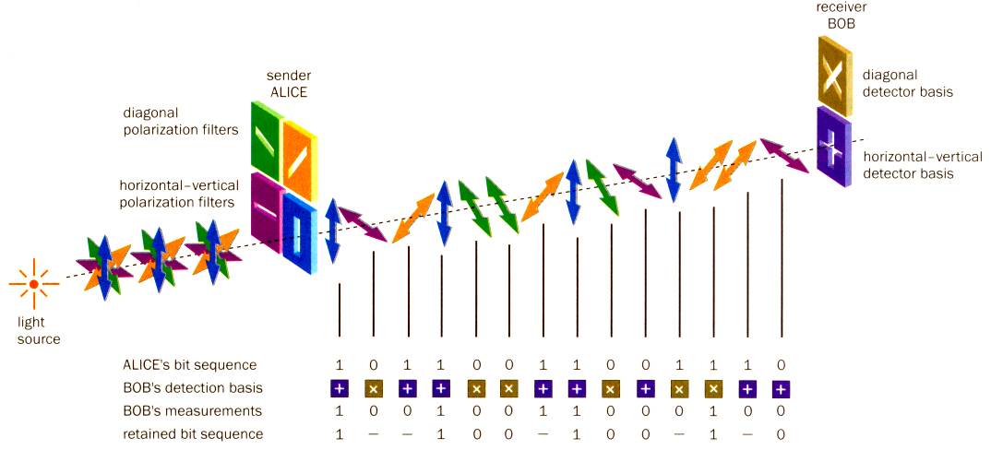
Quantum key distribution (QKD)
Bob
Alice
Diagonal detector basis
Diagonal polarization filters
0
1
Horizontal-vertical detector basis
Horizontal-vertical polarization filters
0
1
Light source
Alice’s bit sequence 1 0 1 1 0 0 1 1 0 0 1 1 1 0
Bob’s detection basis
Bob’s measurement 1 0 0 1 0 0 1 1 0 0 0 1 0 0
Retained bit sequence 1 – – 1 0 0 – 1 0 0 – 1 – 0
Image reprinted from article: W. Tittel, G. Ribordy & N. Gisin, “Quantum cryptography,” Physics World, March 1998

Slide 7
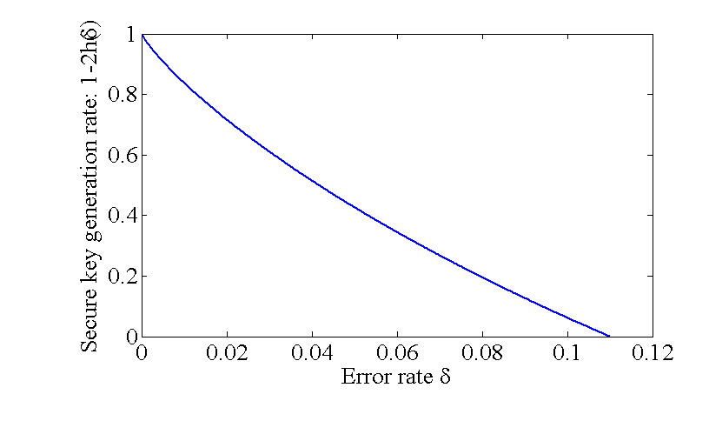
Dealing with errors
Errors due to imperfections and Eve.
Must assume that all errors are due to Eve!
Error correction: standard classical protocols
Privacy amplification:
secure key
random matrix
raw key
0
1
1
1
1 | 0 | 1 | 1 | 1 | 0 | 0
1 | 1 | 0 | 0 | 0 | 1 | 1
0 | 0 | 1 | 0 | 0 | 0 | 1
0 | 1 | 1 | 1 | 0 | 0 | 0
1
1
0
0
1
0
1
=
Security proof:
Secure key generation rate
Error rate

Slide 8
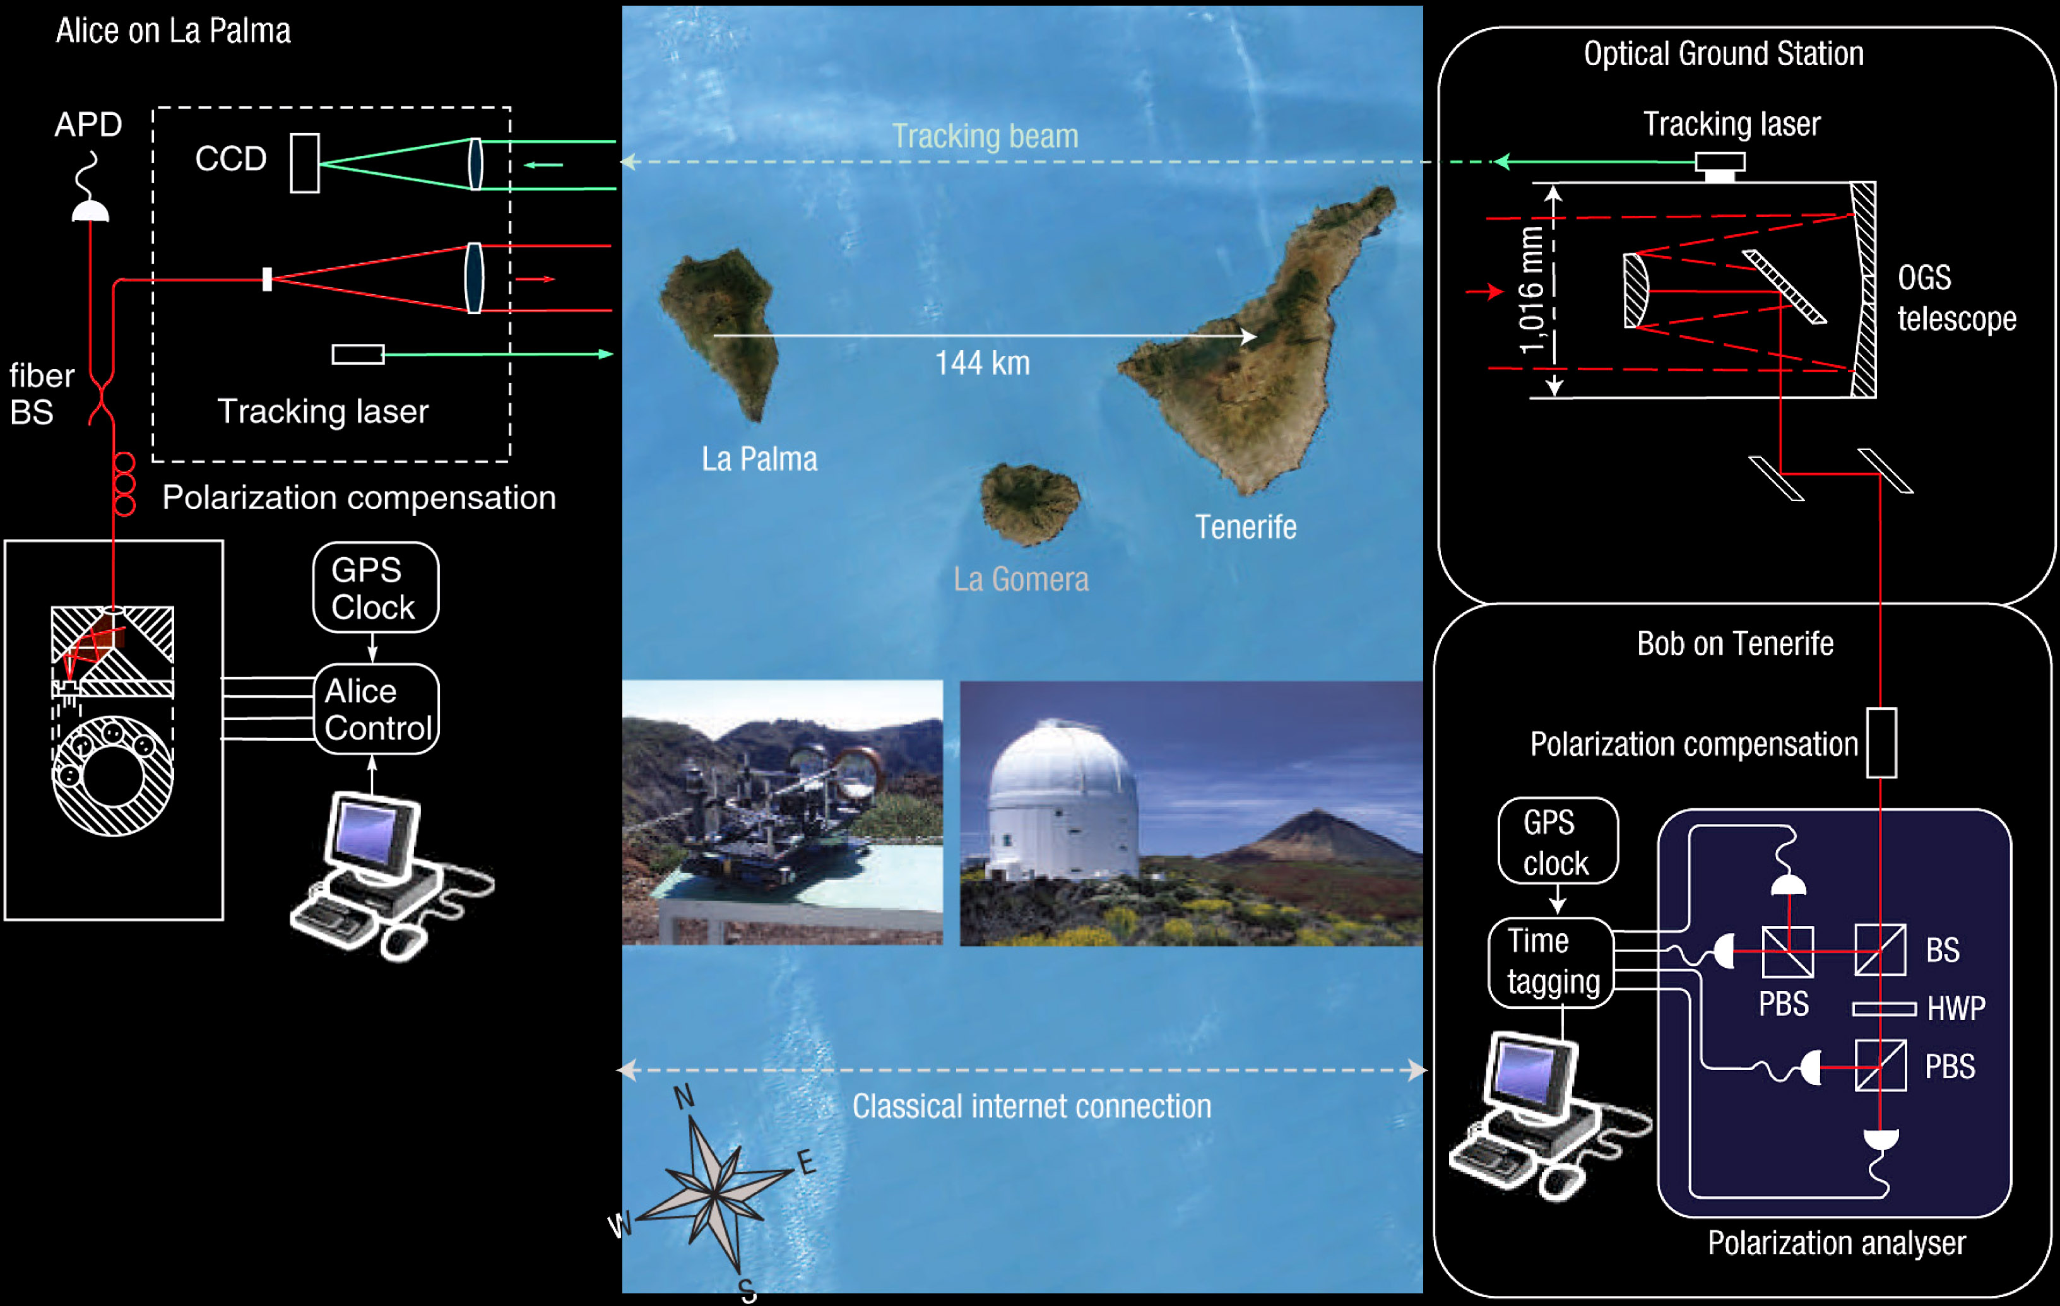
Free-space QKD over 144 km
T. Schmitt-Manderbach et al., Phys. Rev. Lett. 98, 010504 (2007)

Slide 9
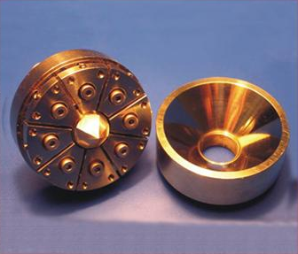
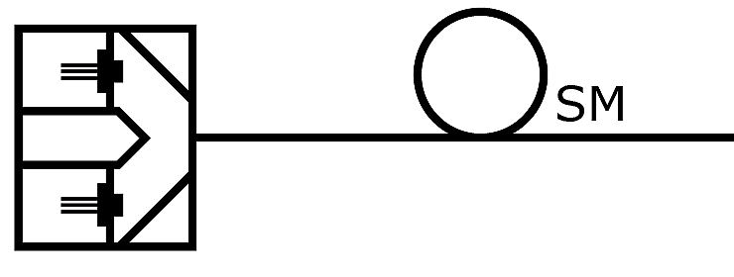
Alice:
Polarized photon source
S. Nauerth et al., New J. Phys. 11, 065001 (2009)

Slide 10








Single-photon sources
Attenuated laser
Laser
Attenuator
$$P_{n}\left(μ\right)=\frac{μ^{n}e^{−μ}}{n!}$$
$$μ$$
$$P$$
$$μ=0.2$$
$$P$$
$$μ=0.02$$
1
1
0.1
0.1
0.01
0.01
0.001
0.001
0 1 2 3 $n$
0 1 2 3 $n$
Parametric down-conversion
Non-linear
crystal
Pump
laser
Heralding detector

Slide 11
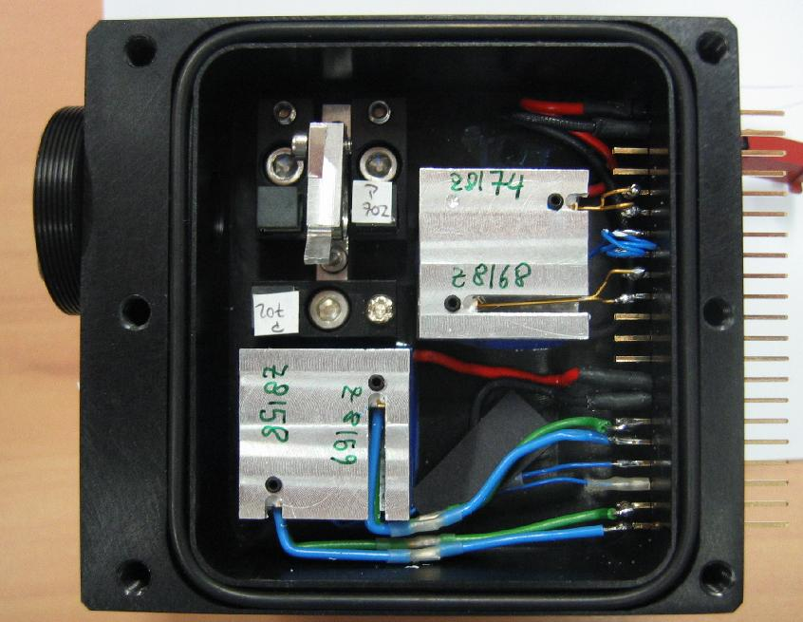
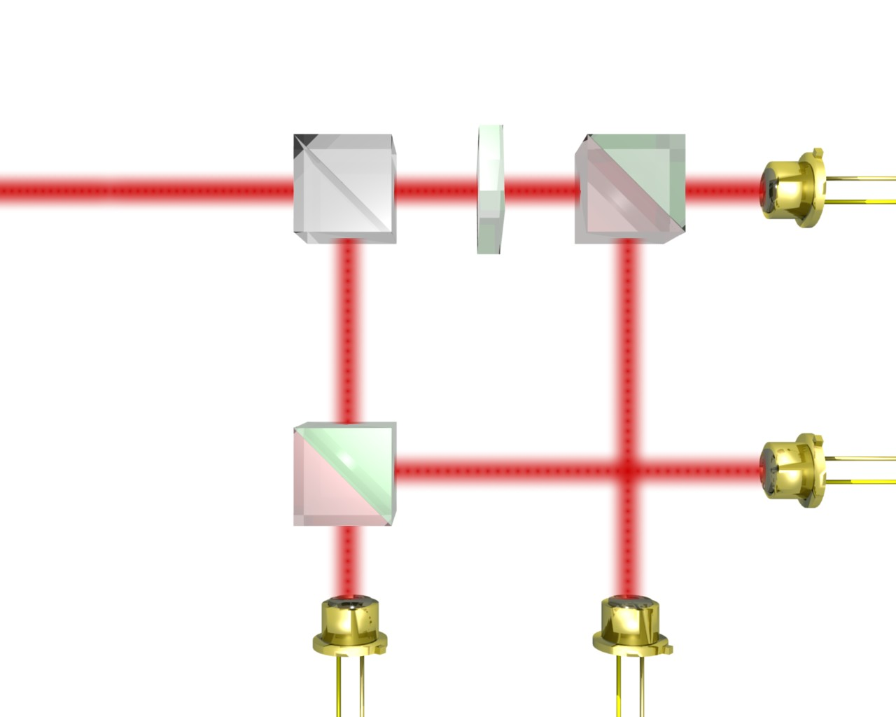
Bob:
Polarization analyzer with single-photon detectors
λ/2
22.5°
50:50
PBS
APD,
+45°
V
PBS
H
-45°
J. G. Rarity, P. C. M. Owens, P. R. Tapster, J. Mod. Opt. 41, 2435 (1994)

Slide 12
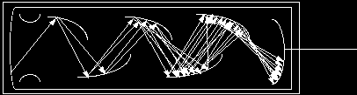
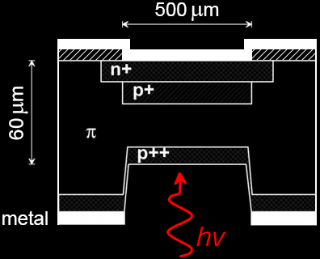


Single-photon detectors
Photomultiplier tube
$$ℏω$$
e
Photocathode
Dynodes
Avalanche photodiode
+V_{bias} > V_{br}
Output
$$ℏω$$
Images reprinted from: http://www.frankswebspace.org.uk/ScienceAndMaths/physics/physicsGCE/D1-5.htm; S. Cova et al., J. Mod. Opt. 51, 1267 (2004)

Slide 13
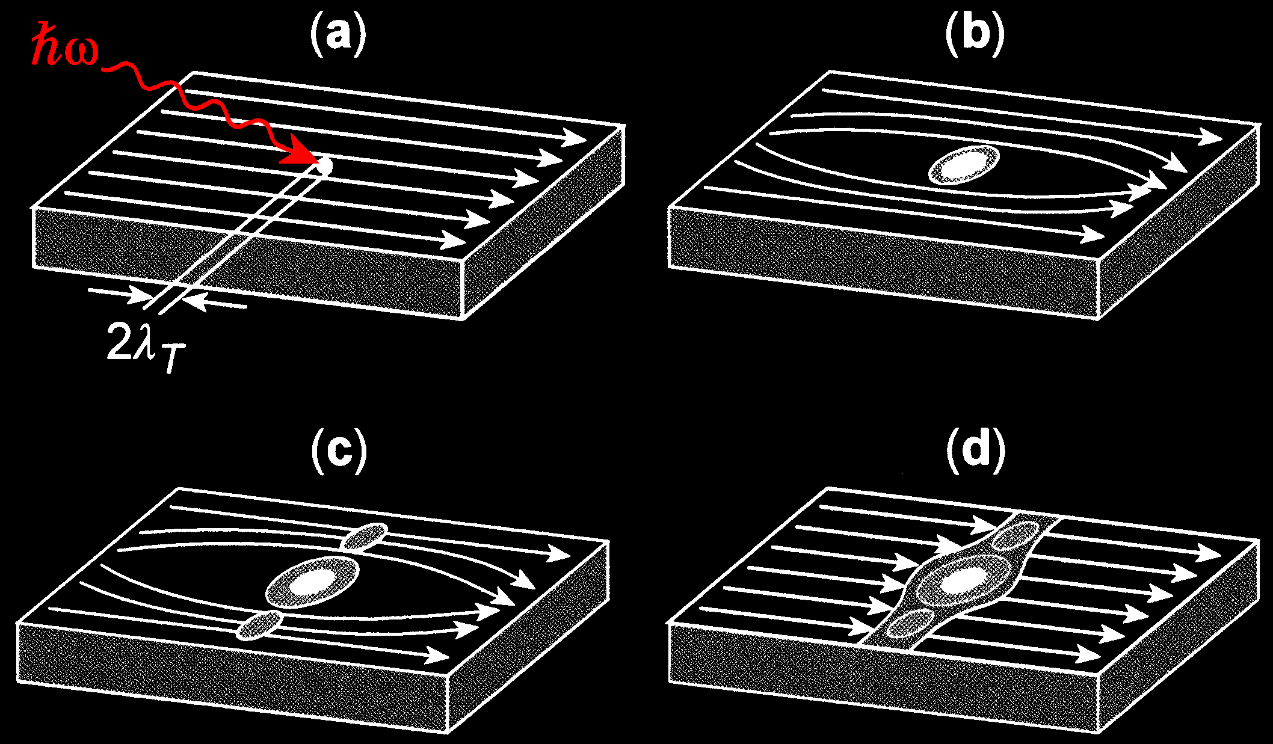
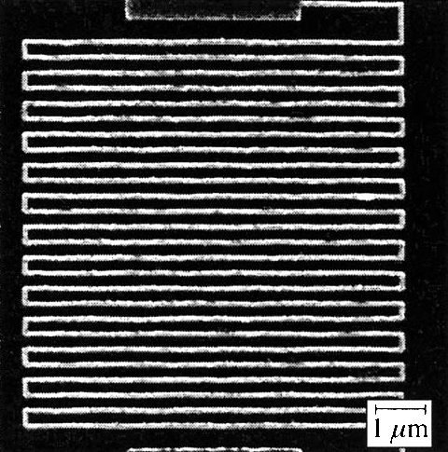
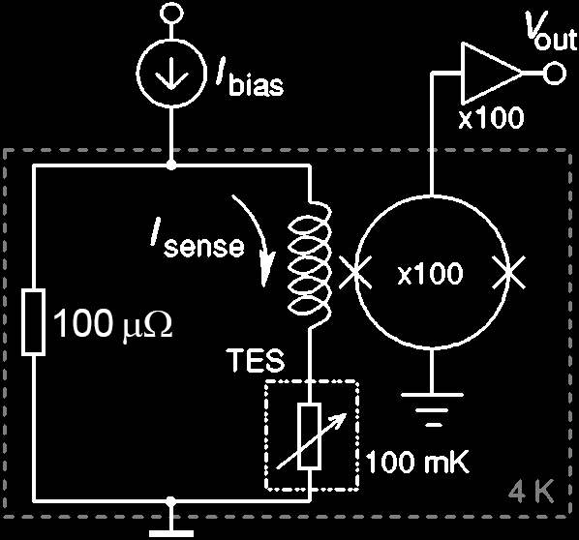
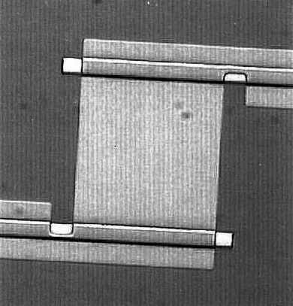

Single-photon detectors
Superconducting nanowire
Images reprinted from: R. Sobolewski et al., IEEE Trans. Appl. Supercond. 13, 1151 (2003)
Transition-edge sensor
Al lead
W sensor
$$ℏω$$
10 µm
Images reprinted from: B. Cabrera et al., Appl. Phys. Lett. 73, 735 (1998); A.J. Miller et al., Appl. Phys. Lett. 83, 791 (2003)

Slide 14
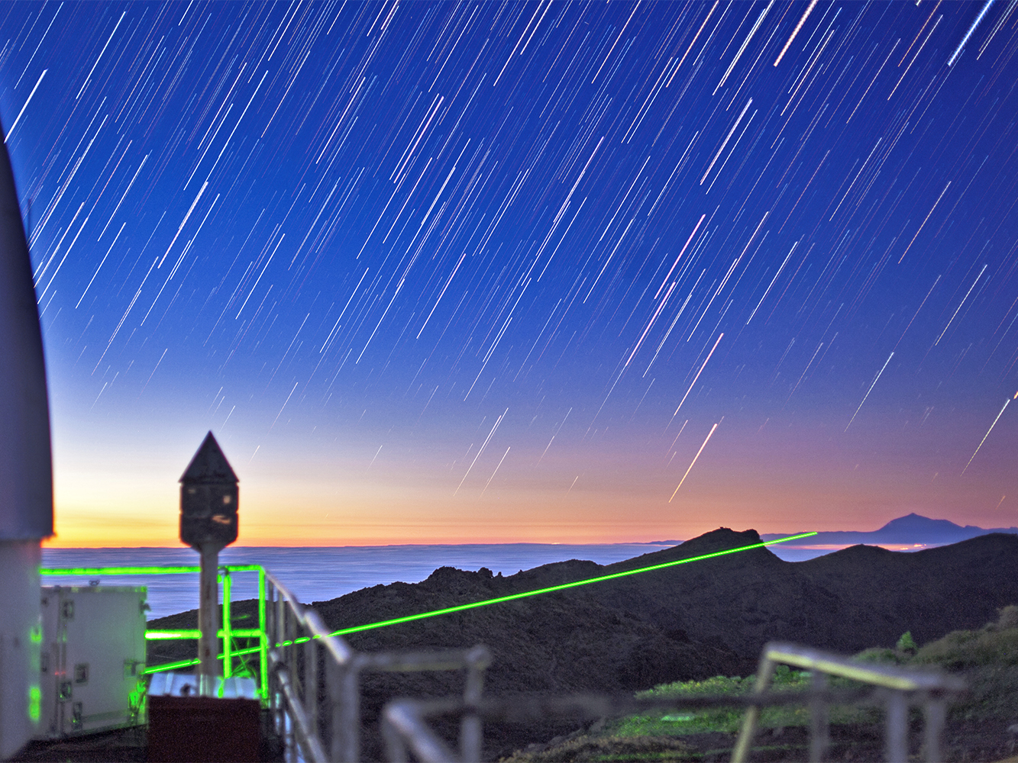
Alice on La Palma
Photo © IQOQI Vienna

Slide 15
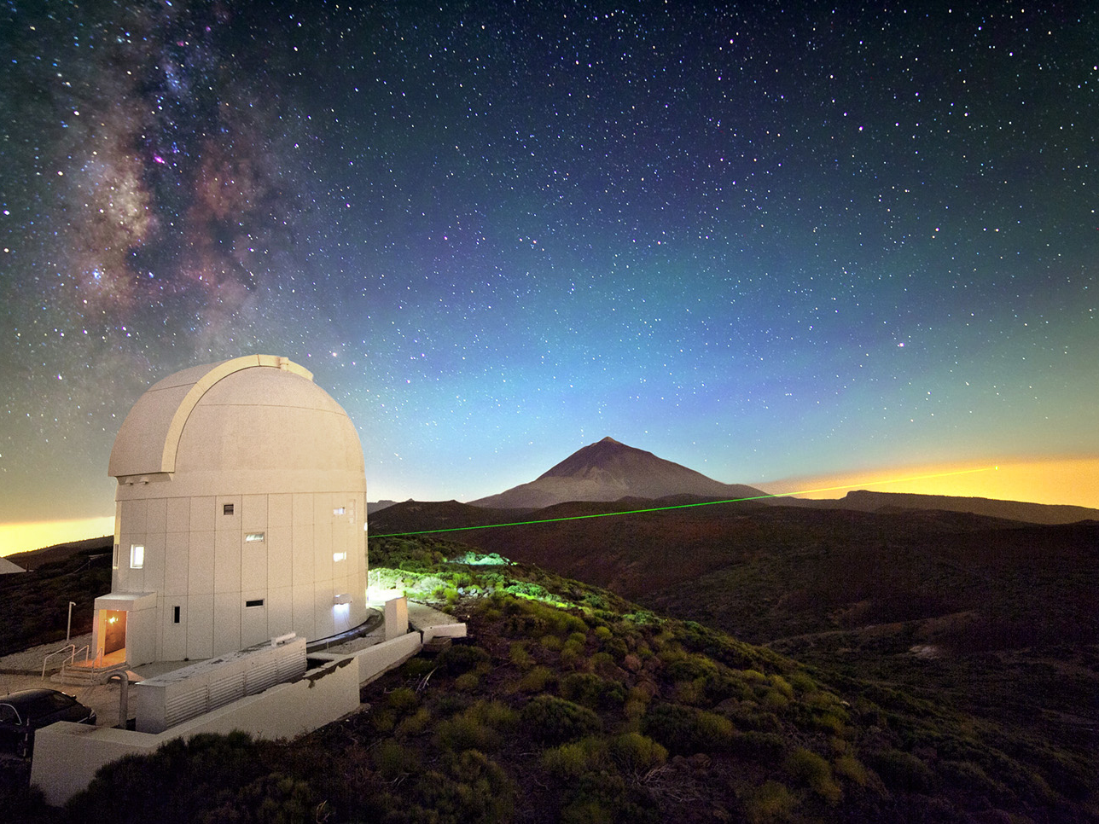
Bob on Tenerife
Photo © IQOQI Vienna

Slide 16
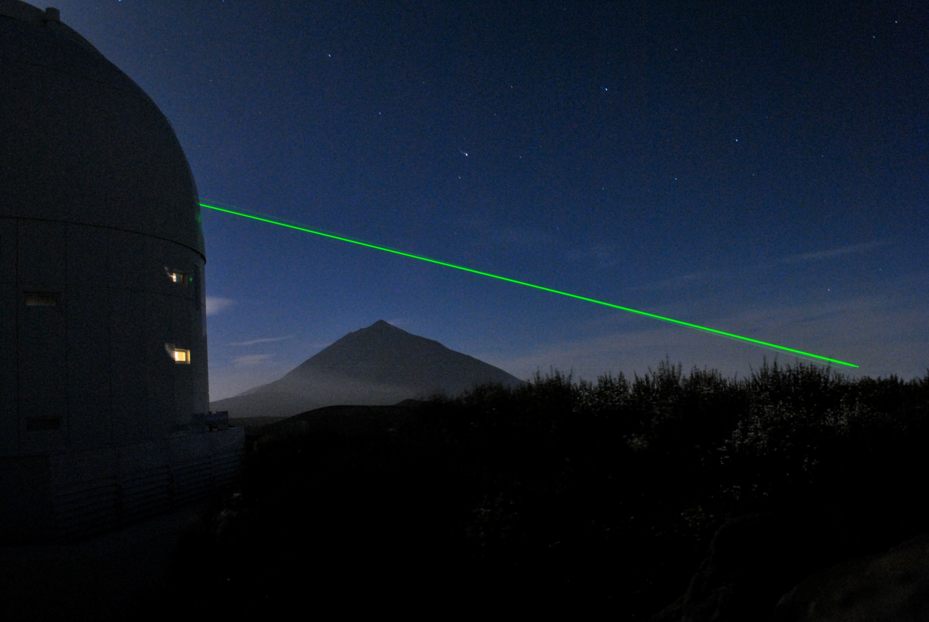
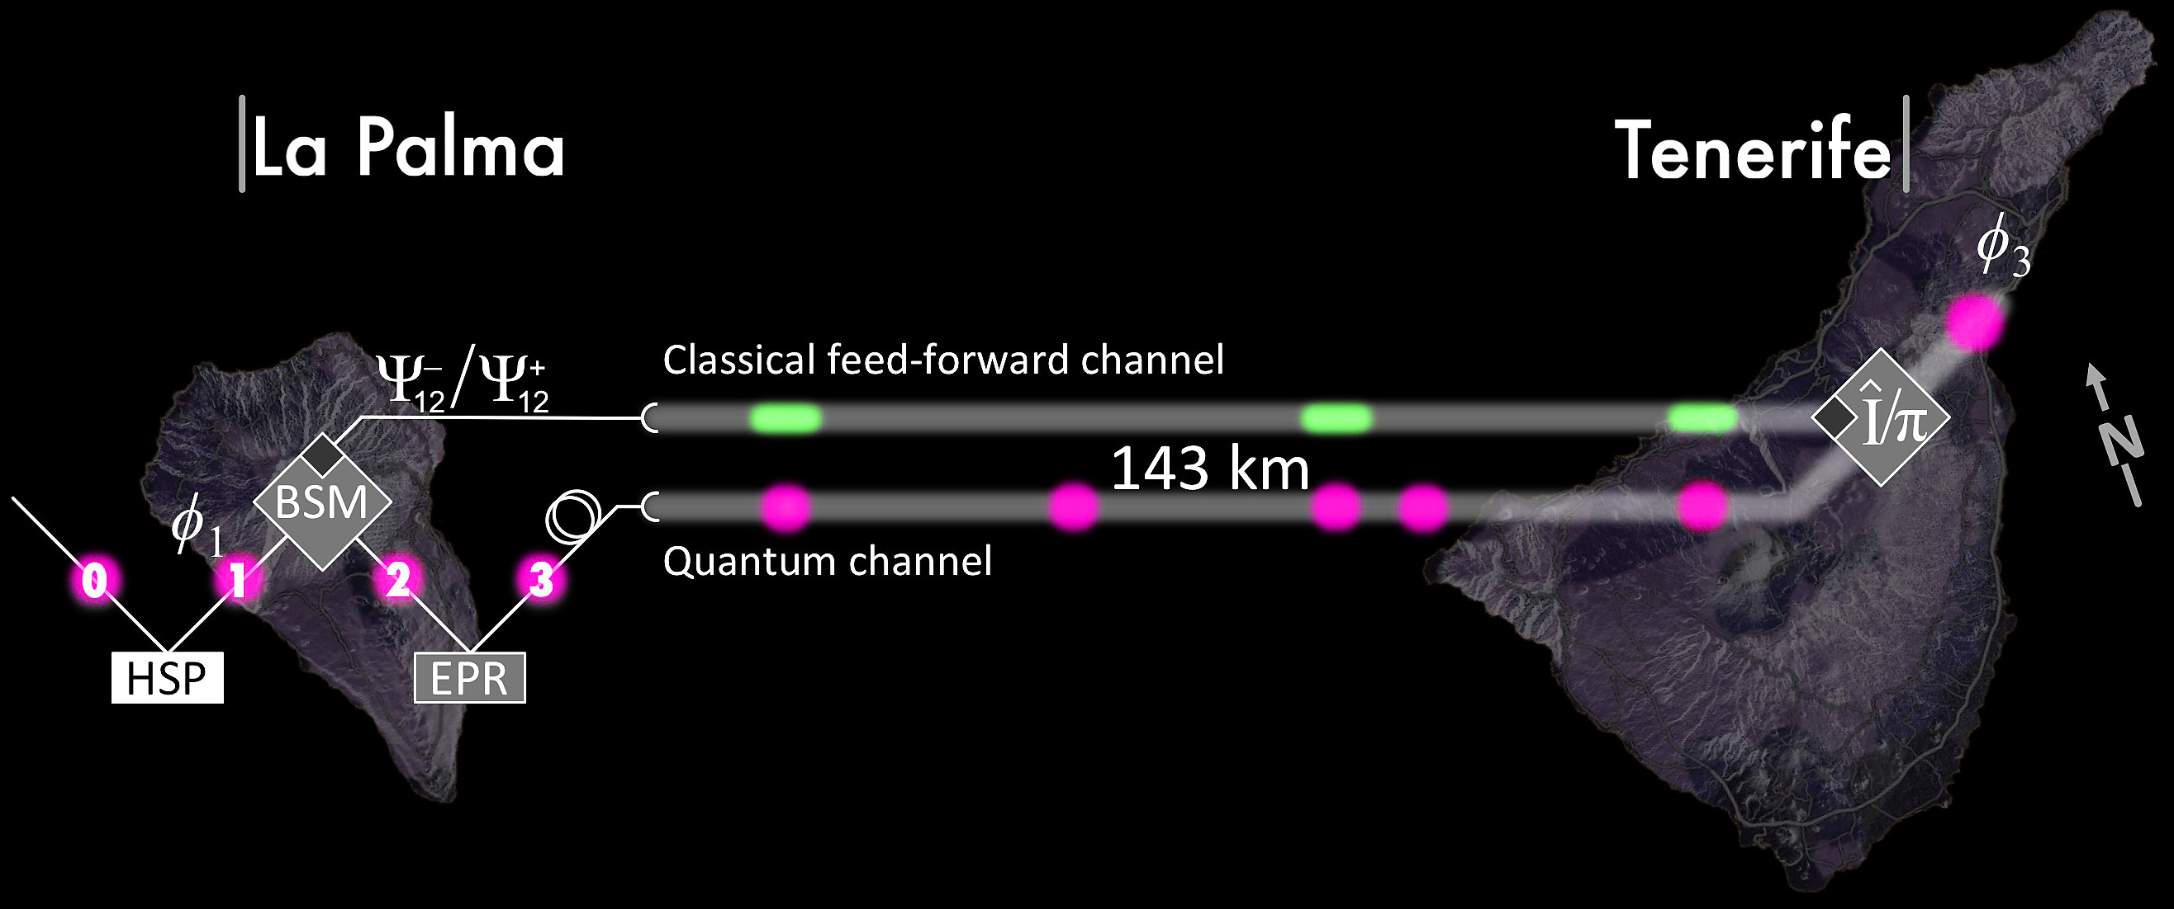
Quantum teleportation over 143 km
Photo by Tobias Schmitt-Manderbach
X.-S. Ma et al., Nature 489, 269 (2012)

Slide 17
Polarization encoding
Bob
Alice
Diagonal detector basis
Diagonal polarization filters
0
1
Horizontal-vertical detector basis
Horizontal-vertical polarization filters
0
1
Light source
Alice’s bit sequence 1 0 1 1 0 0 1 1 0 0 1 1 1 0
Bob’s detection basis
Bob’s measurement 1 0 0 1 0 0 1 1 0 0 0 1 0 0
Retained bit sequence 1 – – 1 0 0 – 1 0 0 – 1 – 0
Image reprinted from article: W. Tittel, G. Ribordy & N. Gisin, “Quantum cryptography,” Physics World, March 1998

Slide 18
Phase encoding, interferometric QKD channel
Alice
Bob
Light
source
long
short
ϕ
D
0
B
ϕ
D
A
short
Transmission line
long
1
Detector bases:
ϕ_{B} = – 45° : X
ϕ_{B} = + 45° : Z
ϕ_{A} = – 45° or + 45° : 0
ϕ_{A} = +135° or – 135° : 1

Slide 19
Plug-and-play scheme
Alice
Bob
DL
ϕ
VOA
B
BS
C
FM
ϕ
PBS
L
A
sync
D0
D1
D. Stucki et al., New J. Phys. 4, 41 (2002)

Slide 20
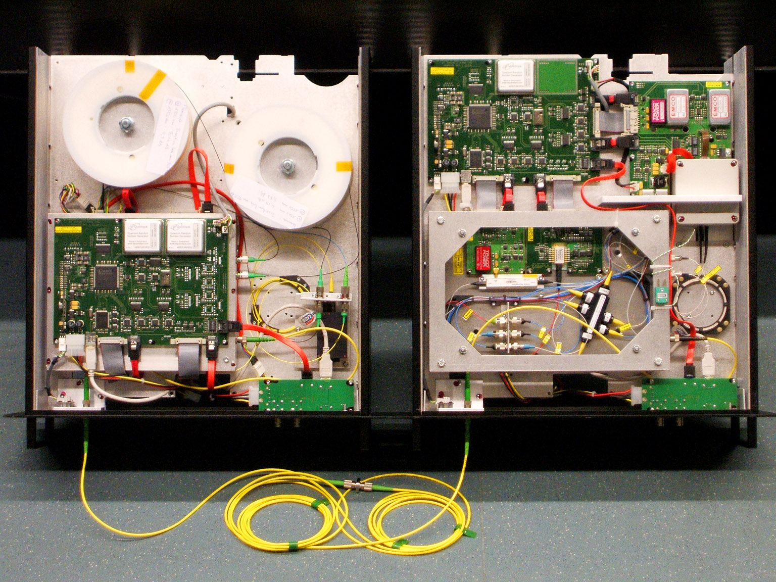
ID Quantique Clavis2 QKD system
Alice
Bob
Photo © 2008 Vadim Makarov. Published with approval of ID Qiantique

Slide 21
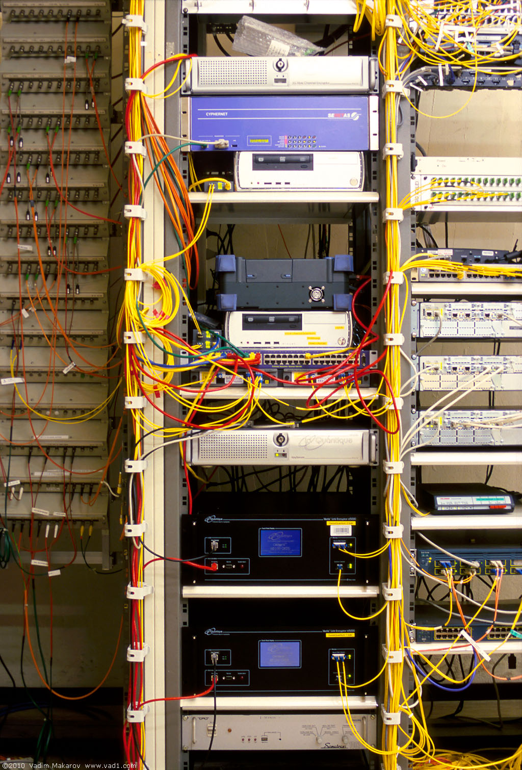
Commercial QKD
Classical encryptors:
L2, 2 Gbit/s
L2, 10 Gbit/s
L3 VPN, 100 Mbit/s
WDMs
17 km (fiber length)
Key manager
14 km
QKD to another node
(4 km)
QKD to another node
(14 km)
4 km
Photo © 2010 Vadim Makarov
www.swissquantum.com
ID Quantique Cerberis system (2010)

Slide 22
Trusted-node repeater
User
Trusted node
User
QKD 1
QKD 2
K1
K1
K2
K2
K1⊕K2
K1
K1⊕K2⊕K2 = K1

Slide 23
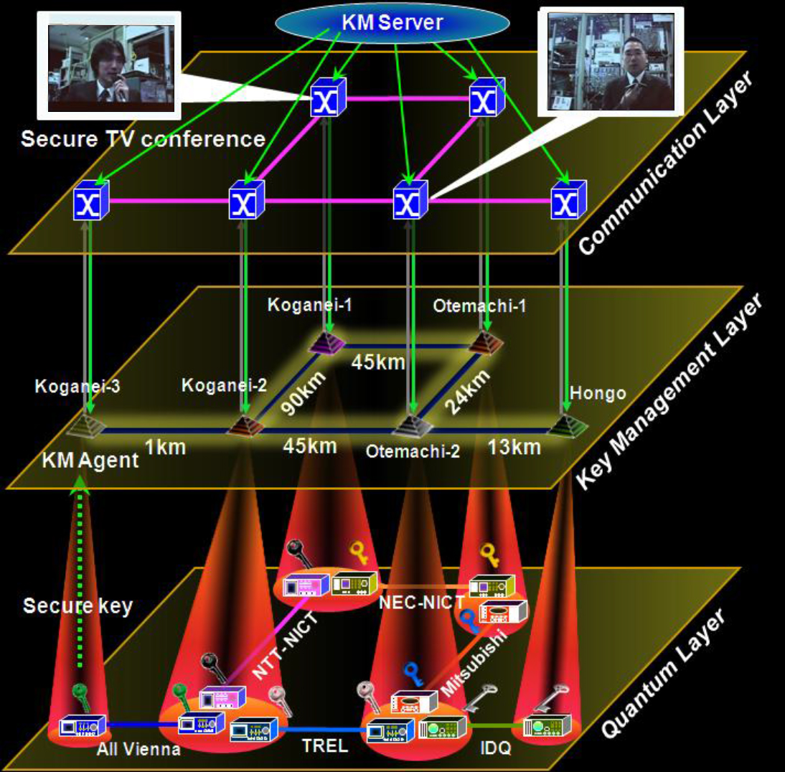
Trusted-node network
M. Sasaki et al., Opt. Express 19, 10387 (2011)

Slide 24
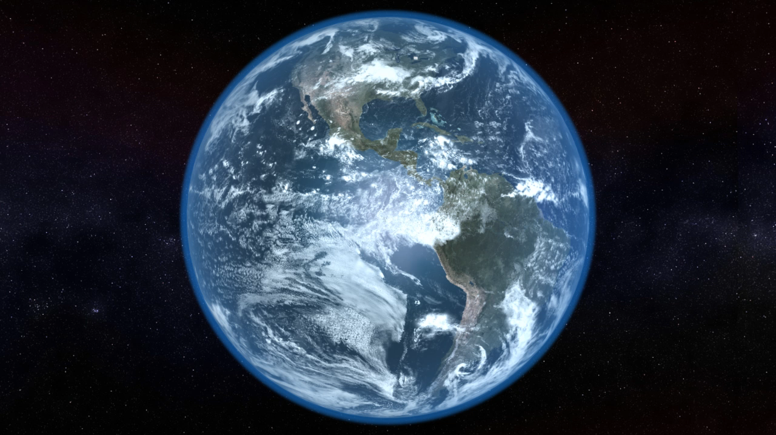
Video ©2012 IQC / group of T. Jennewein

Slide 25
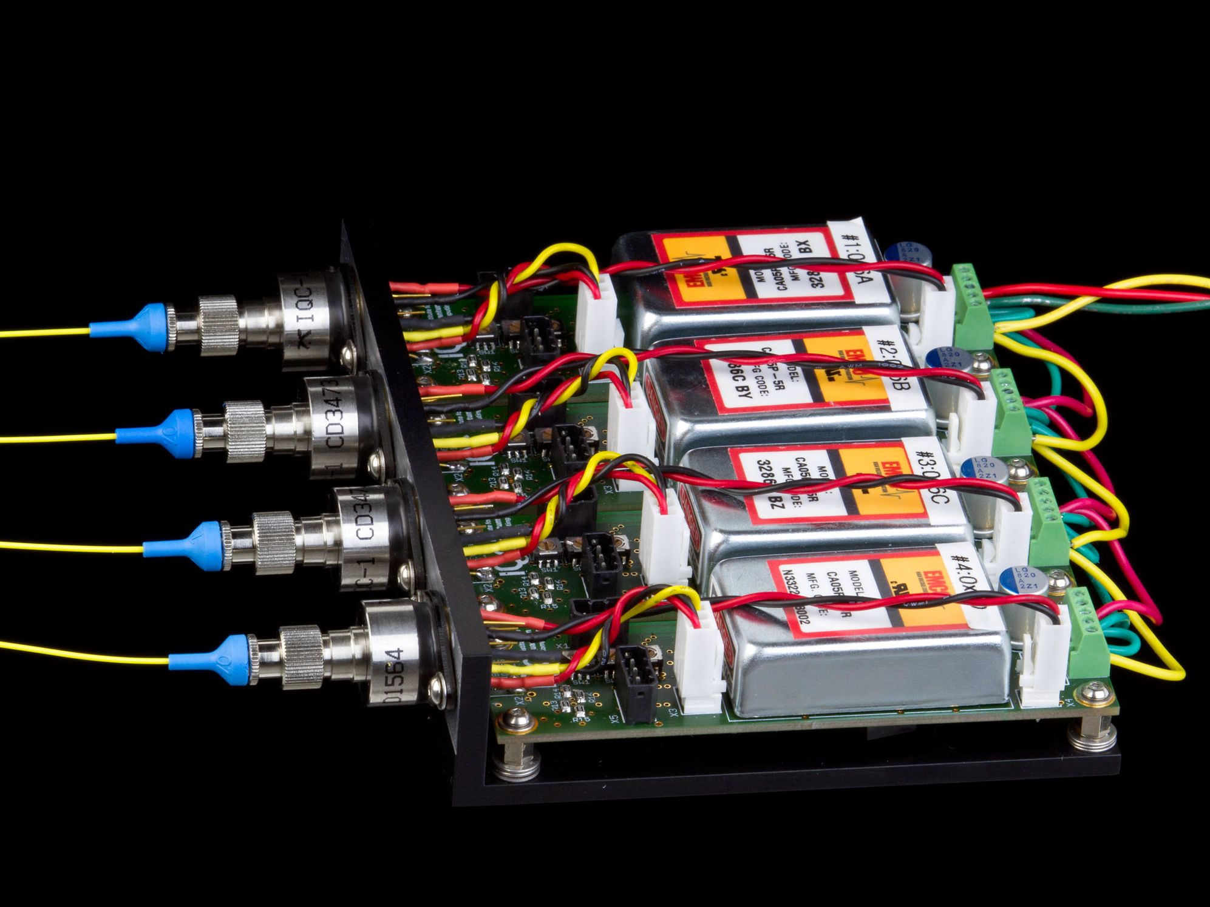
Prototype single-photon detector (4-channel)
Photo © 2014 V. Makarov / IQC

Slide 26
End of lecture 1

Slide 27
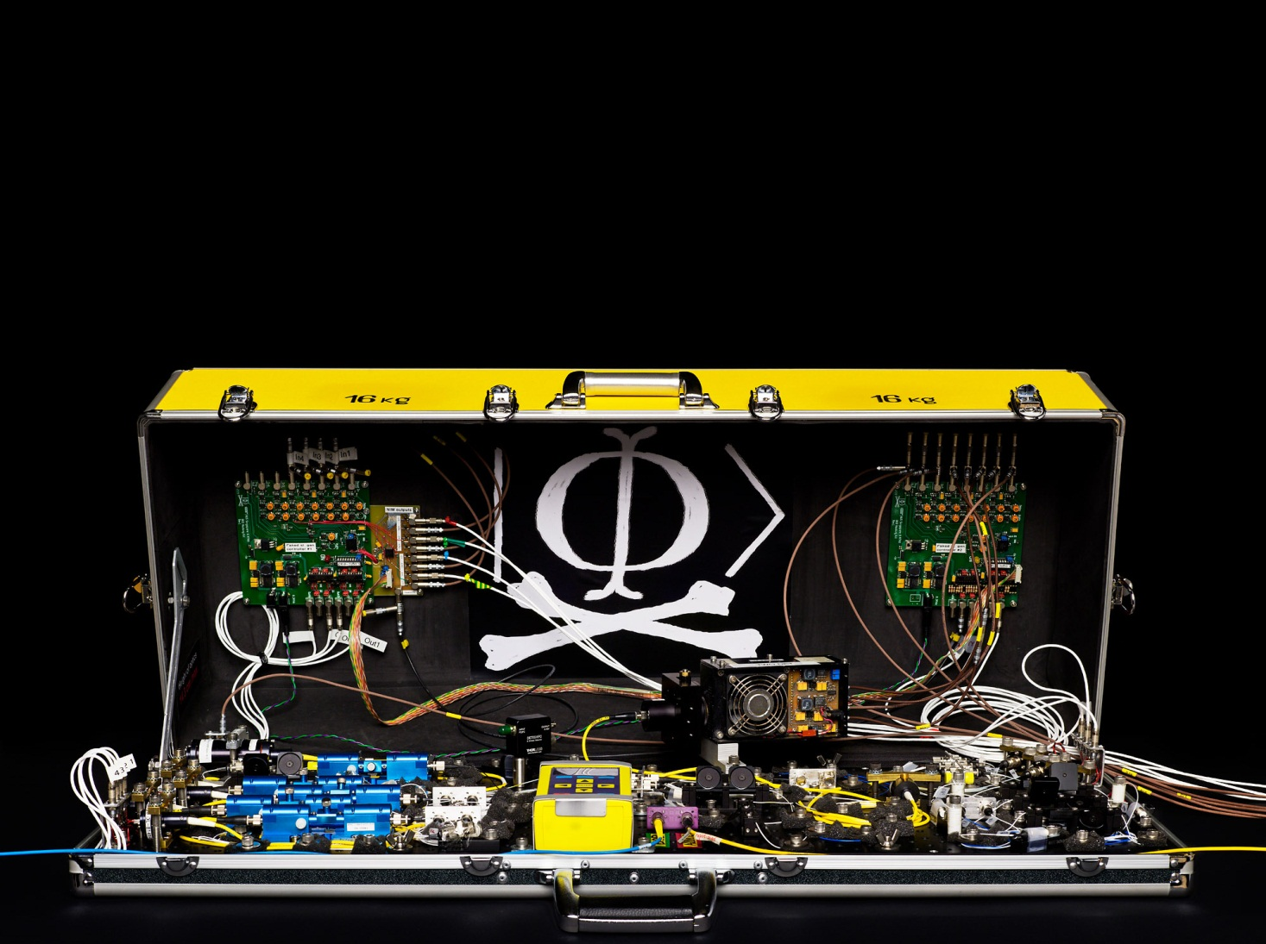
Lecture for CryptoWorks21, IQC, August 1, 2014
Quantum hacking
Vadim Makarov www.vad1.com/lab
Photo © 2010 NTNU Info / Geir Mogen

Slide 28



Security model of QKD
Alice
Bob
1
Secret key rate $R=f\left(\text{QBER}\right)$
R
0
0
0.11
QBER
Security proof
.Laws of physics & Model of equipment

Slide 29
Security model of QKD
Security proof
.Laws of physics & Model of equipment
Integrate imperfection into security model
Hack
Security proof
.Laws of physics & Model of equipment

Slide 30
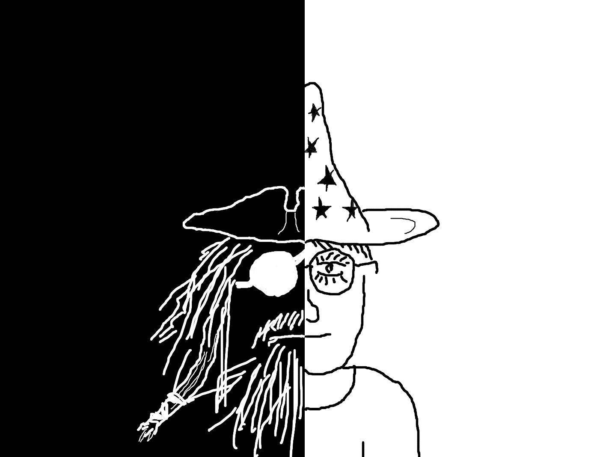
Quantum hacking...
Discover vulnerabilities
Demonstrate attacks
Develop countermeasures
Eliminate imperfections

Slide 31
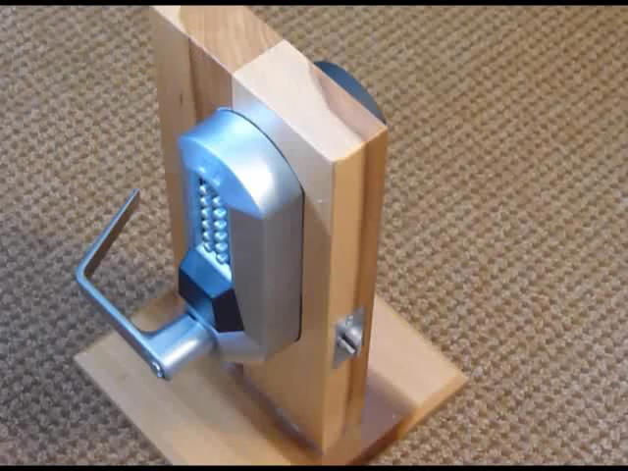
Video ©2011 Marc Weber Tobias

Slide 32
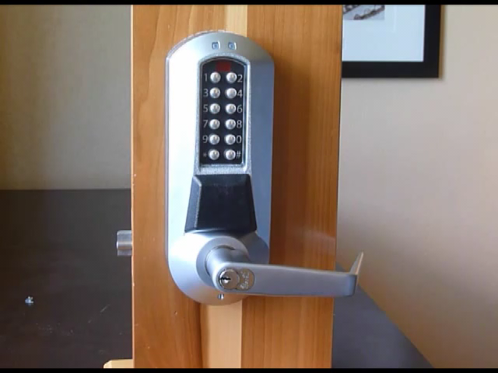
Video ©2011 Marc Weber Tobias

Slide 33
Commercial QKD
ID Quantique Cerberis system
Classical encryptors:
L2, 2 Gbit/s
L2, 10 Gbit/s
L3 VPN, 100 Mbit/s
WDMs
Key manager
QKD to another node (4 km)
QKD to another node (14 km)
Photo © 2010 Vadim Makarov
www.swissquantum.com

Slide 34
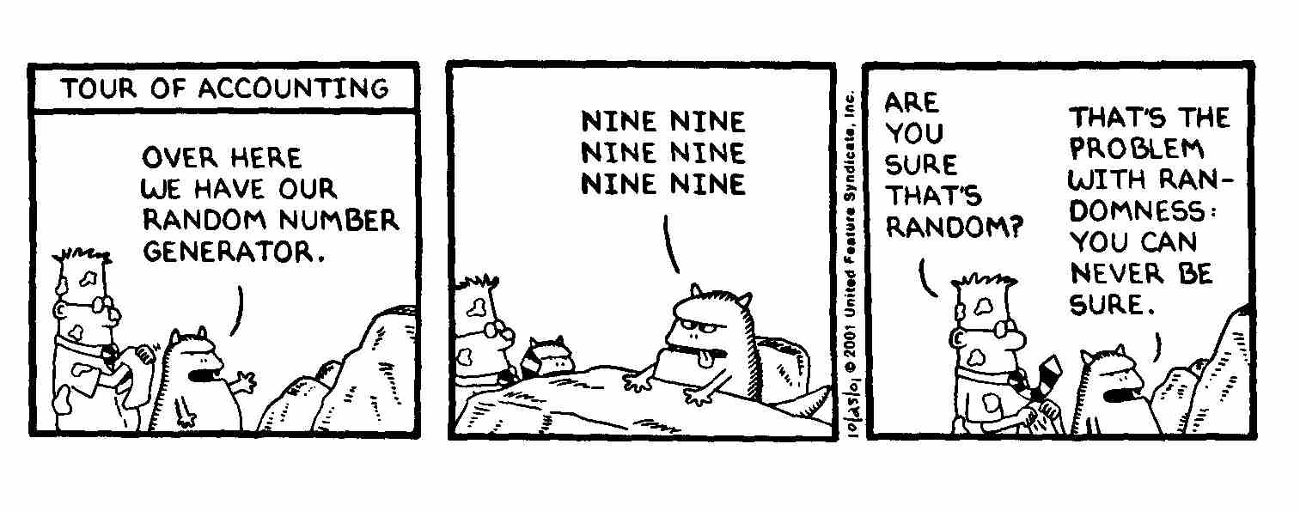
True randomness?
Quantis
RNG
FPGA
Phase modulator in Bob
id Quantique Clavis2 (2008)
OK
V_{π}/2
0
ONE ONE ONE
ONE ONE ONE
ONE ONE ONE

Slide 35
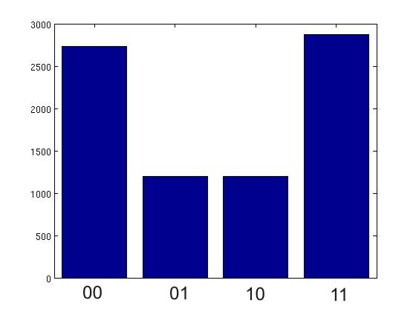
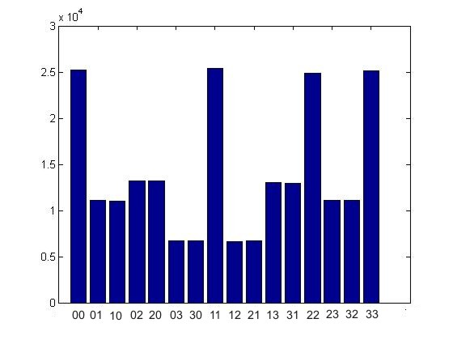
True randomness?
Quantis
RNG
FPGA
Phase modulator in Bob
id Quantique Clavis2 (2008)
V_{π}/2
0
Bob:
Alice:
Issue reported patched, as of January 2010

Slide 36
Do we trust the manufacturer?
Quantis RNG
Quantis RNG, Trojan-horsed :)
*
*
Memory with
pre-recorded
random
sequence
Clicks
processed
Clicks
processed
Random
stream
Random
stream
Switch
Many components in QKD system can be Trojan-horsed:
– access to secret information
– electrical power
– way to communicate outside or compromise security

Slide 37
ID Quantique Clavis2 QKD system
Alice
Bob
Photo © 2008 Vadim Makarov. Published with approval of ID Qiantique

Slide 38
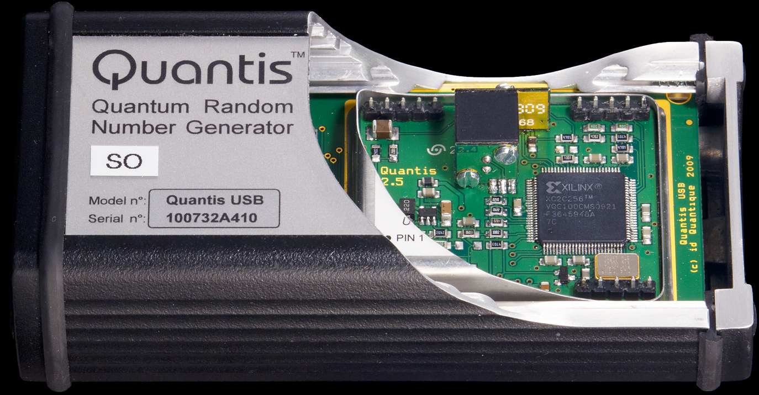
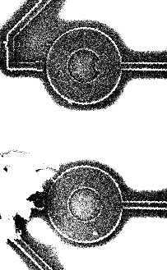
Quantis RNG: what’s inside?
G
20 MHz
Debiasing
LED
820 nm
(40 nm FWHM)
Output
4 Mbit/s
20 µm
G. Ribordy, O. Guinnard, US patent appl. US 2007/0127718 A1 (filed in 2006)
I. Radchenko et al., unpublished

Slide 39
Double clicks
– occur naturally because of detector dark counts, multi-photon pulses...
Discard them?
Intercept-resend attack... with a twist:
Bob:
Detects in
Eve’s basis:
single click
Eve
100
photons
Alice
Bob´
Alice´
Detects in
conjugate basis:
double click,
discarded
Proper treatment for double clicks: assign a random bit value.
N. Lütkenhaus, Phys. Rev. A 59, 3301 (1999)
T. Tsurumaru & K. Tamaki, Phys. Rev. A 78, 032302 (2008)

Slide 40
Trojan-horse attack
Alice
Phase modulator
Attenuator
Alice’s
PC
Line
Eve’s equipment
– interrogating Alice’s phase modulator with powerful
external pulses (can give Eve bit values directly)

Slide 41
Trojan-horse attack experiment
Alice
4% reflection
Phase modulator
Laser
V_{mod}
Eve
L₁
OTDR
Out
Received OTDR pulse
Variable attenuator
In
L₂
Fine length adjustment
to get L₁ = L₂
0
4.1
8.2
V_{mod}, V
A. Vakhitov et al., J. Mod. Opt. 48, 2023 (2001)

Slide 42
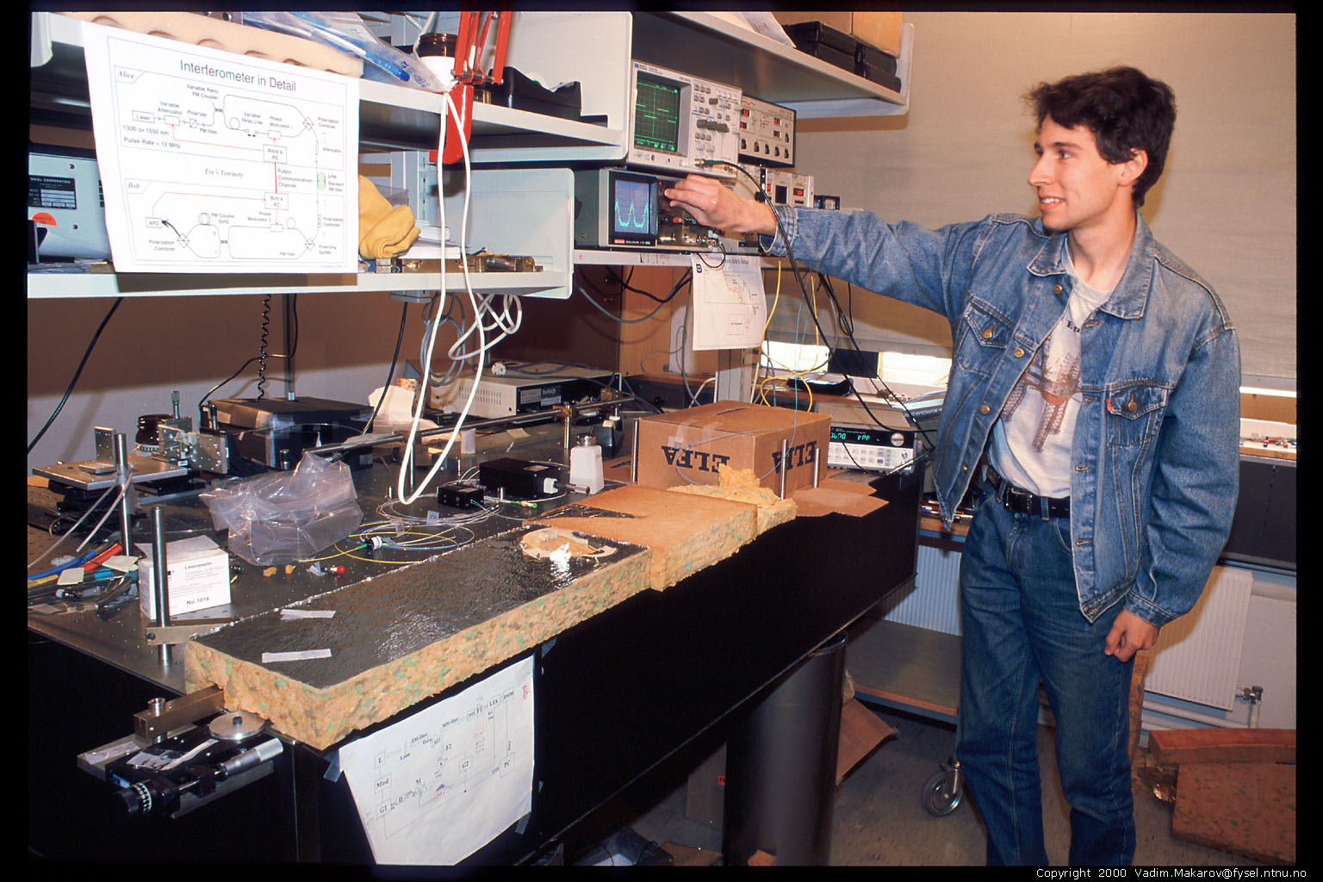
Artem Vakhitov tunes up Eve’s setup
Photo © 2000 Vadim Makarov

Slide 43
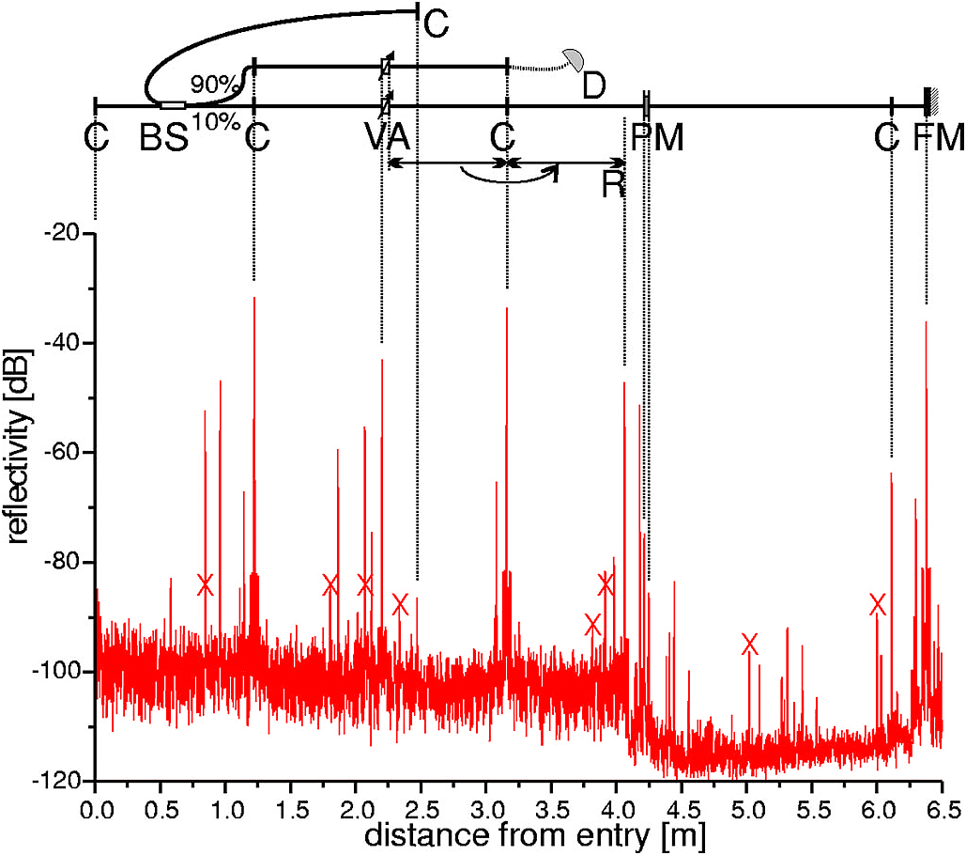
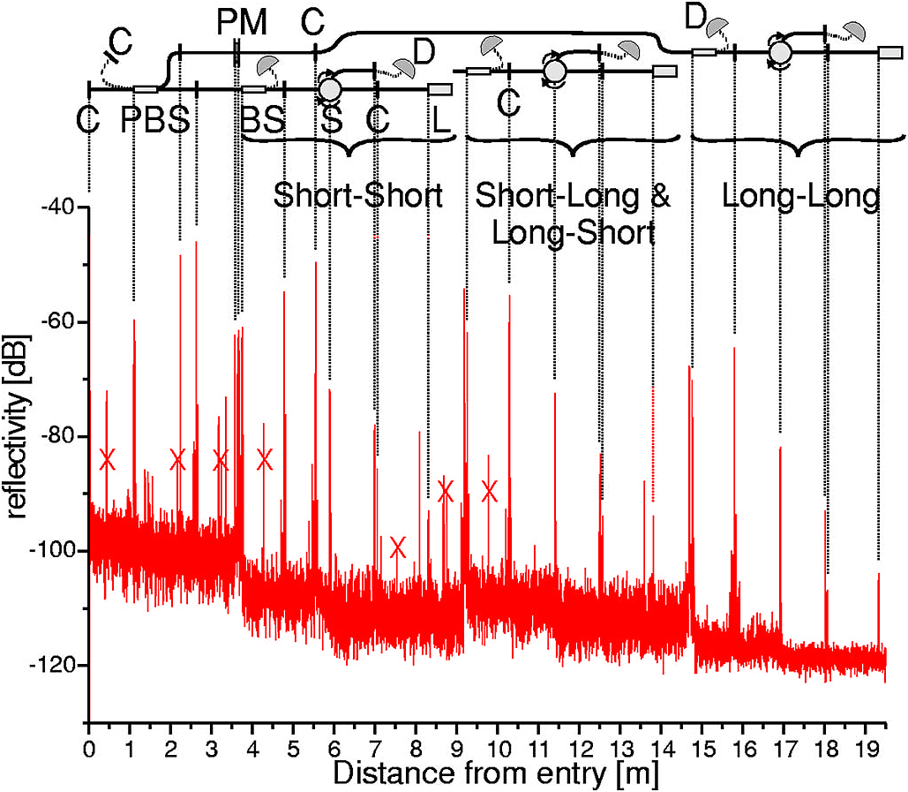
Trojan-horse attack for plug-and-play system
Alice
Bob
Eve gets back one photon → in principle, extracts 100% information
N. Gisin et al., Phys. Rev. A 73, 022320 (2006)

Slide 44
Countermeasures?
Alice
Bob
DL
ϕ
VOA
B
BS
C
FM
ϕ
PBS
L
A
sync
D0
D1
D. Stucki et al., New J. Phys. 4, 41 (2002)

Slide 45
Countermeasures for plug-and-play system
Alice:
1. Add narrowband
(200 GHz) filter
2. Add
CW
and
pulse energy
monitoring detectors
S. Sajeed, I. Radchenko, S. Kaiser, J.-P. Bourgoin, L. Monat, M. Legré, V. Makarov, unpublished
Bob: none
(one consequence: SARG protocol may be insecure)
N. Jain, E. Anisimova, I. Khan, V. Makarov, Ch. Marquardt, G. Leuchs, arXiv:1406.5813

Slide 46
Trojan-horse attack on Bob
Bob
ϕ
B
BS
C
PBS
L
D0
D1
N. Jain, E. Anisimova, I. Khan, V. Makarov, Ch. Marquardt, G. Leuchs, arXiv:1406.5813

Slide 47
Example of vulnerability and countermeasures
Photon-number-splitting attack
C. Bennett, F. Bessette, G. Brassard, L. Salvail, J. Smolin, J. Cryptology 5, 3 (1992)
G. Brassard, N. Lütkenhaus, T. Mor, B. C. Sanders, Phys. Rev. Lett. 85, 1330 (2000)
N. Lütkenhaus, Phys. Rev. A 61, 052304 (2000)
S. Félix, N. Gisin, A. Stefanov, H. Zbinden, J. Mod. Opt. 48, 2009 (2001)
N. Lütkenhaus, M. Jahma, New J. Phys. 4, 44 (2002)
Decoy-state protocol
W.-Y. Hwang, Phys. Rev. Lett. 91, 057901 (2003)
SARG04 protocol
V. Scarani, A. Acín, G. Ribordy, N. Gisin, Phys. Rev. Lett. 92, 057901 (2004)
Distributed-phase-reference protocols
K. Inoue, E. Waks, Y. Yamamoto, Phys. Rev. Lett. 89, 037902 (2002)
K. Inoue, E. Waks, Y. Yamamoto, Phys. Rev. A. 68, 022317 (2003)
N. Gisin, G. Ribordy, H. Zbinden, D. Stucki, N. Brunner, V. Scarani, arXiv:quant-ph/0411022v1 (2004)
Laser
Attenuator

Slide 48
Attack | Target component | Tested system
Detector saturation | homodyne detector | SeQureNet
H. Qin, R. Kumar, R. Alleaume, presentation at QCrypt (2013)
Shot-noise calibration | sync detector | SeQureNet
P. Jouguet, S. Kunz-Jacques, E. Diamanti, Phys. Rev. A 87, 062313 (2013)
Wavelength-selected PNS | intensity modulator | (theory)
M.-S. Jiang, S.-H. Sun, C.-Y. Li, L.-M. Liang, Phys. Rev. A 86, 032310 (2012)
Multi-wavelength | beamsplitter | research syst.
H.-W. Li et al., Phys. Rev. A 84, 062308 (2011)
Deadtime | single-photon detector | research syst.
H. Weier et al., New J. Phys. 13, 073024 (2011)
Channel calibration | single-photon detector | ID Quantique
N. Jain et al., Phys. Rev. Lett. 107, 110501 (2011)
Faraday-mirror | Faraday mirror | (theory)
S.-H. Sun, M.-S. Jiang, L.-M. Liang, Phys. Rev. A 83, 062331 (2011)
Phase-remapping | phase modulator | ID Quantique
F. Xu, B. Qi, H.-K. Lo, New J. Phys. 12, 113026 (2010)
Detector control | single-photon detector | ID Quantique, MagiQ, research syst.
I. Gerhardt et al., Nat. Commun. 2, 349 (2011) L. Lydersen et al., Nat. Photonics 4, 686 (2010)
Time-shift | single-photon detector | ID Quantique
Y. Zhao et al., Phys. Rev. A 78, 042333 (2008)

Slide 49
Attack | Target component | Tested system
Detector saturation | homodyne detector | SeQureNet
H. Qin, R. Kumar, R. Alleaume, presentation at QCrypt (2013)
Shot-noise calibration | sync detector | SeQureNet
P. Jouguet, S. Kunz-Jacques, E. Diamanti, Phys. Rev. A 87, 062313 (2013)
Wavelength-selected PNS | intensity modulator | (theory)
M.-S. Jiang, S.-H. Sun, C.-Y. Li, L.-M. Liang, Phys. Rev. A 86, 032310 (2012)
Multi-wavelength | beamsplitter | research syst.
H.-W. Li et al., Phys. Rev. A 84, 062308 (2011)
Deadtime | single-photon detector | research syst.
H. Weier et al., New J. Phys. 13, 073024 (2011)
Channel calibration | single-photon detector | ID Quantique
N. Jain et al., Phys. Rev. Lett. 107, 110501 (2011)
Faraday-mirror | Faraday mirror | (theory)
S.-H. Sun, M.-S. Jiang, L.-M. Liang, Phys. Rev. A 83, 062331 (2011)
Phase-remapping | phase modulator | ID Quantique
F. Xu, B. Qi, H.-K. Lo, New J. Phys. 12, 113026 (2010)
Detector control | single-photon detector | ID Quantique, MagiQ, research syst.
I. Gerhardt et al., Nat. Commun. 2, 349 (2011) L. Lydersen et al., Nat. Photonics 4, 686 (2010)
Time-shift | single-photon detector | ID Quantique
Y. Zhao et al., Phys. Rev. A 78, 042333 (2008)

Slide 50
Attack example: avalanche photodetectors (APDs)
I
Linear mode
Geiger mode
I
I_{th}
P_{th}
Popt
Quenching
I_{th}
Single photon
V
Breakdown
voltage V_{br}

Slide 51
Faked-state attack in APD linear mode
Identical bases & bit values
Eve
Bright
state
Alice
.Bob´
.Alice´
Bob
Listen, do same,
get same final key
Classical post-processing
Bob chooses same basis as Eve:
Bob chooses different basis:
“0”
I
0
“0
”
I
0
I
th
I
th
Click!
t
t
“1
”
I
1
“1
”
I
1
I
th
I
th
t
t
L. Lydersen, C. Wiechers, C. Wittmann, D. Elser, J. Skaar, V. Makarov, Nat. Photonics 4, 686 (2010)

Slide 52

Blinding APD with bright light
Eve applies CW light
Bias to APD
(V_{bias})
No light
V_{APD}
V_{br}
Detector blind!
Zero dark count rate
V_{bias}
R_{bias}
V_{HV} ≈ 40 V
0
t
2
647 μW
t
808 μW
Input
illumination,
mW
t
1.5
1
0.5
0
Logic 1
(never clicks)
(always clicks)
Detector
output
ID Quantique
Clavis2
Logic 0
-10
0
10
20
30
-10
0
10
20
30
Time, ns
Time, ns
L. Lydersen, C. Wiechers, C. Wittmann, D. Elser, J. Skaar, V. Makarov, Nat. Photonics 4, 686 (2010)

Slide 53
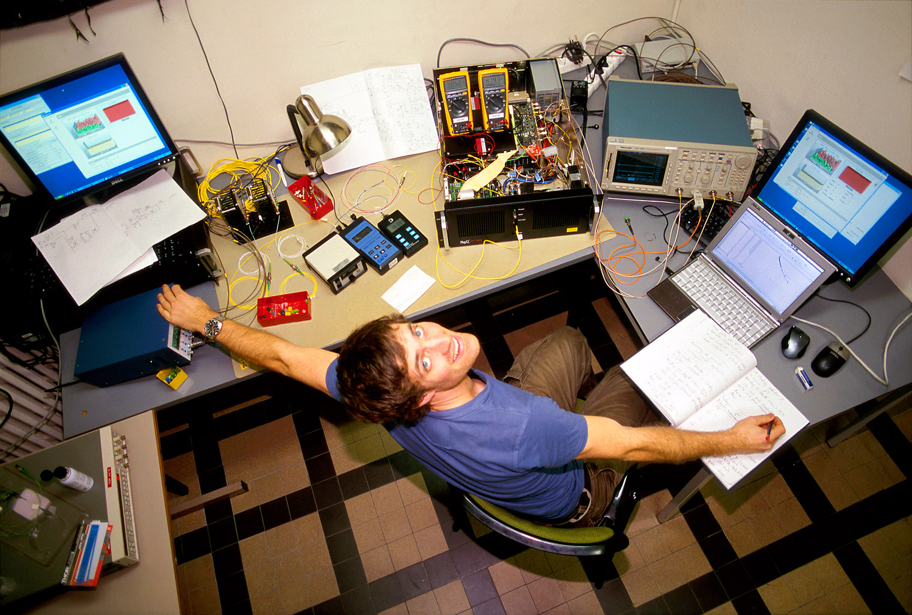
Lars Lydersen testing MagiQ Technologies QPN 5505
Photo © 2010 Vadim Makarov

Slide 54
Proposed full eavesdropper
Eve
Optical
Alice
Bob´
Alice´
amplifier
Bob
Basis
Basis
Detection result
Bit in
Blinding laser

Slide 55
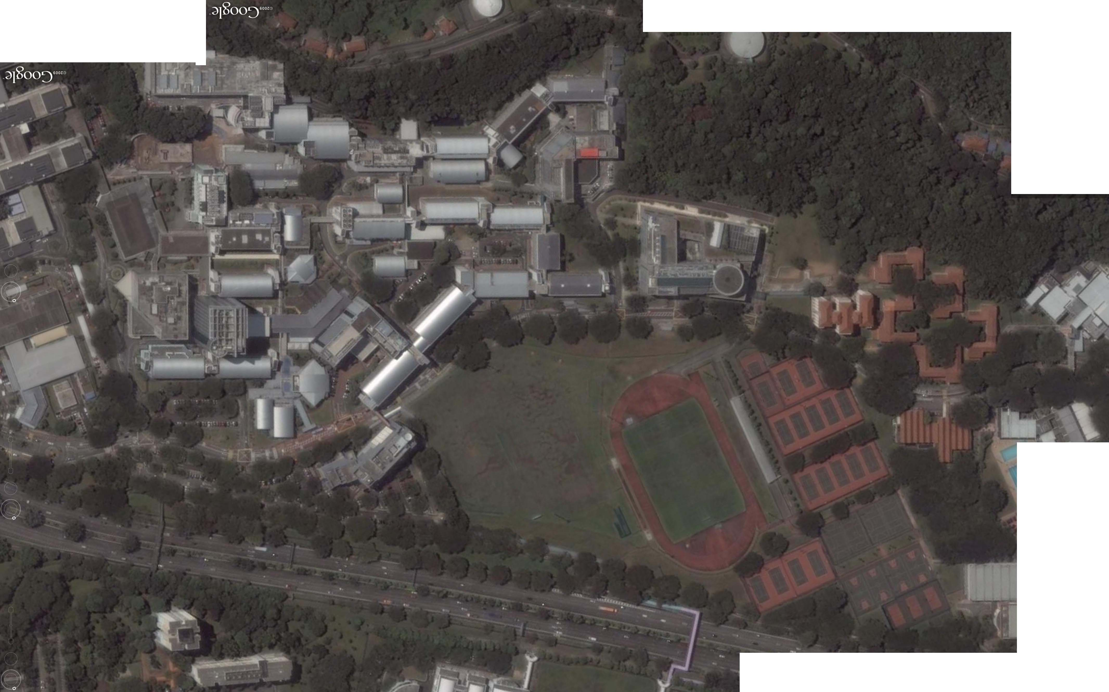
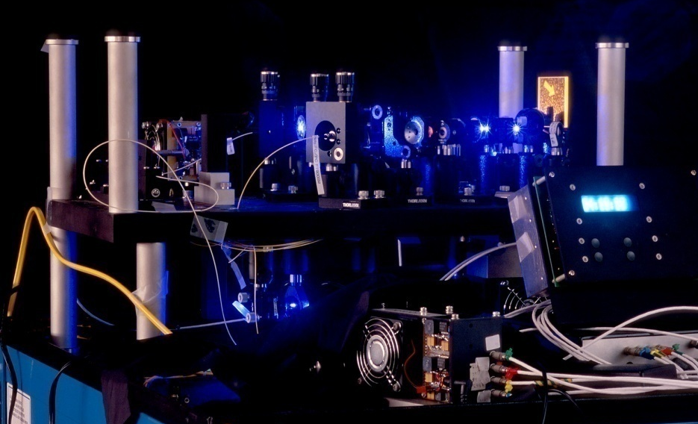
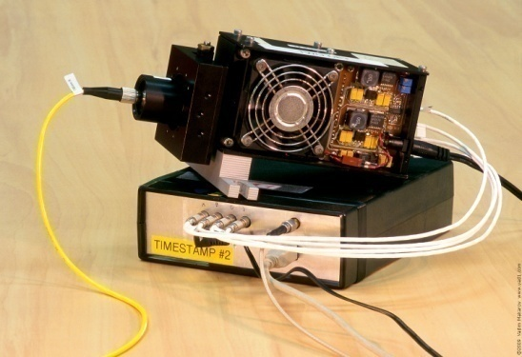
Eavesdropping 100% key on installed QKD line on campus of the National University of Singapore, July 4–5, 2009
290 m of fiber
S14
S13
Bob
Alice
S12
S15
Image © 2009 DigitalGlobe
I. Gerhardt, Q. Liu et al.,
Nat. Commun. 2, 349 (2011)

Slide 56
Entanglement-based QKD
M. P. Peloso et al., New J. Phys. 11, 045007 (2009)

Slide 57
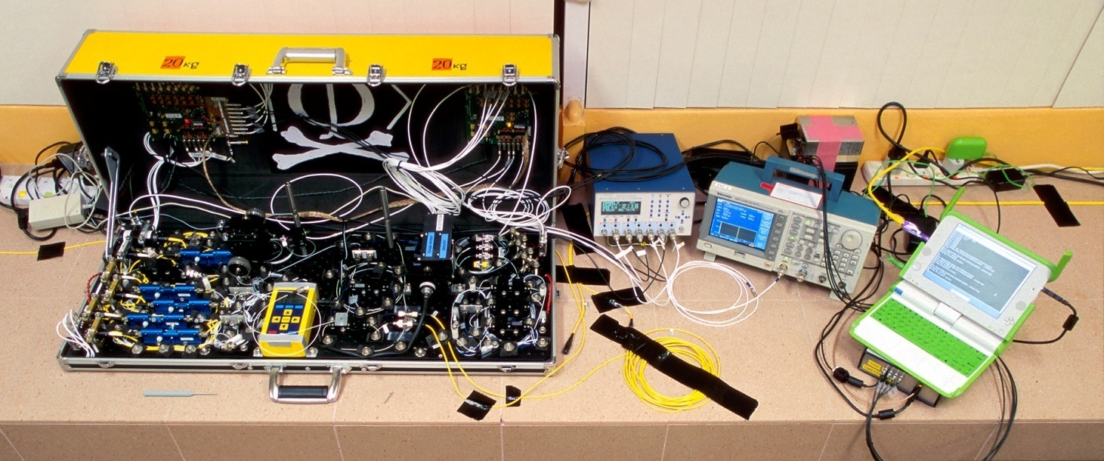
Eavesdropping 100% key on installed QKD line on campus of the National University of Singapore, July 4–5, 2009
290 m of fiber
Eve
S14
S13
Bob
Alice
S12
S15
Image © 2009 DigitalGlobe
I. Gerhardt, Q. Liu et al.,
Nat. Commun. 2, 349 (2011)

Slide 58
Eve does not affect QKD performance
Without eavesdropping
During eavesdropping
3000
2000
Raw key bit rate, s^{–1}
1000
0
10
8
QBER, %
6
4
2
0
0
100
200
300
0
100
200
300
Time, s
Time, s
I. Gerhardt, Q. Liu, A. Lamas-Linares, J. Skaar, C. Kurtsiefer, V. Makarov, Nat. Commun. 2, 349 (2011)

Slide 59

Faking violation of Bell inequality
CHSH inequality: $\left|S=E_{AB}+E_{A´B}+E_{AB´}−E_{A´B´}\right|≤2$
$E∈\left[−1, 1\right]$
Entangled photons: $\left|S\right|≤2\sqrt{2}$
Polarization
analyser A
Polarization
analyser B
BS
λ/2
PBS
Source of
entangled photons
BS
λ/2
PBS
PBS
PBS
I. Gerhardt, Q. Liu et al., Phys. Rev. Lett. 107, 170404 (2011); N. Sultana, V. Makarov, unpublished

Slide 60

Faking violation of Bell inequality
CHSH inequality: $\left|S=E_{AB}+E_{A´B}+E_{AB´}−E_{A´B´}\right|≤2$
$E∈\left[−1, 1\right]$
Entangled photons: $\left|S\right|≤2\sqrt{2}$
Polarization
analyser A
Polarization
analyser B
BS
λ/2
PBS
Faked
state
generator
Faked
state
generator
BS
λ/2
PBS
PBS
Pattern generator
PBS
Passive basis choice: $\left|S\right|≤4, \text{click} \text{probability}\text{ =}$ 100$\%$
Active basis choice: $\left|S\right|≤2\sqrt{2} \left(4\right), \text{click} \text{probability} \text{=}$ $66.7\%$ $\left(50\%\right)$
I. Gerhardt, Q. Liu et al., Phys. Rev. Lett. 107, 170404 (2011); N. Sultana, V. Makarov, unpublished

Slide 61
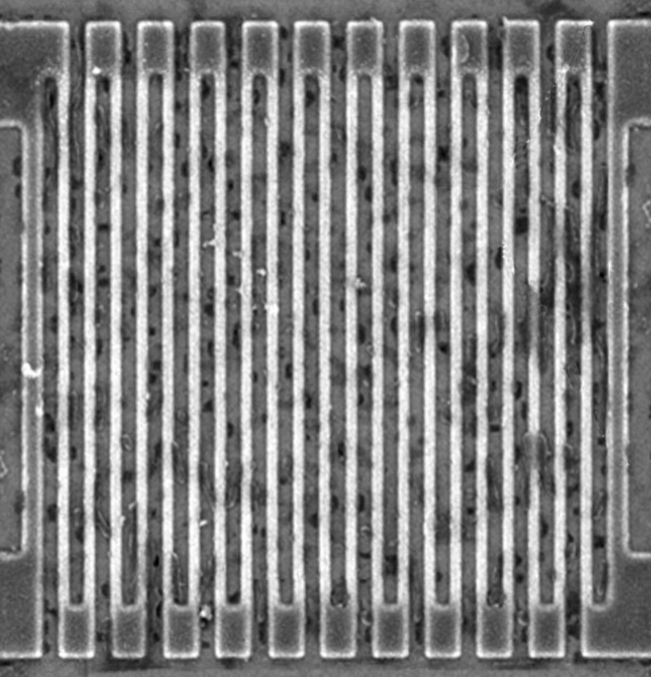
Controlling superconducting nanowire single-photon detectors
Comparator input
voltage, a.u.
1. Blind (latch)
0
2. Control
0
1
0
2
0
3
0
Time, ns
Normal single-
photon click
14 mW pulse
7 mW pulse
L. Lydersen, M. K. Akhlaghi, A. H. Majedi, J. Skaar, V. Makarov, New J. Phys. 13, 113042 (2011)
M. G. Tanner, V. Makarov, R. H. Hadfield, arXiv:1305.5989

Slide 62
Countermeasures to detector attacks
Band-aid
Integrated into
security model
Software patch to randomly vary detector sensitivity
M. Legre, G. Ribordy, intl. patent appl. WO 2012/046135 A2 (filed in 2010)
Monitoring extra electrical parameters in detector
Z. L. Yuan, J. F. Dynes, A. J. Shields, Appl. Phys. Lett. 98, 231104 (2011)
...
Measurement-device-independent QKD
H.-K. Lo, M. Curty, B. Qi, Phys. Rev. Lett. 108, 130503 (2012)
Demonstration
in Calgary
/ Eve
A. Rubenok et al., arXiv:1204.0738v2

Slide 63
Responsible disclosure is important
2009
Example: hacking commercial systems
ID Quantique got a detailed vulnerability report
  reaction: requested time, developed a patch
MagiQ Technologies got a detailed vulnerability report
  reaction: informed us that QPN 5505 is discontinued
Results presented orally at a scientific conference
Public disclosure in a journal paper
  L. Lydersen et al., Nat. Photonics 4, 686 (2010)
2010
M. Legre, G. Ribordy, intl. patent appl. WO 2012/046135 A2 (filed in 2010)

Slide 64
Can we eavesdrop on commercial systems?
ID Quantique’s Cerberis:
Dual key agreement
QKD
BB84
QKD
PKI
RSA-2048
PKI
Key
Key
Symmetric
cipher
AES-256
Symmetric
cipher
Photo © 2010 Vadim Makarov

Slide 65
Some other topics in experimental quantum cryptography...
Continuous-variable QKD
Differential-phase-shift-keying protocols
Quantum repeaters
Device-independent QKD

Slide 66
Quantum cryptography is a viable complement to aging classical cryptography methods
Quantum cryptography has implementation imperfections, too, and the research community handles this problem successfully

Slide 67

Vadim Makarov www.vad1.com/lab

