Slide 1
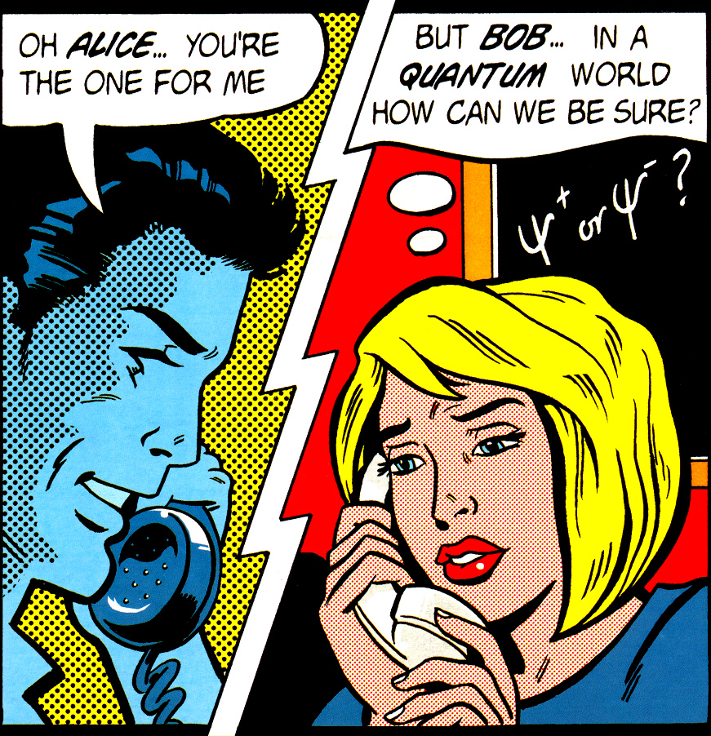
Lecture at Phys 10 undergraduate seminar, University of Waterloo, September 30, 2014
Quantum cryptography
Quantum hacking lab
www.vad1.com/lab
Vadim Makarov
Image from cover of
Physics World, March 1998

Slide 2
Communication security you enjoy daily
Paying by credit card in a supermarket
Cell phone conversations, SMS
Email, chat, online calls
Secure browsing, shopping online
Cloud storage and communication between your devices
Software updates on your computer, phone, tablet
Online banking
Off-line banking: the bank needs to communicate internally
Electricity, water: the utility needs to communicate internally
Car keys
Electronic door keys
Government services (online or off-line)
Medical records at your doctor, hospital
Bypassing government surveillance and censorship

Slide 3
Encryption and key distribution
Alice
Bob
Secure channel
RNG
Secret key
Public (insecure) channel
Symmetric
cipher
Symmetric
cipher
Encrypted messages
Messages
Messages
Quantum key distribution transmits secret key
by sending quantum states over open channel.

Slide 4
Public key cryptography
E.g., RSA (Rivest-Shamir-Adleman)
Elliptic-curve
Based on hypothesized one-way functions
Unexpected advances in classical cryptanalysis
Shor’s factorization algorithm for quantum computer
P. W. Shor, SIAM J. Comput. 26, 1484 (1997)
Time to build large quantum computer
Re-tool infrastructure
Encryption needs be secure
What do we do here?
here?
Time
Diagram courtesy M. Mosca

Slide 5
Encryption and key distribution
Alice
Bob
Secure channel
RNG
Secret key
Public (insecure) channel
Symmetric
cipher
Symmetric
cipher
Encrypted messages
Messages
Messages
Quantum key distribution transmits secret key
by sending quantum states over open channel.

Slide 6
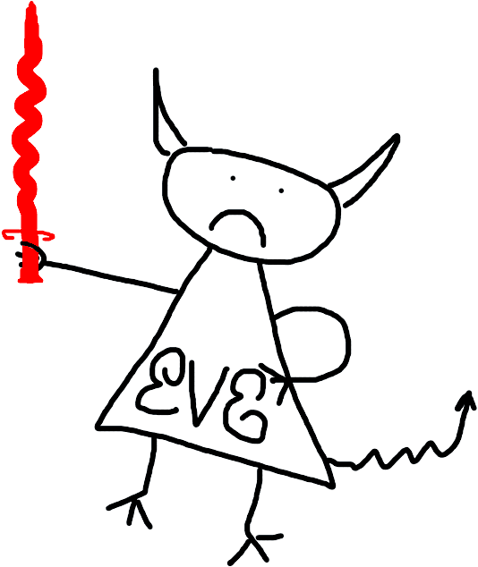
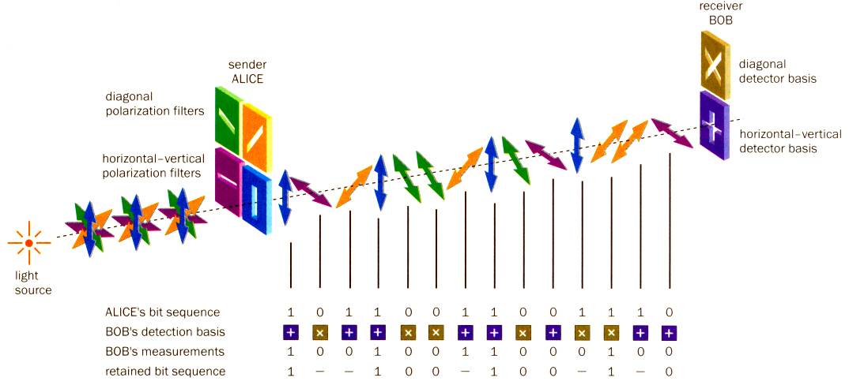
Quantum key distribution (QKD)
Bob
Alice
Diagonal detector basis
Diagonal polarization filters
0
1
Horizontal-vertical detector basis
Horizontal-vertical polarization filters
0
1
Light source
Alice’s bit sequence 1 0 1 1 0 0 1 1 0 0 1 1 1 0
Bob’s detection basis
Bob’s measurement 1 0 0 1 0 0 1 1 0 0 0 1 0 0
Retained bit sequence 1 – – 1 0 0 – 1 0 0 – 1 – 0
Image reprinted from article: W. Tittel, G. Ribordy & N. Gisin, “Quantum cryptography,” Physics World, March 1998

Slide 7
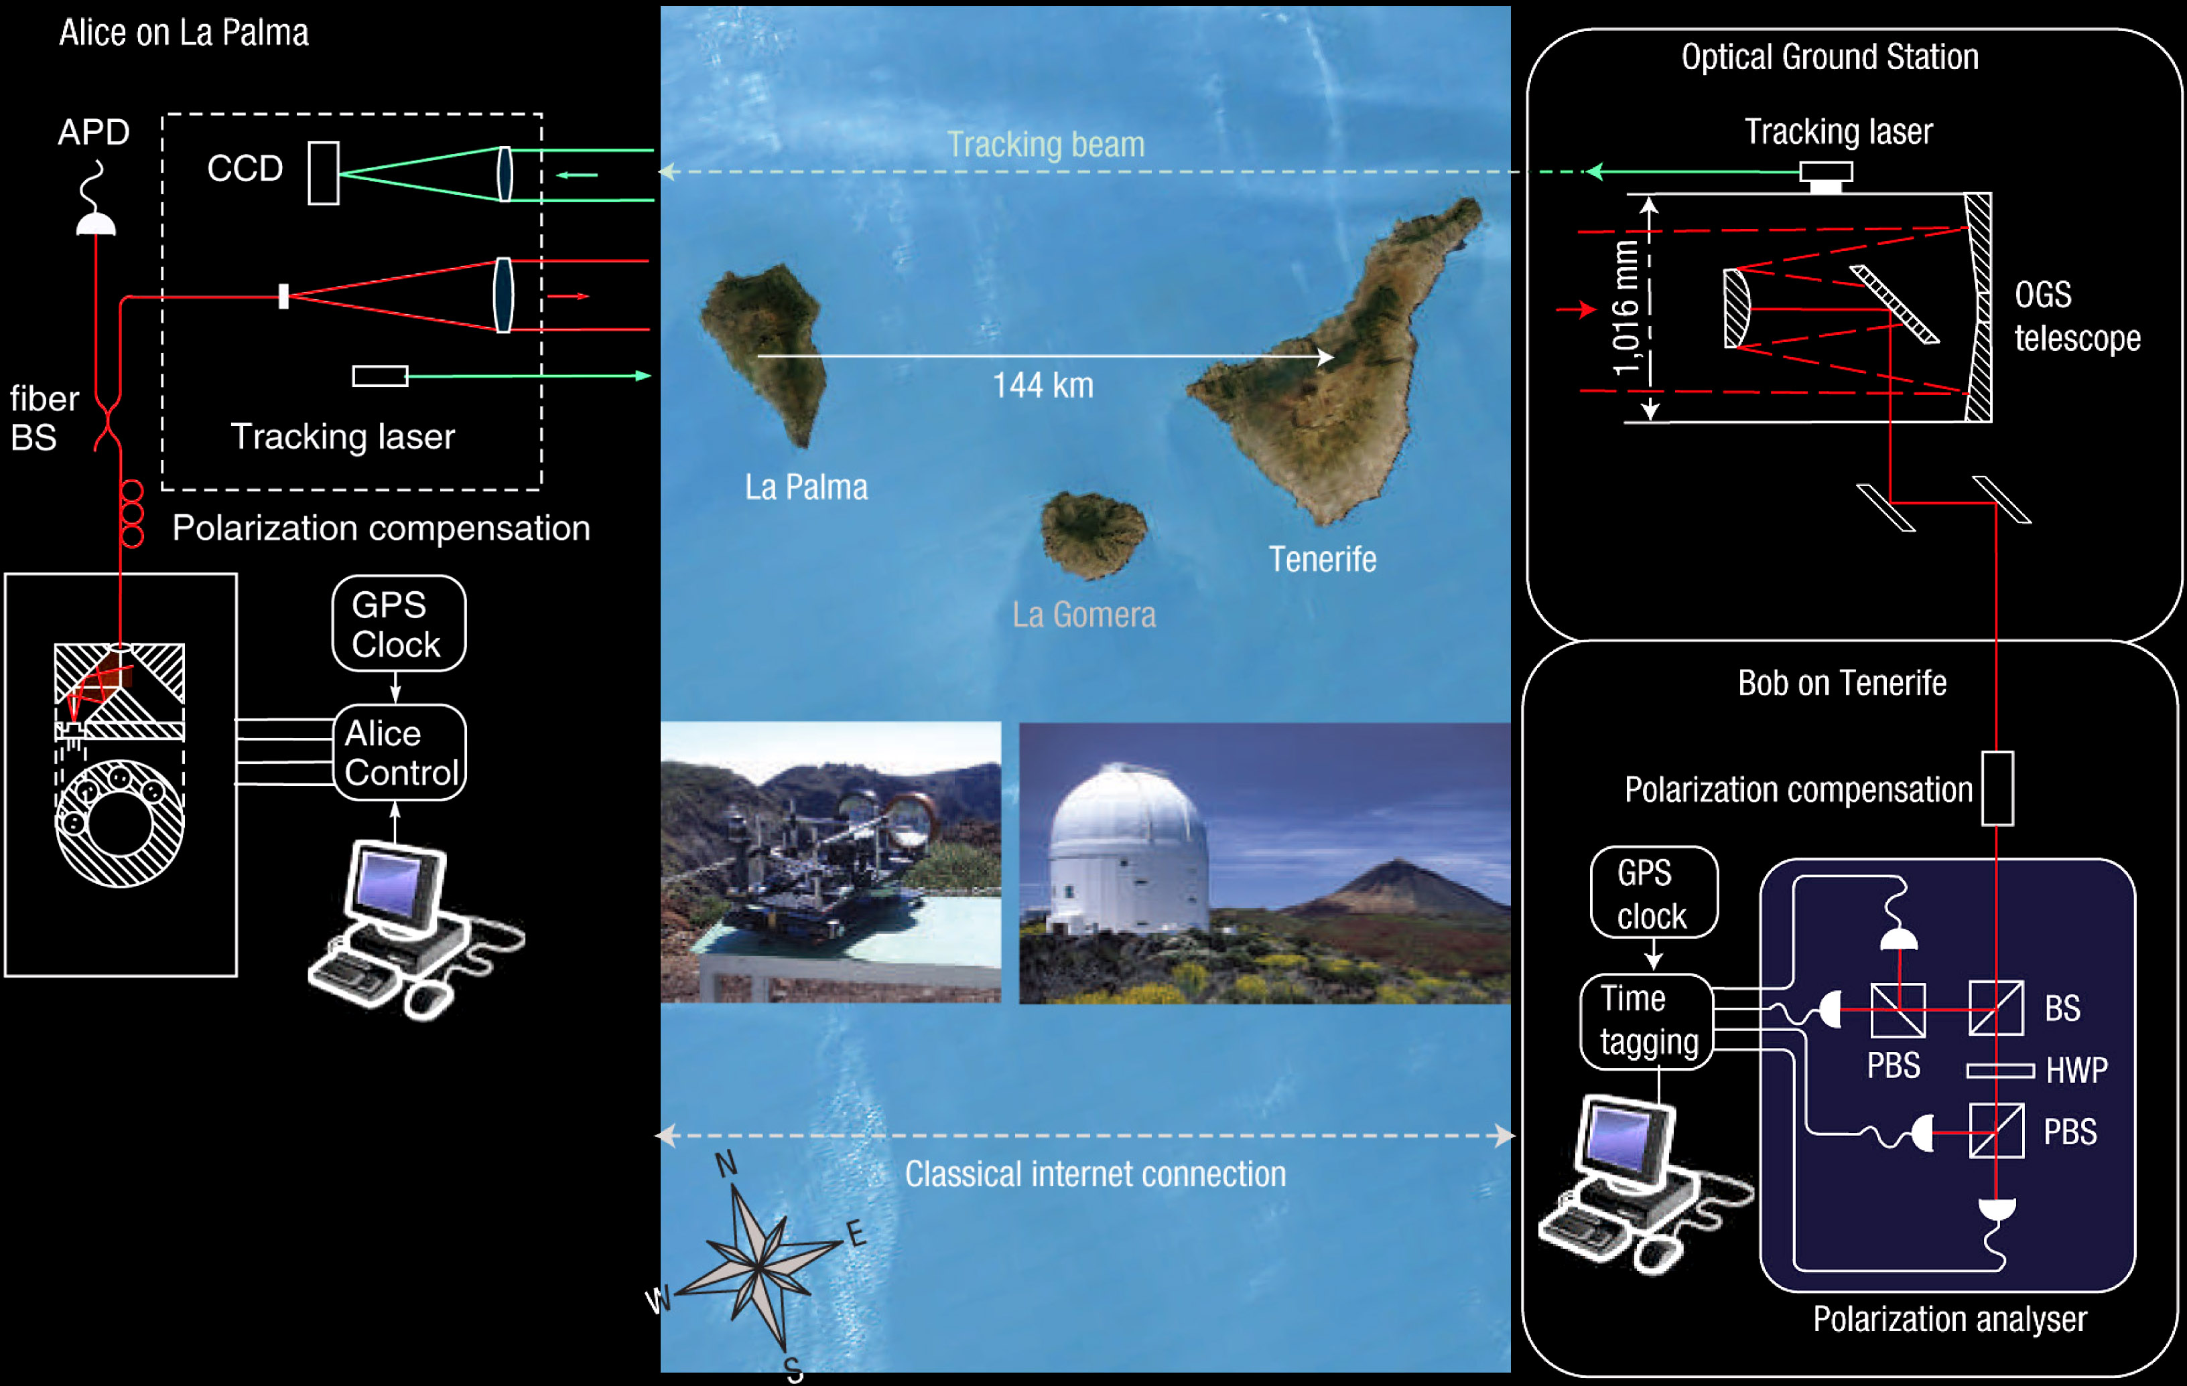
Free-space QKD over 144 km
T. Schmitt-Manderbach et al., Phys. Rev. Lett. 98, 010504 (2007)

Slide 8
Phase encoding, interferometric QKD channel
Alice
Bob
Light
source
long
short
ϕ
D
0
B
ϕ
D
A
short
Transmission line
long
1
Detector bases:
ϕ_{B} = – 45° : X
ϕ_{B} = + 45° : Z
ϕ_{A} = – 45° or + 45° : 0
ϕ_{A} = +135° or – 135° : 1

Slide 9
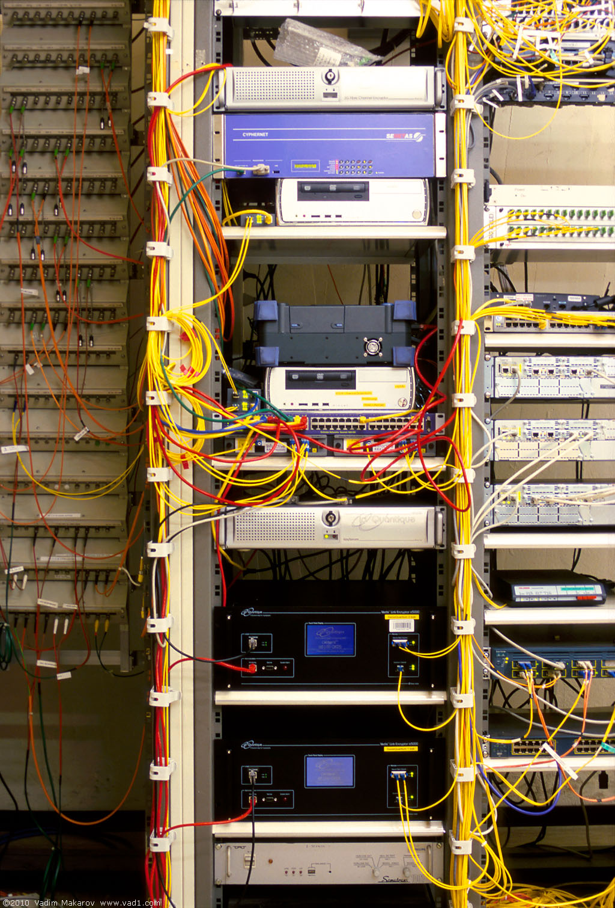
Commercial QKD
Classical encryptors:
L2, 2 Gbit/s
L2, 10 Gbit/s
L3 VPN, 100 Mbit/s
WDMs
17 km (fiber length)
Key manager
14 km
QKD to another node
(4 km)
QKD to another node
(14 km)
4 km
Photo © 2010 Vadim Makarov
www.swissquantum.com
ID Quantique Cerberis system (2010)

Slide 10
Trusted-node repeater
User
Trusted node
User
QKD 1
QKD 2
K1
K1
K2
K2
K1⊕K2
K1
K1⊕K2⊕K2 = K1

Slide 11
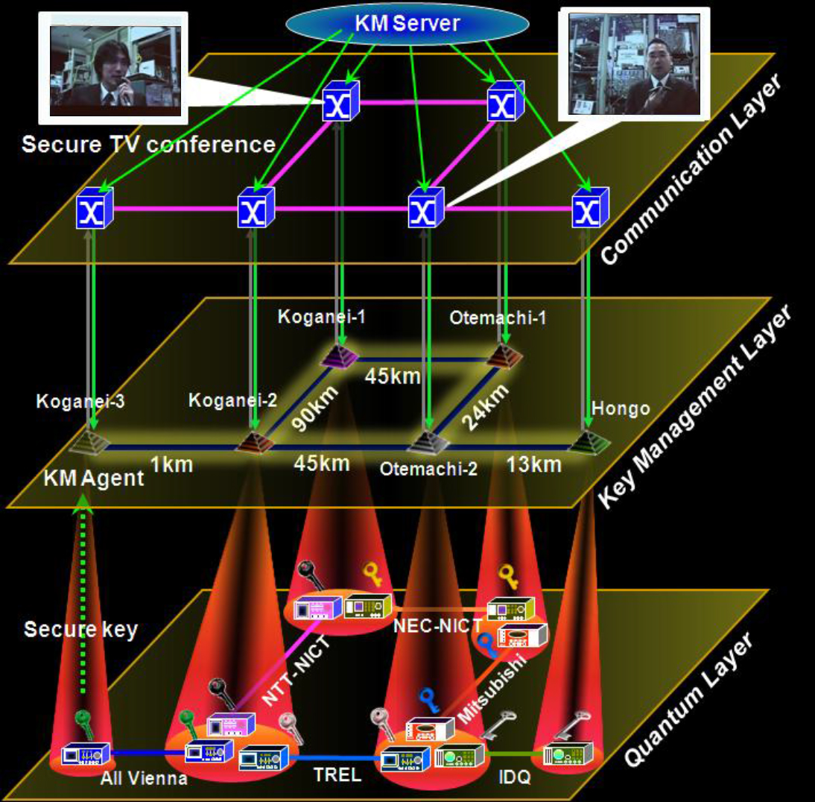
Trusted-node network
M. Sasaki et al., Opt. Express 19, 10387 (2011)

Slide 12
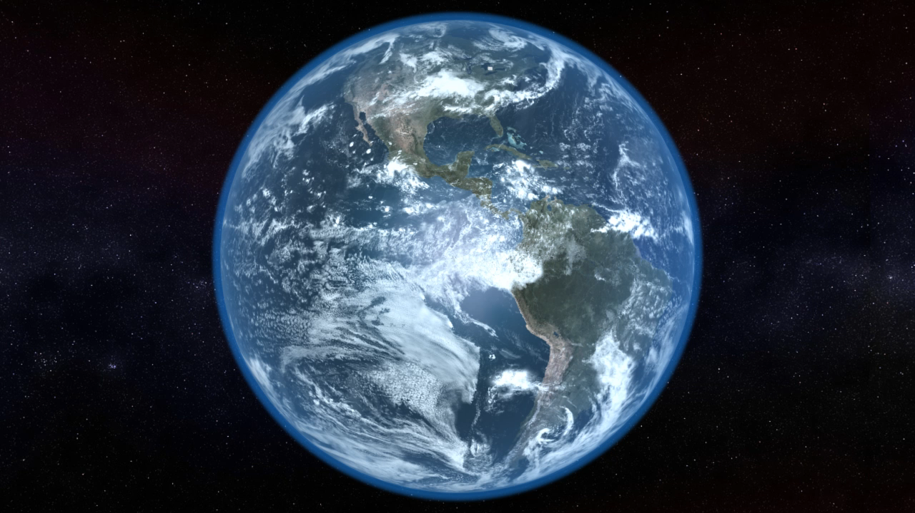
Video ©2012 IQC / group of T. Jennewein

Slide 13
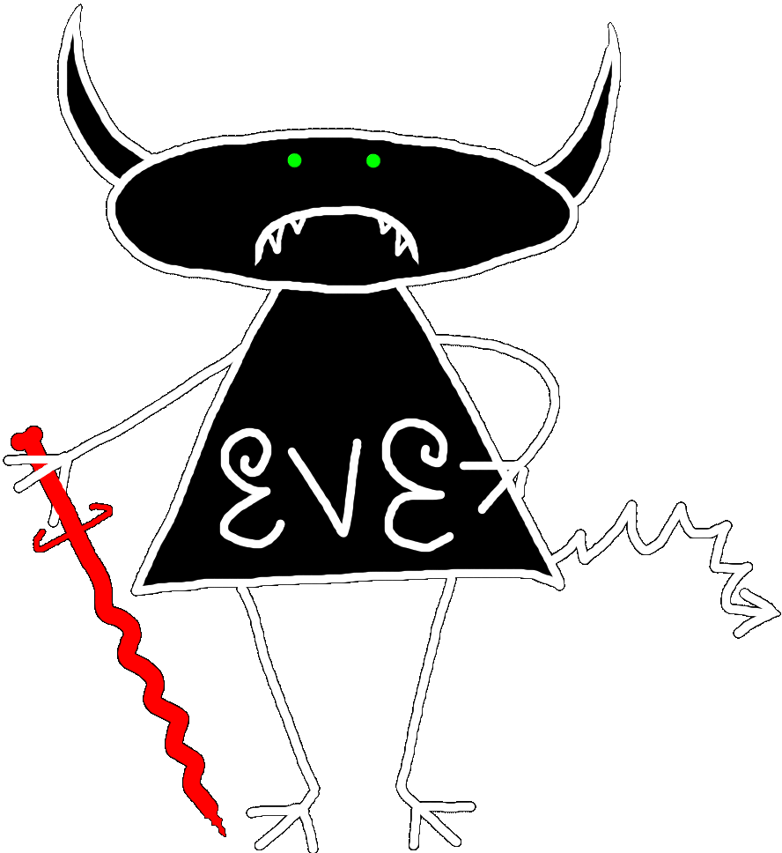


Security model of QKD
Alice
Bob
1
Secret key rate $R=f\left(\text{QBER}\right)$
R
0
0
0.11
QBER
Security proof
.Laws of physics & Model of equipment

Slide 14
Security model of QKD
Security proof
.Laws of physics & Model of equipment
Integrate imperfection into security model
Hack
Security proof
.Laws of physics & Model of equipment

Slide 15
Example of vulnerability and countermeasures
Photon-number-splitting attack
C. Bennett, F. Bessette, G. Brassard, L. Salvail, J. Smolin, J. Cryptology 5, 3 (1992)
G. Brassard, N. Lütkenhaus, T. Mor, B. C. Sanders, Phys. Rev. Lett. 85, 1330 (2000)
N. Lütkenhaus, Phys. Rev. A 61, 052304 (2000)
S. Félix, N. Gisin, A. Stefanov, H. Zbinden, J. Mod. Opt. 48, 2009 (2001)
N. Lütkenhaus, M. Jahma, New J. Phys. 4, 44 (2002)
Decoy-state protocol
W.-Y. Hwang, Phys. Rev. Lett. 91, 057901 (2003)
SARG04 protocol
V. Scarani, A. Acín, G. Ribordy, N. Gisin, Phys. Rev. Lett. 92, 057901 (2004)
Distributed-phase-reference protocols
K. Inoue, E. Waks, Y. Yamamoto, Phys. Rev. Lett. 89, 037902 (2002)
K. Inoue, E. Waks, Y. Yamamoto, Phys. Rev. A. 68, 022317 (2003)
N. Gisin, G. Ribordy, H. Zbinden, D. Stucki, N. Brunner, V. Scarani, arXiv:quant-ph/0411022v1 (2004)
Laser
Attenuator

Slide 16
Attack | Target component | Tested system
Detector saturation | homodyne detector | SeQureNet
H. Qin, R. Kumar, R. Alleaume, presentation at QCrypt (2013)
Shot-noise calibration | sync detector | SeQureNet
P. Jouguet, S. Kunz-Jacques, E. Diamanti, Phys. Rev. A 87, 062313 (2013)
Wavelength-selected PNS | intensity modulator | (theory)
M.-S. Jiang, S.-H. Sun, C.-Y. Li, L.-M. Liang, Phys. Rev. A 86, 032310 (2012)
Multi-wavelength | beamsplitter | research syst.
H.-W. Li et al., Phys. Rev. A 84, 062308 (2011)
Deadtime | single-photon detector | research syst.
H. Weier et al., New J. Phys. 13, 073024 (2011)
Channel calibration | single-photon detector | ID Quantique
N. Jain et al., Phys. Rev. Lett. 107, 110501 (2011)
Faraday-mirror | Faraday mirror | (theory)
S.-H. Sun, M.-S. Jiang, L.-M. Liang, Phys. Rev. A 83, 062331 (2011)
Phase-remapping | phase modulator | ID Quantique
F. Xu, B. Qi, H.-K. Lo, New J. Phys. 12, 113026 (2010)
Detector control | single-photon detector | ID Quantique, MagiQ, research syst.
I. Gerhardt et al., Nat. Commun. 2, 349 (2011) L. Lydersen et al., Nat. Photonics 4, 686 (2010)
Time-shift | single-photon detector | ID Quantique
Y. Zhao et al., Phys. Rev. A 78, 042333 (2008)

Slide 17
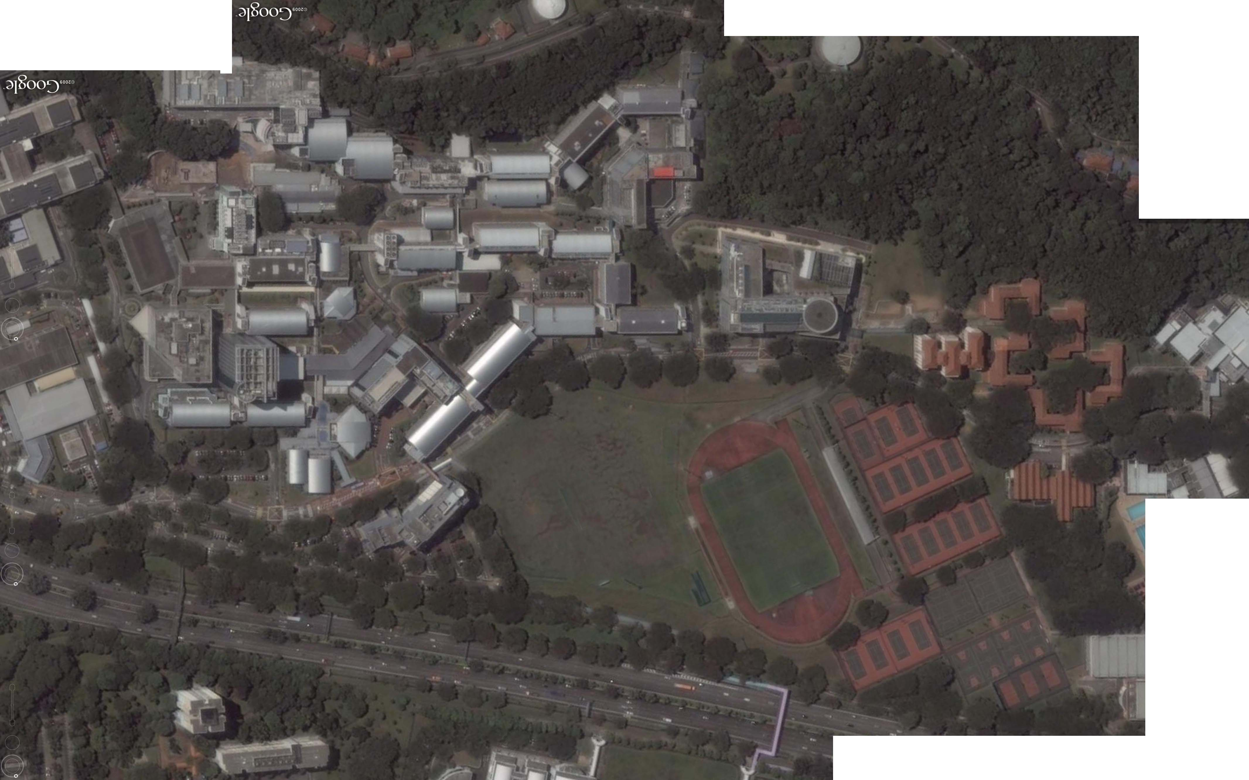
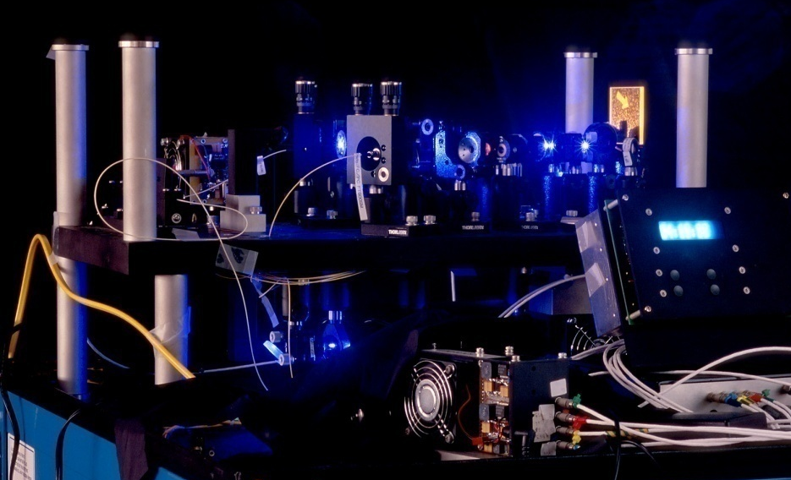
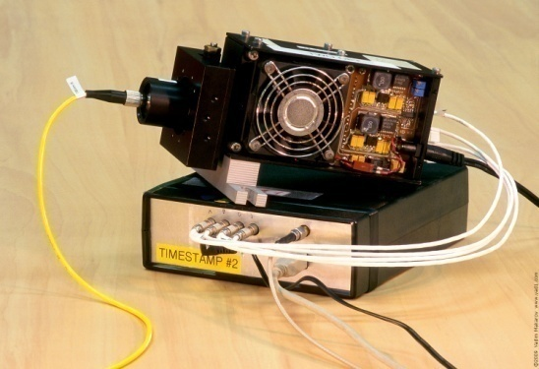
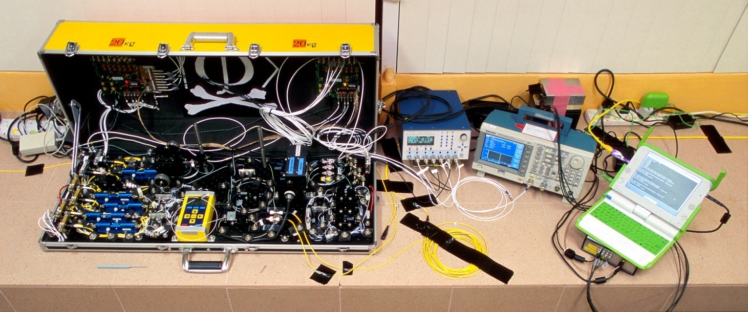
Eavesdropping 100% key on installed QKD line on campus of the National University of Singapore, July 4–5, 2009
290 m of fiber
Eve
S14
S13
Bob
Alice
S12
S15
Image © 2009 DigitalGlobe
I. Gerhardt, Q. Liu et al.,
Nat. Commun. 2, 349 (2011)

Slide 18
Responsible disclosure is important
2009
Example: hacking commercial systems
ID Quantique got a detailed vulnerability report
  reaction: requested time, developed a patch
MagiQ Technologies got a detailed vulnerability report
  reaction: informed us that QPN 5505 is discontinued
Results presented orally at a scientific conference
Public disclosure in a journal paper
  L. Lydersen et al., Nat. Photonics 4, 686 (2010)
2010
M. Legre, G. Ribordy, intl. patent appl. WO 2012/046135 A2 (filed in 2010)

Slide 19
Can we eavesdrop on commercial systems?
ID Quantique’s Cerberis:
Dual key agreement
QKD
BB84
QKD
PKI
RSA-2048
PKI
Key
Key
Symmetric
cipher
AES-256
Symmetric
cipher
Photo © 2010 Vadim Makarov

Slide 20
Quantum cryptography is a viable complement to aging classical cryptography methods
Quantum cryptography has implementation imperfections, too, and the research community handles this problem successfully

Slide 21

Vadim Makarov www.vad1.com/lab

