Slide 1
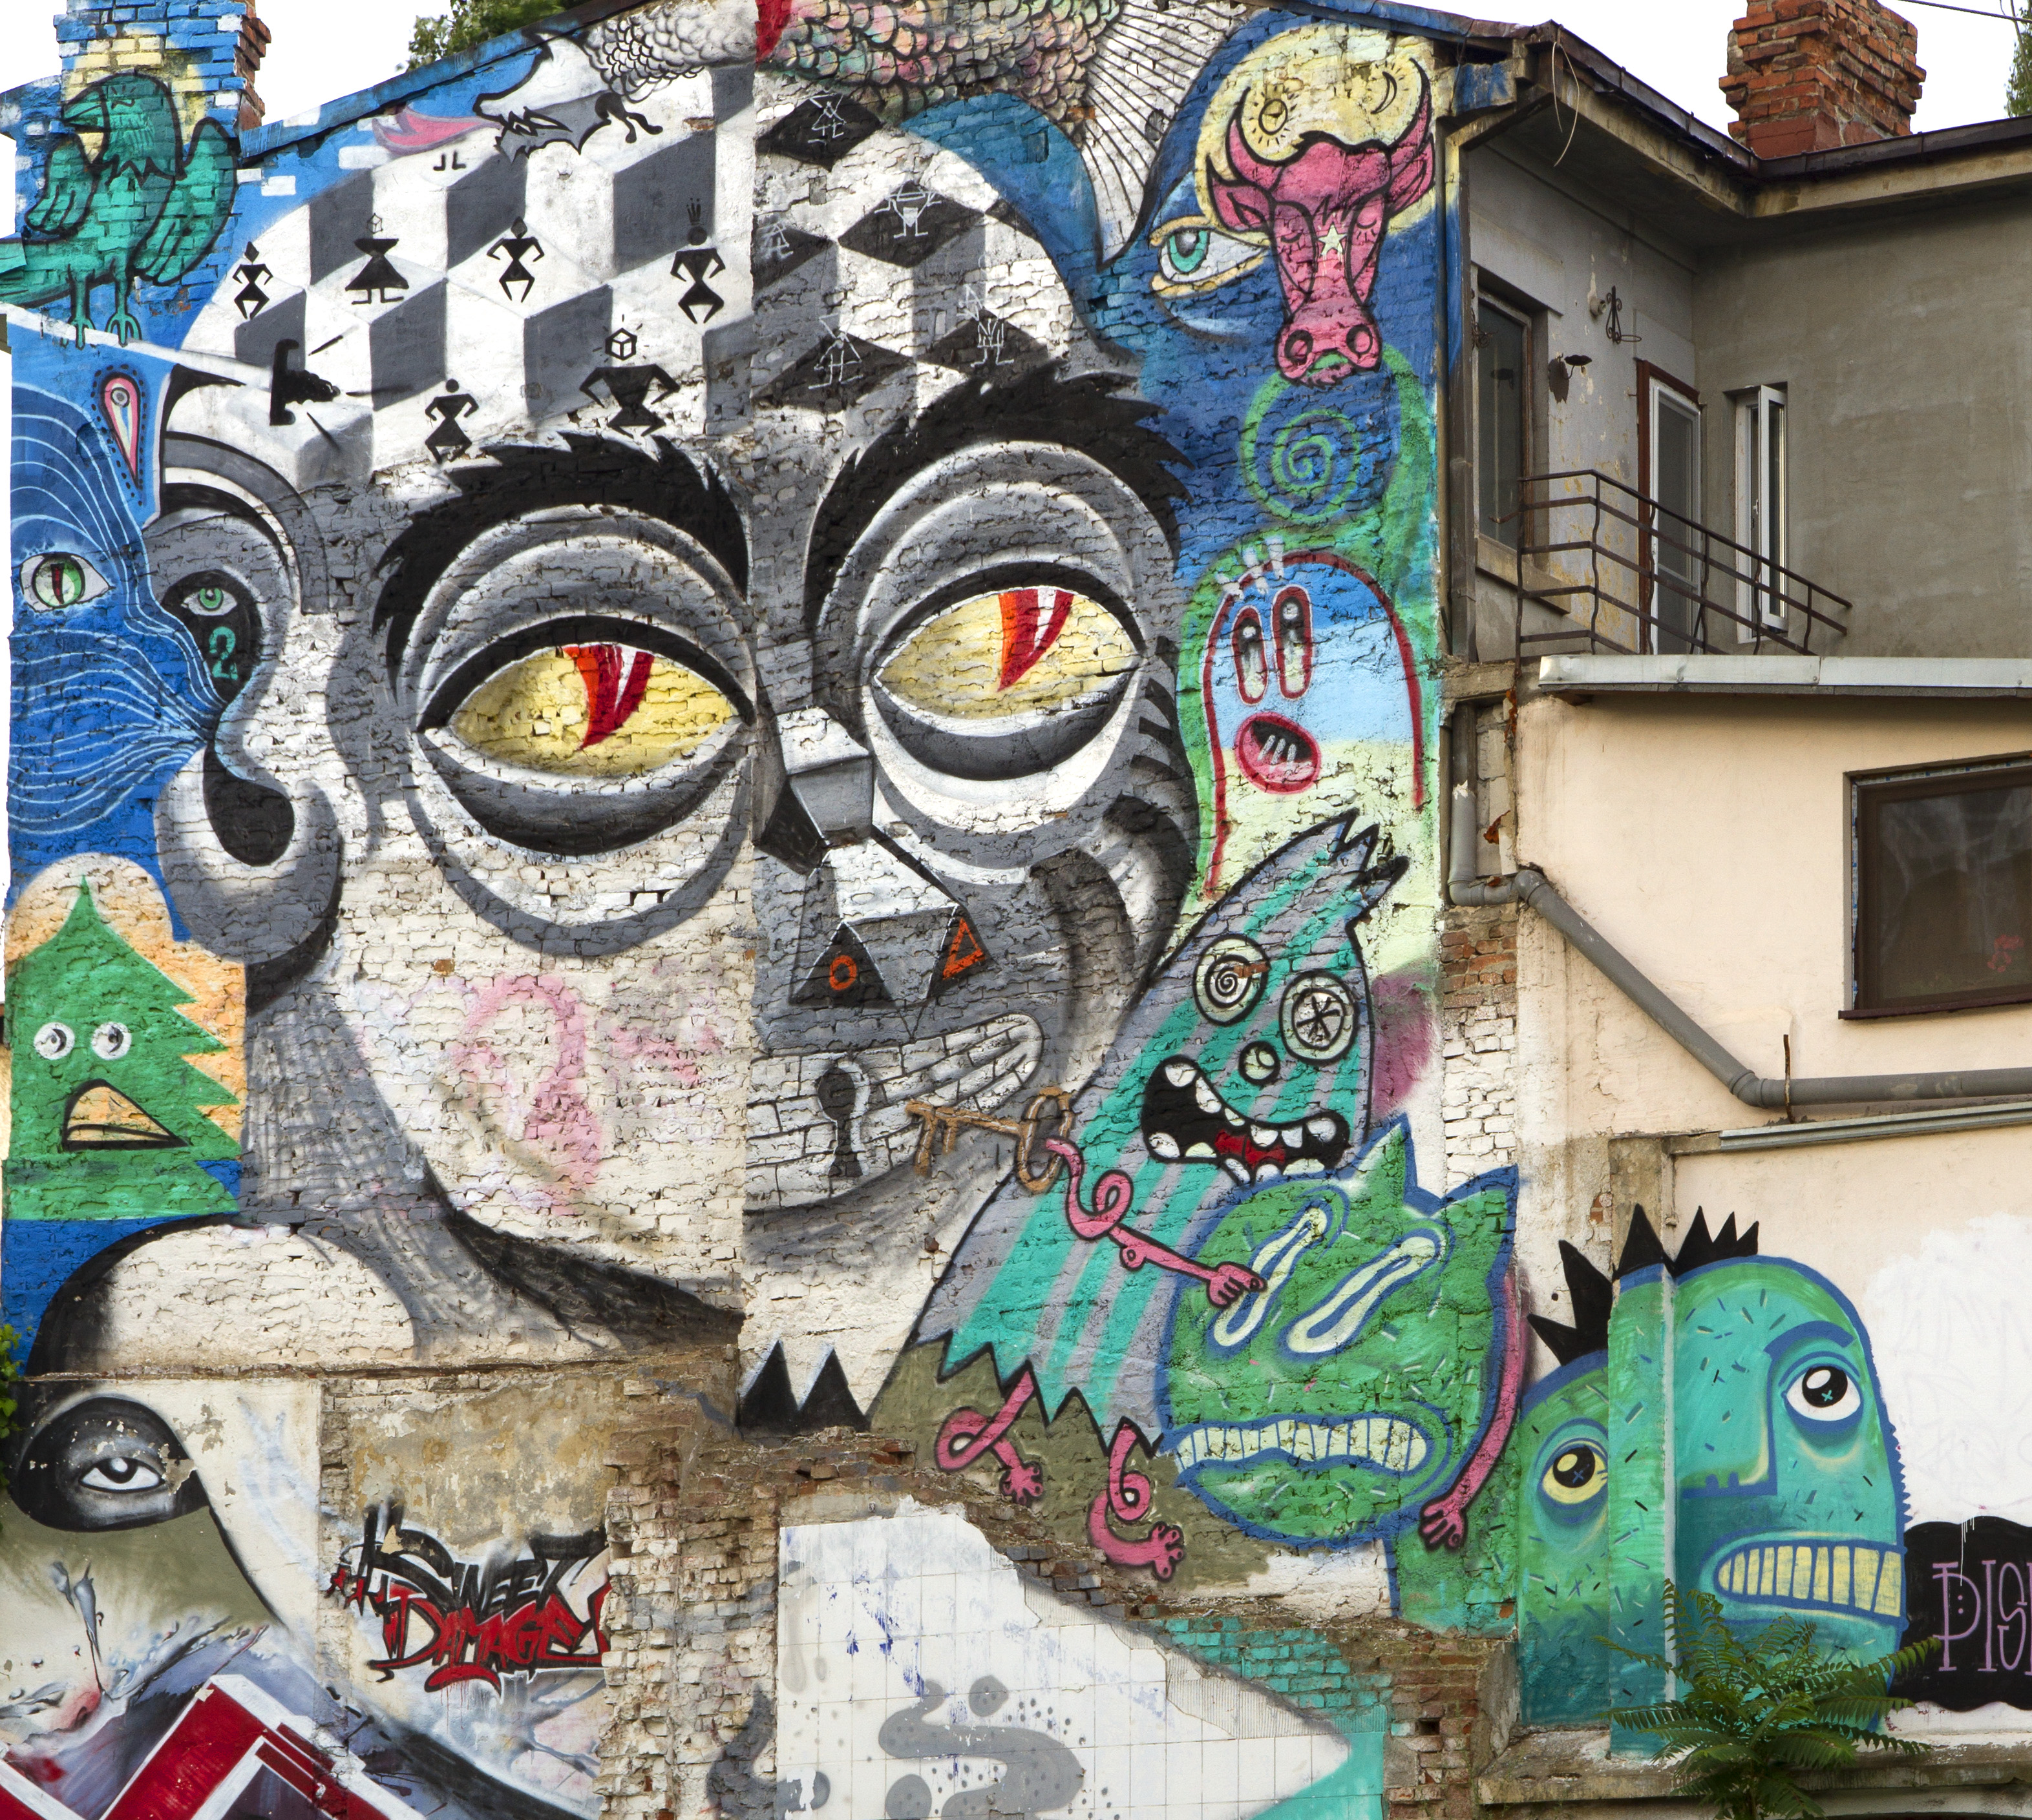
Vadim Makarov
Image: street mural in Bucharest (fragment)
© 2013 Obie Platon, Irlo, Pisica Pătrată, Last, Spesh, Lumin
Testing
quantum
crypto
Talk at ETSI 2nd quantum-safe crypto workshop, Ottawa, 6–7 October 2014

Slide 2
Cryptography: classical vs. quantum
Unproven mathematical assumptions
Laws of
physics
Based on...
Convenient to implement?
Yes
No
Forward secure?
No
Yes
Authenticate via PKI?
Yes
Yes
Loopholes in implementations?
Yes

Slide 3
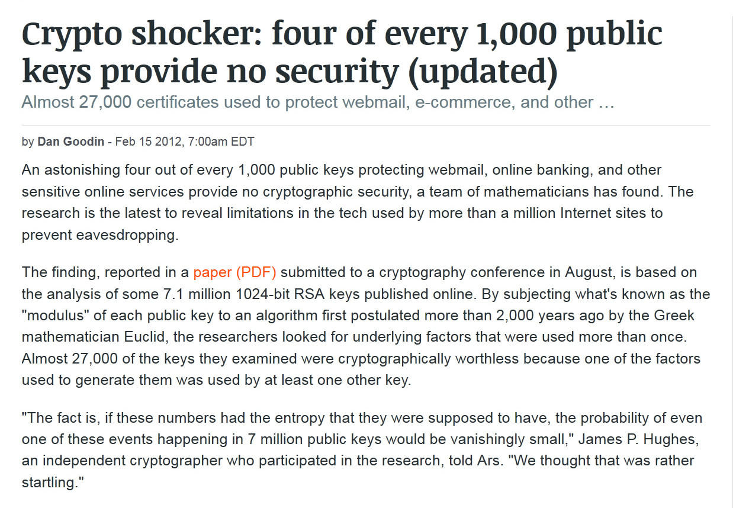
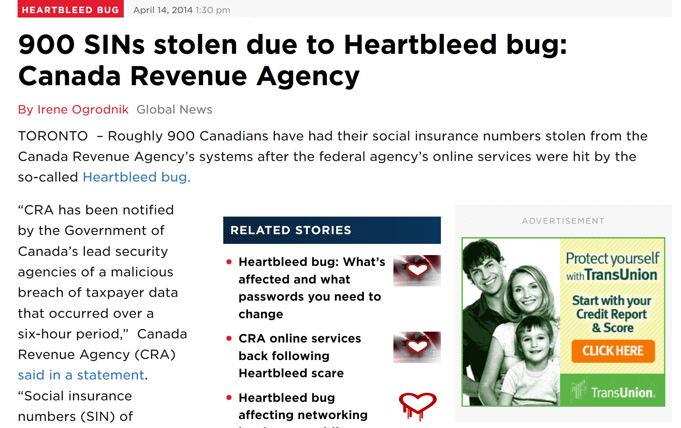
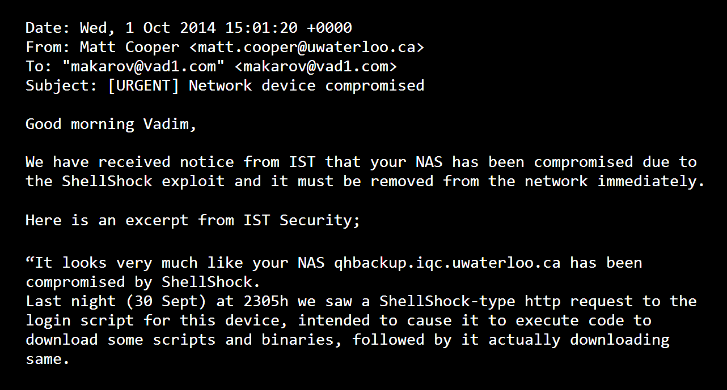

Slide 4
Cryptography: classical vs. quantum
Unproven mathematical assumptions
Laws of
physics
Based on...
Convenient to implement?
Yes
No
Forward secure?
No
Yes
Authenticate via PKI?
Yes
Yes
Loopholes in implementations?
Yes
Yes
Exploitable retroactively?
Sometimes
No*
* Single exception: A. Lamas-Linares & C. Kurtsiefer, Opt. Express 15, 9388 (2007)

Slide 5
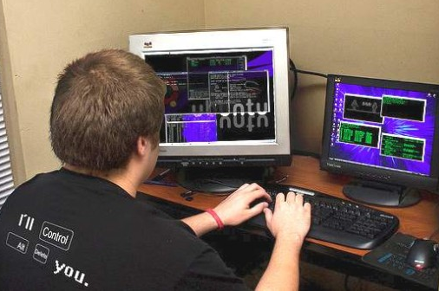
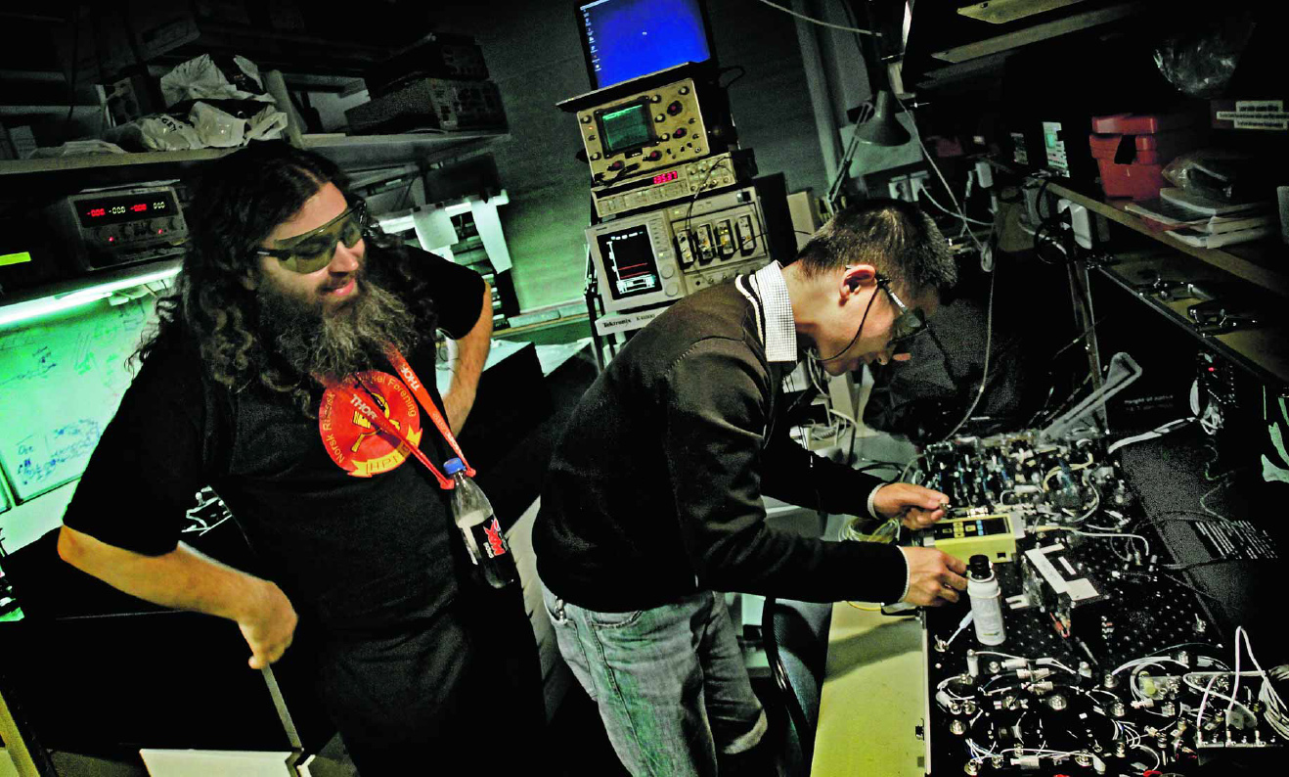


Classical hacking vs. quantum hacking
Often, just a computer
($∼$$0 equipment)
Optics lab
($≳$$0.5M equipment)
Photo 2008 Joshua Delaughter CC-NC-BY 2.0
Photo ©2010 VG / Øyvind Nordahl Næss

Slide 6
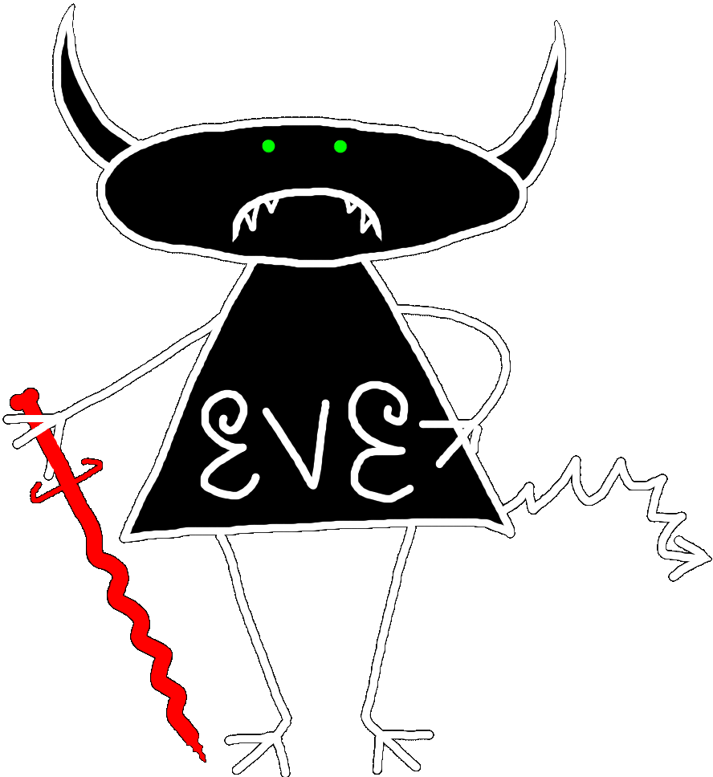


Security model of QKD
Alice
Bob
1
Secret key rate $R=f\left(\text{QBER}\right)$
R
0
0
0.11
QBER
Security proof
.Laws of physics & Model of equipment

Slide 7
Security model of QKD
Security proof
.Laws of physics & Model of equipment
Integrate imperfection into security model
Hack
Security proof
.Laws of physics & Model of equipment

Slide 8
Example of vulnerability and countermeasures
Photon-number-splitting attack
C. Bennett, F. Bessette, G. Brassard, L. Salvail, J. Smolin, J. Cryptology 5, 3 (1992)
G. Brassard, N. Lütkenhaus, T. Mor, B. C. Sanders, Phys. Rev. Lett. 85, 1330 (2000)
N. Lütkenhaus, Phys. Rev. A 61, 052304 (2000)
S. Félix, N. Gisin, A. Stefanov, H. Zbinden, J. Mod. Opt. 48, 2009 (2001)
N. Lütkenhaus, M. Jahma, New J. Phys. 4, 44 (2002)
Decoy-state protocol
W.-Y. Hwang, Phys. Rev. Lett. 91, 057901 (2003)
SARG04 protocol
V. Scarani, A. Acín, G. Ribordy, N. Gisin, Phys. Rev. Lett. 92, 057901 (2004)
Distributed-phase-reference protocols
K. Inoue, E. Waks, Y. Yamamoto, Phys. Rev. Lett. 89, 037902 (2002)
K. Inoue, E. Waks, Y. Yamamoto, Phys. Rev. A. 68, 022317 (2003)
N. Gisin, G. Ribordy, H. Zbinden, D. Stucki, N. Brunner, V. Scarani, arXiv:quant-ph/0411022v1 (2004)
Laser
Attenuator

Slide 9
Attack | Target component | Tested system
Pulse energy calibration | classical watchdog detector | ID Quantique
S. Sajeed et al., presentation at QCrypt (2014)
Trojan-horse | phase modulator in Alice | SeQureNet
I. Khan et al., presentation at QCrypt (2014)
Trojan-horse | phase modulator in Bob | ID Quantique*
N. Jain et al., arXiv:1406.5813
Detector saturation | homodyne detector | SeQureNet
H. Qin, R. Kumar, R. Alleaume, presentation at QCrypt (2013)
Shot-noise calibration | classical sync detector | SeQureNet
P. Jouguet, S. Kunz-Jacques, E. Diamanti, Phys. Rev. A 87, 062313 (2013)
Wavelength-selected PNS | intensity modulator | (theory)
M.-S. Jiang, S.-H. Sun, C.-Y. Li, L.-M. Liang, Phys. Rev. A 86, 032310 (2012)
Multi-wavelength | beamsplitter | research syst.
H.-W. Li et al., Phys. Rev. A 84, 062308 (2011)
Deadtime | single-photon detector | research syst.
H. Weier et al., New J. Phys. 13, 073024 (2011)
Channel calibration | single-photon detector | ID Quantique
N. Jain et al., Phys. Rev. Lett. 107, 110501 (2011)
Faraday-mirror | Faraday mirror | (theory)
S.-H. Sun, M.-S. Jiang, L.-M. Liang, Phys. Rev. A 83, 062331 (2011)
Detector control | single-photon detector | ID Quantique, MagiQ, research syst.
I. Gerhardt et al., Nat. Commun. 2, 349 (2011); L. Lydersen et al., Nat. Photonics 4, 686 (2010)
Phase-remapping | phase modulator in Alice | ID Quantique*
F. Xu, B. Qi, H.-K. Lo, New J. Phys. 12, 113026 (2010)
Time-shift | single-photon detector | ID Quantique
Y. Zhao et al., Phys. Rev. A 78, 042333 (2008)
* Attack did not break security of the tested system, but may be applicable to a different implementation.

Slide 10
Attack | Target component | Tested system
Pulse energy calibration | classical watchdog detector | ID Quantique
S. Sajeed et al., presentation at QCrypt (2014)
Trojan-horse | phase modulator in Alice | SeQureNet
I. Khan et al., presentation at QCrypt (2014)
Trojan-horse | phase modulator in Bob | ID Quantique*
N. Jain et al., arXiv:1406.5813
Detector saturation | homodyne detector | SeQureNet
H. Qin, R. Kumar, R. Alleaume, presentation at QCrypt (2013)
Shot-noise calibration | classical sync detector | SeQureNet
P. Jouguet, S. Kunz-Jacques, E. Diamanti, Phys. Rev. A 87, 062313 (2013)
Wavelength-selected PNS | intensity modulator | (theory)
M.-S. Jiang, S.-H. Sun, C.-Y. Li, L.-M. Liang, Phys. Rev. A 86, 032310 (2012)
Multi-wavelength | beamsplitter | research syst.
H.-W. Li et al., Phys. Rev. A 84, 062308 (2011)
Deadtime | single-photon detector | research syst.
H. Weier et al., New J. Phys. 13, 073024 (2011)
Channel calibration | single-photon detector | ID Quantique
N. Jain et al., Phys. Rev. Lett. 107, 110501 (2011)
Faraday-mirror | Faraday mirror | (theory)
S.-H. Sun, M.-S. Jiang, L.-M. Liang, Phys. Rev. A 83, 062331 (2011)
Detector control | single-photon detector | ID Quantique, MagiQ, research syst.
I. Gerhardt et al., Nat. Commun. 2, 349 (2011); L. Lydersen et al., Nat. Photonics 4, 686 (2010)
Phase-remapping | phase modulator in Alice | ID Quantique*
F. Xu, B. Qi, H.-K. Lo, New J. Phys. 12, 113026 (2010)
Time-shift | single-photon detector | ID Quantique
Y. Zhao et al., Phys. Rev. A 78, 042333 (2008)
* Attack did not break security of the tested system, but may be applicable to a different implementation.

Slide 11
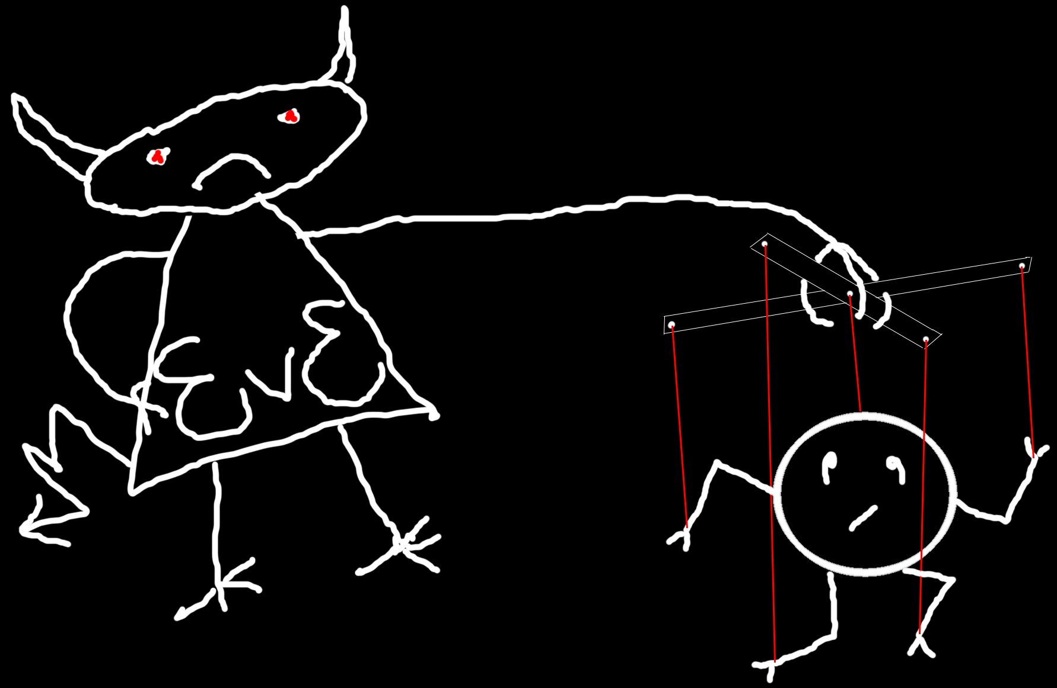
Intercept-resend attack with Bob’s detector control
Eve
Alice
.Bob´
Bright-light controller
Bob
(blinded)
Repeat what I have detected!
Now-classical
detectors
Identical bases & bit values
L. Lydersen et al., Nat. Photonics 4, 686 (2010)
V. Makarov, New J. Phys. 11, 065003 (2009)
V. Makarov, D. R. Hjelme, J. Mod. Opt. 52, 691 (2005)

Slide 12
Countermeasures to detector attacks
Technical
Integrated into
security model
Monitoring extra electrical parameters in detector
Z. L. Yuan, J. F. Dynes, A. J. Shields, Appl. Phys. Lett. 98, 231104 (2011)
Randomly varying detector sensitivity
M. Legre, G. Robordy, Intl. patent appl. WO 2012/046135 A2 (filed in 2010)
C. C. W. Lim et al., arXiv:1408.6398
Measurement-device-independent QKD
H.-K. Lo, M. Curty, B. Qi, Phys. Rev. Lett. 108, 130503 (2012)

Slide 13
Monitoring extra electrical parameters in detector (Toshiba)
3.5 ns
Gate
1 R_{bias} = 0
R_{bias}
Gain
modulation
@ R_{bias} = 0
V_{bias}
Bias
tee
Avalanche
3 Monitor I_{bias}
for “anomalously
high” values
2 Comparator
threshold
just above
capacitive signal
50 Ω
Capacitive signal
4 Accept clicks
in narrow
time window
Z. L. Yuan, J. F. Dynes, A. J. Shields, Appl. Phys. Lett. 98, 231104 (2011);
L. Lydersen, V. Makarov, J. Skaar, Appl. Phys. Lett. 99, 196101 (2011).
Z. L. Yuan, J. F. Dynes, A. J. Shields, Nat. Photonics 4, 800 (2010); L. Lydersen et al., ibid. 801.

Slide 14
I: Can we test your detector?
Toshiba: No.
I: Why not?
Toshiba: Still no.
Chinese way: build a copy and hack it.
M.-S. Jiang et al., Phys. Rev. A 88, 062335 (2013)

Slide 15
Randomly varying detector sensitivity
(ID Quantique)
V_{APD}
Click
Click
V_{APD}
Click
Click
Alarm!
C. C. W. Lim et al., arXiv:1408.6398
M. Legre, G. Robordy, Intl. patent appl. WO 2012/046135 A2 (filed in 2010)

Slide 16
Countermeasures to detector attacks
Technical
Integrated into
security model
Monitoring extra electrical parameters in detector
Z. L. Yuan, J. F. Dynes, A. J. Shields, Appl. Phys. Lett. 98, 231104 (2011)
Randomly varying detector sensitivity
M. Legre, G. Robordy, Intl. patent appl. WO 2012/046135 A2 (filed in 2010)
C. C. W. Lim et al., arXiv:1408.6398
Measurement-device-independent QKD
H.-K. Lo, M. Curty, B. Qi, Phys. Rev. Lett. 108, 130503 (2012)
Alice
Charlie
(untrusted)
Bob
Mod.
BSM
Mod.
Photon
source
Photon
source
RNG
RNG
publicly announces BSM result

Slide 17
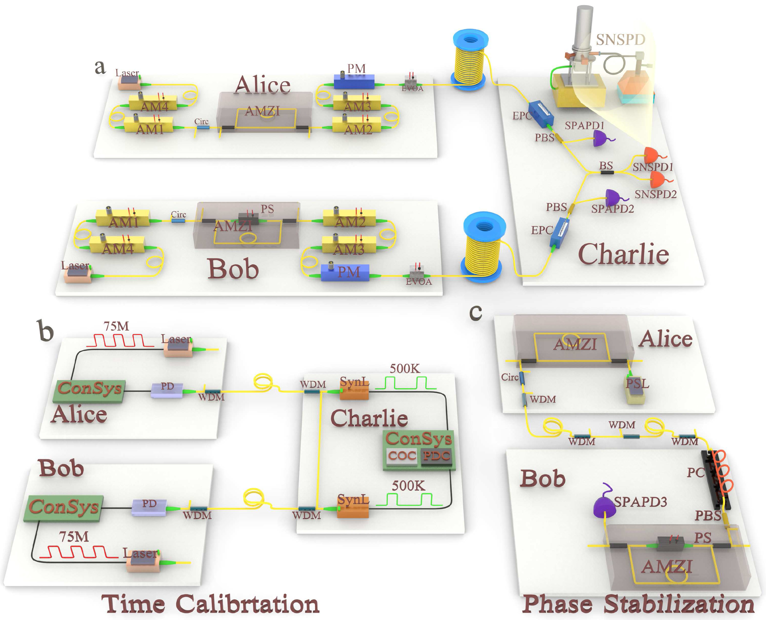
Measurement-device-independent QKD: experiments
Calgary, 28 km
A. Rubenok et al., arXiv:1204.0738v2
Rio de Janeiro, 17 km
T. Ferreira da Silva et al., Phys. Rev. A 88, 052303 (2013)
Toronto, 10 km
Z. Tang et al., Phys. Rev. Lett. 112,
190503 (2014)
Hefei, 200 km
Y.-L. Tang et al., arXiv:1407.8012

Slide 18
Responsible disclosure is important
2009
Example: hacking commercial systems
ID Quantique got a detailed vulnerability report
  reaction: requested time, developed a patch
MagiQ Technologies got a detailed vulnerability report
  reaction: informed us that QPN 5505 is discontinued
Results presented orally at a scientific conference
Public disclosure in a journal paper
  L. Lydersen et al., Nat. Photonics 4, 686 (2010)
2010
M. Legre, G. Ribordy, intl. patent appl. WO 2012/046135 A2 (filed in 2010)

Slide 19
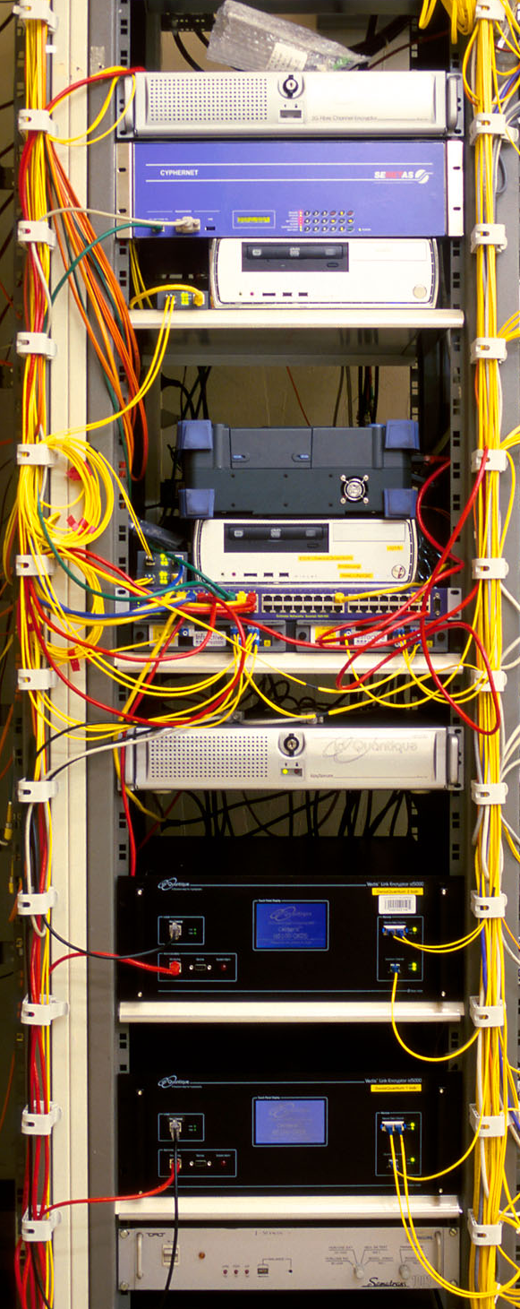
Dual key agreement
QKD
BB84
QKD
PKI
RSA-2048
PKI
Key
Key
Symmetric
cipher
AES-256
Symmetric
cipher
Certified
Photo © 2010 Vadim Makarov
www.swissquantum.com
ID Quantique Cerberis system (2010)

Slide 20

Vadim Makarov www.vad1.com/lab

