Slide 1
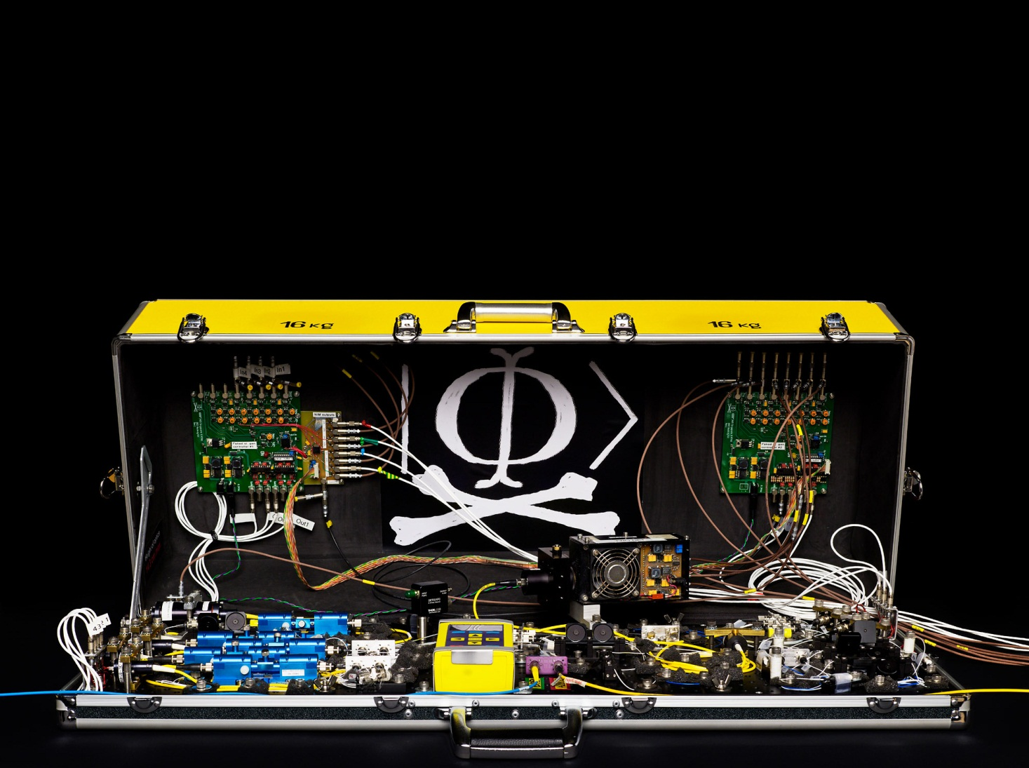
Lecture at ID Quantique 8th winter school on quantum cybersecurity, Les Diablerets, January 16–21, 2016
Quantum hacking
Vadim Makarov www.vad1.com/lab
Photo © 2010 NTNU Info / Geir Mogen

Slide 2



Security model of QKD
Alice
Bob
1
Secret key rate $R=f\left(\text{QBER}\right)$
R
0
0
0.11
QBER
Security proof
.Laws of physics & Model of equipment

Slide 3
Security model of QKD
Security proof
.Laws of physics & Model of equipment
Integrate imperfection into security model
Hack
Security proof
.Laws of physics & Model of equipment

Slide 4
Example of vulnerability and countermeasures
Photon-number-splitting attack
C. Bennett, F. Bessette, G. Brassard, L. Salvail, J. Smolin, J. Cryptology 5, 3 (1992)
G. Brassard, N. Lütkenhaus, T. Mor, B. C. Sanders, Phys. Rev. Lett. 85, 1330 (2000)
N. Lütkenhaus, Phys. Rev. A 61, 052304 (2000)
S. Félix, N. Gisin, A. Stefanov, H. Zbinden, J. Mod. Opt. 48, 2009 (2001)
N. Lütkenhaus, M. Jahma, New J. Phys. 4, 44 (2002)
Decoy-state protocol
W.-Y. Hwang, Phys. Rev. Lett. 91, 057901 (2003)
SARG04 protocol
V. Scarani, A. Acín, G. Ribordy, N. Gisin, Phys. Rev. Lett. 92, 057901 (2004)
Distributed-phase-reference protocols
K. Inoue, E. Waks, Y. Yamamoto, Phys. Rev. Lett. 89, 037902 (2002)
K. Inoue, E. Waks, Y. Yamamoto, Phys. Rev. A. 68, 022317 (2003)
N. Gisin, G. Ribordy, H. Zbinden, D. Stucki, N. Brunner, V. Scarani, arXiv:quant-ph/0411022v1 (2004)
Laser
Attenuator

Slide 5
Attack | Target component | Tested system
Laser damage | any | ID Quantique, research system
V. Makarov et al., arXiv:1510.03148
Spatial efficiency mismatch | receiver optics | research system
M Rau et al., IEEE J. Quantum Electron. 21, 6600905 (2015); S. Sajeed et al., Phys. Rev. A 91, 062301 (2015)
Pulse energy calibration | classical watchdog detector | ID Quantique
S. Sajeed et al., Phys. Rev. A 91, 032326 (2015)
Trojan-horse | phase modulator in Alice | SeQureNet
I. Khan et al., presentation at QCrypt (2014)
Trojan-horse | phase modulator in Bob | ID Quantique*
N. Jain et al., New J. Phys. 16, 123030 (2014)
Detector saturation | homodyne detector | SeQureNet
H. Qin, R. Kumar, R. Alleaume, Proc. SPIE 88990N (2013)
Shot-noise calibration | classical sync detector | SeQureNet
P. Jouguet, S. Kunz-Jacques, E. Diamanti, Phys. Rev. A 87, 062313 (2013)
Wavelength-selected PNS | intensity modulator | (theory)
M.-S. Jiang, S.-H. Sun, C.-Y. Li, L.-M. Liang, Phys. Rev. A 86, 032310 (2012)
Multi-wavelength | beamsplitter | research system
H.-W. Li et al., Phys. Rev. A 84, 062308 (2011)
Deadtime | single-photon detector | research system
H. Weier et al., New J. Phys. 13, 073024 (2011)
Channel calibration | single-photon detector | ID Quantique
N. Jain et al., Phys. Rev. Lett. 107, 110501 (2011)
Faraday-mirror | Faraday mirror | (theory)
S.-H. Sun, M.-S. Jiang, L.-M. Liang, Phys. Rev. A 83, 062331 (2011)
Detector control | single-photon detector | ID Quantique, MagiQ, research system
I. Gerhardt et al., Nat. Commun. 2, 349 (2011); L. Lydersen et al., Nat. Photonics 4, 686 (2010)
* Attack did not break security of the tested system, but may be applicable to a different implementation.

Slide 6
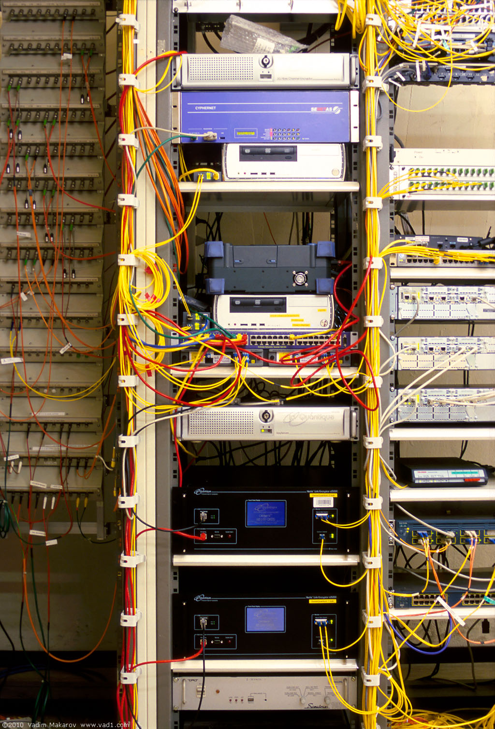
Commercial QKD
ID Quantique Cerberis system
Classical encryptors:
L2, 2 Gbit/s
L2, 10 Gbit/s
L3 VPN, 100 Mbit/s
WDMs
Key manager
QKD to another node (4 km)
QKD to another node (14 km)
Photo © 2010 Vadim Makarov
www.swissquantum.com

Slide 7
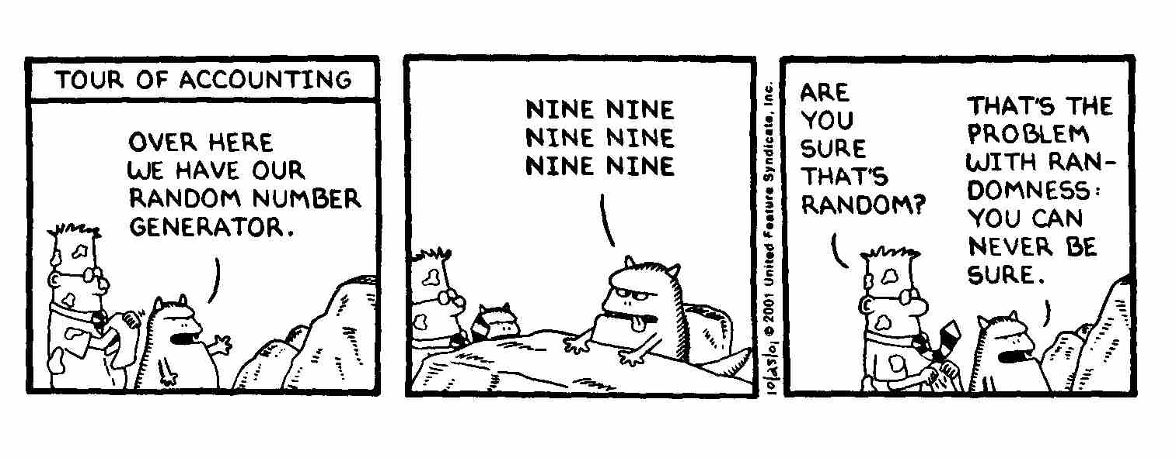
True randomness?
Quantis
RNG
FPGA
Phase modulator in Bob
id Quantique Clavis2 (2008)
OK
V_{π}/2
0
ONE ONE ONE
ONE ONE ONE
ONE ONE ONE

Slide 8
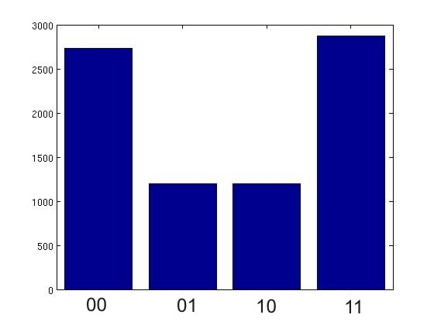
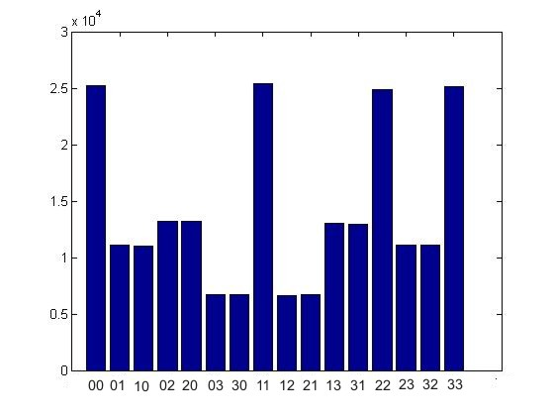
True randomness?
Quantis
RNG
FPGA
Phase modulator in Bob
id Quantique Clavis2 (2008)
V_{π}/2
0
Bob:
Alice:
Issue reported patched in 2010

Slide 9
Do we trust the manufacturer?
Quantis RNG
Quantis RNG, Trojan-horsed :)
*
*
Memory with
pre-recorded
random
sequence
Clicks
processed
Clicks
processed
Random
stream
Random
stream
Switch
Many components in QKD system can be Trojan-horsed:
– access to secret information
– electrical power
– way to communicate outside or compromise security

Slide 10
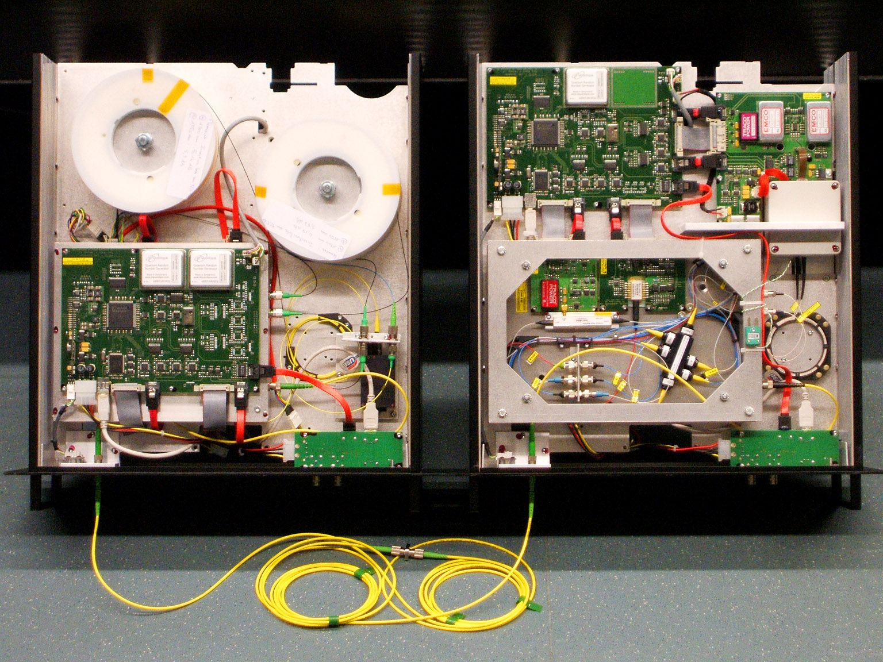
ID Quantique Clavis2 QKD system
Alice
Bob
Photo © 2008 Vadim Makarov. Published with approval of ID Qiantique

Slide 11
Double clicks
– occur naturally because of detector dark counts, multi-photon pulses...
Discard them?
Intercept-resend attack... with a twist:
Bob:
Detects in
Eve’s basis:
single click
Eve
100
photons
Alice
Bob´
Alice´
Detects in
conjugate basis:
double click,
discarded
Proper treatment for double clicks: assign a random bit value.
N. Lütkenhaus, Phys. Rev. A 59, 3301 (1999)
T. Tsurumaru & K. Tamaki, Phys. Rev. A 78, 032302 (2008)

Slide 12
Trojan-horse attack
Alice
Phase modulator
Attenuator
Alice’s
PC
Line
Eve’s equipment
– interrogating Alice’s phase modulator with powerful
external pulses (can give Eve bit values directly)

Slide 13
Trojan-horse attack experiment
Alice
4% reflection
Phase modulator
Laser
V_{mod}
Eve
L₁
OTDR
Out
Received OTDR pulse
Variable attenuator
In
L₂
Fine length adjustment
to get L₁ = L₂
0
4.1
8.2
V_{mod}, V
A. Vakhitov et al., J. Mod. Opt. 48, 2023 (2001)

Slide 14
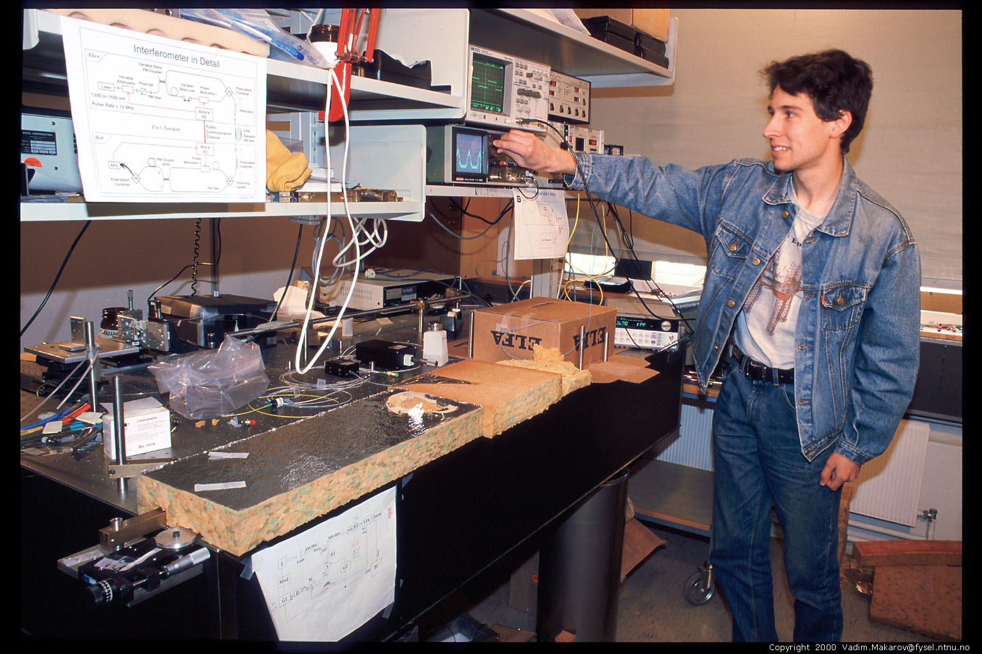
Artem Vakhitov tunes up Eve’s setup
Photo © 2000 Vadim Makarov

Slide 15
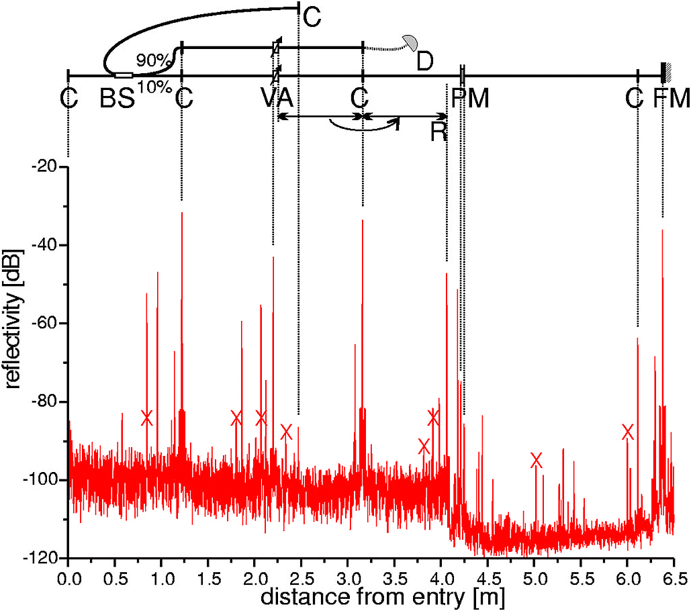
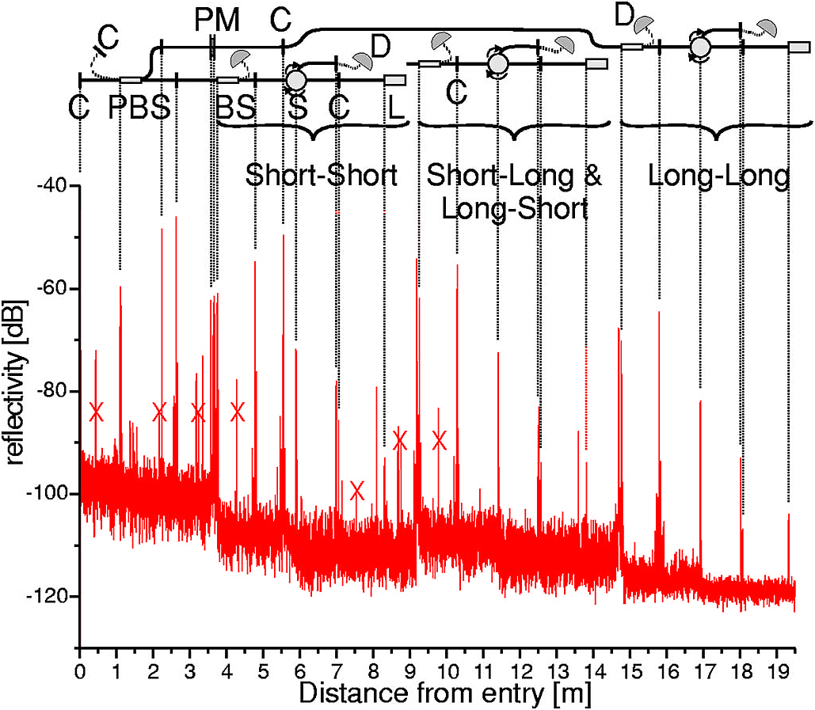
Trojan-horse attack for plug-and-play system
Alice
Bob
Eve gets back one photon → in principle, extracts 100% information
N. Gisin et al., Phys. Rev. A 73, 022320 (2006)

Slide 16
Countermeasures?
Alice
Bob
DL
ϕ
VOA
B
BS
C
FM
ϕ
PBS
L
A
sync
D0
D1
D. Stucki et al., New J. Phys. 4, 41 (2002)

Slide 17
Countermeasures for plug-and-play system
Alice:
1. Add narrowband
(∼1 nm) filter
2. Add
CW
and
pulse energy
monitoring detectors
S. Sajeed et al., Phys. Rev. A 91, 032326 (2015)
Bob: none
(one consequence: SARG protocol may be insecure)
N. Jain et al., New J. Phys. 16, 123030 (2014)

Slide 18
Pulse-energy-monitoring detector
Theory:
Implementation:
S. Sajeed et al., Phys. Rev. A 91, 032326 (2015)

Slide 19
Pulse-energy-monitoring detector
Theory:
Attack:
S. Sajeed et al., Phys. Rev. A 91, 032326 (2015)

Slide 20
Trojan-horse attack on Bob
Bob
2×10⁶
photons
ϕ
∼ −50 dB
B
BS
C
PBS
L
−57 dB
4 photons
D0
D1
ϕ
B
readout
N. Jain et al., New J. Phys. 16, 123030 (2014)

Slide 21
End of lecture 1

Slide 22
Attack example: avalanche photodetectors (APDs)
I
Linear mode
Geiger mode
I
I_{th}
P_{th}
P_{opt}
Quenching
I_{th}
Single photon
V
Breakdown
voltage V_{br}

Slide 23
Faked-state attack in APD linear mode
Identical bases & bit values
Eve
Bright
state
Alice
.Bob´
.Alice´
Bob
Listen, do same,
get same final key
Classical post-processing
Bob chooses same basis as Eve:
Bob chooses different basis:
“0”
I
0
“0
”
I
0
I
th
I
th
Click!
t
t
“1
”
I
1
“1
”
I
1
I
th
I
th
t
t
L. Lydersen, C. Wiechers, C. Wittmann, D. Elser, J. Skaar, V. Makarov, Nat. Photonics 4, 686 (2010)

Slide 24

Blinding APD with bright light
Eve applies CW light
Bias to APD
(V_{bias})
No light
V_{APD}
V_{br}
Detector blind!
Zero dark count rate
V_{bias}
R_{bias}
V_{HV} ≈ 40 V
0
t
2
647 μW
t
808 μW
Input
illumination,
mW
t
1.5
1
0.5
0
Logic 1
(never clicks)
(always clicks)
Detector
output
ID Quantique
Clavis2
Logic 0
-10
0
10
20
30
-10
0
10
20
30
Time, ns
Time, ns
L. Lydersen, C. Wiechers, C. Wittmann, D. Elser, J. Skaar, V. Makarov, Nat. Photonics 4, 686 (2010)

Slide 25
Proposed full eavesdropper
Eve
Optical
Alice
Bob´
Alice´
amplifier
Bob
Basis
Basis
Detection result
Bit in
Blinding laser

Slide 26
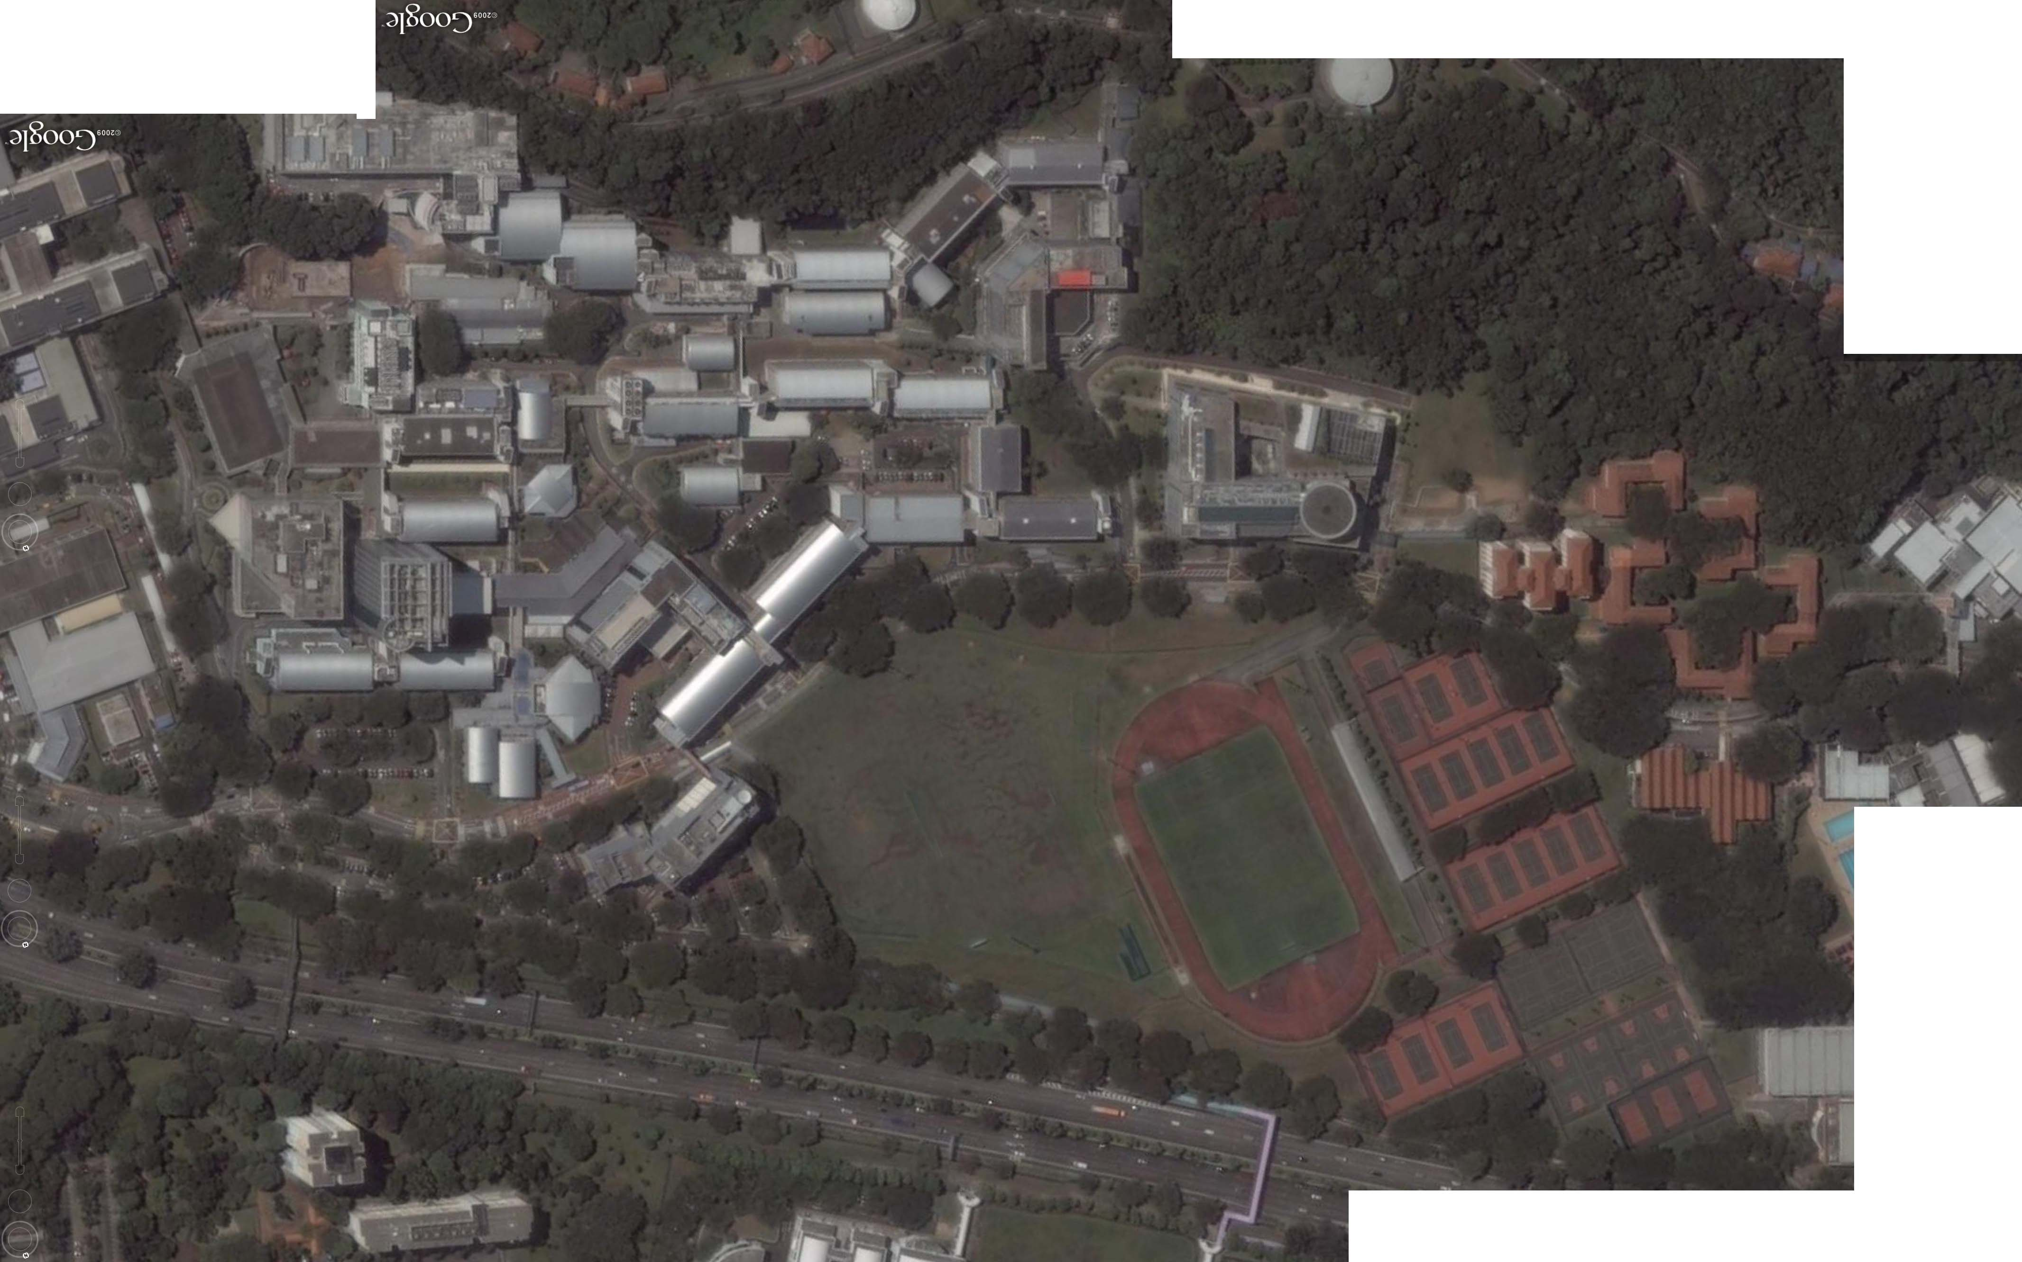
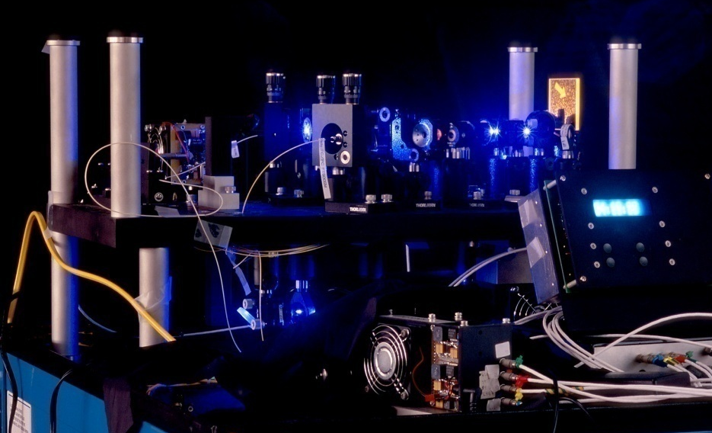
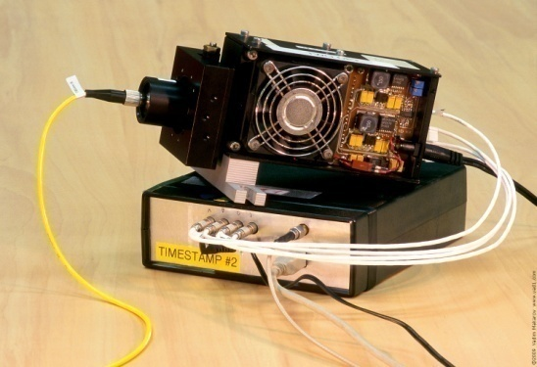
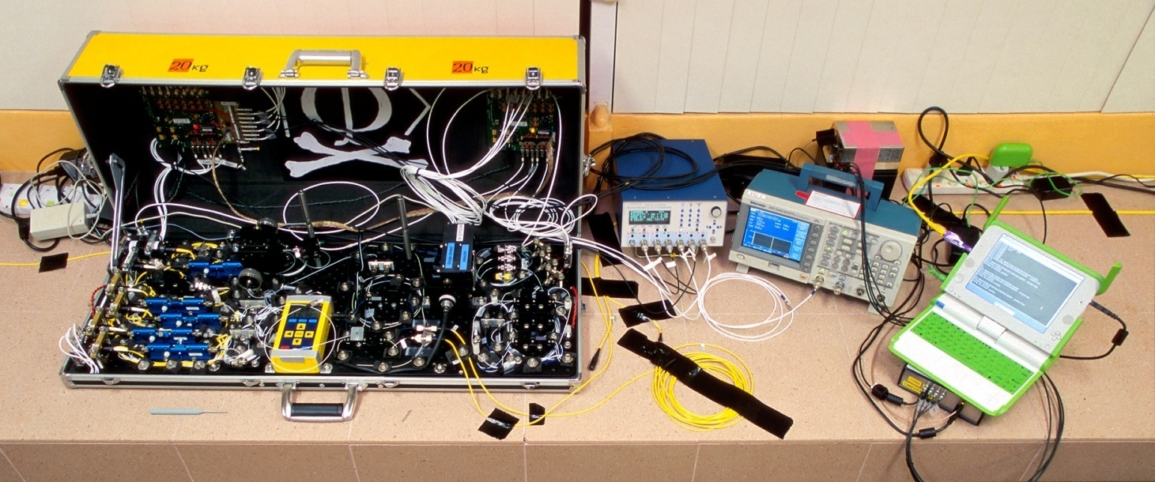
Eavesdropping 100% key on installed QKD line on campus of the National University of Singapore, July 4–5, 2009
290 m of fiber
Eve
S14
S13
Bob
Alice
S12
S15
Image © 2009 DigitalGlobe
I. Gerhardt, Q. Liu et al.,
Nat. Commun. 2, 349 (2011)

Slide 27
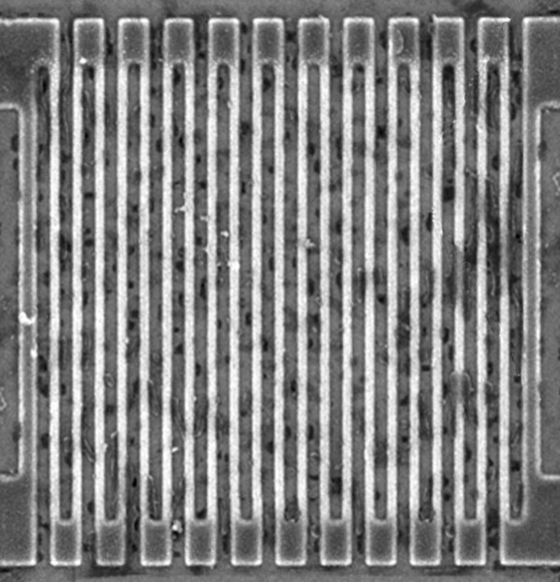
Controlling superconducting nanowire single-photon detectors
Comparator input
voltage, a.u.
1. Blind (latch)
0
2. Control
0
1
0
2
0
3
0
Time, ns
Normal single-
photon click
14 mW pulse
7 mW pulse
L. Lydersen, M. K. Akhlaghi, A. H. Majedi, J. Skaar, V. Makarov, New J. Phys. 13, 113042 (2011)
M. G. Tanner, V. Makarov, R. H. Hadfield, arXiv:1305.5989

Slide 28
Countermeasures to detector attacks?

Slide 29
Perfect countermeasure to detector attacks
Alice
Charlie
(untrusted)
Bob
Photon
source
Bell-state
measurement
Photon
source
Mod.
Mod.
RNG
RNG
Measurement-device-independent QKD
H.-K. Lo, M. Curty, B. Qi, Phys. Rev. Lett. 108, 130503 (2012)

Slide 30
Industrial countermeasure (ID Quantique)
2004-11-10
First commercial Clavis1 system is shipped to a customer
2009-10-22
Report about detector blinding attack sent to IDQ
2010-10-08
IDQ applies for a patent on randomization of detector efficiency
as a countermeasure
Lim et al. upload a preprint about countermeasure arXiv:1408.6398
2014-08-27
Implementation of countermeasure delivered by IDQ to our lab
(firmware update for Clavis2)
2014-11-18
2015-04-17
2015-12-21
Testing report sent to IDQ proposing a modified attack that works
Testing report sent to IDQ showing full implementation of
countermeasure to be unreliable
A. Huang et al., arXiv:1601.00993

Slide 31
Randomly varying detector efficiency
V_{APD}
Click
Click
V_{APD}
Click
Click
Alarm!
M. Legre, G. Robordy, Intl. patent appl. WO 2012/046135 A2 (filed in 2010)

Slide 32
Oscillograms at comparator input
A. Huang et al., arXiv:1601.00993

Slide 33
Full two-efficiency-level countermeasure
V_{APD}
η
η/2
0
η
η
0
η/2
η
η
C. C. W. Lim et al., IEEE J. Sel. Top. Quantum Electron. 21, 6601305 (2015)
M. Legre, G. Robordy, Intl. patent appl. WO 2012/046135 A2 (filed in 2010)
A. Huang et al., arXiv:1601.00993

Slide 34
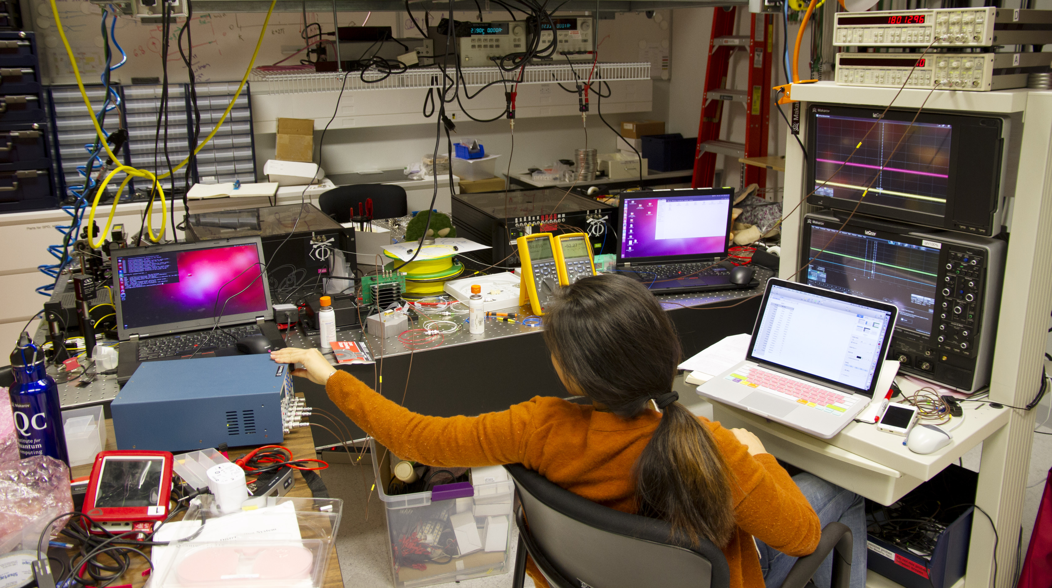
Anqi Huang tests countermeasure in Clavis2
Photo © 2015 Vadim Makarov

Slide 35
Security model of QKD
Security proof
.Laws of physics & Model of equipment
Integrate imperfection into security model
Hack

Slide 36

Laser damage!
Limits on physical security
Security proof
.Laws of physics & Model of equipment
Who knows what...?
Physical access
to equipment

Slide 37
Laser damage in commercial QKD system Clavis2
Power
~25 s
0
t
V. Makarov et al., arXiv:1510.03148

Slide 38
InGaAs p-i-n photodiode D_{pulse} (JDSU EPM 605LL)
Reproducible
(repeated with 3 samples)
V. Makarov et al., arXiv:1510.03148

Slide 39
QKD system log
V. Makarov et al., arXiv:1510.03148

Slide 40
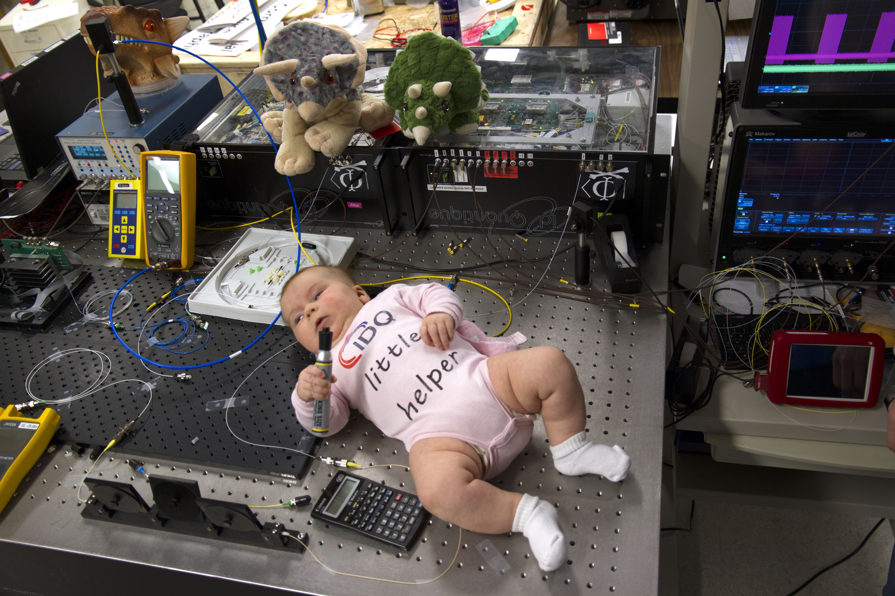
Photo © 2015 Vadim Makarov

Slide 41
Can we eavesdrop on commercial systems?
ID Quantique’s Cerberis:
Dual key agreement
QKD
BB84
QKD
PKI
RSA-2048
PKI
Key
Key
Symmetric
cipher
AES-256
Symmetric
cipher
Photo © 2010 Vadim Makarov

Slide 42
Kerckhoffs’ principle
Alice
Future technology
Bob
characteristics known
characteristics known
Il faut qu’il n’exige pas le secret, et qu’il puisse sans inconvénient tomber entre les mains de l’ennemi
A. Kerckhoffs, J. des Sciences Militaires IX, 5 (1883)
Everything about the system that is not explicitly secret is known to the enemy

Slide 43
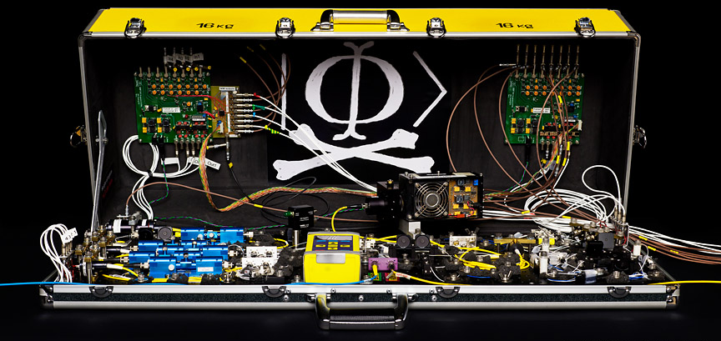
Eavesdropping in real life?
Future technology
Alice
Future technology
Bob
Alice
Future technology
Bob
Many papers
characteristics known
characteristics known
Alice
Today’s technology
(modeled)
Bob
characteristics known
characteristics known
Many papers
characteristics measured
characteristics measured
Alice
Implemented
Bob
characteristics measured
characteristics measured
I. Gerhardt et al., Nat. Commun. 2, 349 (2011)
Alice
Implemented
Bob
Not yet :)
no access
no access

Slide 44


