Slide 1
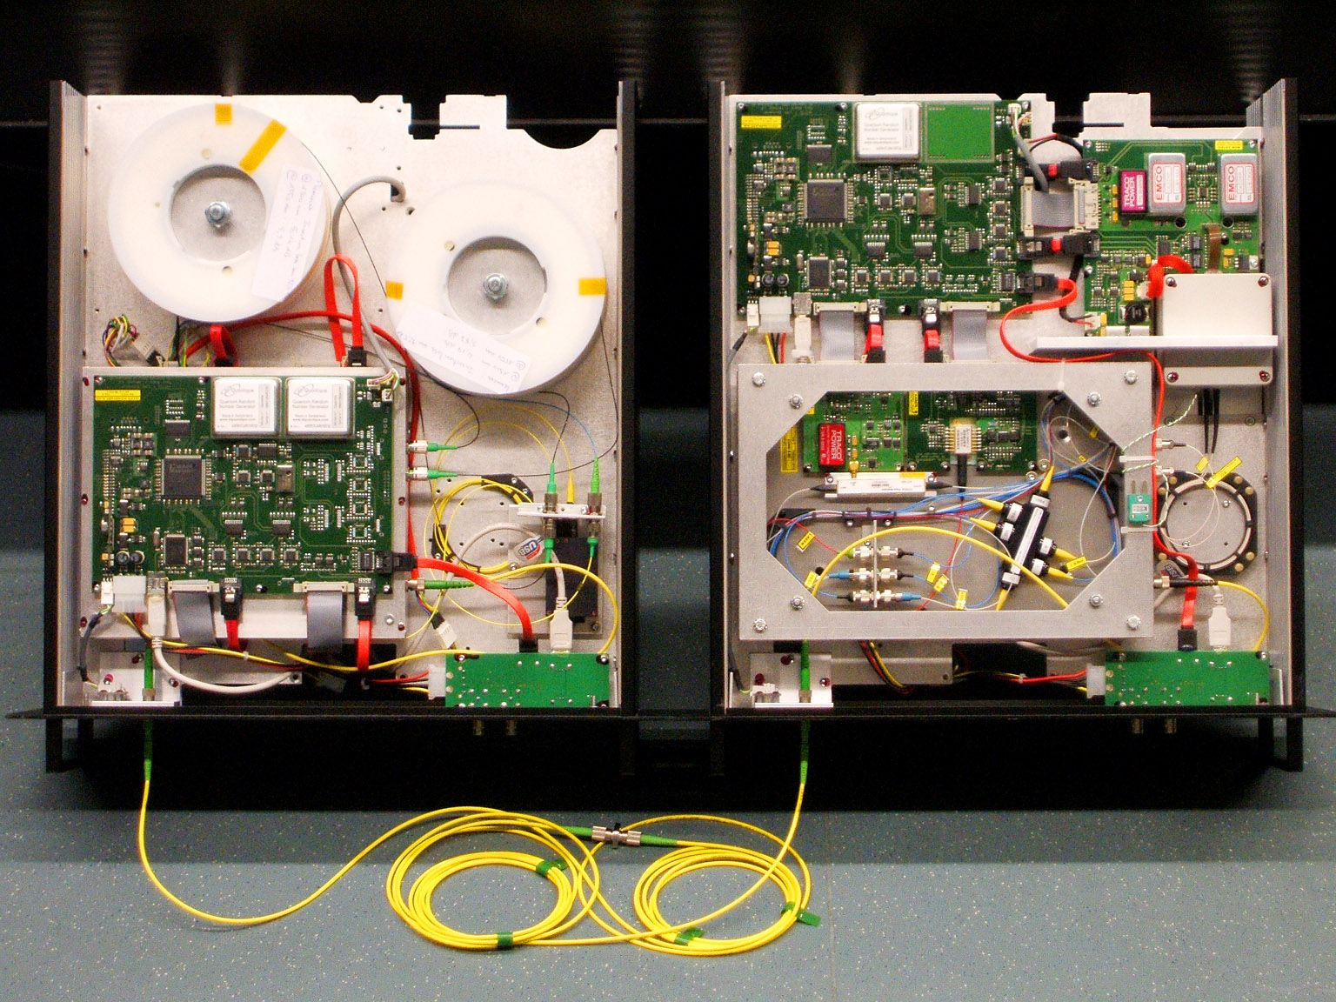
Course QIC 891, University of Waterloo, August 3, 2016
Implementation of quantum communication:
Lecture 3
Vadim Makarov www.vad1.com/lab
Photo © 2008 Vadim Makarov. Published with approval of ID Qiantique

Slide 2
Outline of the rest of this course
Summary of communication security,
quantum key distribution, trusted-repeater networks
Security model of QKD, side-channels in implementations
Examples of side-channel attacks,
countermeasures,
testing countermeasures
Conclusion & discussion
(optional) Lab visit
August 12 3

Slide 3
Communication security you enjoy daily
Paying by credit card in a supermarket
Cell phone conversations, SMS
Email, chat, online calls
Secure browsing, shopping online
Cloud storage and communication between your devices
Software updates on your computer, phone, tablet
Online banking
Off-line banking: the bank needs to communicate internally
Electricity, water: the utility needs to communicate internally
Car keys, electronic door keys, access control
Government services (online or off-line)
Medical records at your doctor, hospital
Bypassing government surveillance and censorship
Security cameras, industrial automation, military, spies...

Slide 4
A (very) brief history of cryptography
 |  |  |  |  | Broken?
Monoalphabetic cipher |  | invented ~50 BC (J. Caesar) |  |  | ~850 (Al-Kindi)
Nomenclators (code books) |  | ~1400 – ~1800 |  |  | ✓
Polyalphabetic (Vigenère) |  | 1553 – ~1900 |  |  | 1863 (F. W. Kasiski)
···
One-time pad |  | invented 1918 (G. Vernam) |  |  | impossible (C. Shannon 1949)
Polyalphabetic electromechanical (Enigma, Purple, etc.) |  | 1920s – 1970s |  |  | ✓
···
DES |  | 1977 – 2005 |  |  | 1998: 56 h (EFF)
Public-key crypto (RSA, elliptic-curve) |  |  | 1977 – |  | will be once we have q. computer (P. Shor 1994)
AES |  | 2001 – |  |  | ?
Quantum cryptography | invented 1984, in development |  |  |  |  | impossible
Public-key crypto (‘quantum-safe’) |  | in development |  |  | ?
 |  |  |  |  | Broken?
Monoalphabetic cipher |  | invented ~50 BC (J. Caesar) |  |  | ~850 (Al-Kindi)
Nomenclators (code books) |  | ~1400 – ~1800 |  |  | ✓
Polyalphabetic (Vigenère) |  | 1553 – ~1900 |  |  | 1863 (F. W. Kasiski)
···
Polyalphabetic electromechanical (Enigma, Purple, etc.) |  | 1920s – 1970s |  |  | ✓
···
DES |  | 1977 – 2005 |  |  | 1998: 56 h (EFF)
Public-key crypto (RSA, elliptic-curve) |  |  | 1977 – |  | will be once we have q. computer (P. Shor 1994)
AES |  | 2001 – |  |  | ?
Public-key crypto (‘quantum-safe’) |  | in development |  |  | ?


Slide 5
One-time pad
Alice
Bob
Random
secret key
of same length as message
Random
secret key
Message
Message
α | β | α ⊕ β
0 | 0 | 0
0 | 1 | 1
1 | 0 | 1
1 | 1 | 0
G. Vernam, U.S. patent 1310719 (filed in 1918, granted 1919)
C. E. Shannon, Bell Syst. Tech. J. 28, 656 (1949)

Slide 6
A (very) brief history of cryptography
 |  |  |  |  | Broken?
Monoalphabetic cipher |  | invented ~50 BC (J. Caesar) |  |  | ~850 (Al-Kindi)
Nomenclators (code books) |  | ~1400 – ~1800 |  |  | ✓
Polyalphabetic (Vigenère) |  | 1553 – ~1900 |  |  | 1863 (F. W. Kasiski)
···
One-time pad |  | invented 1918 (G. Vernam) |  |  | impossible (C. Shannon 1949)
Polyalphabetic electromechanical (Enigma, Purple, etc.) |  | 1920s – 1970s |  |  | ✓
···
DES |  | 1977 – 2005 |  |  | 1998: 56 h (EFF)
Public-key crypto (RSA, elliptic-curve) |  |  | 1977 – |  | will be once we have q. computer (P. Shor 1994)
AES |  | 2001 – |  |  | ?
Quantum cryptography | invented 1984, in development |  |  |  |  | impossible
Public-key crypto (‘quantum-safe’) |  | in development |  |  | ?


Slide 7
Encryption and key distribution
Alice
Bob
Secure channel
RNG
Secret key
Public (insecure) channel
Symmetric
cipher
Symmetric
cipher
Encrypted messages
Messages
Messages
Quantum key distribution transmits secret key
by sending quantum states over open channel.

Slide 8
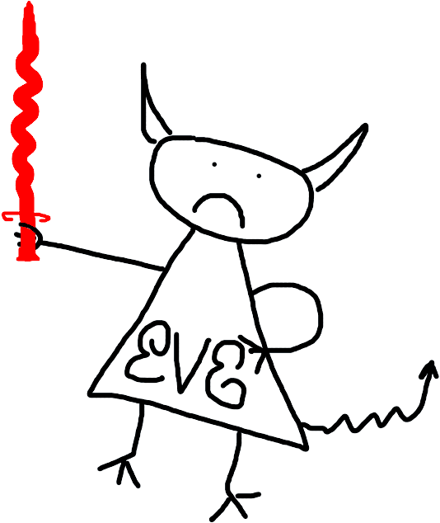
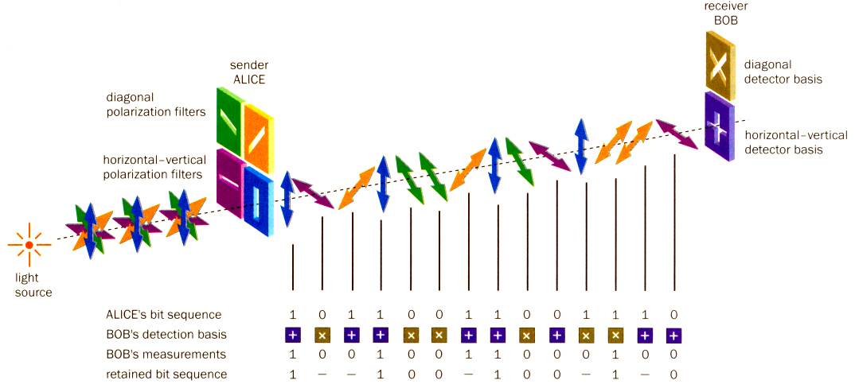
Quantum key distribution (QKD)
Bob
Alice
Diagonal detector basis
Diagonal polarization filters
0
1
Horizontal-vertical detector basis
Horizontal-vertical polarization filters
0
1
Light source
Alice’s bit sequence 1 0 1 1 0 0 1 1 0 0 1 1 1 0
Bob’s detection basis
Bob’s measurement 1 0 0 1 0 0 1 1 0 0 0 1 0 0
Retained bit sequence 1 – – 1 0 0 – 1 0 0 – 1 – 0
Image reprinted from article: W. Tittel, G. Ribordy & N. Gisin, “Quantum cryptography,” Physics World, March 1998

Slide 9
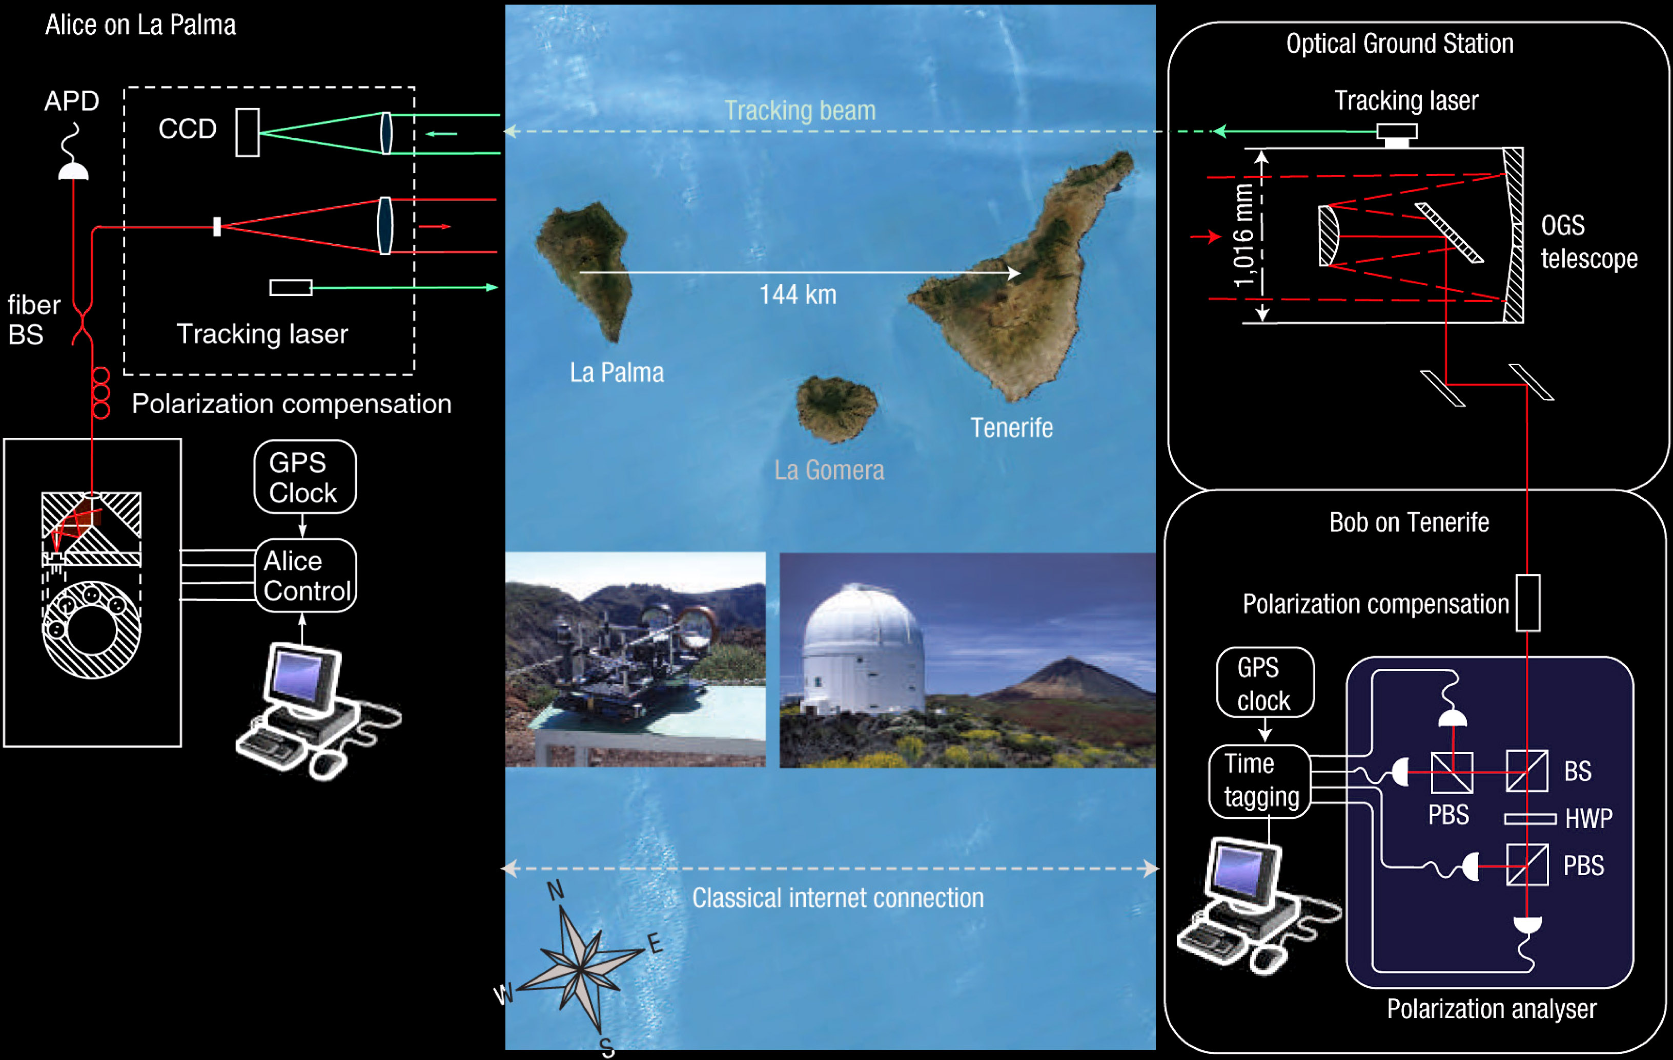
Free-space QKD
T. Schmitt-Manderbach et al., Phys. Rev. Lett. 98, 010504 (2007)

Slide 10
Phase encoding, interferometric QKD channel
Alice
Bob
Light
source
long
short
ϕ
D
0
B
ϕ
D
A
short
Transmission line
long
1
Detection basis:
ϕ_{B} = 0 : X
ϕ_{B} = π/2 : Z
ϕ_{A} = 0 or π/2 : 0
ϕ_{A} = π or 3π/2 : 1

Slide 11
Plug-and-play scheme
Alice
Bob
DL
ϕ
VOA
B
BS
C
FM
ϕ
PBS
L
A
sync
D0
D1
D. Stucki et al., New J. Phys. 4, 41 (2002)

Slide 12
ID Quantique Clavis2 QKD system
Alice
Bob
Photo © 2008 Vadim Makarov. Published with approval of ID Qiantique

Slide 13
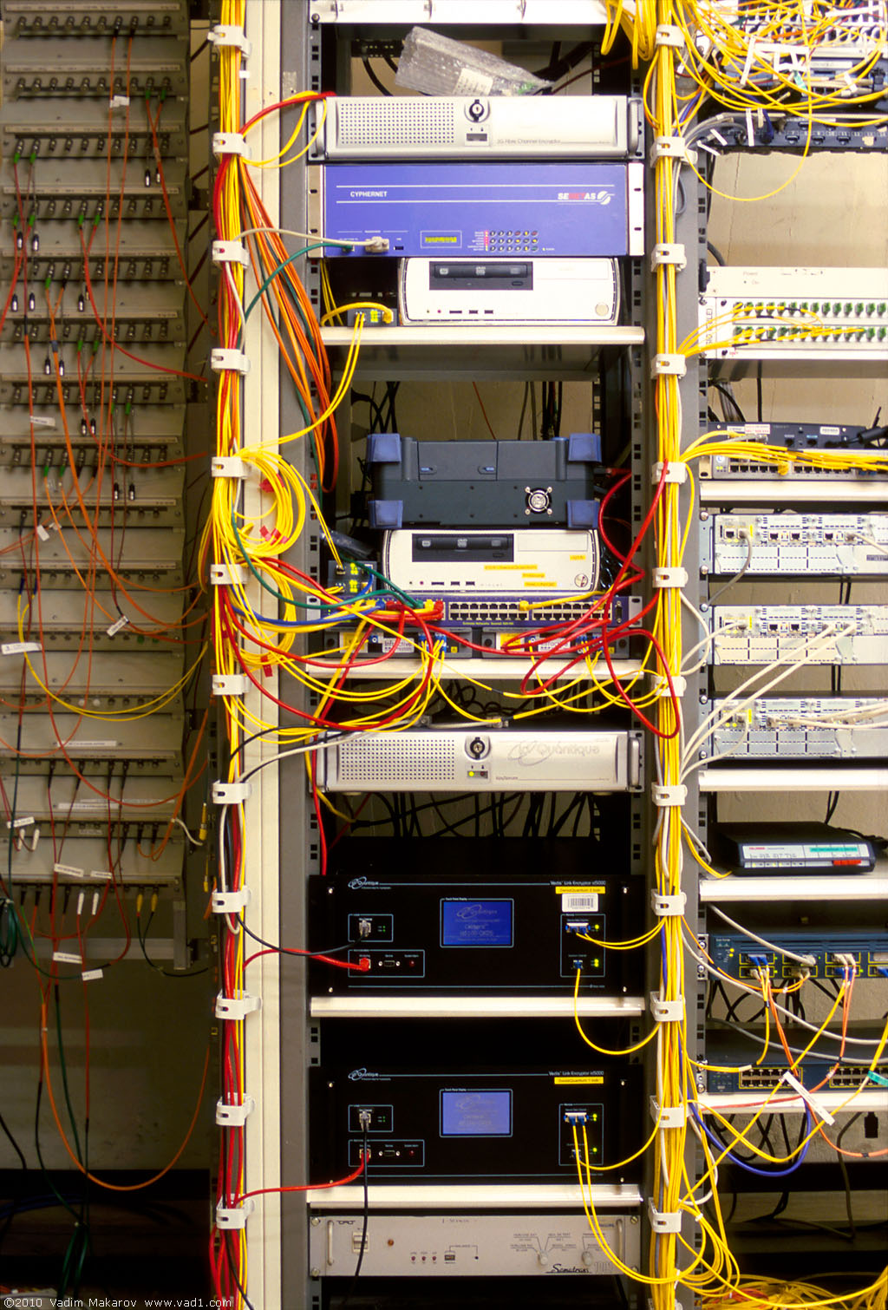
Commercial QKD
Classical encryptors:
L2, 2 Gbit/s
L2, 10 Gbit/s
L3 VPN, 100 Mbit/s
WDMs
17 km (fiber length)
Key manager
14 km
QKD to another node
(4 km)
QKD to another node
(14 km)
4 km
Photo © 2010 Vadim Makarov
www.swissquantum.com
ID Quantique Cerberis system (2010)

Slide 14
Trusted-node repeater
User
Trusted node
User
QKD 1
QKD 2
K1
K1
K2
K2
K1⊕K2
K1
K1⊕K2⊕K2 = K1

Slide 15
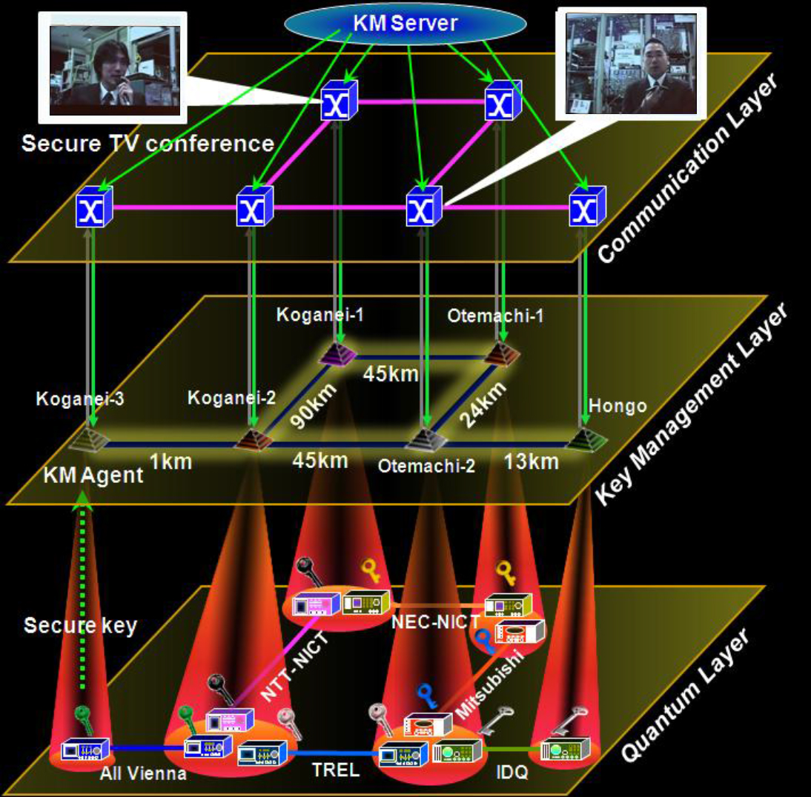
Trusted-node network
M. Sasaki et al., Opt. Express 19, 10387 (2011)

Slide 16
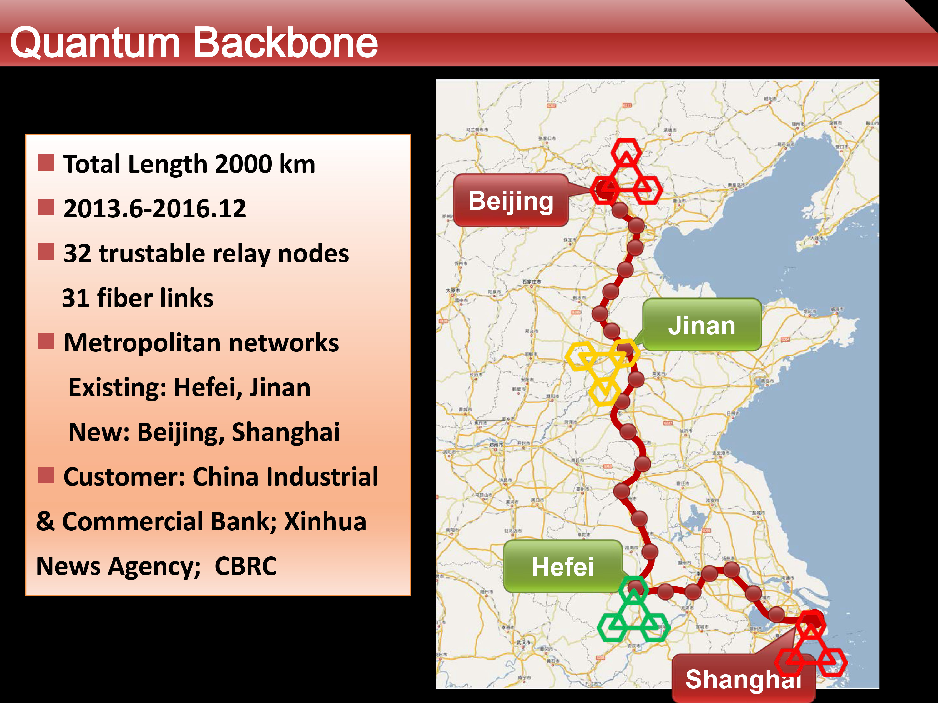
Q. Zhang, talk at QCrypt 2014

Slide 17
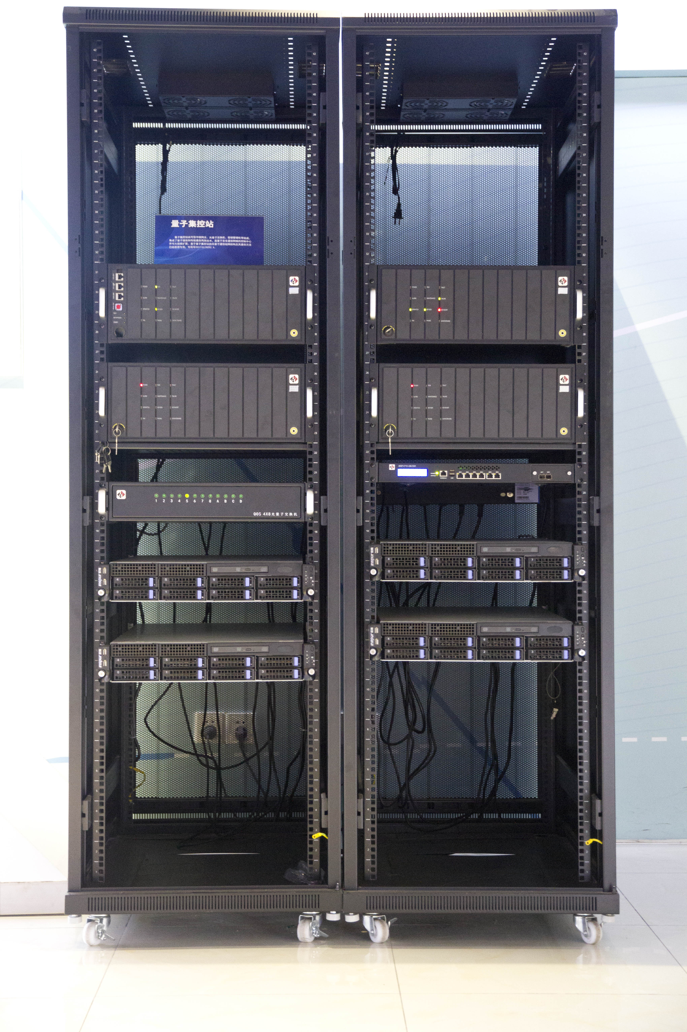
One repeater of Chinese backbone quantum key distribution line
(2000 km Beijing–Shanghai, consisting of a chain of
32 such trusted repeaters)
Photo © 2016 Vadim Makarov

Slide 18
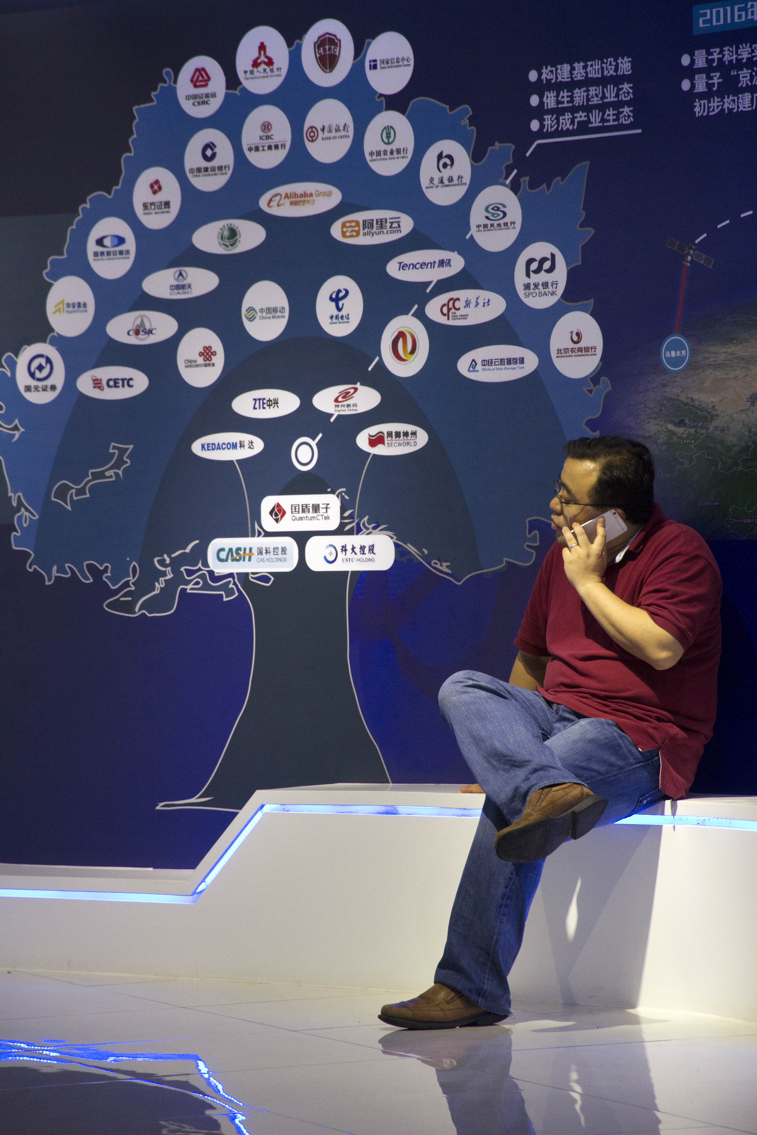
Customers of the Chinese quantum key distribution network (upper three rings), component suppliers and developers (lower three rings)
Photo © 2016 Vadim Makarov

Slide 19
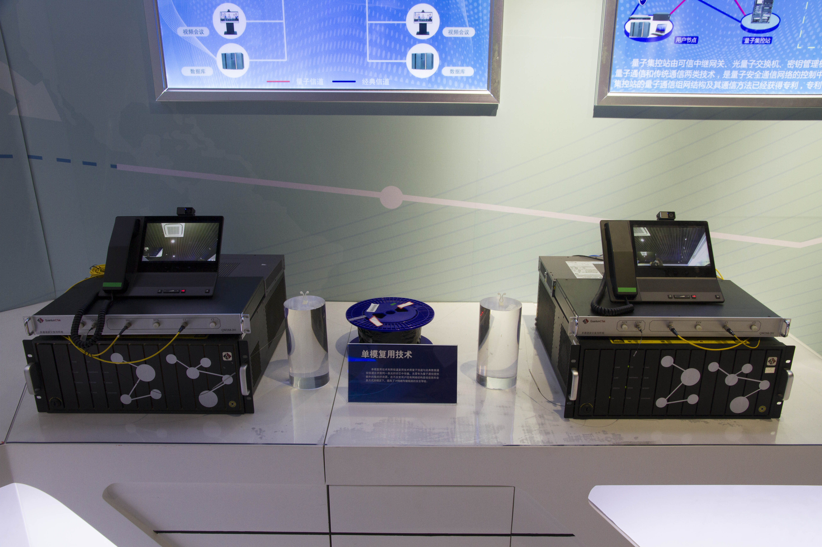
Quantum cryptography system with secure videotelephone made by QuantumCTek (China)
Photo © 2016 Vadim Makarov

Slide 20
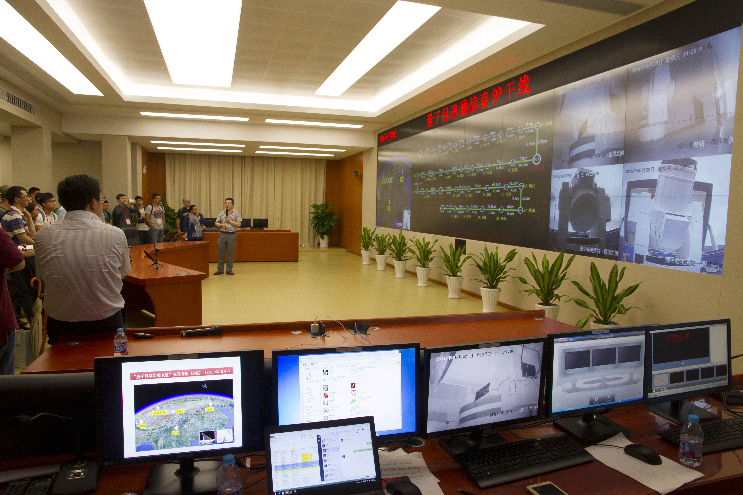
Shanghai control center of the Chinese quantum key distribution network and satellite
Photo © 2016 Vadim Makarov

Slide 21
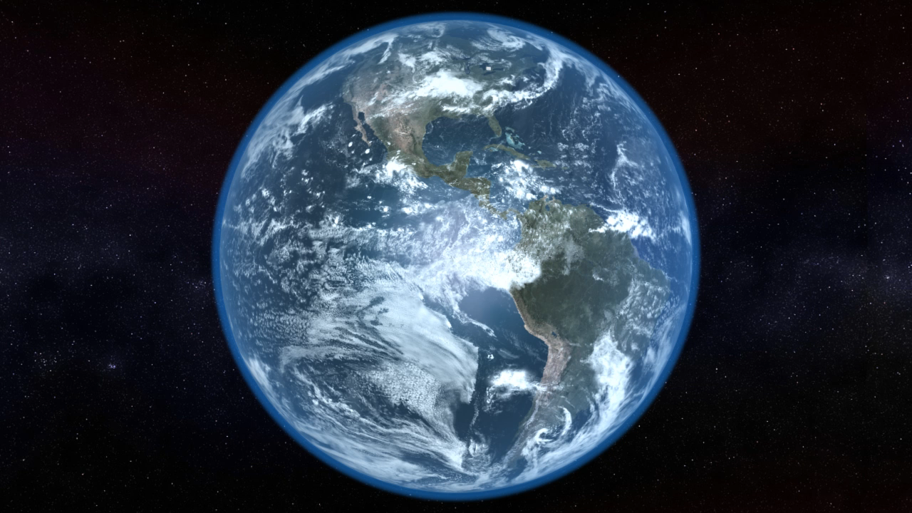
Video ©2012 IQC / group of T. Jennewein

Slide 22
Quantum communication primitives
 | Advantages over classical primitives:
 | Unconditionally secure? | Less resources? | Other quantum advantages?
Key distribution | 
Secret sharing | 
Digital signatures |  | 
Superdense coding |  | 
Fingerprinting |  | 
Oblivious transfer | Impossible |  | 
Bit commitment | Impossible |  | 
Coin-tossing | 
Cloud computing | 
Bell inequality testing | (no classical equivalent)
Teleportation
Entanglement swapping
Random number generators | 

Slide 23



Security model of QKD
Alice
Bob
1
Secret key rate $R=f\left(\text{QBER}\right)$
R
0
0
0.11
QBER
Security proof
.Laws of physics & Model of equipment

Slide 24
Security model of QKD
Security proof
.Laws of physics & Model of equipment
Integrate imperfection into security model
Hack
Security proof
.Laws of physics & Model of equipment

Slide 25
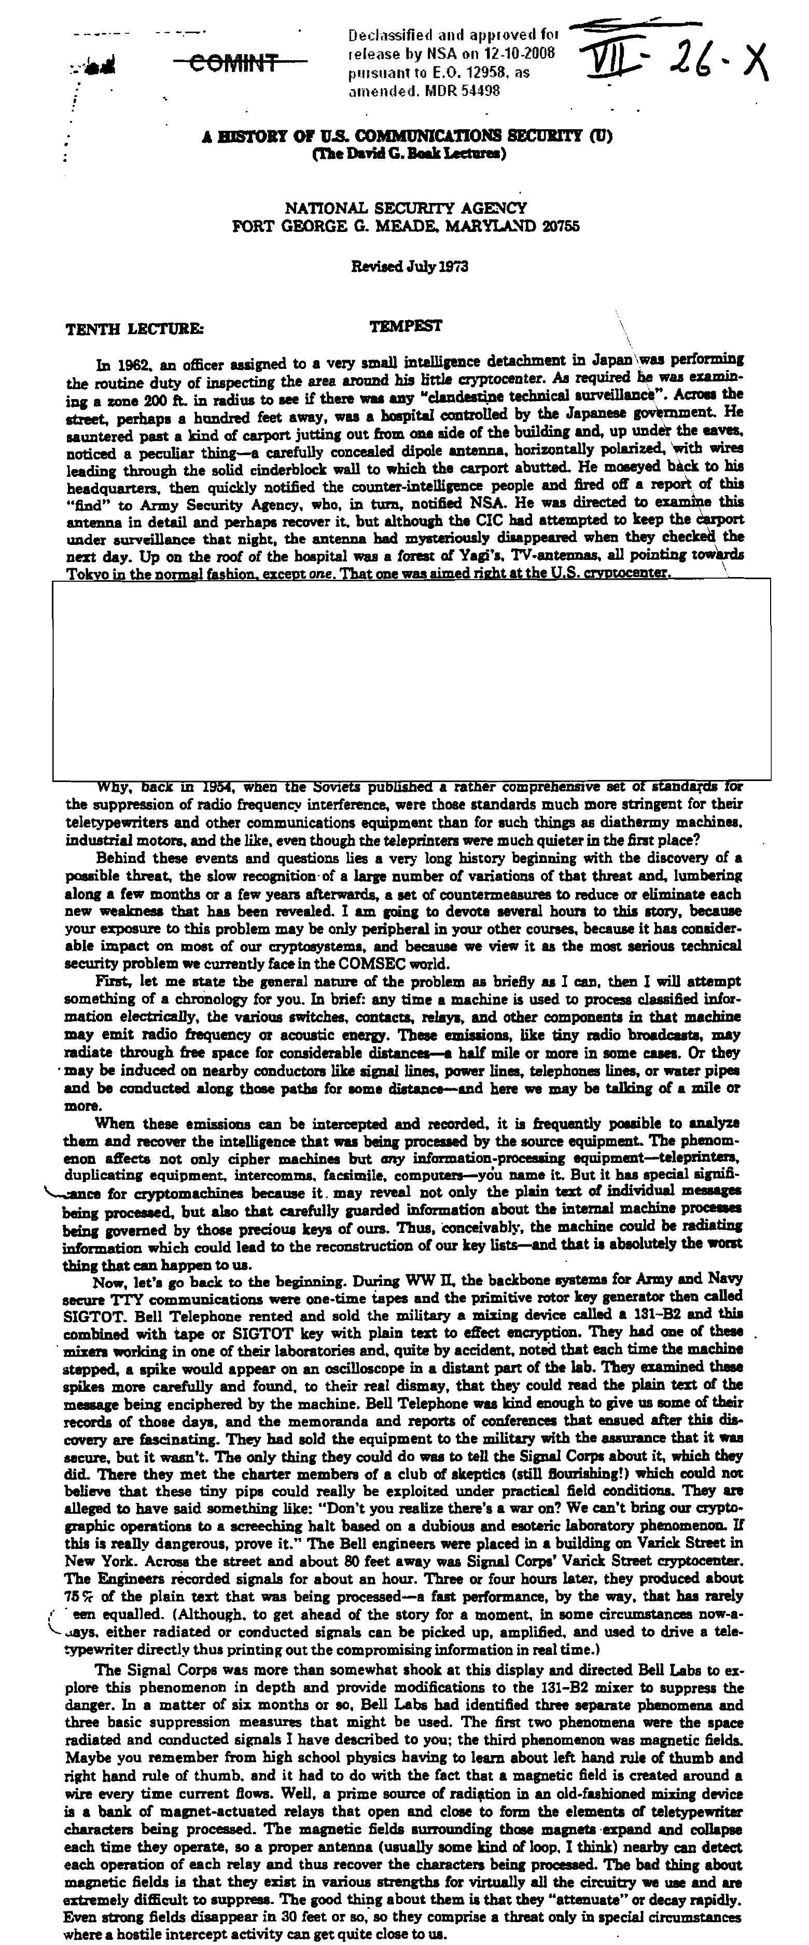

Slide 27
Today’s digital
Crypto module
Bus
Memory
Software
Bus
Signal proc.
DAC
Amplifier
vs. quantum
Crypto module
Optical line
[vs. future]
Crypto module
Quantum bus, computer, memory...

Slide 28
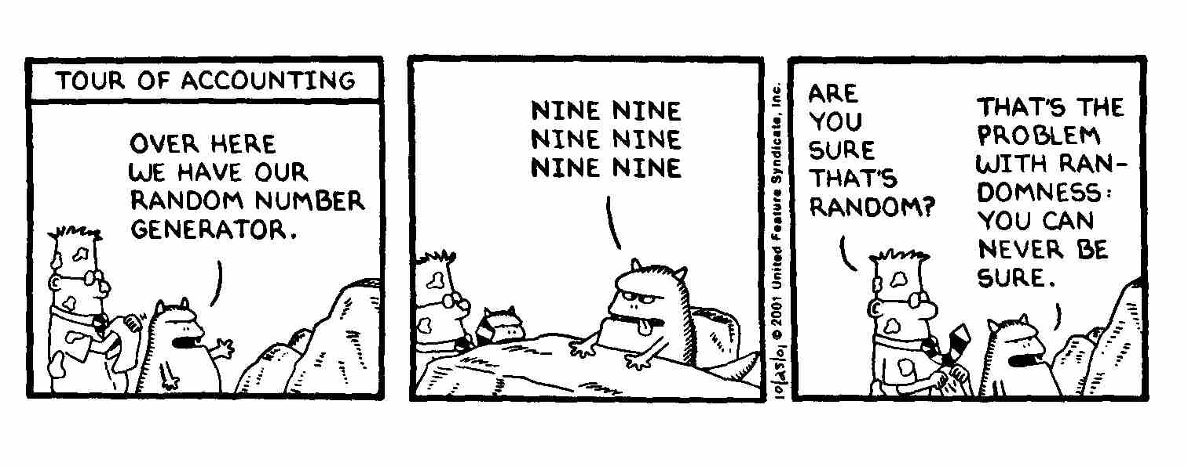
True randomness?
Quantis
RNG
FPGA
Phase modulator in Bob
id Quantique Clavis2 (2008)
OK
V_{π}/2
0
ONE ONE ONE
ONE ONE ONE
ONE ONE ONE

Slide 29
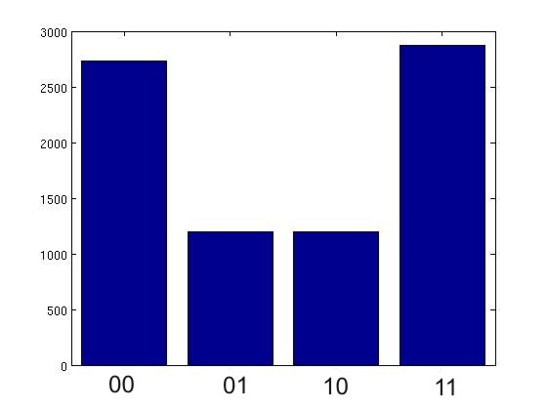
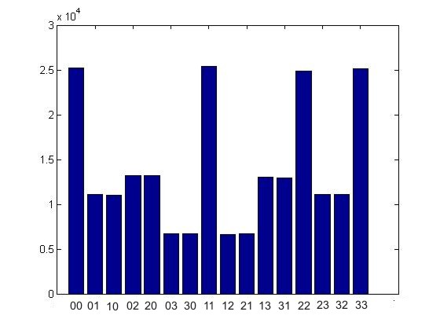
True randomness?
Quantis
RNG
FPGA
Phase modulator in Bob
id Quantique Clavis2 (2008)
V_{π}/2
0
Bob:
Alice:
Issue reported patched in 2010

Slide 30
Do we trust the manufacturer?
Quantis RNG
Quantis RNG, Trojan-horsed :)
*
*
Memory with
pre-recorded
random
sequence
Clicks
processed
Clicks
processed
Random
stream
Random
stream
Switch
Many components in QKD system can be Trojan-horsed:
– access to secret information
– electrical power
– way to communicate outside or compromise security

Slide 31
ID Quantique Clavis2 QKD system
Alice
Bob
Photo © 2008 Vadim Makarov. Published with approval of ID Qiantique

Slide 32
Double clicks
– occur naturally because of detector dark counts, multi-photon pulses...
Discard them?
Intercept-resend attack... with a twist:
Bob:
Detects in
Eve’s basis:
single click
Eve
100
photons
Alice
Bob´
Alice´
Detects in
conjugate basis:
double click,
discarded
Proper treatment for double clicks: assign a random bit value.
N. Lütkenhaus, Phys. Rev. A 59, 3301 (1999)
T. Tsurumaru & K. Tamaki, Phys. Rev. A 78, 032302 (2008)

Slide 33
Trojan-horse attack
Alice
Phase modulator
Attenuator
Alice’s
PC
Line
Eve’s equipment
– interrogating Alice’s phase modulator with powerful
external pulses (can give Eve bit values directly)

Slide 34
Trojan-horse attack experiment
Alice
4% reflection
Phase modulator
Laser
V_{mod}
Eve
L₁
OTDR
Out
Received OTDR pulse
Variable attenuator
In
L₂
Fine length adjustment
to get L₁ = L₂
0
4.1
8.2
V_{mod}, V
A. Vakhitov et al., J. Mod. Opt. 48, 2023 (2001)

Slide 35
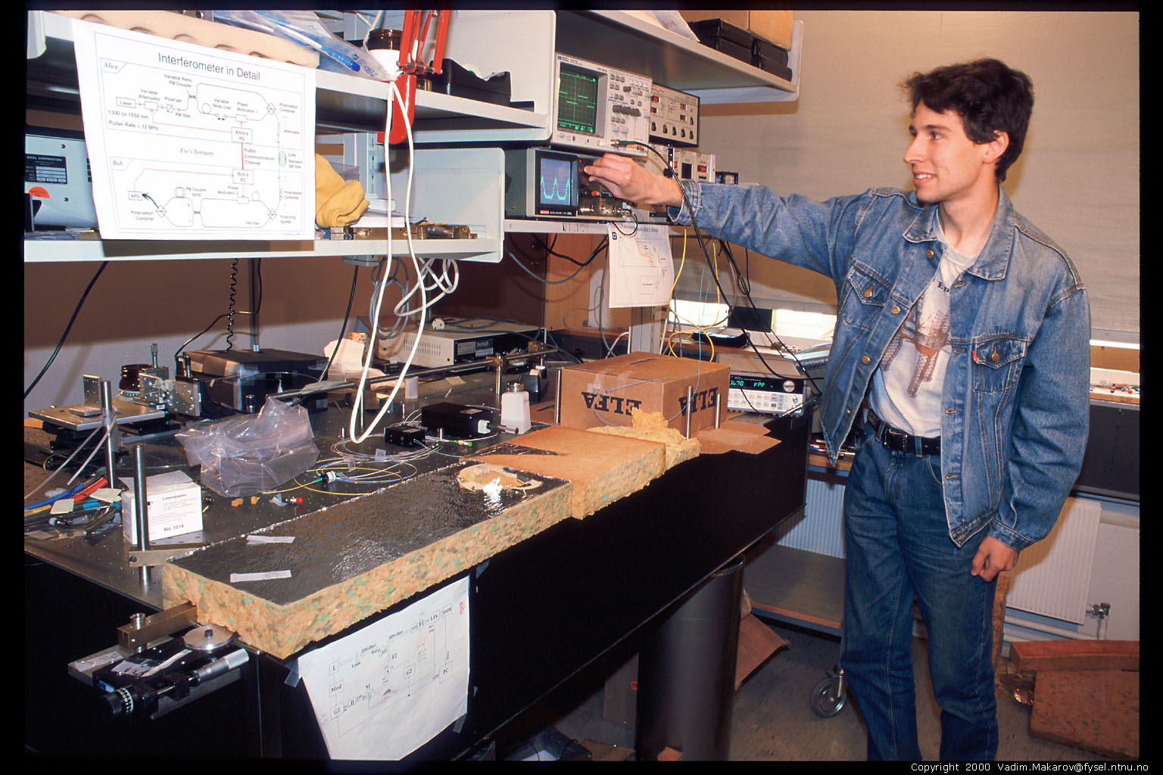
Artem Vakhitov tunes up Eve’s setup
Photo © 2000 Vadim Makarov

Slide 36
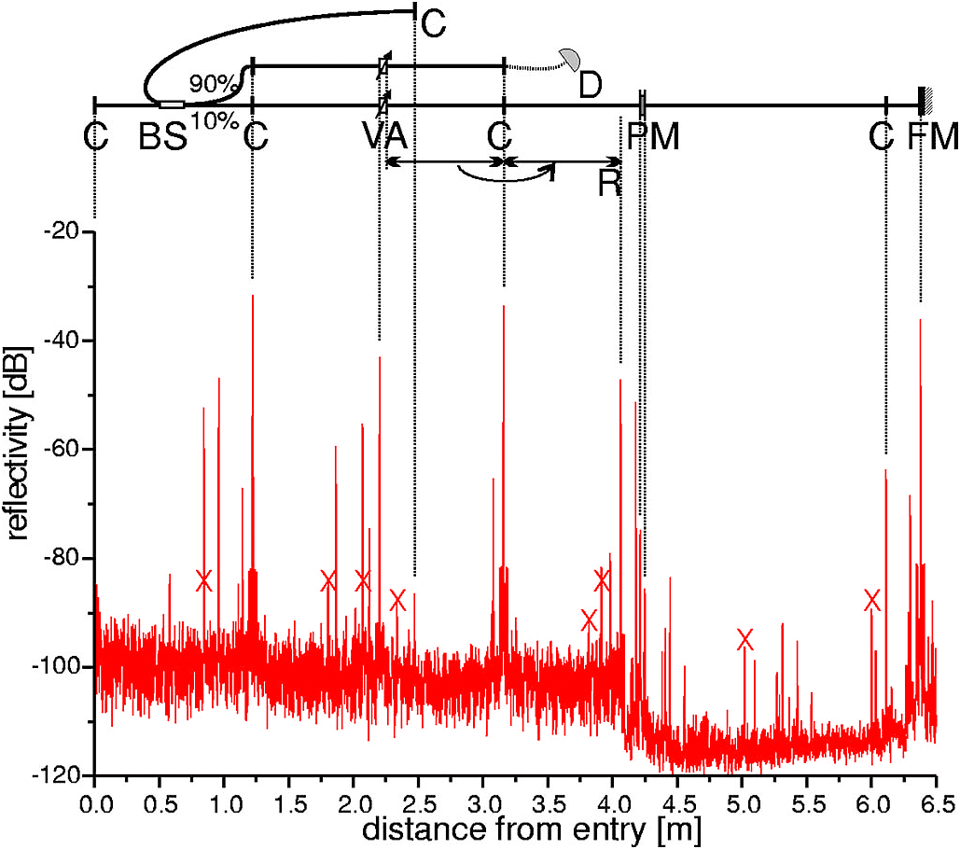
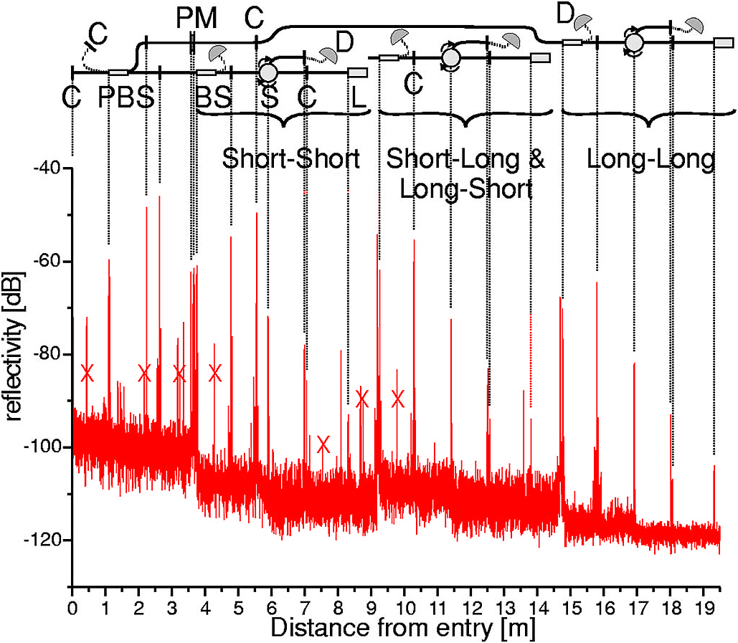
Trojan-horse attack for plug-and-play system
Alice
Bob
Eve gets back one photon → in principle, extracts 100% information
N. Gisin et al., Phys. Rev. A 73, 022320 (2006)

Slide 37
End of lecture 3

Slide 38
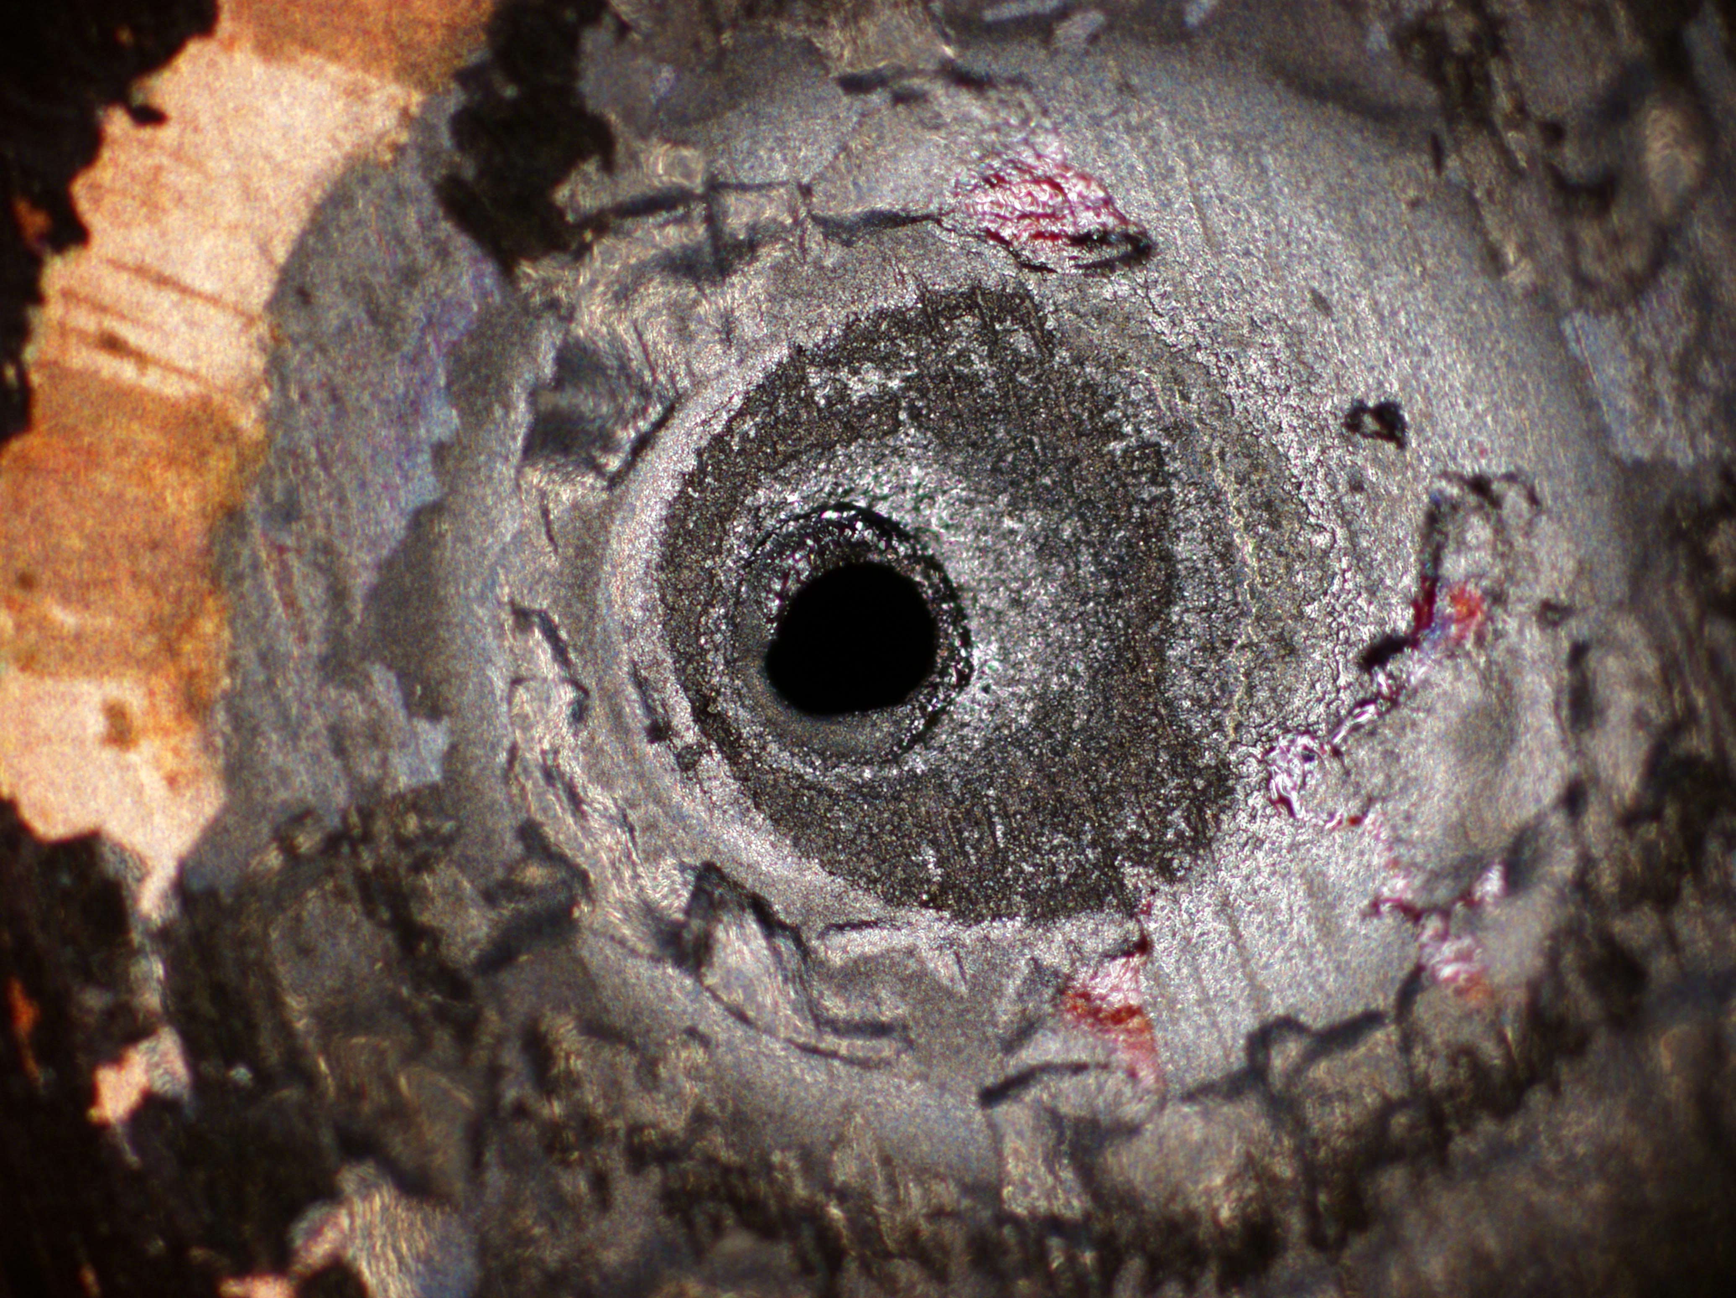
Course QIC 891, University of Waterloo, August 12, 2016
Implementation of quantum communication:
Lecture 4
Vadim Makarov www.vad1.com/lab

Slide 39
Outline of the rest of this course
Summary of communication security,
quantum key distribution, trusted-repeater networks
Security model of QKD, side-channels in implementations
Examples of side-channel attacks,
countermeasures,
testing countermeasures
Conclusion & discussion
(optional) Lab visit
August 12 3

Slide 40
Security model of quantum cryptography
Security proof
.Laws of physics & Model of equipment
Integrate imperfection into security model
Hack
Today’s technology
Crypto module
Optical line

Slide 41
Countermeasures?
Alice
Bob
DL
ϕ
VOA
B
BS
C
FM
ϕ
PBS
L
A
sync
D0
D1
D. Stucki et al., New J. Phys. 4, 41 (2002)

Slide 42
Countermeasures for plug-and-play system
Alice
Bob
DL
ϕ
VOA
B
BS
C
FM
ϕ
PBS
L
A
sync
D0
D1
1. Pulse-energy-monitoring detector
2. Narrowpass
(∼1 nm) filter
None
(one consequence: SARG
protocol may be insecure)
S. Sajeed et al., Phys. Rev. A 91, 032326 (2015)
N. Jain et al., New J. Phys. 16, 123030 (2014)

Slide 43
Trojan-horse attack on Bob
Bob
2×10⁶
photons
ϕ
∼ −50 dB
B
BS
Bob
C
PBS
ϕ
L
−57 dB
4 photons
B
BS
C
D0
D1
ϕ
PBS
L
B
readout
D0
D1
N. Jain et al., New J. Phys. 16, 123030 (2014)

Slide 44
Example of vulnerability and countermeasures
Photon-number-splitting attack
C. Bennett, F. Bessette, G. Brassard, L. Salvail, J. Smolin, J. Cryptology 5, 3 (1992)
G. Brassard, N. Lütkenhaus, T. Mor, B. C. Sanders, Phys. Rev. Lett. 85, 1330 (2000)
N. Lütkenhaus, Phys. Rev. A 61, 052304 (2000)
S. Félix, N. Gisin, A. Stefanov, H. Zbinden, J. Mod. Opt. 48, 2009 (2001)
N. Lütkenhaus, M. Jahma, New J. Phys. 4, 44 (2002)
Decoy-state protocol
W.-Y. Hwang, Phys. Rev. Lett. 91, 057901 (2003)
SARG04 protocol
V. Scarani, A. Acín, G. Ribordy, N. Gisin, Phys. Rev. Lett. 92, 057901 (2004)
Distributed-phase-reference protocols
K. Inoue, E. Waks, Y. Yamamoto, Phys. Rev. Lett. 89, 037902 (2002)
K. Inoue, E. Waks, Y. Yamamoto, Phys. Rev. A. 68, 022317 (2003)
N. Gisin, G. Ribordy, H. Zbinden, D. Stucki, N. Brunner, V. Scarani, arXiv:quant-ph/0411022v1 (2004)
Laser
Attenuator

Slide 45
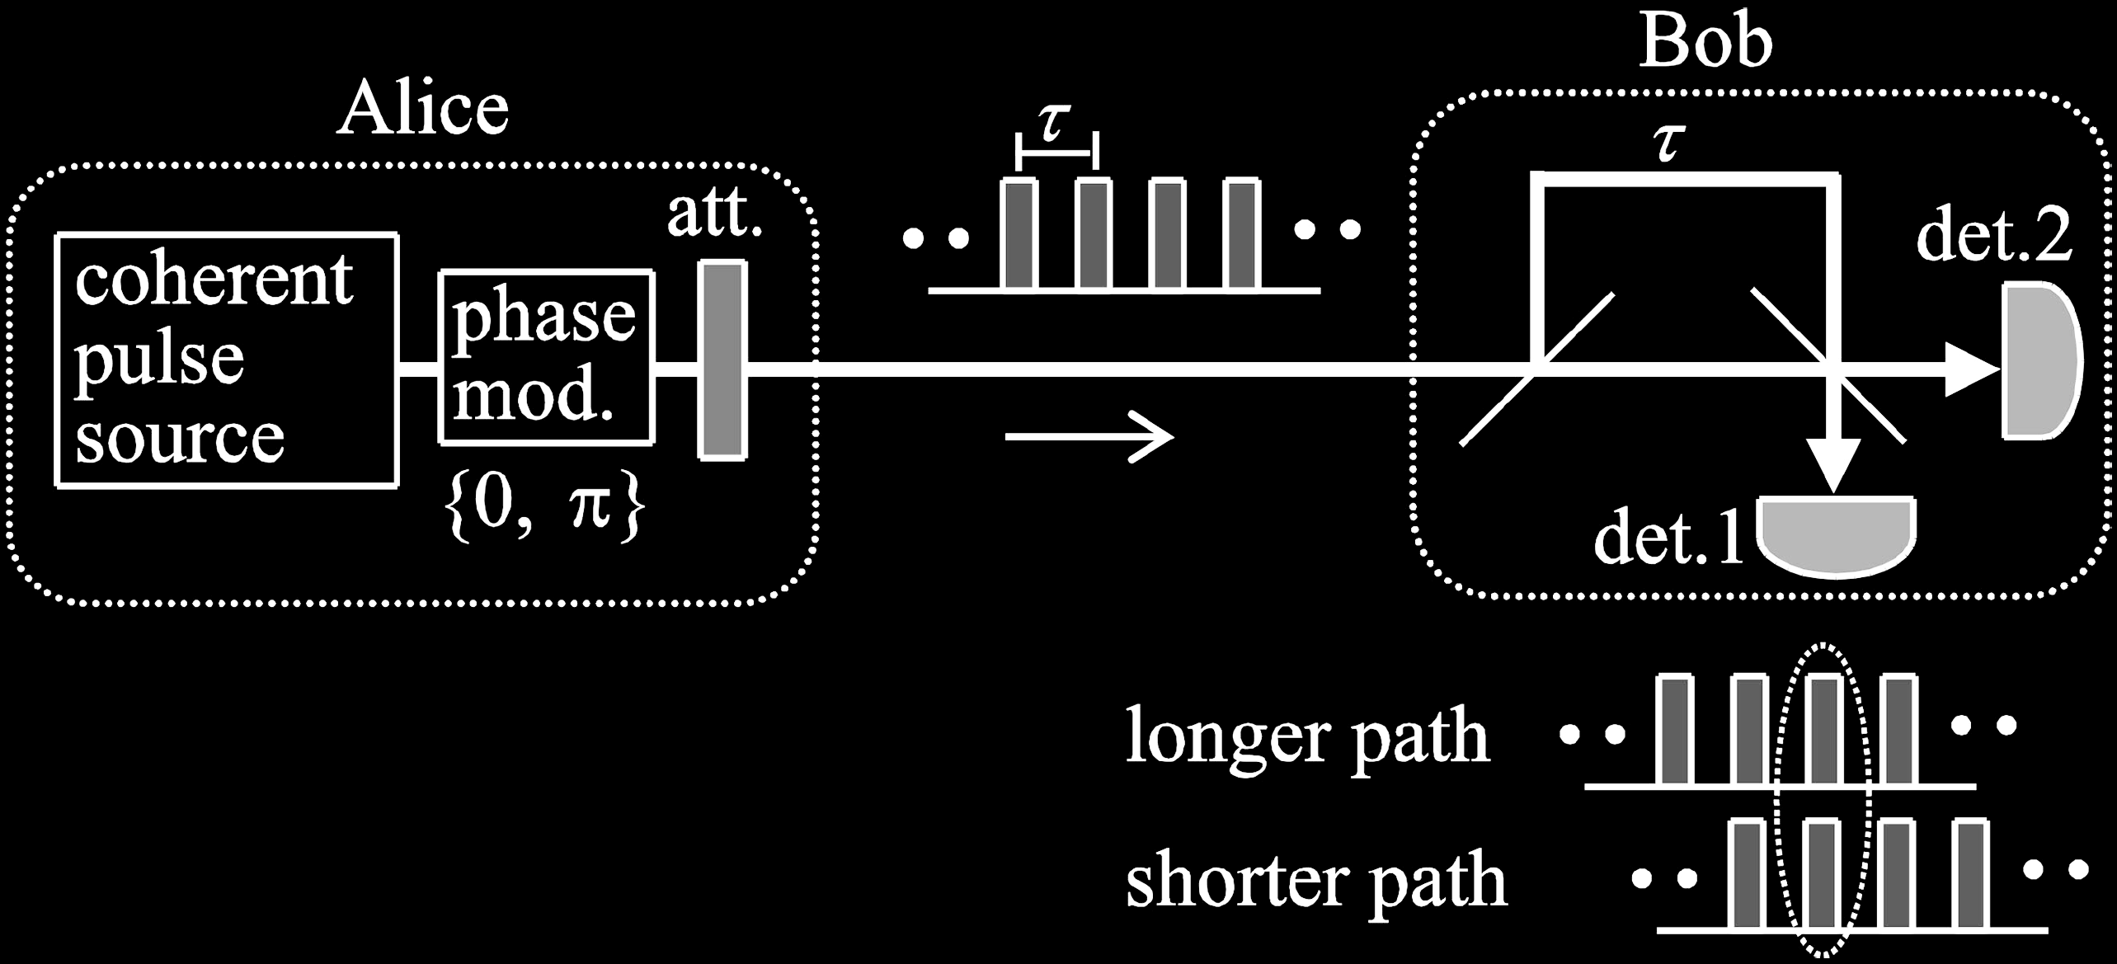
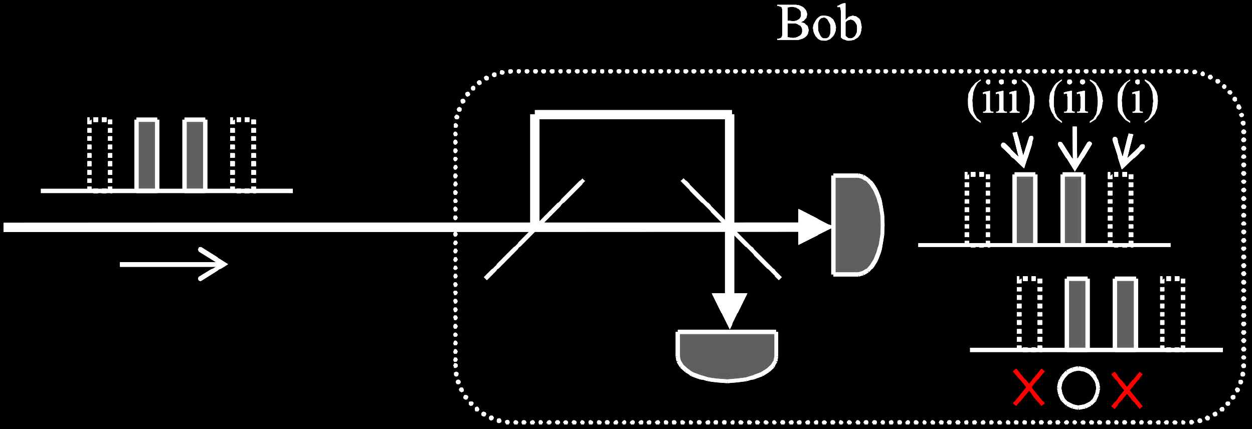
Differential-phase-shift QKD
Intercept-resend attack
Bob
Review: K. Inoue, IEEE J. Sel. Top. Quantum Electron. 21, 6600207 (2015)

Slide 46
Attack | Target component | Tested system
Laser damage | any | ID Quantique, research system
V. Makarov et al., arXiv:1510.03148
Spatial efficiency mismatch | receiver optics | research system
M Rau et al., IEEE J. Quantum Electron. 21, 6600905 (2015); S. Sajeed et al., Phys. Rev. A 91, 062301 (2015)
Pulse energy calibration | classical watchdog detector | ID Quantique
S. Sajeed et al., Phys. Rev. A 91, 032326 (2015)
Trojan-horse | phase modulator in Alice | SeQureNet
I. Khan et al., presentation at QCrypt (2014)
Trojan-horse | phase modulator in Bob | ID Quantique*
N. Jain et al., New J. Phys. 16, 123030 (2014)
Detector saturation | homodyne detector | SeQureNet
H. Qin, R. Kumar, R. Alleaume, Proc. SPIE 88990N (2013)
Shot-noise calibration | classical sync detector | SeQureNet
P. Jouguet, S. Kunz-Jacques, E. Diamanti, Phys. Rev. A 87, 062313 (2013)
Wavelength-selected PNS | intensity modulator | (theory)
M.-S. Jiang, S.-H. Sun, C.-Y. Li, L.-M. Liang, Phys. Rev. A 86, 032310 (2012)
Multi-wavelength | beamsplitter | research system
H.-W. Li et al., Phys. Rev. A 84, 062308 (2011)
Deadtime | single-photon detector | research system
H. Weier et al., New J. Phys. 13, 073024 (2011)
Channel calibration | single-photon detector | ID Quantique
N. Jain et al., Phys. Rev. Lett. 107, 110501 (2011)
Faraday-mirror | Faraday mirror | (theory)
S.-H. Sun, M.-S. Jiang, L.-M. Liang, Phys. Rev. A 83, 062331 (2011)
Detector control | single-photon detector | ID Quantique, MagiQ, research system
I. Gerhardt et al., Nat. Commun. 2, 349 (2011); L. Lydersen et al., Nat. Photonics 4, 686 (2010)
* Attack did not break security of the tested system, but may be applicable to a different implementation.

Slide 47
Attack example: avalanche photodetectors (APDs)
I
Linear mode
Geiger mode
I
I_{th}
P_{th}
P_{opt}
Quenching
I_{th}
Single photon
V
Breakdown
voltage V_{br}

Slide 48
Faked-state attack in APD linear mode
Identical bases & bit values
Eve
Bright
state
Alice
.Bob´
.Alice´
Bob
Listen, do same,
get same final key
Classical post-processing
Bob chooses same basis as Eve:
Bob chooses different basis:
“0”
I
0
“0
”
I
0
I
th
I
th
Click!
t
t
“1
”
I
1
“1
”
I
1
I
th
I
th
t
t
L. Lydersen, C. Wiechers, C. Wittmann, D. Elser, J. Skaar, V. Makarov, Nat. Photonics 4, 686 (2010)

Slide 49

Blinding APD with bright light
Eve applies CW light
Bias to APD
(V_{bias})
No light
V_{APD}
V_{br}
Detector blind!
Zero dark count rate
V_{bias}
R_{bias}
V_{HV} ≈ 40 V
0
t
2
647 μW
t
808 μW
Input
illumination,
mW
t
1.5
1
0.5
0
Logic 1
(never clicks)
(always clicks)
Detector
output
ID Quantique
Clavis2
Logic 0
-10
0
10
20
30
-10
0
10
20
30
Time, ns
Time, ns
L. Lydersen, C. Wiechers, C. Wittmann, D. Elser, J. Skaar, V. Makarov, Nat. Photonics 4, 686 (2010)

Slide 50
Proposed full eavesdropper
Eve
Optical
Alice
Bob´
Alice´
amplifier
Bob
Basis
Basis
Detection result
Bit in
Blinding laser

Slide 51
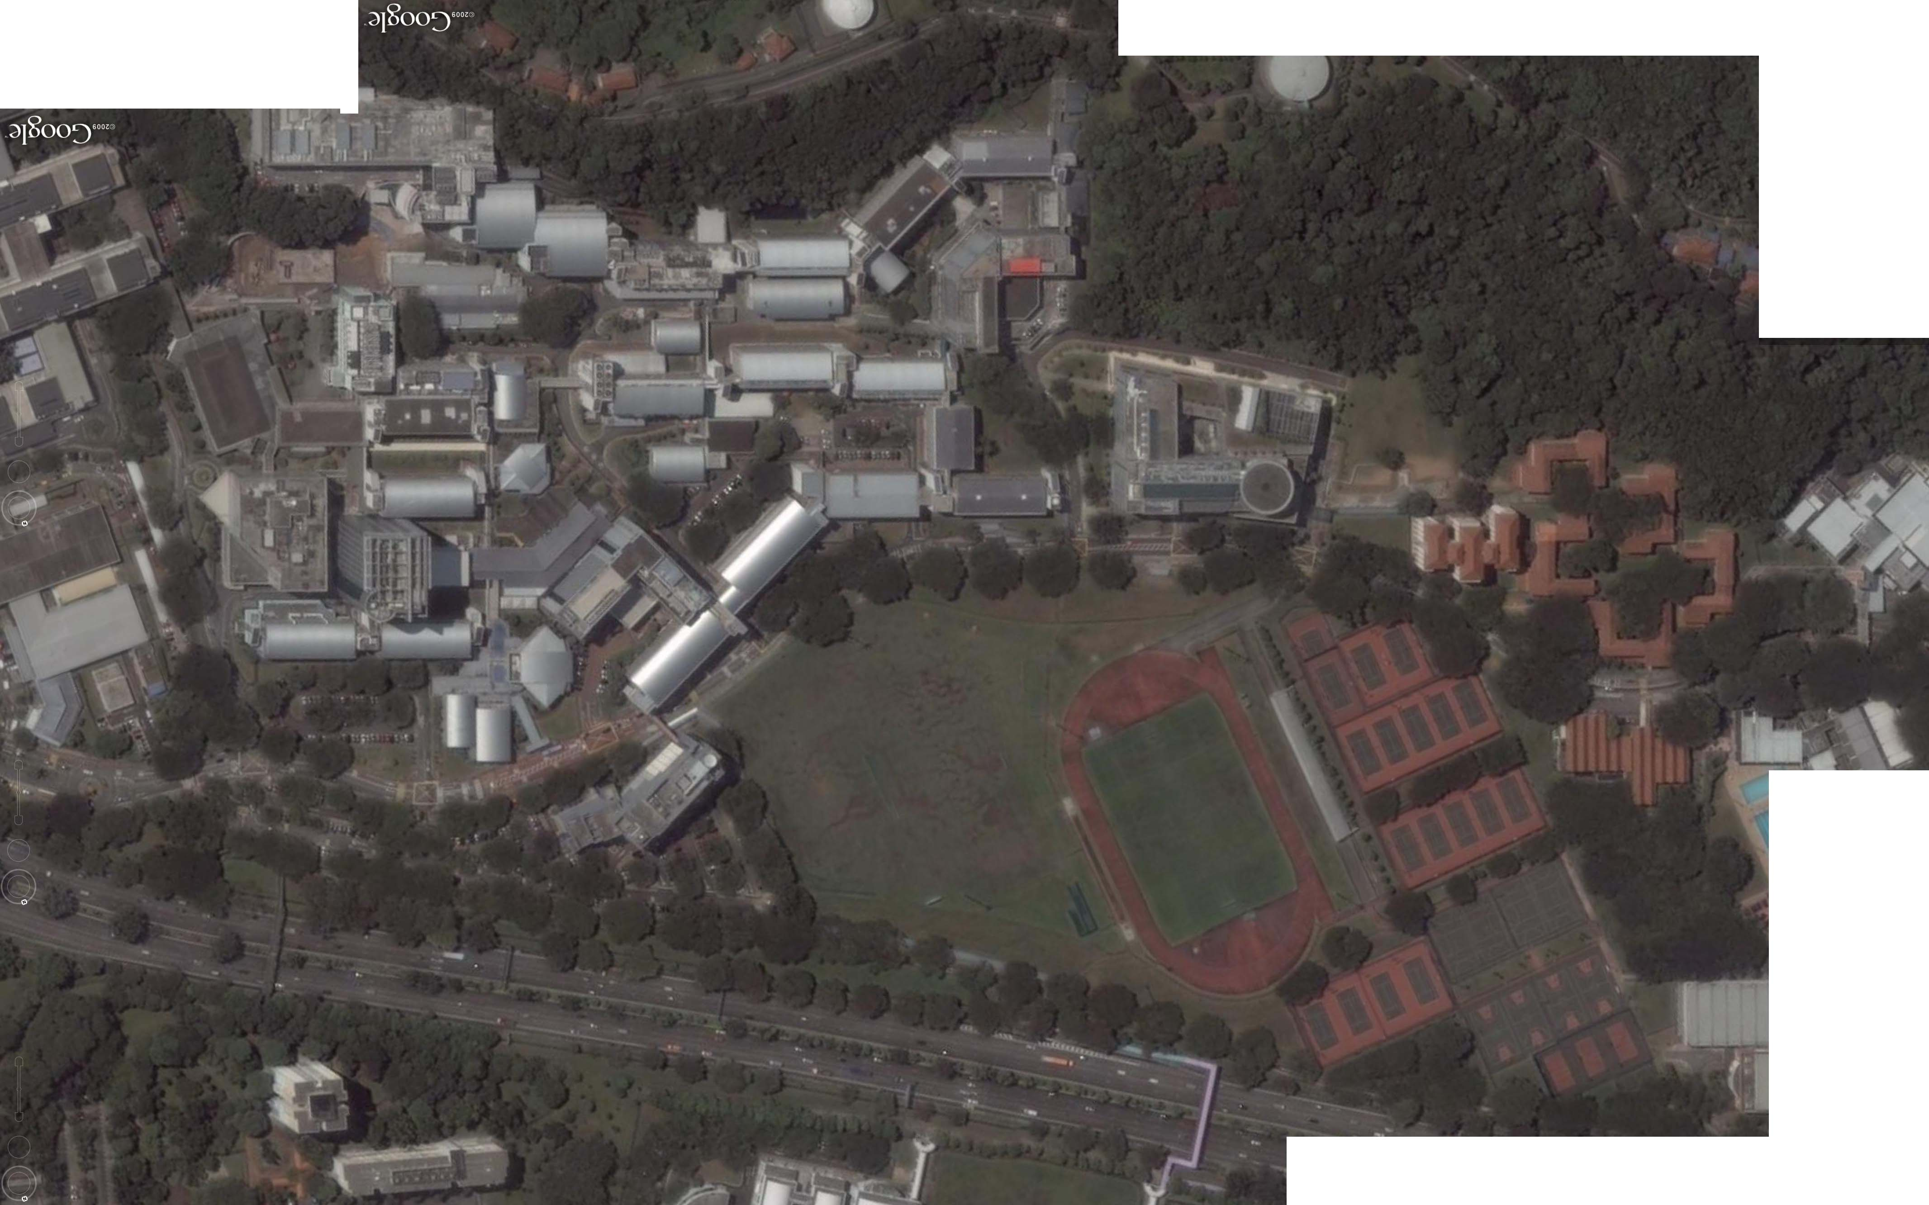
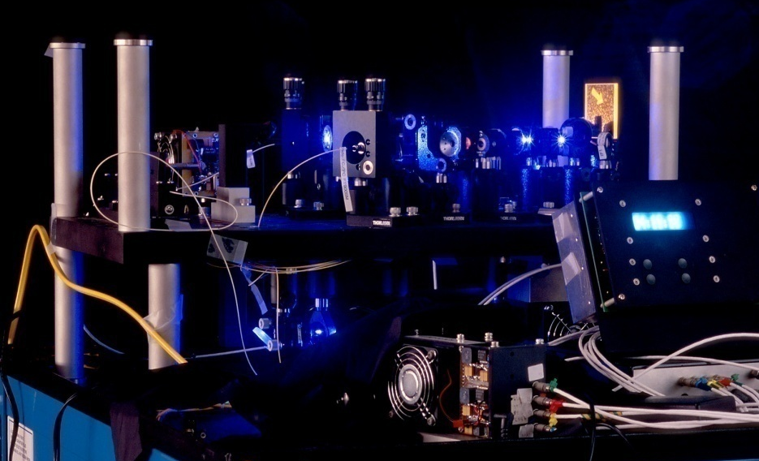
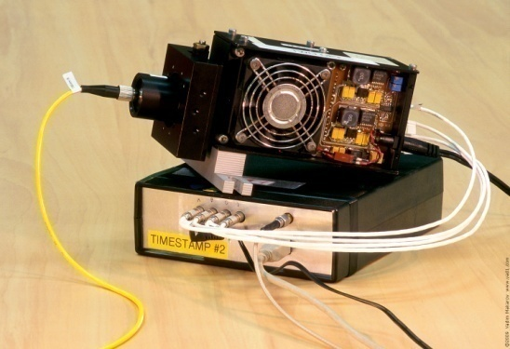
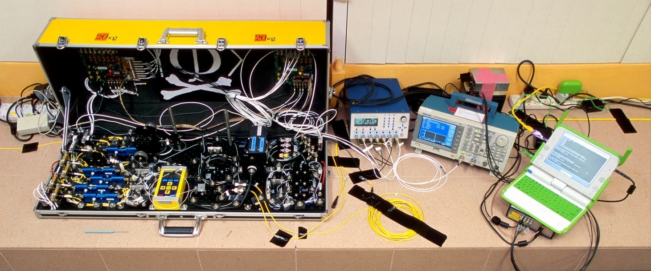
Eavesdropping 100% key on installed QKD line on campus of the National University of Singapore, July 4–5, 2009
290 m of fiber
Eve
S14
S13
Bob
Alice
S12
S15
Image © 2009 DigitalGlobe
I. Gerhardt, Q. Liu et al.,
Nat. Commun. 2, 349 (2011)

Slide 52
Countermeasures to detector attacks
Alice
Charlie (untrusted)
Bob
EPR
EPR
BSM
EPR
Photon
source
Photon
source
Mod.
BSM
Mod.
RNG
RNG
Measurement-device-independent QKD
H.-K. Lo, M. Curty, B. Qi, Phys. Rev. Lett. 108, 130503 (2012)
1st experimental demonstration, over 18 km fiber: A. Rubenok et al., arXiv:1204.0738v2

Slide 53
Industrial countermeasure (ID Quantique)
First commercial Clavis1 system is shipped to a customer
Report about detector blinding attack sent to IDQ
IDQ applies for a patent on randomization of detector efficiency
as a countermeasure
Lim et al. upload a preprint about countermeasure arXiv:1408.6398
Implementation of countermeasure delivered by IDQ to our lab
(firmware update for Clavis2)
Testing report sent to IDQ proposing a modified attack that works
Testing report sent to IDQ showing full implementation of
countermeasure to be unreliable
A. Huang et al., arXiv:1601.00993

Slide 54
Randomly varying detector efficiency
V_{APD}
Click
Click
V_{APD}
Click
Click
Alarm!
M. Legre, G. Robordy, Intl. patent appl. WO 2012/046135 A2 (filed in 2010)

Slide 55
Oscillograms at comparator input
A. Huang et al., arXiv:1601.00993

Slide 56
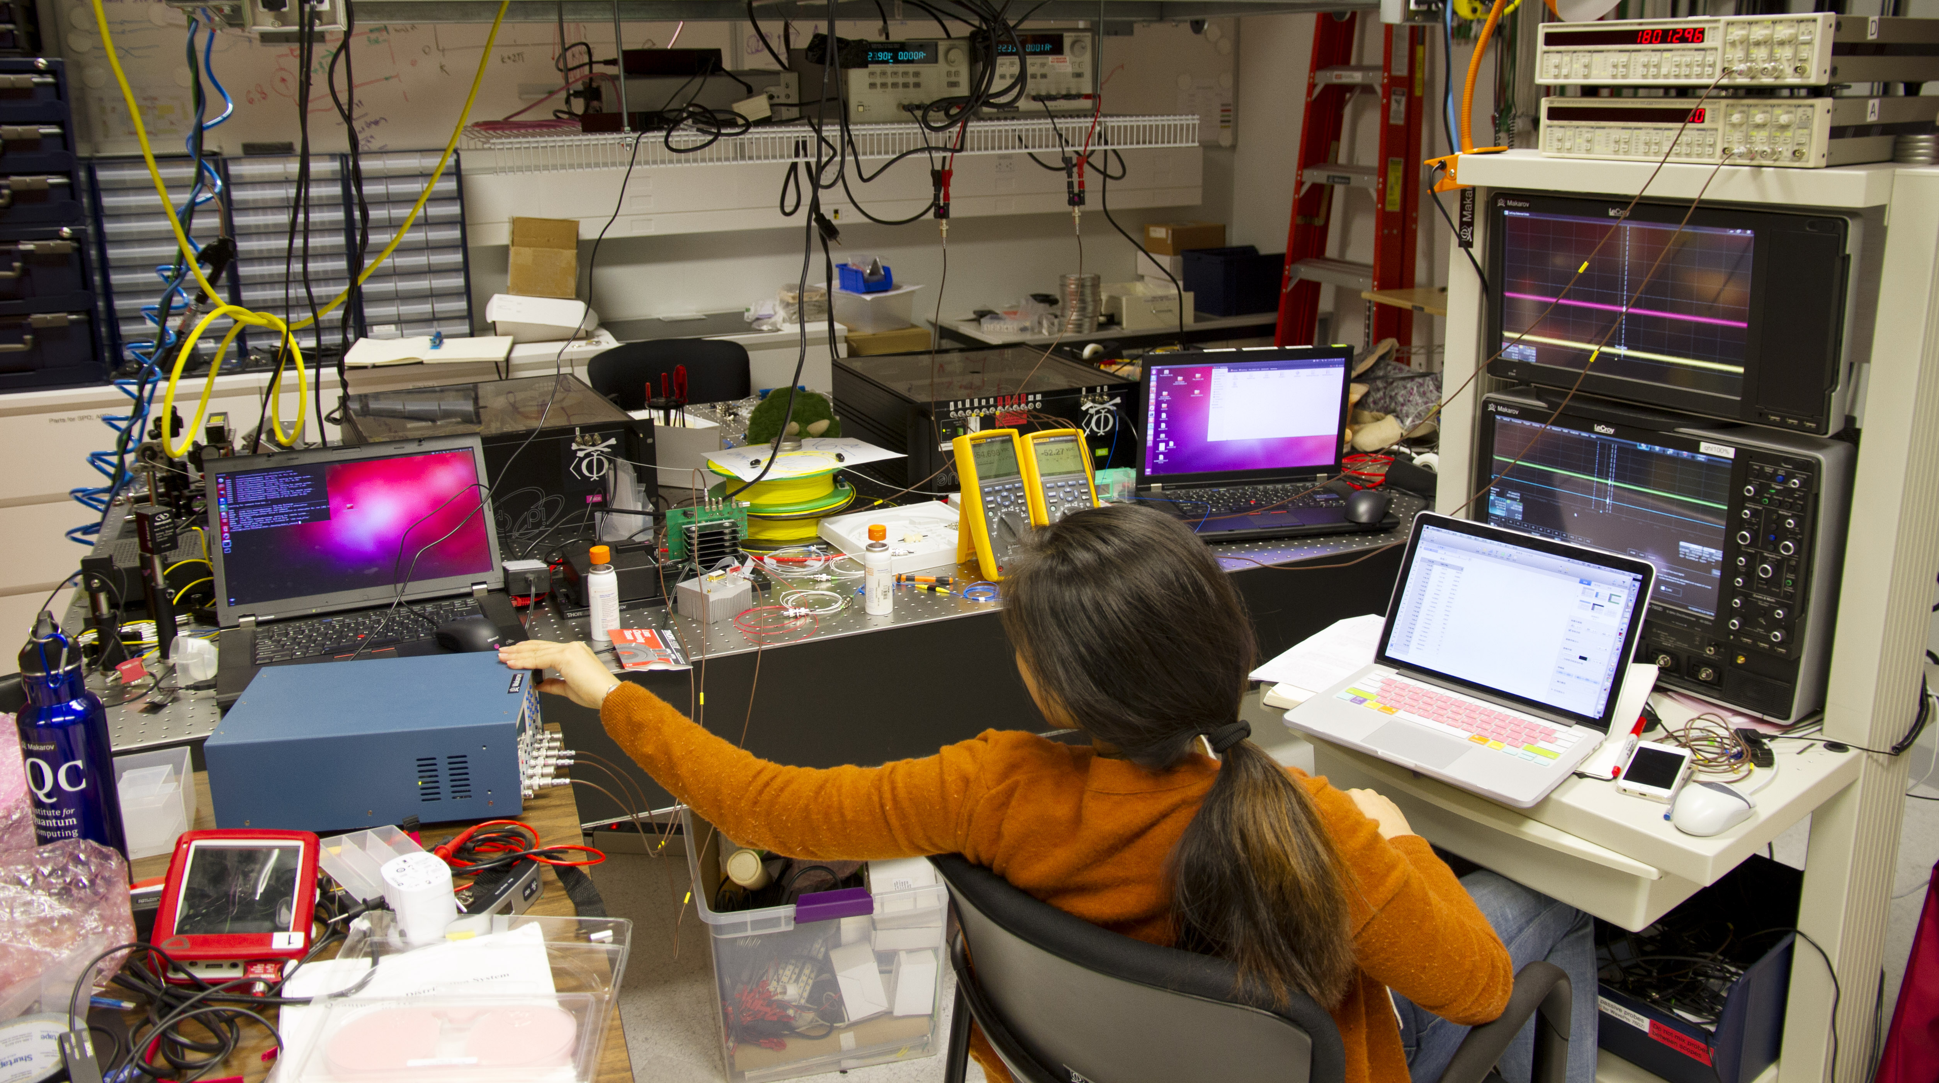
Anqi Huang tests countermeasure in Clavis2
Photo © 2015 Vadim Makarov

Slide 57

Lesson 1. Industry needs implementation standards, certification and testing standards.
Once equipment is tested and certified,
end of story?
Can Eve modify equipment after installation?
Crypto module
Optical line

Slide 58
Efficiency mismatch in QKD receiver
S. Sajeed et al., Phys. Rev. A 91, 062301 (2015)
V. Makarov et al., arXiv:1510.03148

Slide 59
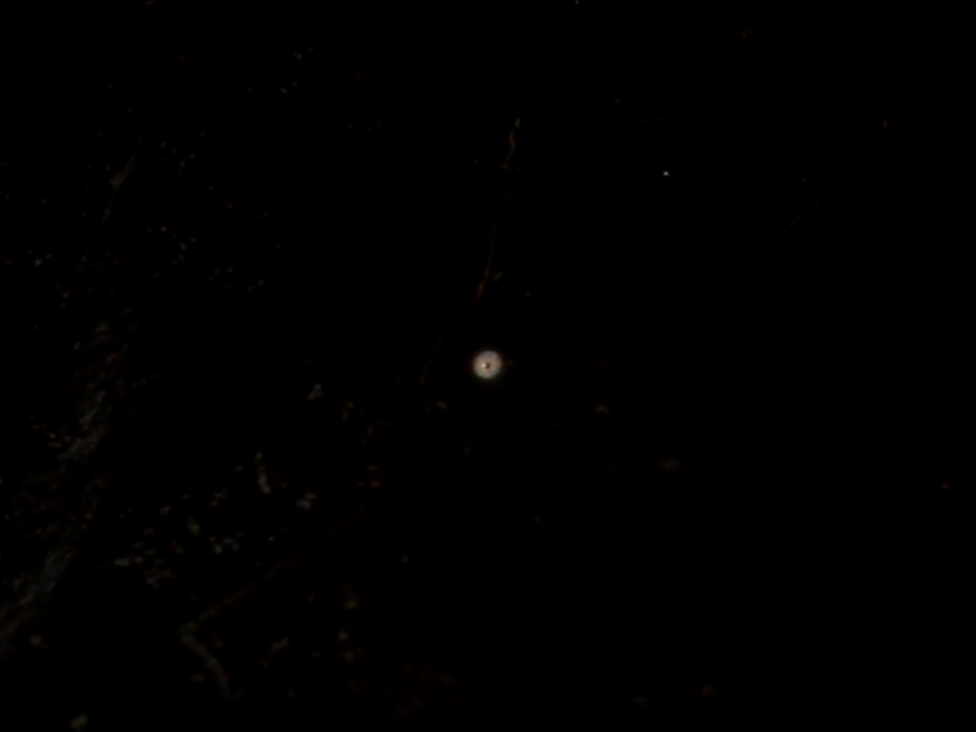
Thorlabs P20S pinhole
13 μm thick stainless steel
3.6 W, 810 nm laser
0
1 mm
* Sound was added later

Slide 60
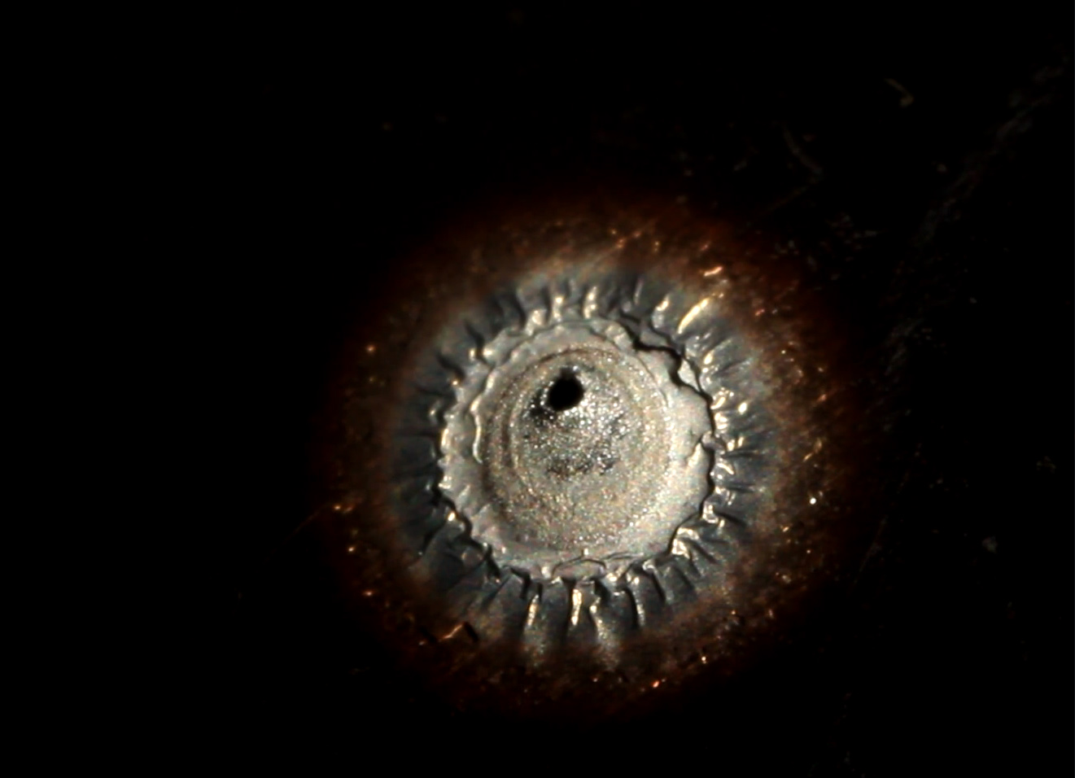
Thorlabs P20S pinhole
13 μm thick stainless steel
3.6 W, 810 nm laser
0
1 mm
* Sound was added later

Slide 61
Detector efficiency with laser-damaged pinhole
V. Makarov et al., arXiv:1510.03148

Slide 62
Can we eavesdrop on commercial systems?
ID Quantique’s Cerberis:
Dual key agreement
QKD
BB84
QKD
PKI
RSA-2048
PKI
Key
Key
Symmetric
cipher
AES-256
Symmetric
cipher
Photo © 2010 Vadim Makarov

Slide 63
Kerckhoffs’ principle
Alice
Future technology
Bob
characteristics known
characteristics known
Il faut qu’il n’exige pas le secret, et qu’il puisse sans inconvénient tomber entre les mains de l’ennemi
A. Kerckhoffs, J. des Sciences Militaires IX, 5 (1883)
Everything about the system that is not explicitly secret is known to the enemy

Slide 64
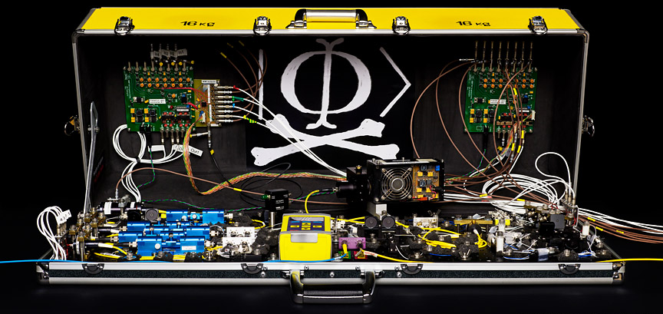
Eavesdropping in real life?
Future technology
Alice
Future technology
Bob
Alice
Future technology
Bob
Many papers
characteristics known
characteristics known
Alice
Today’s technology
(modeled)
Bob
characteristics known
characteristics known
Many papers
characteristics measured
characteristics measured
Alice
Implemented
Bob
characteristics measured
characteristics measured
I. Gerhardt et al., Nat. Commun. 2, 349 (2011)
Alice
Implemented
Bob
Not yet :)
no access
no access

Slide 65
Conclusion
Physics promises unbreakable cryptography, but implementing it with our rudimentary quantum technology is a research challenge.

Slide 66
Suggested reading
Introduction to detector attacks and MDI-QKD
H.-K. Lo, M. Curty, K. Tamaki, Nat. Photonics 8, 595 (2014), 10 pages
Review of more hacking techniques
N. Jain et al., Contemp. Phys. 57, 366 (2016), 22 pages
Reviews are incomplete. If you are engineering a system, read original literature (or ask for my expert advice).

Slide 67


