Slide 1
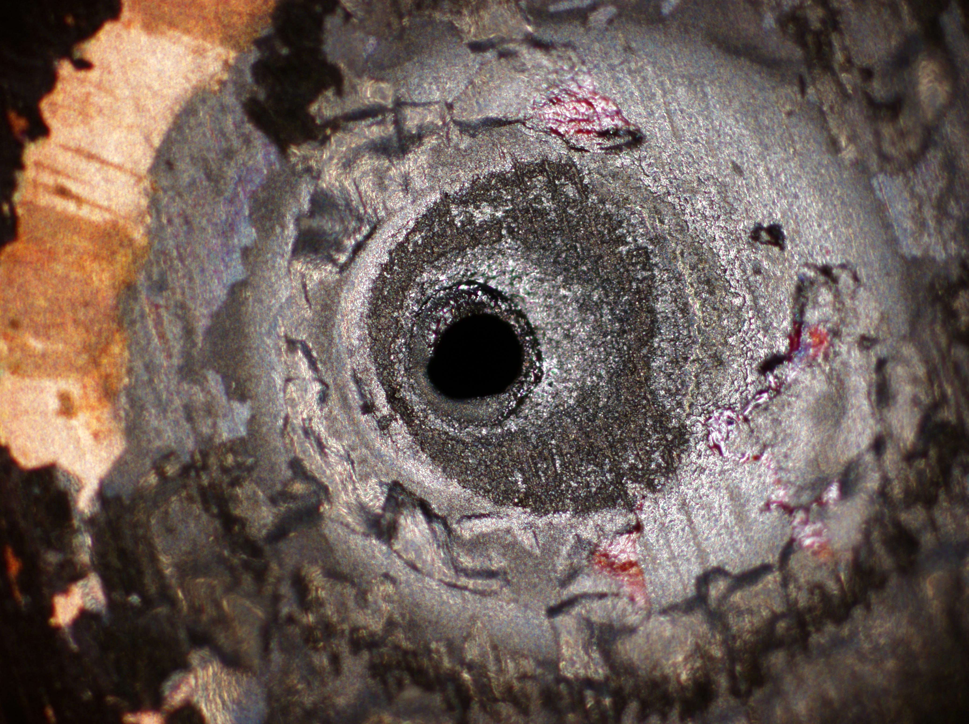
Tutorial at QCrypt, September 12-16, 2016
Challenges to physical security
of
today’s quantum technologies
Vadim Makarov www.vad1.com/lab

Slide 2
A (very) brief history of cryptography
 |  |  |  |  | Broken?
Monoalphabetic cipher |  | invented ~50 BC (J. Caesar) |  |  | ~850 (Al-Kindi)
Nomenclators (code books) |  | ~1400 – ~1800 |  |  | ✓
Polyalphabetic (Vigenère) |  | 1553 – ~1900 |  |  | 1863 (F. W. Kasiski)
···
One-time pad |  | invented 1918 (G. Vernam) |  |  | impossible (C. Shannon 1949)
Polyalphabetic electromechanical (Enigma, Purple, etc.) |  | 1920s – 1970s |  |  | ✓
···
DES |  | 1977 – 2005 |  |  | 1998: 56 h (EFF)
Public-key crypto (RSA, elliptic-curve) |  |  | 1977 – |  | will be once we have q. computer (P. Shor 1994)
AES |  | 2001 – |  |  | ?
Quantum cryptography | invented 1984, in development |  |  |  |  | impossible
Public-key crypto (‘quantum-safe’) |  | in development |  |  | ?
 |  |  |  |  | Broken?
Monoalphabetic cipher |  | invented ~50 BC (J. Caesar) |  |  | ~850 (Al-Kindi)
Nomenclators (code books) |  | ~1400 – ~1800 |  |  | ✓
Polyalphabetic (Vigenère) |  | 1553 – ~1900 |  |  | 1863 (F. W. Kasiski)
···
Polyalphabetic electromechanical (Enigma, Purple, etc.) |  | 1920s – 1970s |  |  | ✓
···
DES |  | 1977 – 2005 |  |  | 1998: 56 h (EFF)
Public-key crypto (RSA, elliptic-curve) |  |  | 1977 – |  | will be once we have q. computer (P. Shor 1994)
AES |  | 2001 – |  |  | ?
Public-key crypto (‘quantum-safe’) |  | in development |  |  | ?


Slide 3



Security model of QKD
Alice
Bob
1
Secret key rate $R=f\left(\text{QBER}\right)$
R
0
0
0.11
QBER
Security proof
.Laws of physics & Model of equipment

Slide 4
Security model of QKD
Security proof
.Laws of physics & Model of equipment
Integrate imperfection into security model
Hack
Security proof
.Laws of physics & Model of equipment

Slide 5
Attack | Target component | Tested system
Laser damage | any | ID Quantique, research system
V. Makarov et al., arXiv:1510.03148
Spatial efficiency mismatch | receiver optics | research system
M Rau et al., IEEE J. Quantum Electron. 21, 6600905 (2015); S. Sajeed et al., Phys. Rev. A 91, 062301 (2015)
Pulse energy calibration | classical watchdog detector | ID Quantique
S. Sajeed et al., Phys. Rev. A 91, 032326 (2015)
Trojan-horse | phase modulator in Alice | SeQureNet
I. Khan et al., presentation at QCrypt (2014)
Trojan-horse | phase modulator in Bob | ID Quantique*
N. Jain et al., New J. Phys. 16, 123030 (2014)
Detector saturation | homodyne detector | SeQureNet
H. Qin, R. Kumar, R. Alleaume, Proc. SPIE 88990N (2013)
Shot-noise calibration | classical sync detector | SeQureNet
P. Jouguet, S. Kunz-Jacques, E. Diamanti, Phys. Rev. A 87, 062313 (2013)
Wavelength-selected PNS | intensity modulator | (theory)
M.-S. Jiang, S.-H. Sun, C.-Y. Li, L.-M. Liang, Phys. Rev. A 86, 032310 (2012)
Multi-wavelength | beamsplitter | research system
H.-W. Li et al., Phys. Rev. A 84, 062308 (2011)
Deadtime | single-photon detector | research system
H. Weier et al., New J. Phys. 13, 073024 (2011)
Channel calibration | single-photon detector | ID Quantique
N. Jain et al., Phys. Rev. Lett. 107, 110501 (2011)
Faraday-mirror | Faraday mirror | (theory)
S.-H. Sun, M.-S. Jiang, L.-M. Liang, Phys. Rev. A 83, 062331 (2011)
Detector control | single-photon detector | ID Quantique, MagiQ, research system
I. Gerhardt et al., Nat. Commun. 2, 349 (2011); L. Lydersen et al., Nat. Photonics 4, 686 (2010)
* Attack did not break security of the tested system, but may be applicable to a different implementation.

Slide 6
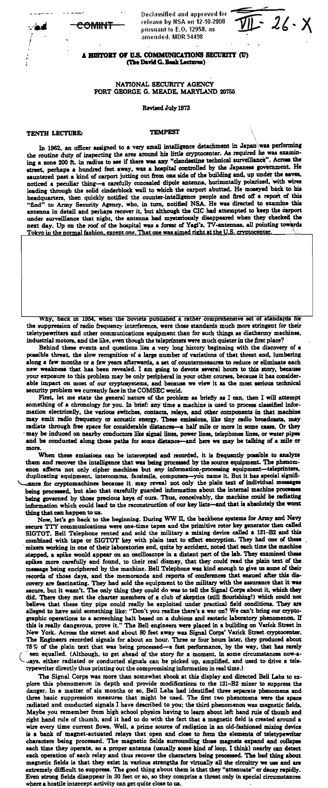

Slide 8
Today’s digital
Crypto module
Bus
Memory
Software
Bus
Signal proc.
DAC
Amplifier
vs. quantum
Crypto module
Optical line
[vs. future quantum]
Crypto module
Quantum bus, computer, memory...

Slide 9
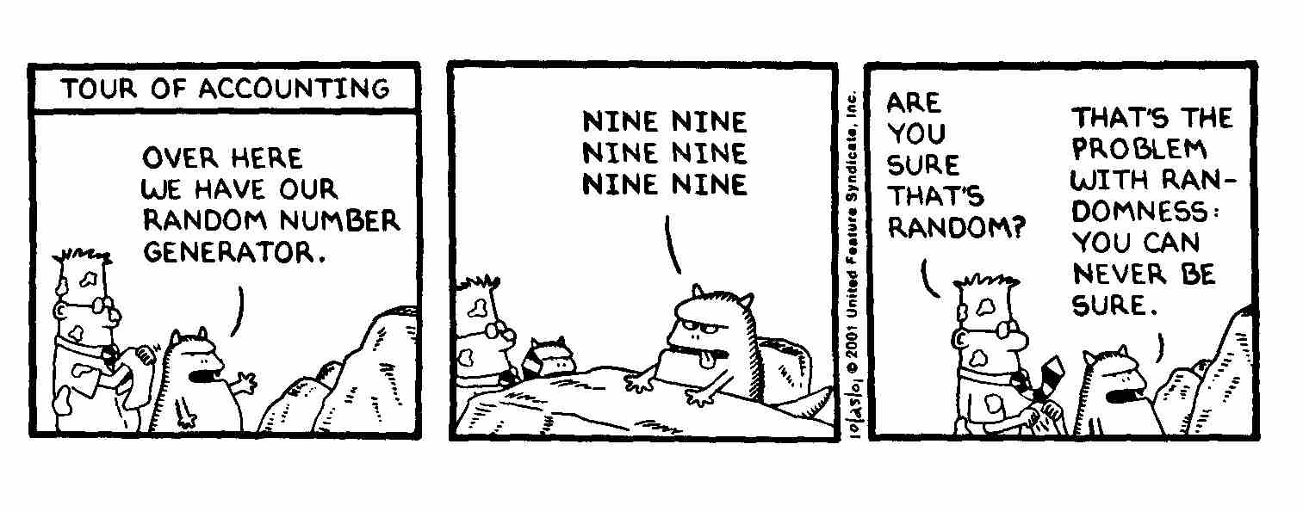
True randomness?
Quantis
RNG
FPGA
Phase modulator in Bob
id Quantique Clavis2 (2008)
OK
V_{π}/2
0
ONE ONE ONE
ONE ONE ONE
ONE ONE ONE

Slide 10
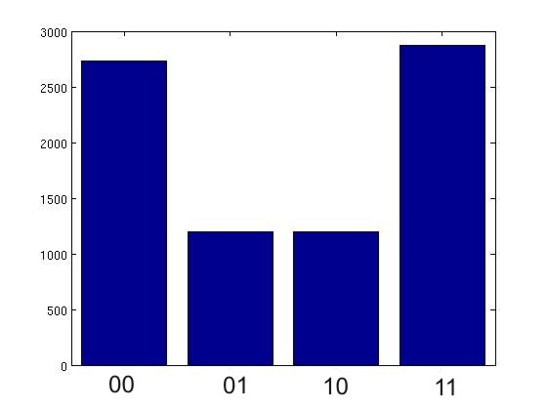
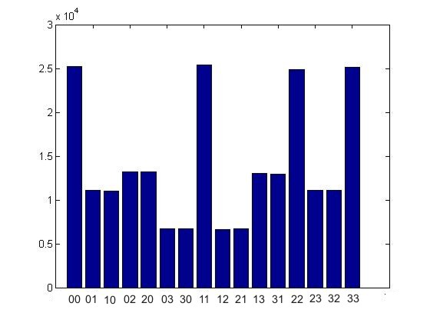
True randomness?
Quantis
RNG
FPGA
Phase modulator in Bob
id Quantique Clavis2 (2008)
V_{π}/2
0
Bob:
Alice:
Issue reported patched in 2010

Slide 11
Do we trust the manufacturer?
Quantis RNG
Quantis RNG, Trojan-horsed :)
*
*
Memory with
pre-recorded
random
sequence
Clicks
processed
Clicks
processed
Random
stream
Random
stream
Switch
Many components in QKD system can be Trojan-horsed:
– access to secret information
– electrical power
– way to communicate outside or compromise security

Slide 12
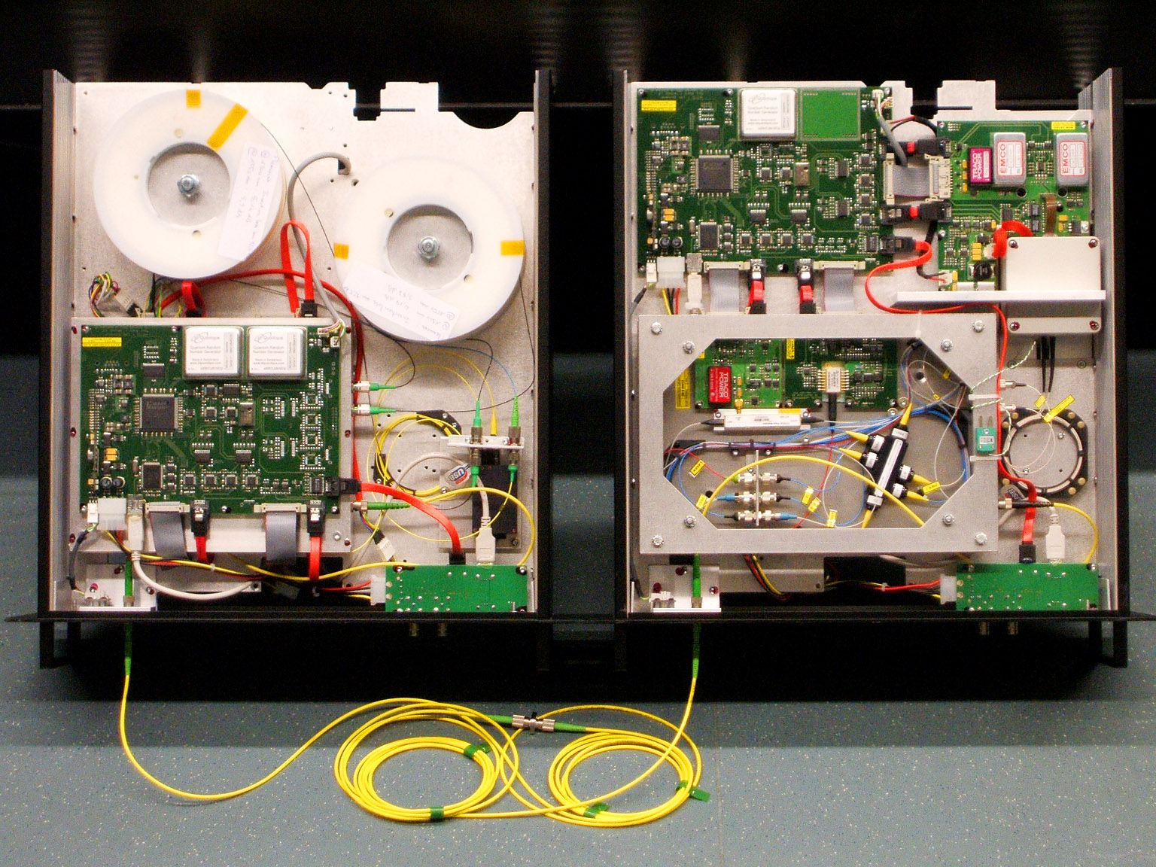
ID Quantique Clavis2 QKD system
Alice
Bob
Photo © 2008 Vadim Makarov. Published with approval of ID Qiantique

Slide 13
Double clicks
– occur naturally because of detector dark counts, multi-photon pulses...
Discard them?
Intercept-resend attack... with a twist:
Bob:
Detects in
Eve’s basis:
single click
Eve
100
photons
Alice
Bob´
Alice´
Detects in
conjugate basis:
double click,
discarded
Proper treatment for double clicks: assign a random bit value.
N. Lütkenhaus, Phys. Rev. A 59, 3301 (1999)
T. Tsurumaru & K. Tamaki, Phys. Rev. A 78, 032302 (2008)

Slide 14
Trojan-horse attack
Alice
Phase modulator
Attenuator
Alice’s
PC
Line
Eve’s equipment
– interrogating Alice’s phase modulator with powerful
external pulses (can give Eve bit values directly)

Slide 15
Trojan-horse attack experiment
Alice
4% reflection
Phase modulator
Laser
V_{mod}
Eve
L₁
OTDR
Out
Received OTDR pulse
Variable attenuator
In
L₂
Fine length adjustment
to get L₁ = L₂
0
4.1
8.2
V_{mod}, V
A. Vakhitov et al., J. Mod. Opt. 48, 2023 (2001)

Slide 16
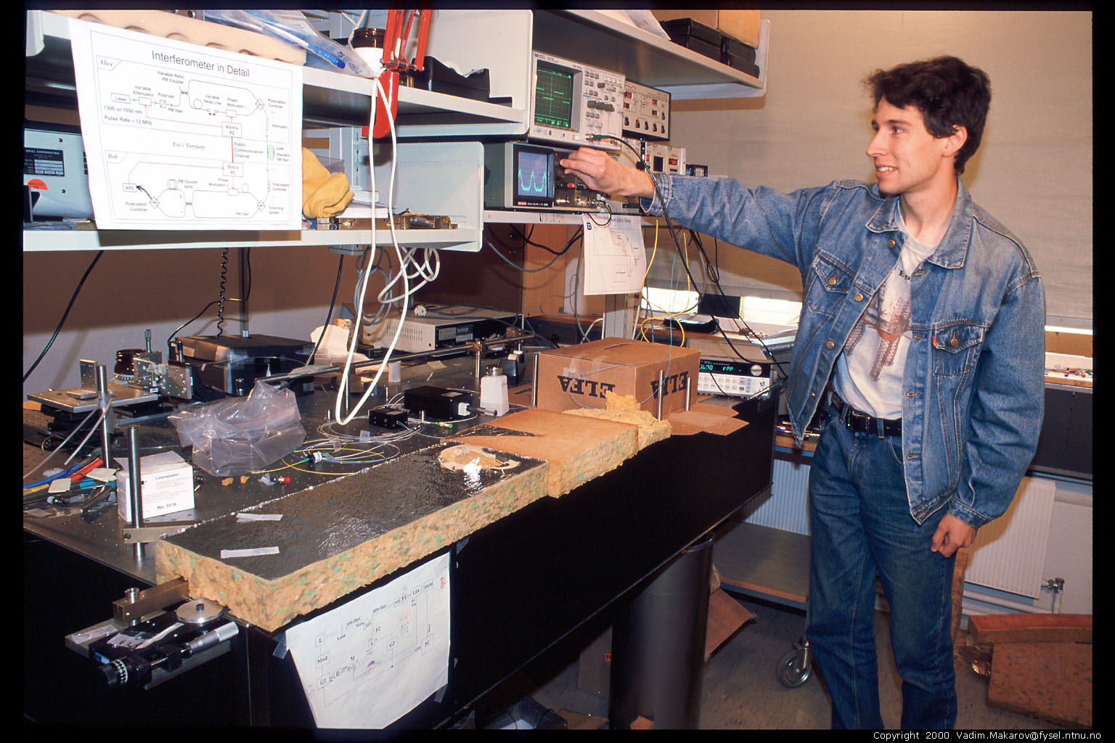
Artem Vakhitov tunes up Eve’s setup
Photo © 2000 Vadim Makarov

Slide 17
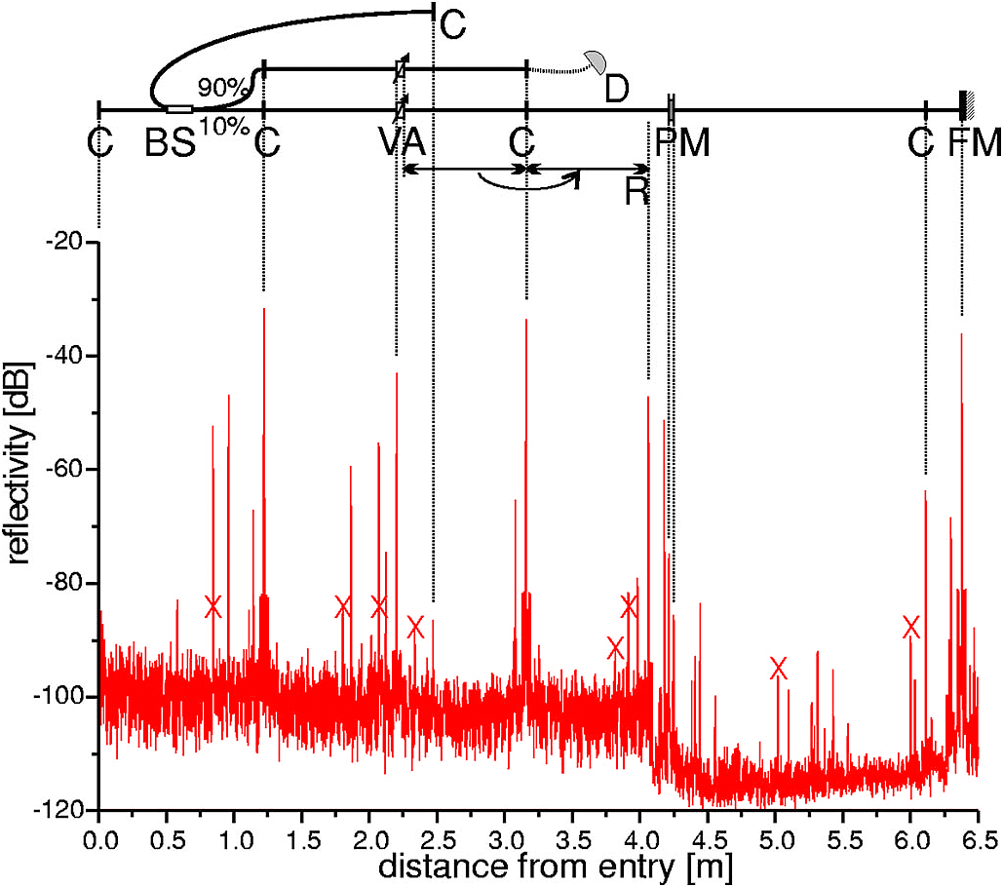
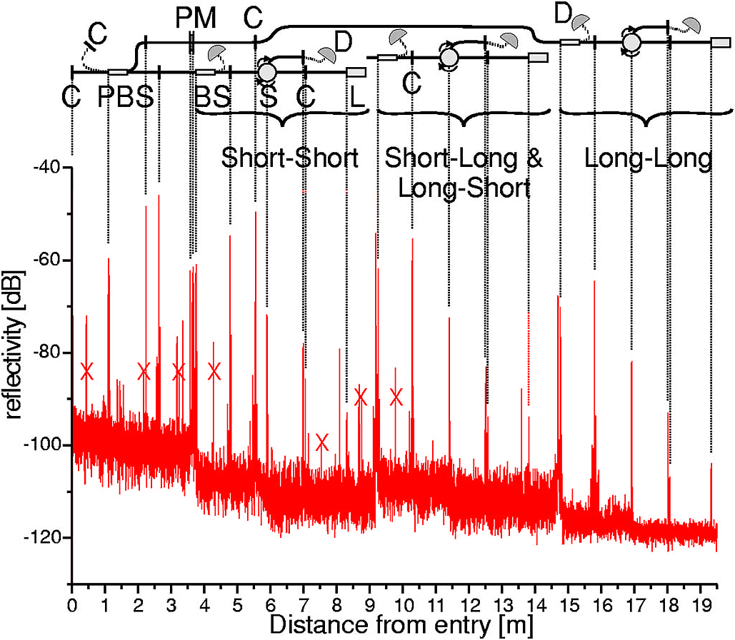
Trojan-horse attack for plug-and-play system
Alice
Bob
Eve gets back one photon → in principle, extracts 100% information
N. Gisin et al., Phys. Rev. A 73, 022320 (2006)

Slide 18
Countermeasures?
Alice
Bob
DL
ϕ
VOA
B
BS
C
FM
ϕ
PBS
L
A
sync
D0
D1
D. Stucki et al., New J. Phys. 4, 41 (2002)

Slide 19
Countermeasures for plug-and-play system
Alice
Bob
DL
ϕ
VOA
B
BS
C
FM
ϕ
PBS
L
A
sync
D0
D1
1. Pulse-energy-monitoring detector
2. Narrowpass
(∼1 nm) filter
None
(one consequence: SARG
protocol may be insecure)
S. Sajeed et al., Phys. Rev. A 91, 032326 (2015)
N. Jain et al., New J. Phys. 16, 123030 (2014)

Slide 20
Trojan-horse attack on Bob
Bob
2×10⁶
photons
ϕ
∼ −50 dB
B
BS
Bob
C
PBS
ϕ
L
−57 dB
4 photons
B
BS
C
D0
D1
ϕ
PBS
L
B
readout
D0
D1
N. Jain et al., New J. Phys. 16, 123030 (2014)

Slide 21
Trojan-horse attack on Bob
Bob
1924 nm
ϕ
B
BS
C
PBS
L
D0
D1
ϕ
B
readout
S. Sajeed et al., unpublished

Slide 22
Countermeasures for plug-and-play system
Alice
Bob
DL
ϕ
VOA
B
BS
C
FM
ϕ
PBS
L
A
sync
D0
D1
1. Pulse-energy-monitoring detector
2. Narrowpass
(∼1 nm) filter
None
(one consequence: SARG
protocol may be insecure)
S. Sajeed et al., Phys. Rev. A 91, 032326 (2015)
N. Jain et al., New J. Phys. 16, 123030 (2014)

Slide 23
Pulse-energy-monitoring detector
Theory:
Implementation:
S. Sajeed et al., Phys. Rev. A 91, 032326 (2015)

Slide 24
Pulse-energy-monitoring detector
“Certification standard” (internal by ID Quantique):
S. Sajeed et al., Phys. Rev. A 91, 032326 (2015)

Slide 25
Pulse-energy-monitoring detector
Theory:
Implementation:
S. Sajeed et al., Phys. Rev. A 91, 032326 (2015)

Slide 26
Pulse-energy-monitoring detector
Theory:
Attack:
S. Sajeed et al., Phys. Rev. A 91, 032326 (2015)

Slide 27
Lesson 1. Industry needs implementation standards, certification and testing standards.
ETSI industry specification group for QKD
First security standard: Trojan-horse in one-way system
R. Alléaume et al., Proc. IEEE Globecom Workshop 2014, p. 656
Alice
Isolator(s)
BPF
Att.


M. Lucamarini et al., Phys. Rev. X 5, 031030 (2015)

Slide 28
Example of vulnerability and countermeasures
Photon-number-splitting attack
C. Bennett, F. Bessette, G. Brassard, L. Salvail, J. Smolin, J. Cryptology 5, 3 (1992)
G. Brassard, N. Lütkenhaus, T. Mor, B. C. Sanders, Phys. Rev. Lett. 85, 1330 (2000)
N. Lütkenhaus, Phys. Rev. A 61, 052304 (2000)
S. Félix, N. Gisin, A. Stefanov, H. Zbinden, J. Mod. Opt. 48, 2009 (2001)
N. Lütkenhaus, M. Jahma, New J. Phys. 4, 44 (2002)
Decoy-state protocol
W.-Y. Hwang, Phys. Rev. Lett. 91, 057901 (2003)
SARG04 protocol
V. Scarani, A. Acín, G. Ribordy, N. Gisin, Phys. Rev. Lett. 92, 057901 (2004)
Distributed-phase-reference protocols
K. Inoue, E. Waks, Y. Yamamoto, Phys. Rev. Lett. 89, 037902 (2002)
K. Inoue, E. Waks, Y. Yamamoto, Phys. Rev. A. 68, 022317 (2003)
N. Gisin, G. Ribordy, H. Zbinden, D. Stucki, N. Brunner, V. Scarani, arXiv:quant-ph/0411022v1 (2004)
Laser
Attenuator

Slide 29
Attack example: avalanche photodetectors (APDs)
I
Linear mode
Geiger mode
I
I_{th}
P_{th}
P_{opt}
Quenching
I_{th}
Single photon
V
Breakdown
voltage V_{br}

Slide 30
Detector deadtime attack
Eve
Bob
× N
Alice
BS
λ/2
PBS
PBS
Deadtime
Sensitivity
Time
H. Weier et al., New J. Phys. 13, 073024 (2011)

Slide 31
Attack example: avalanche photodetectors (APDs)
I
Linear mode
Geiger mode
I
I_{th}
P_{th}
P_{opt}
Quenching
I_{th}
Single photon
V
Breakdown
voltage V_{br}

Slide 32
Faked-state attack in APD linear mode
Identical bases & bit values
Eve
Bright
state
Alice
.Bob´
.Alice´
Bob
Listen, do same,
get same final key
Classical post-processing
Bob chooses same basis as Eve:
Bob chooses different basis:
“0”
I
0
“0
”
I
0
I
th
I
th
Click!
t
t
“1
”
I
1
“1
”
I
1
I
th
I
th
t
t
L. Lydersen, C. Wiechers, C. Wittmann, D. Elser, J. Skaar, V. Makarov, Nat. Photonics 4, 686 (2010)

Slide 33

Blinding APD with bright light
Eve applies CW light
Bias to APD
(V_{bias})
No light
V_{APD}
V_{br}
Detector blind!
Zero dark count rate
V_{bias}
R_{bias}
V_{HV} ≈ 40 V
0
t
2
647 μW
t
808 μW
Input
illumination,
mW
t
1.5
1
0.5
0
Logic 1
(never clicks)
(always clicks)
Detector
output
ID Quantique
Clavis2
Logic 0
-10
0
10
20
30
-10
0
10
20
30
Time, ns
Time, ns
L. Lydersen, C. Wiechers, C. Wittmann, D. Elser, J. Skaar, V. Makarov, Nat. Photonics 4, 686 (2010)

Slide 34
Proposed full eavesdropper
Eve
Optical
Alice
Bob´
Alice´
amplifier
Bob
Basis
Basis
Detection result
Bit in
Blinding laser
Note: Intercept-resend always breaks QKD security
M. Curty, M. Lewenstein, N. Lütkenhaus, Phys. Rev. Lett. 92, 217903 (2004)

Slide 35
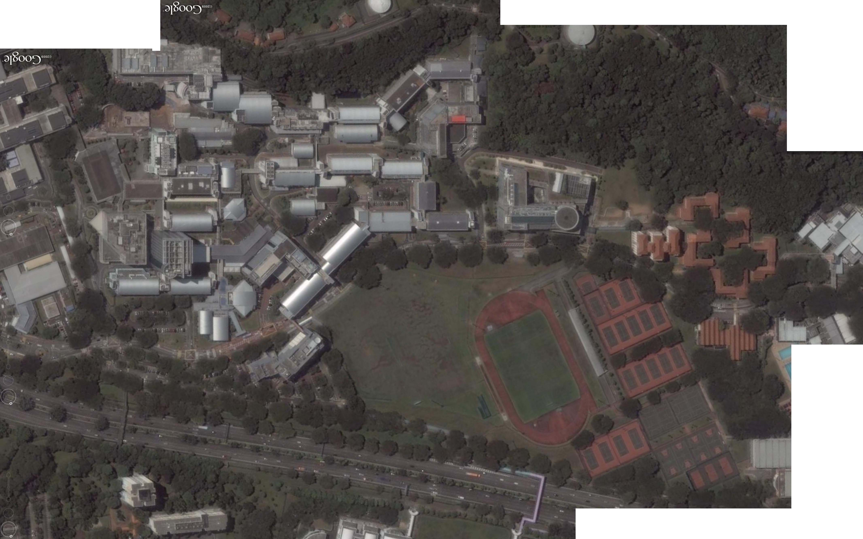
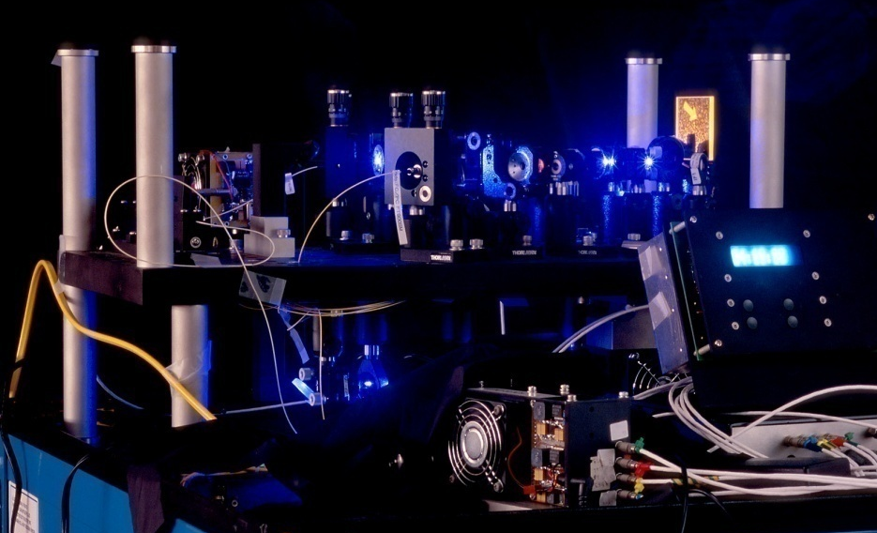
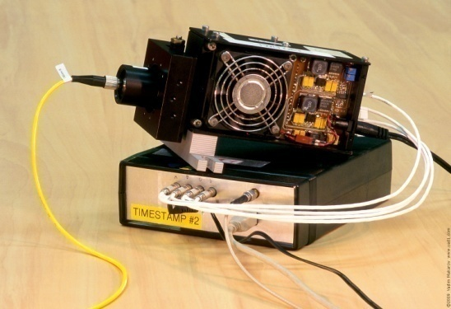
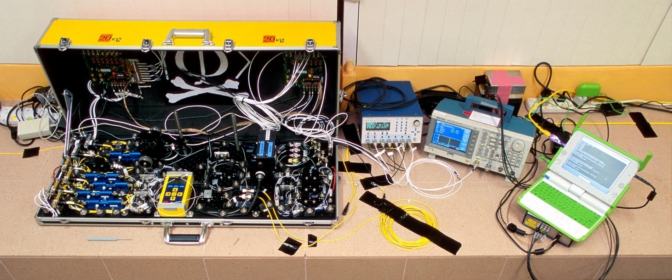
Eavesdropping 100% key on installed QKD line on campus of the National University of Singapore, July 4–5, 2009
290 m of fiber
Eve
S14
S13
Bob
Alice
S12
S15
Image © 2009 DigitalGlobe
I. Gerhardt, Q. Liu et al.,
Nat. Commun. 2, 349 (2011)

Slide 36
Perfect countermeasure to detector attacks
Alice
Charlie
(untrusted)
Bob
Photon
source
Bell-state
measurement
Photon
source
Mod.
Mod.
RNG
RNG
Measurement-device-independent QKD
H.-K. Lo, M. Curty, B. Qi, Phys. Rev. Lett. 108, 130503 (2012)

Slide 37
Industrial countermeasure (ID Quantique)
First commercial Clavis1 system is shipped to a customer
Report about detector blinding attack sent to IDQ
IDQ applies for a patent on randomization of detector efficiency
as a countermeasure
Lim et al. upload a preprint about countermeasure arXiv:1408.6398
Implementation of countermeasure delivered by IDQ to our lab
(firmware update for Clavis2)
Testing report sent to IDQ proposing a modified attack that works
Testing report sent to IDQ showing full implementation of
countermeasure to be unreliable
A. Huang et al., arXiv:1601.00993

Slide 38

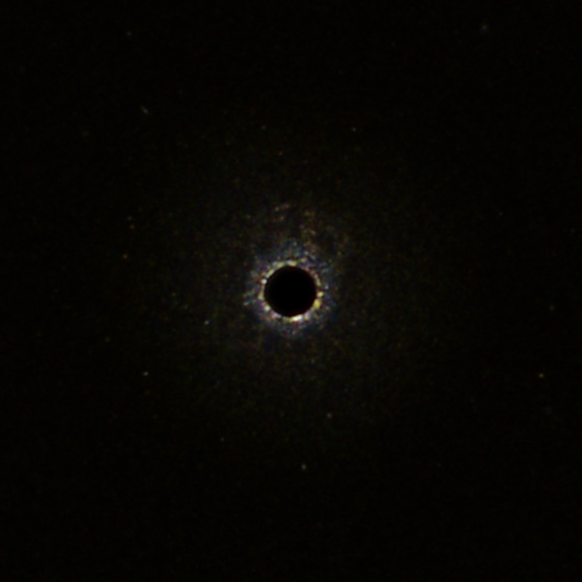
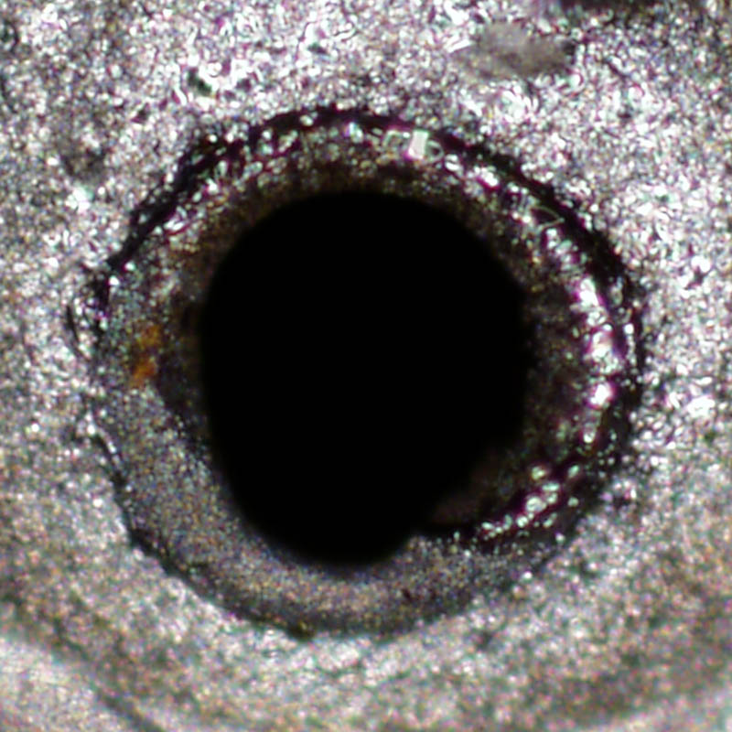
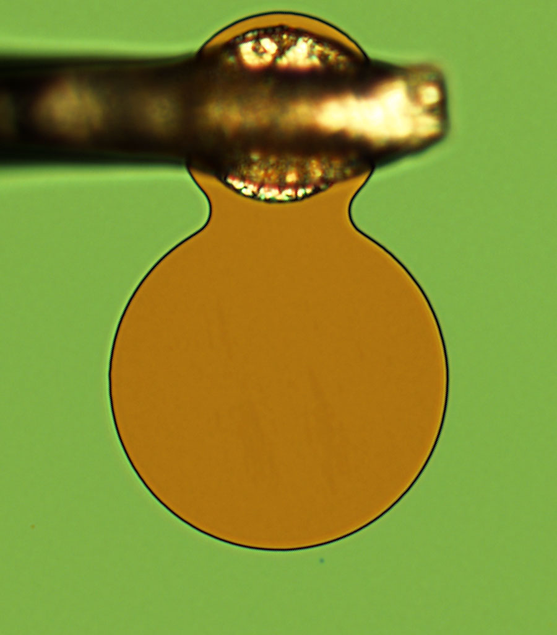
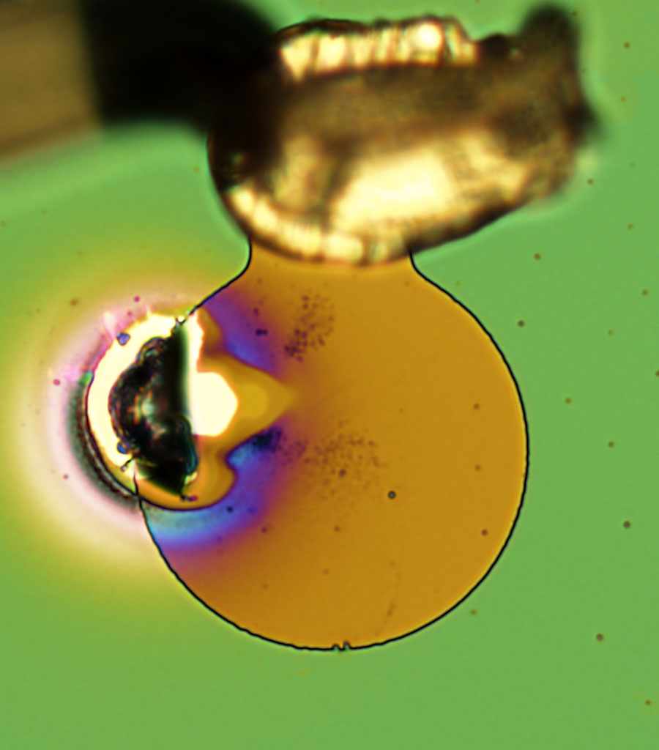
Once equipment is tested and certified, end of story?
Can Eve modify equipment after installation?
Laser damage
Crypto module
Optical line
V. Makarov et al., arXiv:1510.03148

Slide 39
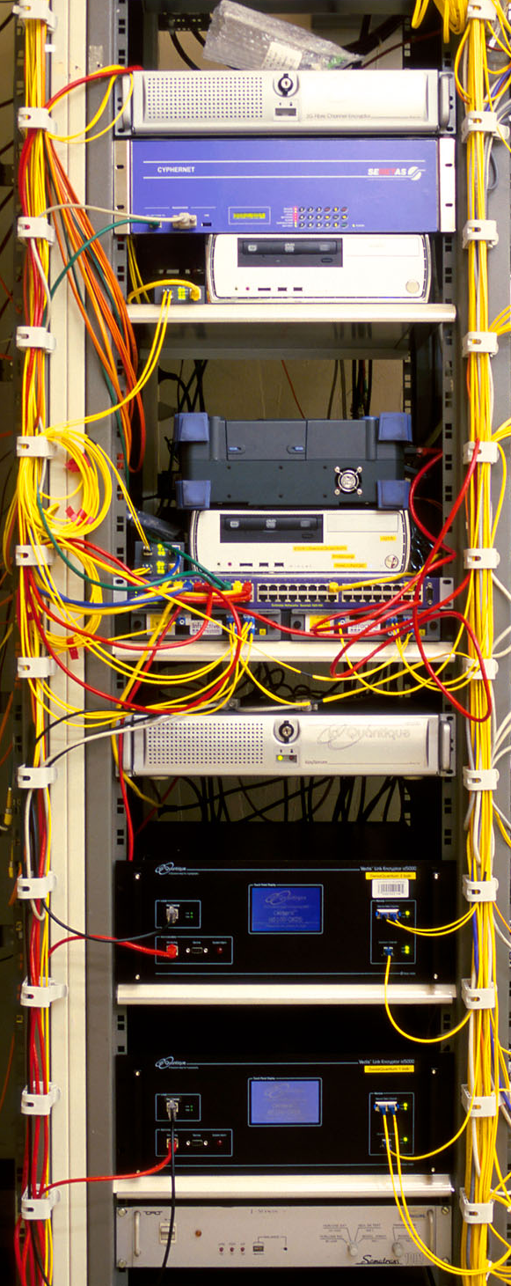
Can we eavesdrop on commercial systems?
ID Quantique’s Cerberis:
Dual key agreement
QKD
BB84
QKD
PKI
RSA-2048
PKI
Key
Key
Symmetric
cipher
AES-256
Symmetric
cipher
Photo © 2010 Vadim Makarov

Slide 40
Kerckhoffs’ principle
Alice
Future technology
Bob
characteristics known
characteristics known
Il faut qu’il n’exige pas le secret, et qu’il puisse sans inconvénient tomber entre les mains de l’ennemi
A. Kerckhoffs, J. des Sciences Militaires 9, 5 (1883)
Everything about the system that is not explicitly secret is known to the enemy

Slide 41
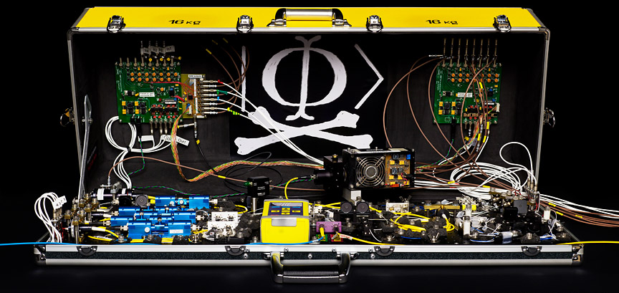
Eavesdropping in real life?
Future technology
Alice
Future technology
Bob
Alice
Future technology
Bob
Many papers
characteristics known
characteristics known
Alice
Today’s technology
(modeled)
Bob
characteristics known
characteristics known
Many papers
characteristics measured
characteristics measured
Alice
Implemented
Bob
characteristics measured
characteristics measured
I. Gerhardt et al., Nat. Commun. 2, 349 (2011)
Alice
Implemented
Bob
Not yet :)
no access
no access

Slide 42





What about device-independent protocols?
$$x$$
$$y$$
Eve
Alice
↑
Bob
$$a$$
$$P\left(a,b | x,y\right)$$
$$b$$
Assumptions:
1. No information-leakage channels
2. No memory
J. Barrett, R. Colbeck, A. Kent, Phys. Rev. Lett. 110, 010503 (2013)
V. Makarov et al., arXiv:1510.03148

Slide 43
Conclusion
Physics promises unbreakable cryptography, but implementing it with our rudimentary quantum technology is a research challenge.

Slide 44
Suggested reading
Introduction to detector attacks and MDI-QKD
H.-K. Lo, M. Curty, K. Tamaki, Nat. Photonics 8, 595 (2014), 10 pages
Review of more hacking techniques
N. Jain et al., Contemp. Phys. 57, 366 (2016), 22 pages
Reviews are incomplete. If you are engineering a system, read original literature (or ask for my expert advice).

Slide 45

Informal security evaluation
Only industrial designs
NDA, full access to
engineering documentation
Team of experts :)
Identify all known potential
vulnerabilities in optics and
electronics (Q1–4)
Stage I: Initial analysis of
documentation
Stage II: Lab testing
Photo © 2016 Vadim Makarov

Slide 46
Security analysis layers in quantum communication
Q7. Installation and maintenance procedures
Q6. Application interface
Q5. Post-processing (e.g., for QKD: sifting, error correction, privacy amplification, authentication)
Q4. Operation cycle (state machine)
Q3. Driver and calibration algorithms
Q2. Analog electronics interface
Q1. Optics

Slide 47
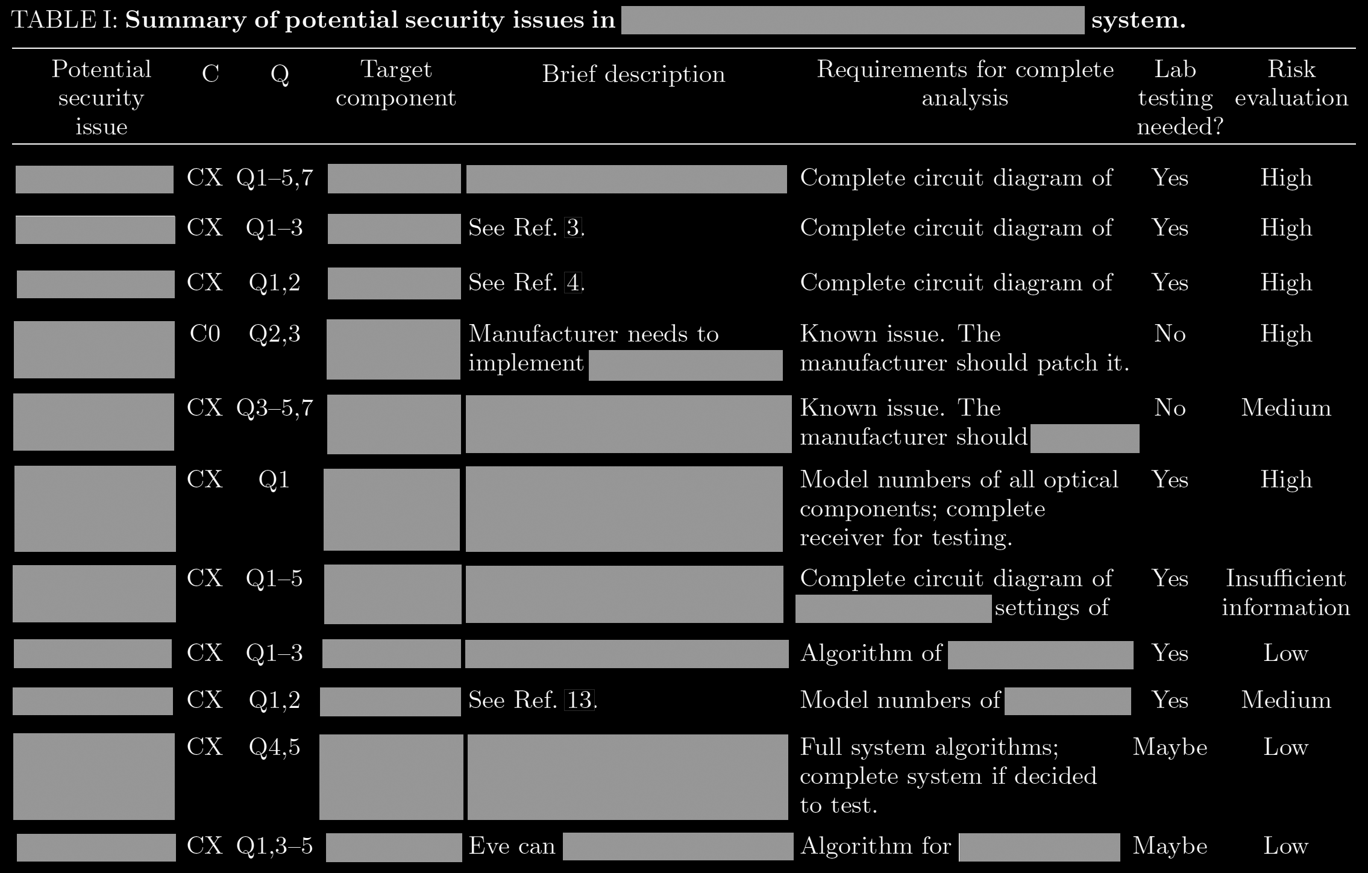
Example of initial analysis report

Slide 48


