Slide 1
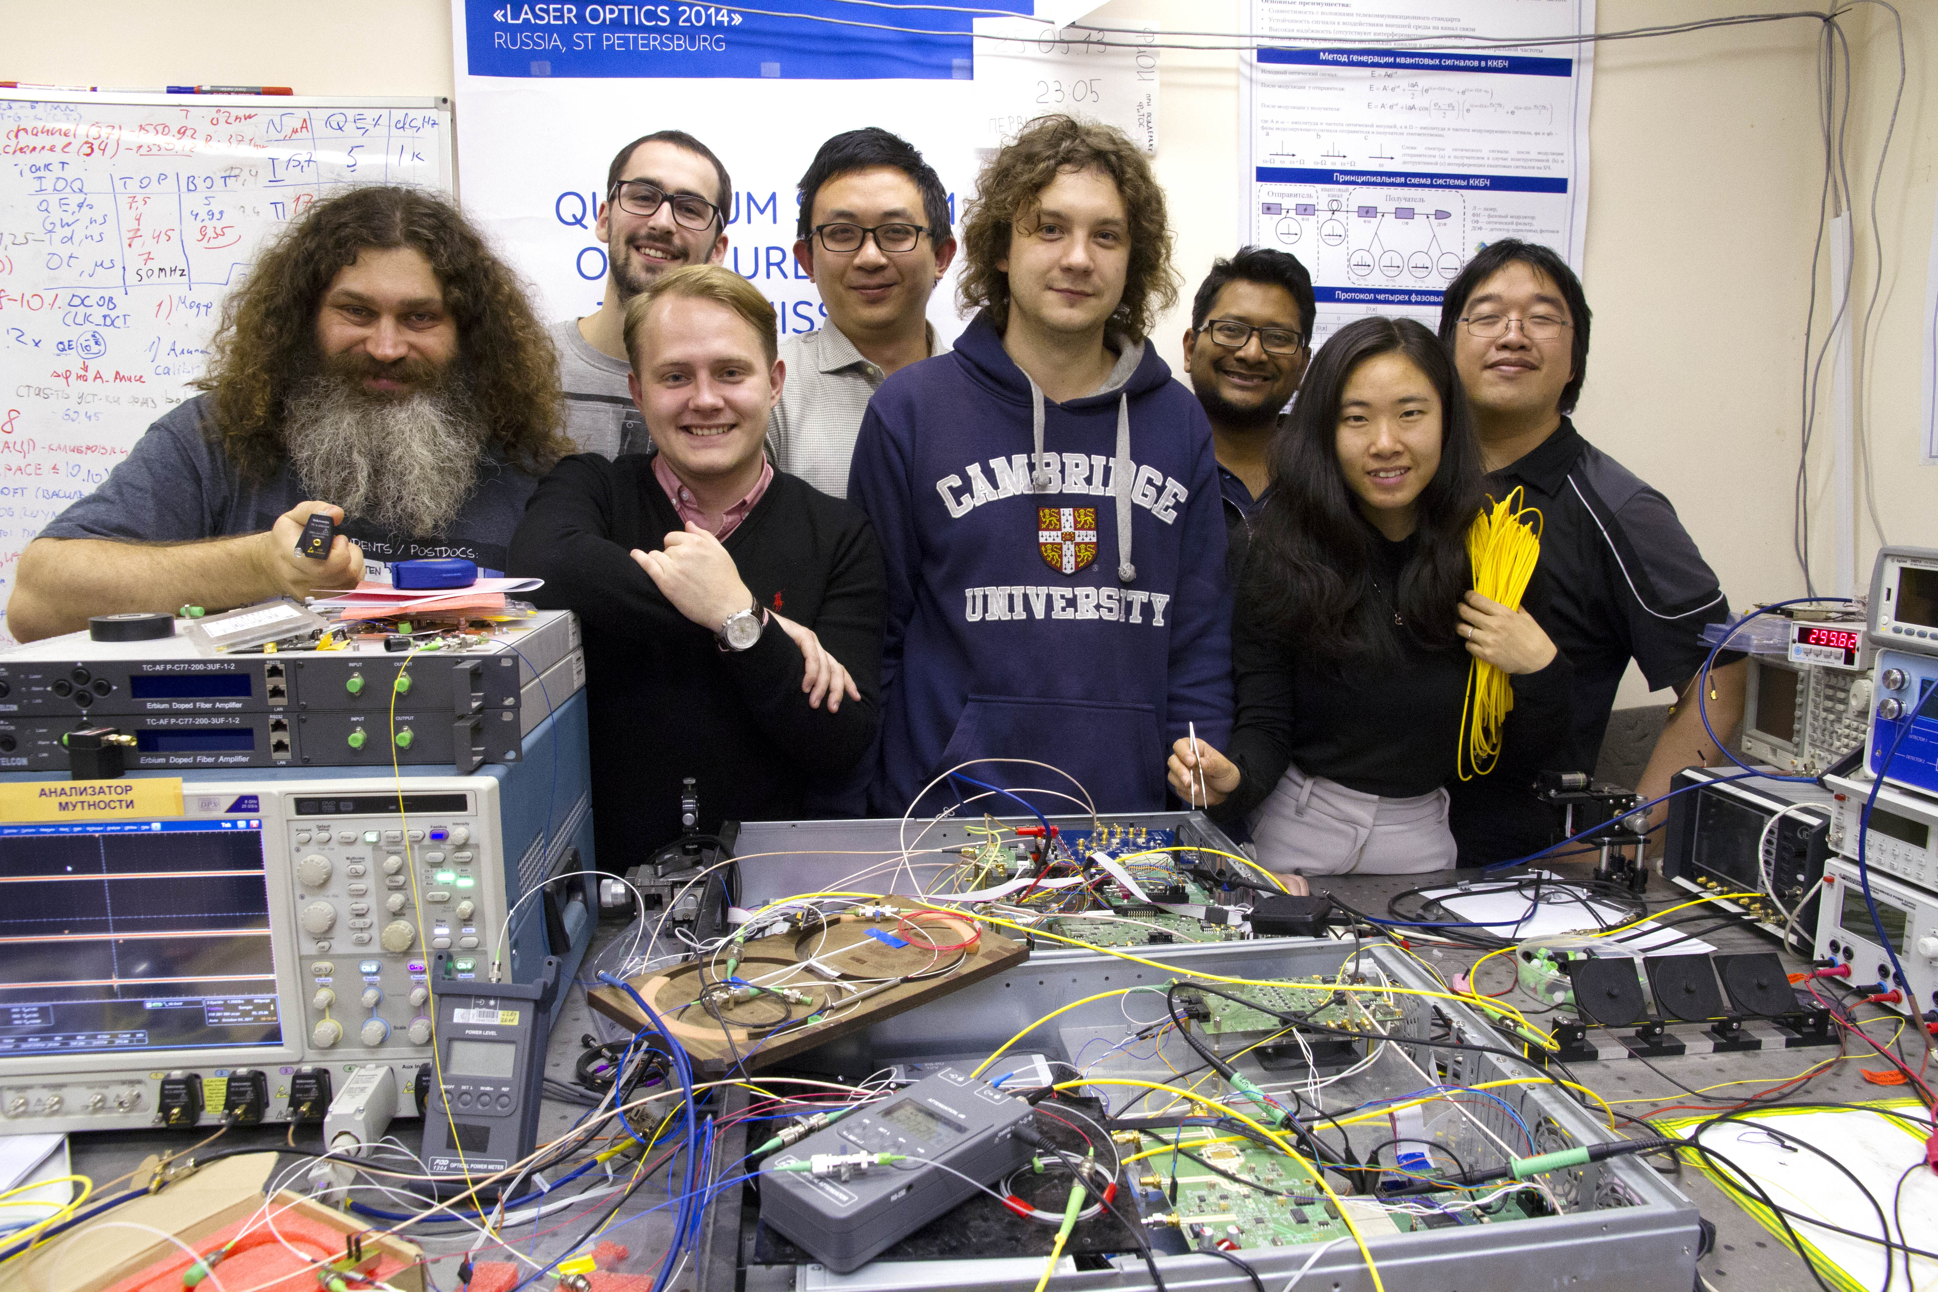
Improving security of a QKD system via an external audit
Talk at BQIT online workshop,
27–30 April 2020
Vadim 大胡子
vad1.com/lab
Quantum hacking lab
Photo © 2017 Vadim Makarov / ITMO

Slide 2
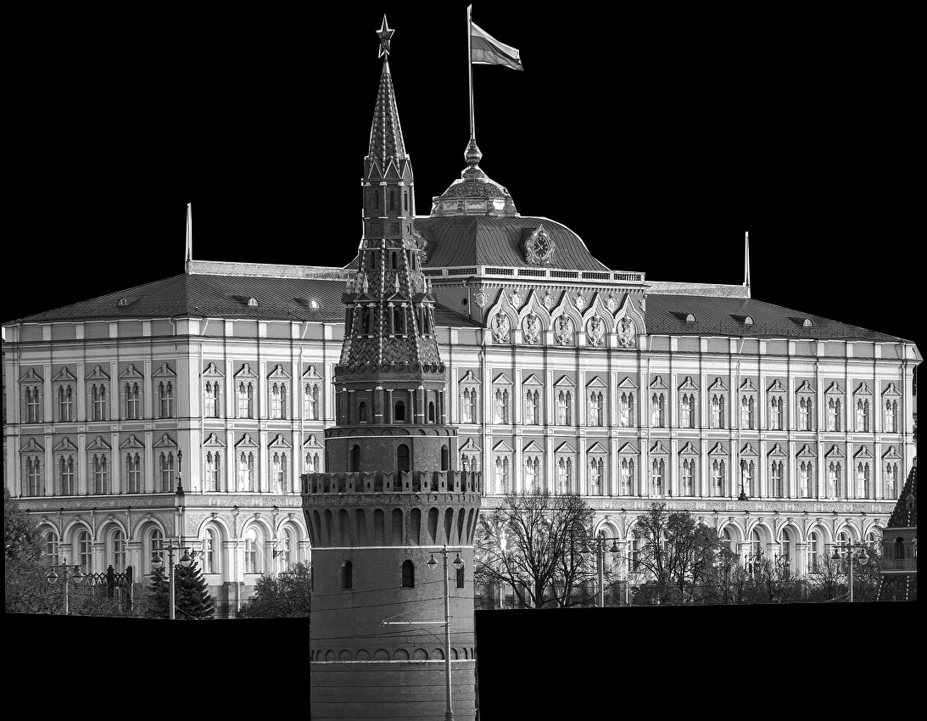
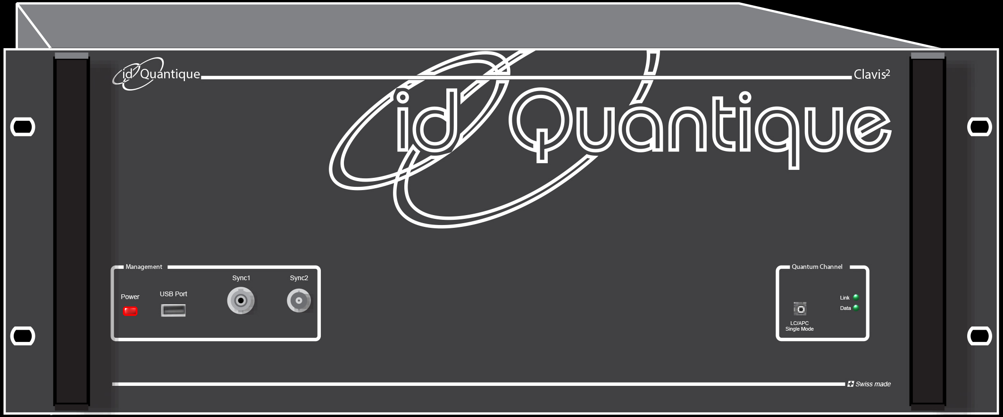
Certification of cryptographic tools
National security authority
Government
Legal requirements
Accredited lab
System
Certificate
Engineering documentation
Sale
Manufacturer
Customer

Slide 3
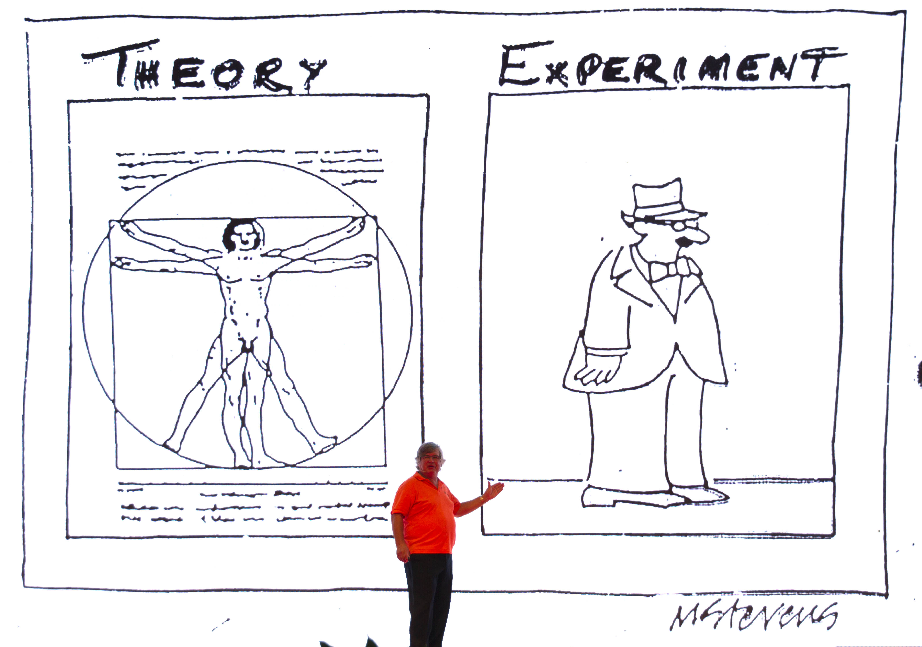

Slide 4
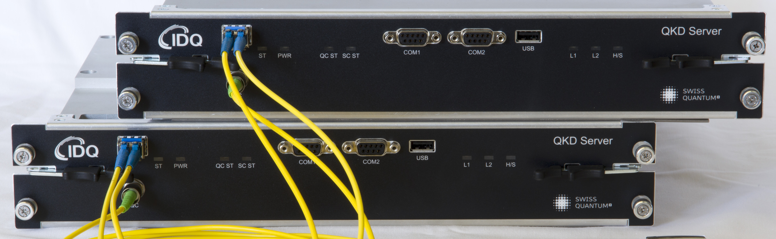
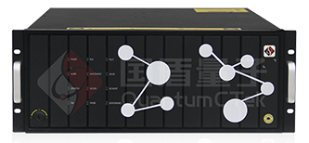




Security audit
 | System | Report | Tests
 | Clavis3 | 2016 | –2018 interrupted
 | 40 MHz | 2016, 2018–19 | ongoing
(ООО Квантовые коммуникации) | Subcarrier scheme | 2018 | ongoing
S. Sajeed et al., arXiv:1909.07898
 | New 312.5 MHz system | (2020) | ongoing
Certification standards are being drafted since 2019 in
Industry standards group in QKD

Slide 5
Hardness against implementation imperfections
Rating | Description
C3. Solution secure | Imperfection not applicable or in security proof
C2. Solution robust | Protects against known attacks but is not in security proof
C1. Solution only partially effective | Protects adainst one attack but fails to another
C0. Insecure | Loophole confirmed, no countermeasure
CX. Not tested | Loophole suspected
S. Sajeed, P. Chaiwongkhot, A. Huang, H. Qin,
V. Egorov, A. Kozubov, A. Gaidash, V. Chistiakov, A. Vasiliev, A. Gleim, V. Makarov, arXiv:1909.07898

Slide 6
Risk evaluation
Loophole
likely 1
or unlikely 0
to exist?
Exploitable with
today’s 1
or future 0
technology?
Leaks
major 1
or minor 0
fraction of key?
+
+
3 Very high
2 High
1 Medium
0 Low
= risk
H. Qin, A. Huang, S.-H. Sun, V. Makarov, confidential report for Quantum CTek (2019), unpublished

Slide 7
Potential issue
 | C₂₀₁₇ | Q | Needed lab testing? | Initial risk eva-luation | C₂₀₂₀ | Status in early 2020
Detector control attack | CX | Q1–5,7 | Yes | High | C2 | Loophole experimentally confirmed, countermeasures implemented
Laser damage | CX | Q1,3 | Yes | High | C2 | Loophole experimentally confirmed in Alice, countermeasures implemented
Trojan horse | C2, C0 | Q1 | Yes | Low (Alice), High (Bob) | C2, C2 | Countermeasure developed, to be implemented
No general security proof | C0 | Q1,5 | No | High | C3 | Security proofs developed, software updated
Time-shift attack | CX | Q1–3,5 | Yes | Medium | CX | Lower priority, future work
Privacy amplification | C0 | Q5 | No | High | C3 | Correct processing implemented
Finite-key-size effects | C0 | Q5 | No | Low | C3 | Security proofs developed, software updated
Non-quantum RNG | C0 | Q5 | No | Low | C3 | Physical RNG selected, to be implemented
Intersymbol interference | CX | Q1–3 | Yes | Low | CX | Lower priority, future work
S. Sajeed, P. Chaiwongkhot, A. Huang, H. Qin,
V. Egorov, A. Kozubov, A. Gaidash, V. Chistiakov, A. Vasiliev, A. Gleim, V. Makarov, arXiv:1909.07898

Slide 8
Subcarrier-wave QKD scheme
Alice
Bob
Ω
Ω
φ_{A}
Att
φ_{B}
ω
ω−Ω ω ω+Ω
ω−Ω ω ω+Ω
ω−Ω ω+Ω
φ_{A} = φ_{B}
ω−Ω ω+Ω
|φ_{A}− φ_{B}| = π
A. V. Gleim et al., Opt. Express 24, 2619 (2016)

Slide 9
1. Detector control attack
Alice
Bob
V. Chistiakov et al., Opt. Express 27, 32253 (2019)
Ω
Ω
ω
Bob´
Alice´
φ_{A}
Att
φ_{B}
ID210 or
Scontel SNSPD
V. Chistiakov et al., Opt. Express 27, 32253 (2019)
M. Elezov et al., Opt. Express 27, 30979 (2019)

Slide 10
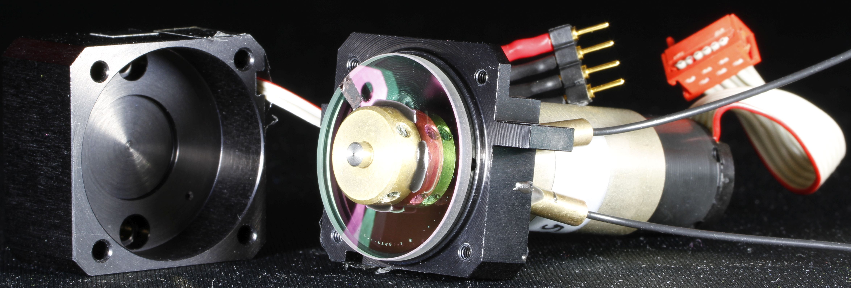
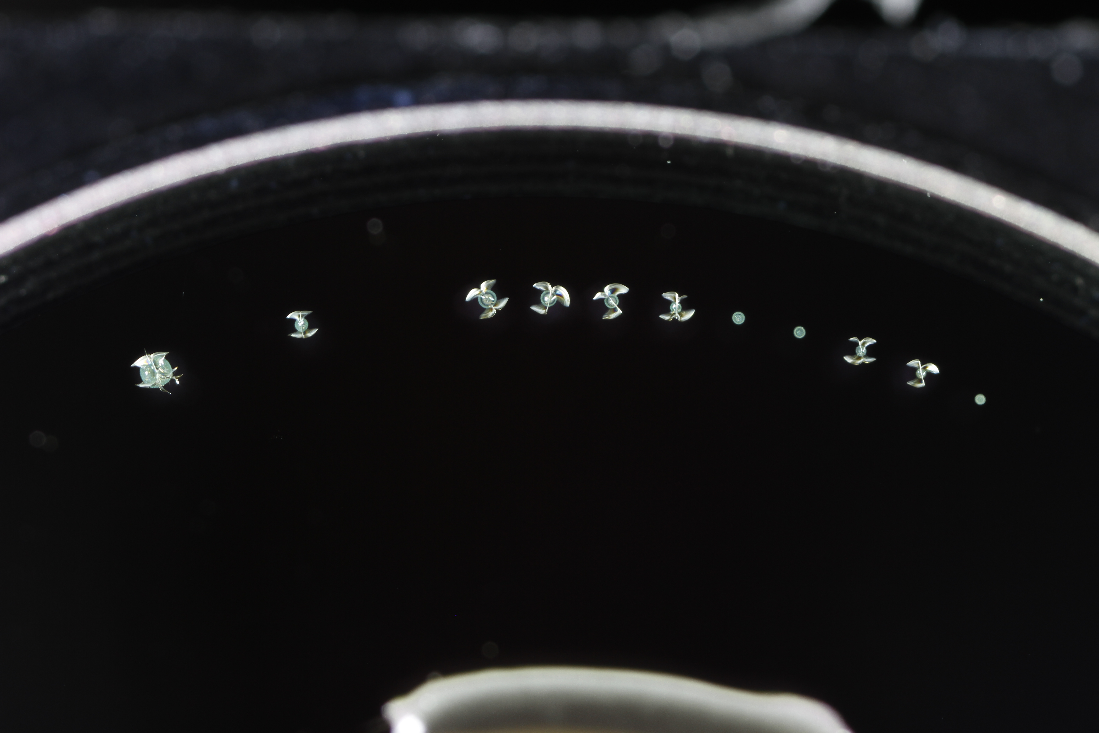
2. Laser damage
Alice
Bob
A. Ponosova et al., unpublished
Ω
Ω
~ 3 W
φ_{A}
Att
φ_{B}
FOD 5418
~ 10 dB reduction
0
1 mm
A. Huang et al., Phys. Rev. Appl. 13, 034017 (2020)

Slide 11
3. Trojan horse
Alice
Bob
Ω
Ω
φ_{A}
φ_{B}
Att
Patent pending
φ_{A}
φ_{B}

Slide 12
4. Lack of general security proof
Alice
Bob
Collective beamsplitting attack
G. P. Miroshnichenko et al., Opt. Express 26, 11292 (2018)
Ω
Ω
φ_{A}
Att
φ_{B}
QND or
manipulating reference ω
General proof
A. Kozubov, A. Gaidash, G. Miroshnichenko, arXiv:1903.04371
A. Gaidash, A. Kozubov, G. Miroshnichenko, J. Opt. Soc. Am. B 36, B16 (2019)
A. Gaidash, A. Kozubov, G. Miroshnichenko, Physica Scr. (2019)

Slide 13
6. Privacy amplification
Alice
Bob
A. Kozubov, A. Gaidash, G. Miroshnichenko,
arXiv:1903.04371
Ω
Ω
φ_{A}
Att
φ_{B}

Slide 14
7. Finite-key-size effects
Alice
Bob
N
A. Kozubov, A. Gaidash, G. Miroshnichenko,
arXiv:1903.04371
Ω
Ω
φ_{A}
Att
φ_{B}

Slide 15
8. Non-quantum random number generator
Alice
Bob
Q
RNG
Q
RNG
Ω
Ω
φ_{A}
Att
φ_{B}
A. Ivanova et al., Nanosyst. Phys. Chem. Math. 8, 441 (2017)

Slide 16
Potential issue
 | C₂₀₁₇ | Q | Needed lab testing? | Initial risk eva-luation | C₂₀₂₀ | Status in early 2020
Detector control attack | CX | Q1–5,7 | Yes | High | C2 | Loophole experimentally confirmed, countermeasures implemented
Laser damage | CX | Q1,3 | Yes | High | C2 | Loophole experimentally confirmed in Alice, countermeasures implemented
Trojan horse | C2, C0 | Q1 | Yes | Low (Alice), High (Bob) | C2, C2 | Countermeasure developed, to be implemented
No general security proof | C0 | Q1,5 | No | High | C3 | Security proofs developed, software updated
Time-shift attack | CX | Q1–3,5 | Yes | Medium | CX | Lower priority, future work
Privacy amplification | C0 | Q5 | No | High | C3 | Correct processing implemented
Finite-key-size effects | C0 | Q5 | No | Low | C3 | Security proofs developed, software updated
Non-quantum RNG | C0 | Q5 | No | Low | C3 | Physical RNG selected, to be implemented
Intersymbol interference | CX | Q1–3 | Yes | Low | CX | Lower priority, future work
S. Sajeed, P. Chaiwongkhot, A. Huang, H. Qin,
V. Egorov, A. Kozubov, A. Gaidash, V. Chistiakov, A. Vasiliev, A. Gleim, V. Makarov, arXiv:1909.07898

Slide 17
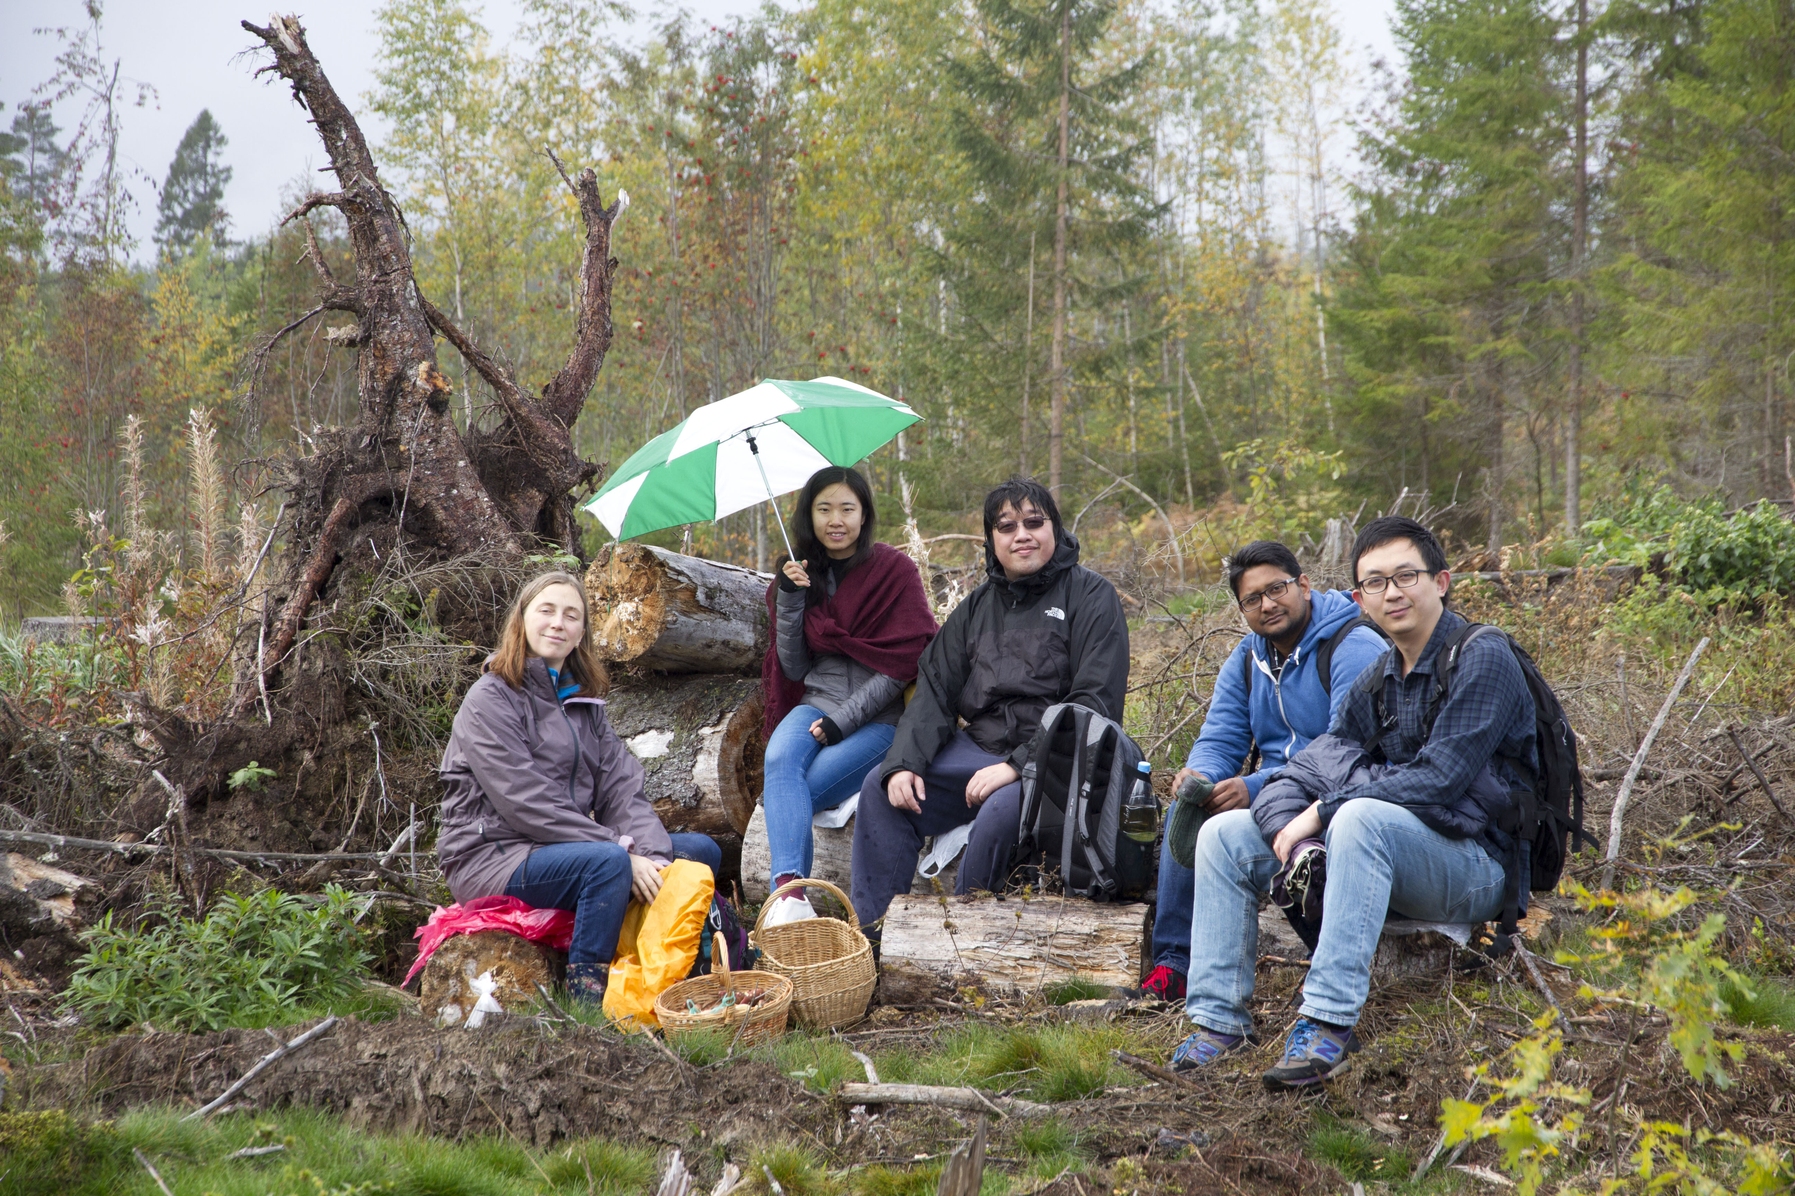
+ V. Chistiakov, V. Egorov, S. Feng, A. Gaidash, A. Gleim, S. Kozlov, A. Kozubov, M. Legre, D. Li, N. Lütkenhaus, G. Ribordy, S.-H. Sun, Y. Tang, A. Vasiliev, Y. Zhao
Photo © 2017 Vadim Makarov
A. Huang S. Sajeed
P. Chaiwongkhot H. Qin

Slide 18
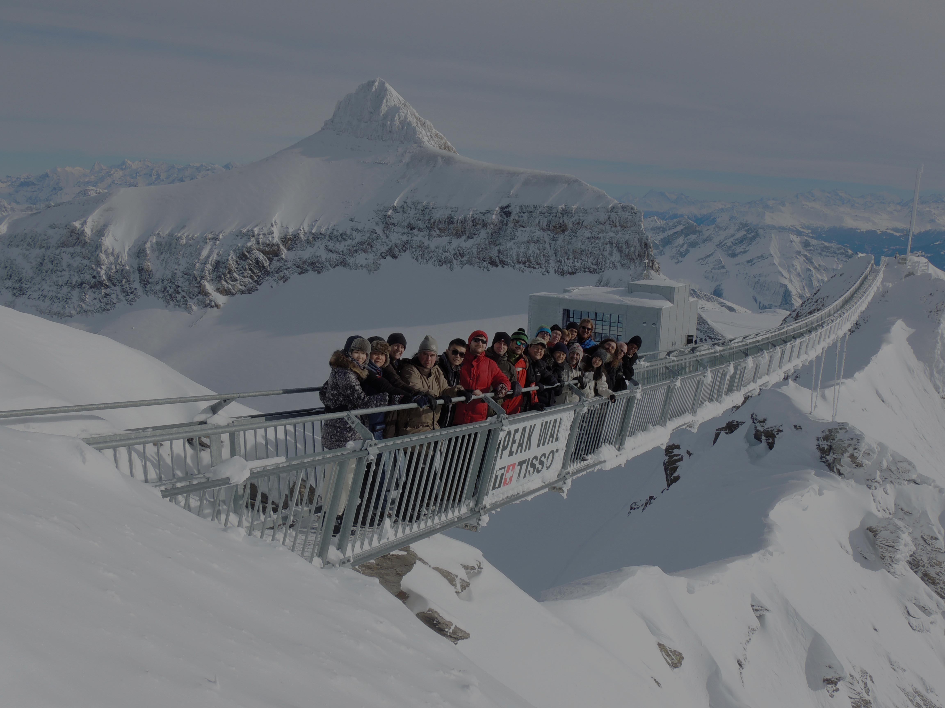
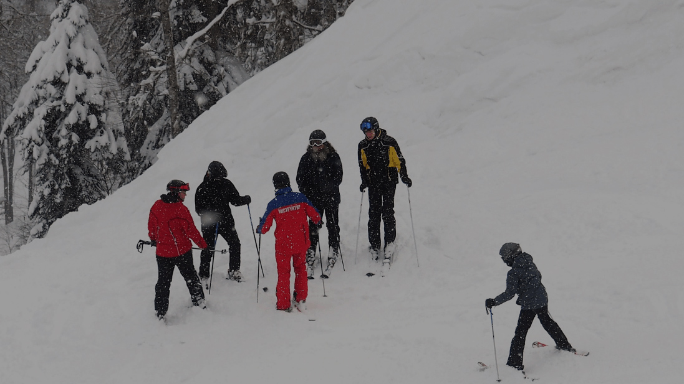
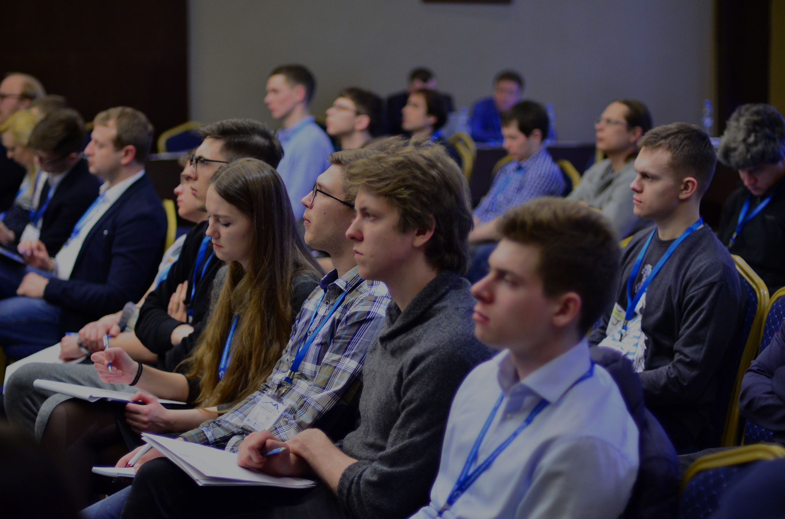
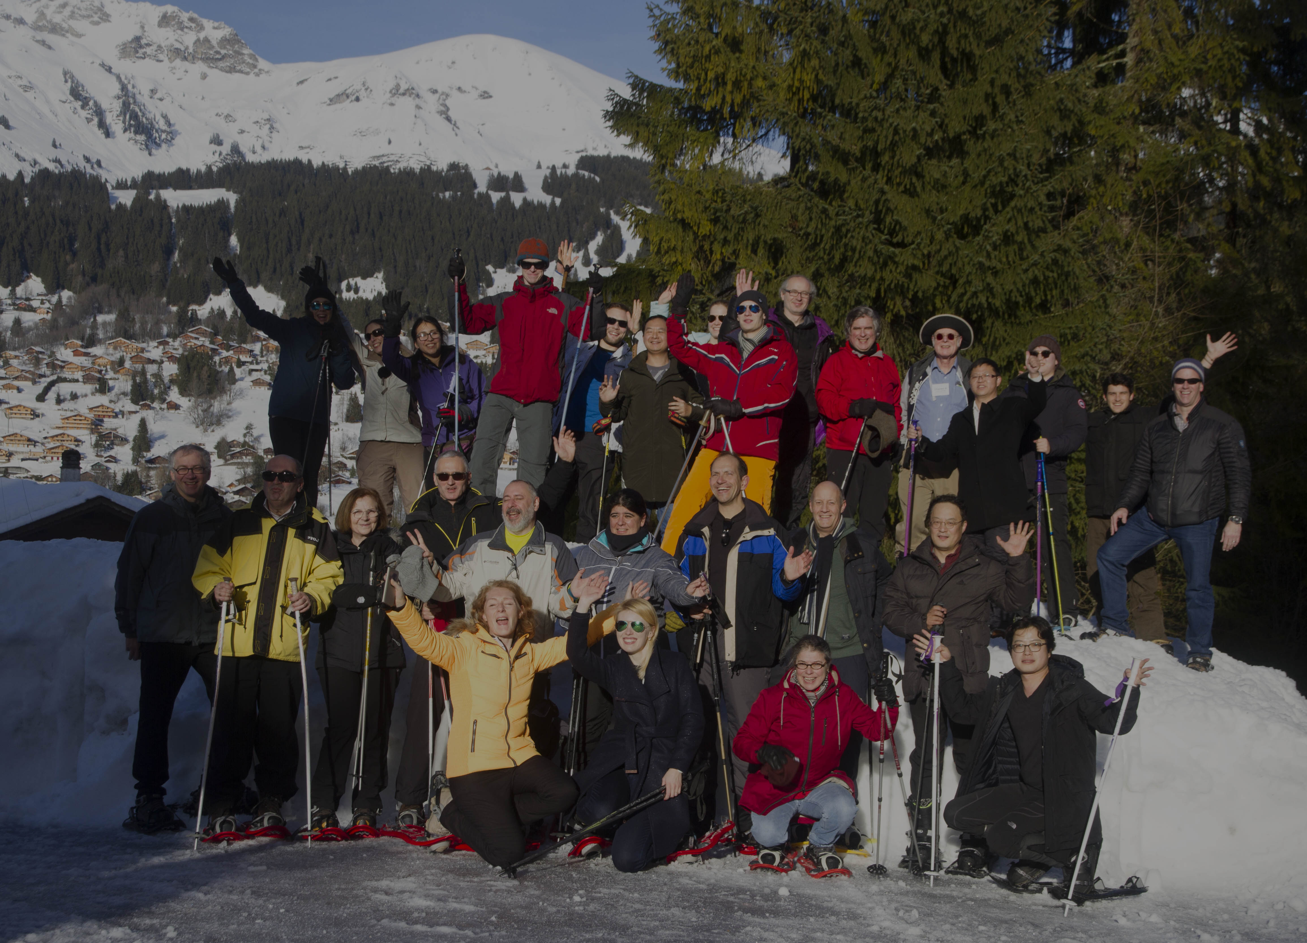
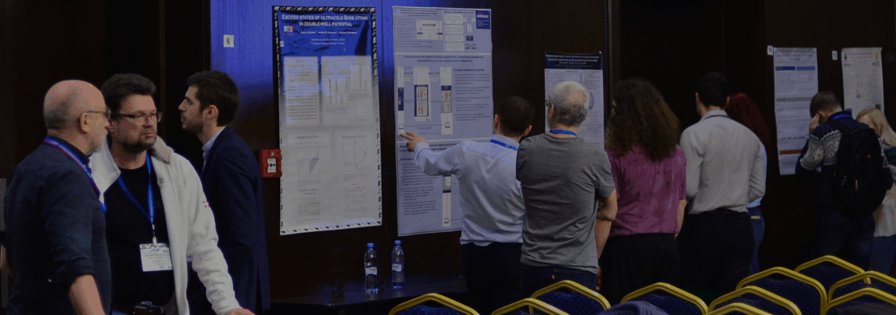

Winter school on quantum cybersecurity
Annual. Next: January 2021
Les Diablerets, Switzerland
2 days (executive track) +
4 days (technical track, with 4 labs)
Overview talks + quantum technologies, including QKD
Lecturers in 2020: R. Alléaume, J. Baloo, G. Brassard, F. Bussières, A. Ekert, N. Gisin, V. Makarov, M. Mosca, L. Perret, S. Popescu, R. Pravahan, R. Renner, H. Riel, G. Ribordy, D. Stucki, N. Walenta, E. Wille
35 students, first-come, sells out
€3200 / €1600 executive track only
Winter sports in breaks
Organised by
Contact www.idquantique.com
for registration
International school on quantum technology
Annual. Next: early March 2021
Roza Khutor, Russia
5 days of lectures and skiing,
poster session, industry exhibit
Tutorials on quantum sensing, computing, metrology, QKD
Lecturers in 2020: S. Astakhov, M. Bellini, J. Biamonte, A. Bramati, E. Duplyakin, M. Fedorov, M. Genovese, P. Grangier, Z. Hradil, E. Il’ichev, N. Kolachevsky, V. Makarov, L. L. S. Soto, S. Takeuchi
100 students, competitive admission
€200
Skiing & snowboarding instruction
Organised by
qutes.org
2016
2018
2019

