Slide 1
Cryptography
1. Make key
2. Encrypt
3. Decrypt

Slide 2
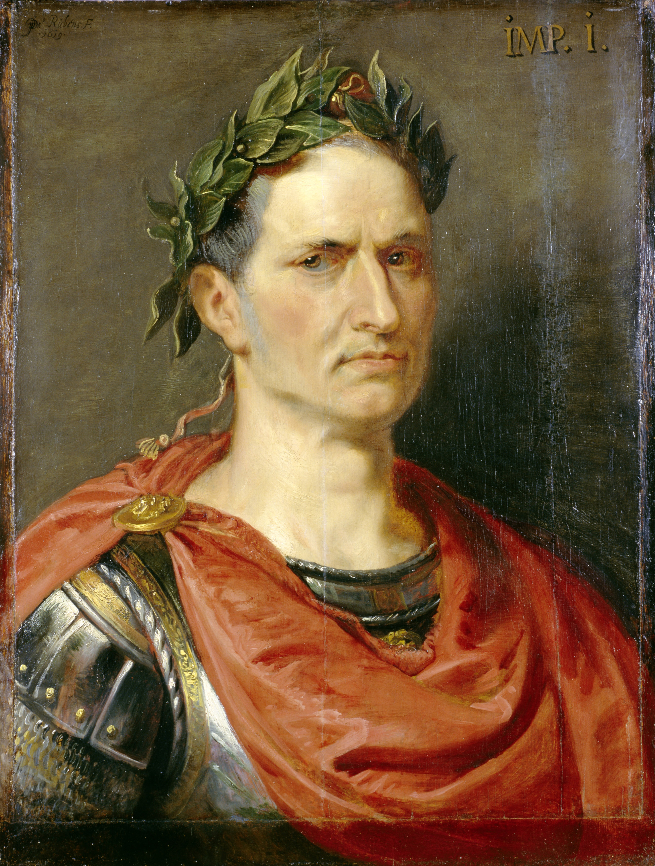
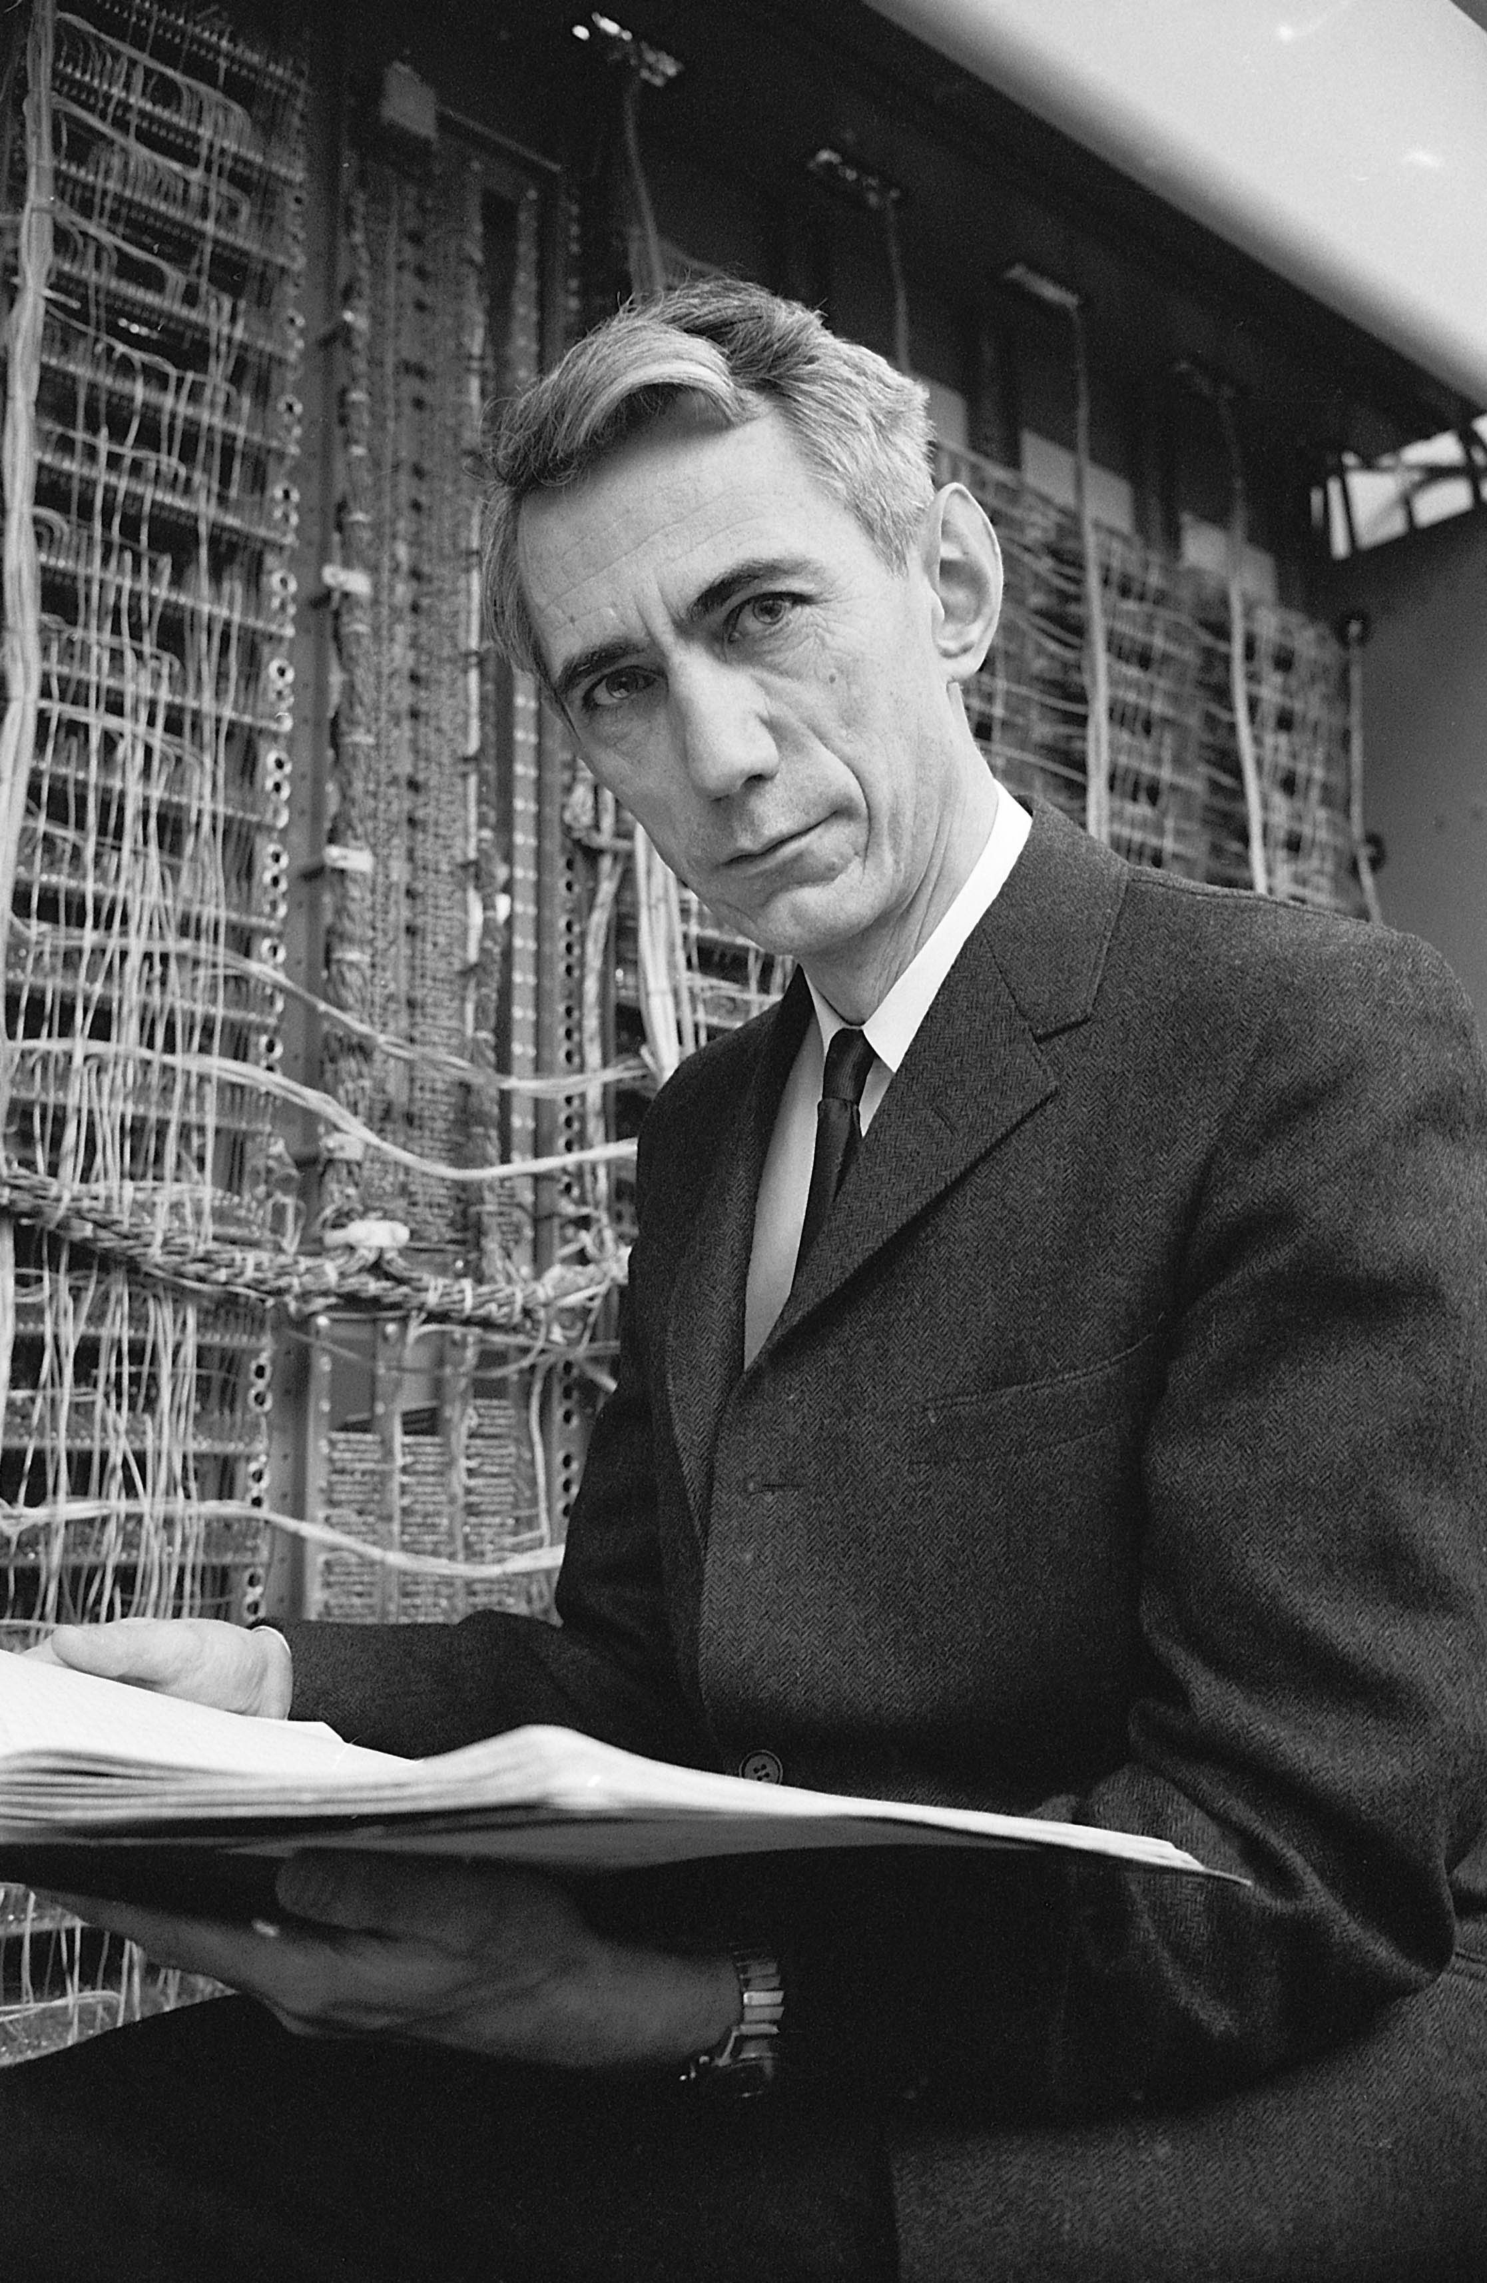
Photo ©1963 Alfred Eisenstaedt / The LIFE Picture Collection / Getty
Caesar cipher
invented ~50 BC (Julius Caesar)
One-time pad
invented 1918 (Gilbert Vernam)
proven unbreakable by information theory 1949 (Claude Shannon )
Peter Paul Rubens, Julius Caesar, 1619, oil on canvas, 69×52 cm,
Stiftung Preußische Schlösser und Gärten Berlin-Brandenburg, Berlin

Slide 3
A (very) brief history of cryptography
 |  |  |  |  | Broken?
Monoalphabetic cipher |  | invented ~50 BC (J. Caesar) |  |  | ~850 (Al-Kindi)
Nomenclators (code books) |  | ~1400 – ~1800 |  |  | ✓
Polyalphabetic (Vigenère) |  | 1553 – ~1900 |  |  | 1863 (F. W. Kasiski)
···
One-time pad |  | invented 1918 (G. Vernam) |  |  | impossible (C. Shannon 1949)
Polyalphabetic electromechanical (Enigma, Purple, etc.) |  | 1920s – 1970s |  |  | ✓
···
DES |  | 1977 – 2005 |  |  | 1998: 56 h (EFF)
Public-key crypto (RSA, elliptic-curve) |  |  | 1977 – |  | will be once we have q. computer (P. Shor 1994)
AES |  | 2001 – |  |  | ?
Public-key crypto (‘quantum-safe’) |  | in development |  |  | ?

Slide 4
Probability of letters in English text
https://en.wikipedia.org/wiki/Frequency_analysis

Slide 5
A (very) brief history of cryptography
 |  |  |  |  | Broken?
Monoalphabetic cipher |  | invented ~50 BC (J. Caesar) |  |  | ~850 (Al-Kindi)
Nomenclators (code books) |  | ~1400 – ~1800 |  |  | ✓
Polyalphabetic (Vigenère) |  | 1553 – ~1900 |  |  | 1863 (F. W. Kasiski)
···
One-time pad |  | invented 1918 (G. Vernam) |  |  | impossible (C. Shannon 1949)
Polyalphabetic electromechanical (Enigma, Purple, etc.) |  | 1920s – 1970s |  |  | ✓
···
DES |  | 1977 – 2005 |  |  | 1998: 56 h (EFF)
Public-key crypto (RSA, elliptic-curve) |  |  | 1977 – |  | will be once we have q. computer (P. Shor 1994)
AES |  | 2001 – |  |  | ?
Public-key crypto (‘quantum-safe’) |  | in development |  |  | ?

Slide 6
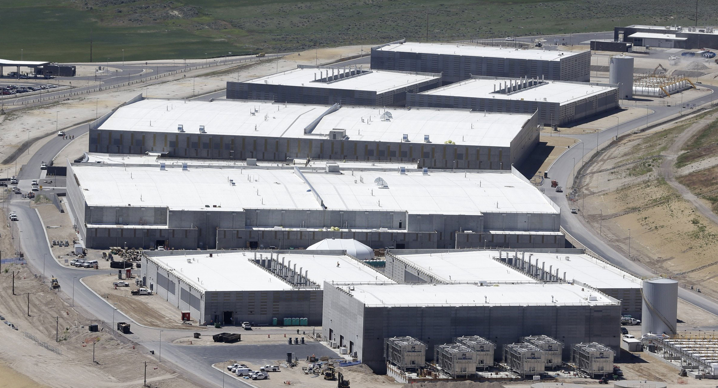
Breaking cryptography retroactively
Encrypt
In future:
Decrypt
Store copy
Decrypt
Photo © 2013 AP / Rick Bowmer

Slide 7
A (very) brief history of cryptography
 |  |  |  |  | Broken?
Monoalphabetic cipher |  | invented ~50 BC (J. Caesar) |  |  | ~850 (Al-Kindi)
Nomenclators (code books) |  | ~1400 – ~1800 |  |  | ✓
Polyalphabetic (Vigenère) |  | 1553 – ~1900 |  |  | 1863 (F. W. Kasiski)
···
One-time pad |  | invented 1918 (G. Vernam) |  |  | impossible (C. Shannon 1949)
Polyalphabetic electromechanical (Enigma, Purple, etc.) |  | 1920s – 1970s |  |  | ✓
···
DES |  | 1977 – 2005 |  |  | 1998: 56 h (EFF)
Public-key crypto (RSA, elliptic-curve) |  |  | 1977 – |  | will be once we have q. computer (P. Shor 1994)
AES |  | 2001 – |  |  | ?
Quantum cryptography | invented 1984, in development |  |  |  |  | impossible
Public-key crypto (‘quantum-safe’) |  | in development |  |  | ?
 |  |  |  |  | Broken?
Monoalphabetic cipher |  | invented ~50 BC (J. Caesar) |  |  | ~850 (Al-Kindi)
Nomenclators (code books) |  | ~1400 – ~1800 |  |  | ✓
Polyalphabetic (Vigenère) |  | 1553 – ~1900 |  |  | 1863 (F. W. Kasiski)
···
One-time pad |  | invented 1918 (G. Vernam) |  |  | impossible (C. Shannon 1949)
Polyalphabetic electromechanical (Enigma, Purple, etc.) |  | 1920s – 1970s |  |  | ✓
···
DES |  | 1977 – 2005 |  |  | 1998: 56 h (EFF)
Public-key crypto (RSA, elliptic-curve) |  |  | 1977 – |  | will be once we have q. computer (P. Shor 1994)
AES |  | 2001 – |  |  | ?
Public-key crypto (‘quantum-safe’) |  | in development |  |  | ?

Slide 8
Encryption and key distribution
Alice
Bob
Secure channel
RNG
Secret key
Public (insecure) channel
Symmetric
cipher
Symmetric
cipher
Encrypted messages
Messages
Messages
Quantum key distribution transmits secret key
by sending quantum states over open channel.

Slide 9


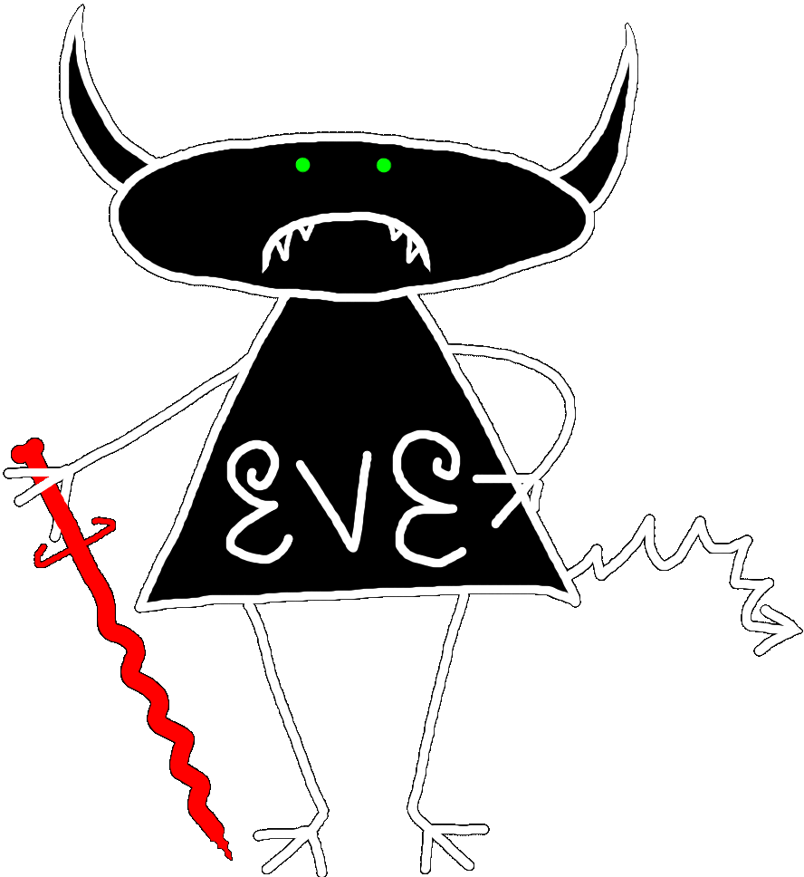
Quantum key distribution (QKD)
Alice
Bob
or ?
Prepares
photons
Measures
photons
(0), (1)
(0), (1)
Eavesdropping
introduces errors
C. H. Bennett, G. Brassard (1984)

Slide 10
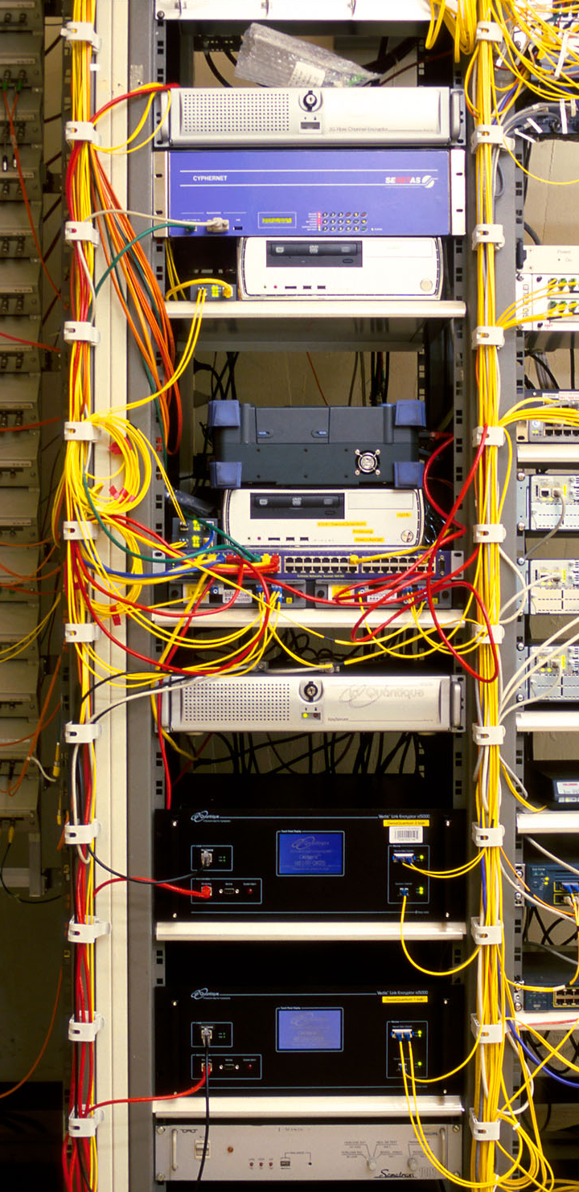

Commercial QKD
Classical encryptors:
L2, 2 Gbit/s
L2, 10 Gbit/s
L3 VPN, 100 Mbit/s
WDMs
17 km (fiber length)
Key manager
14 km
QKD to another node
(4 km)
QKD to another node
(14 km)
4 km
Photo © 2010 Vadim Makarov
www.swissquantum.com
ID Quantique Cerberis system (2010)

Slide 11
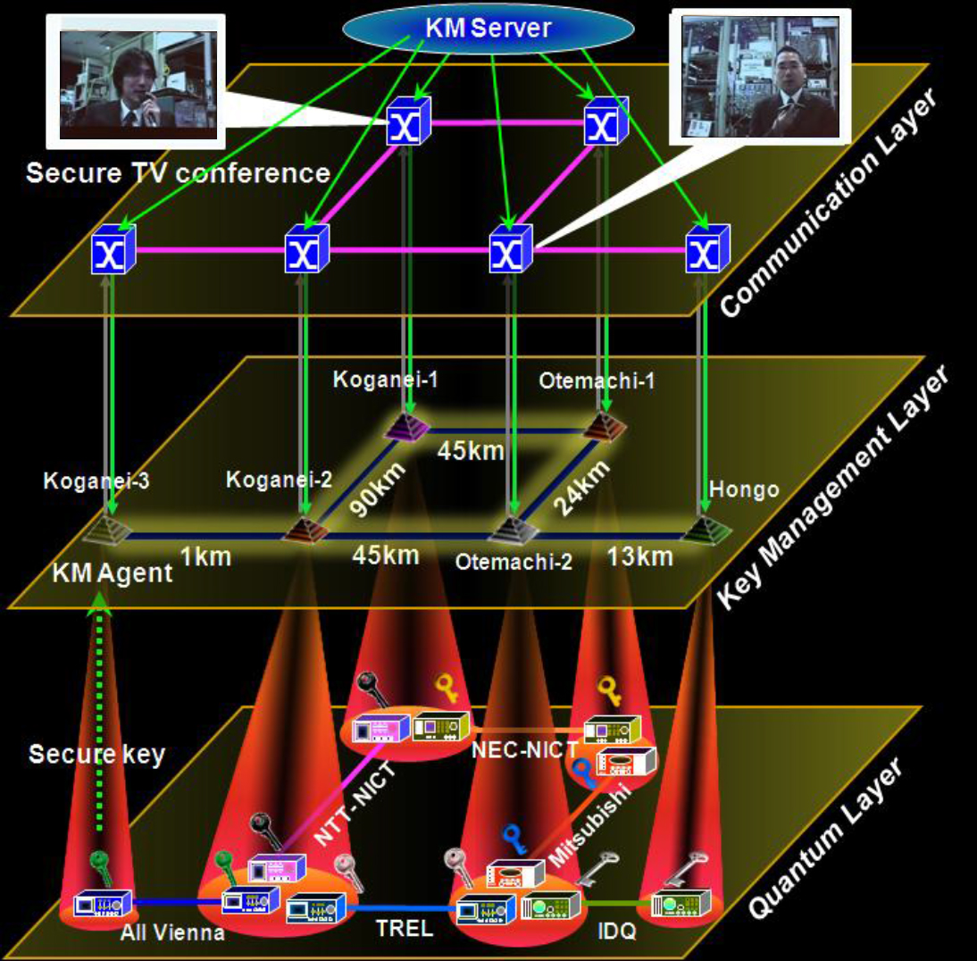
Trusted-node network
M. Sasaki et al., Opt. Express 19, 10387 (2011)

Slide 12
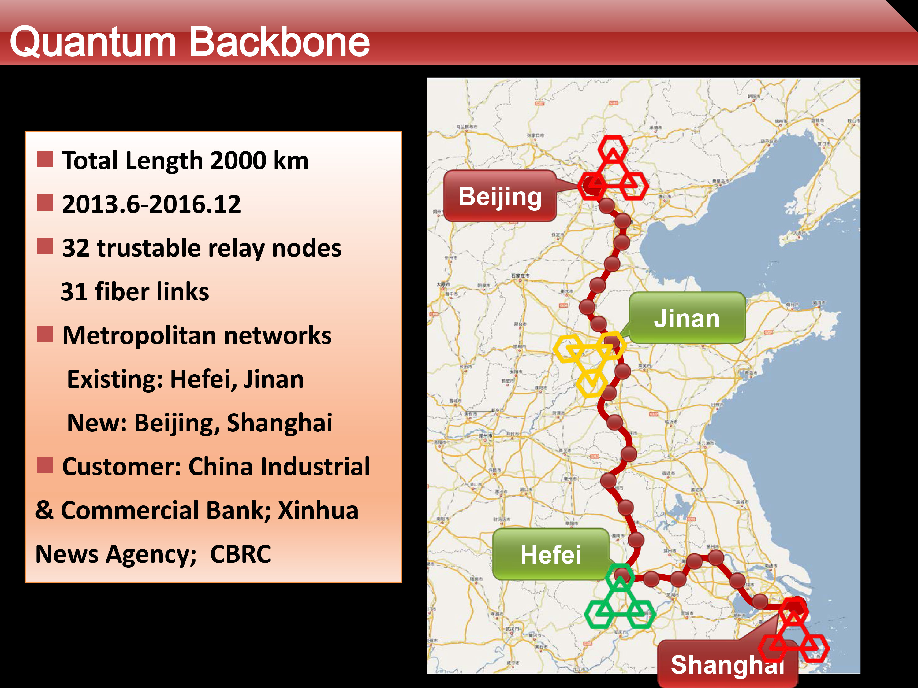
Q. Zhang, talk at QCrypt 2014

Slide 13
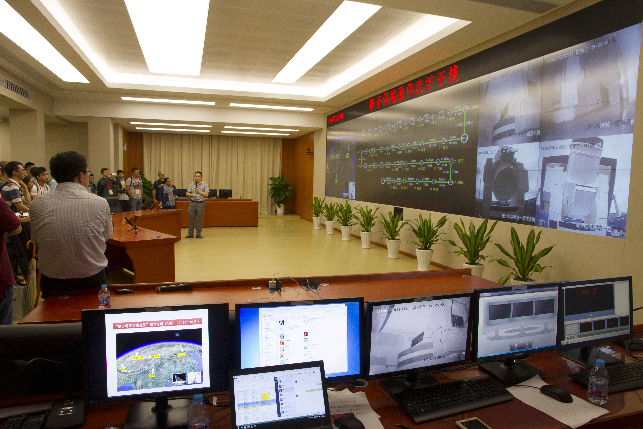
Shanghai control center of the Chinese quantum key distribution network and satellite
Photo © 2016 Vadim Makarov

Slide 14
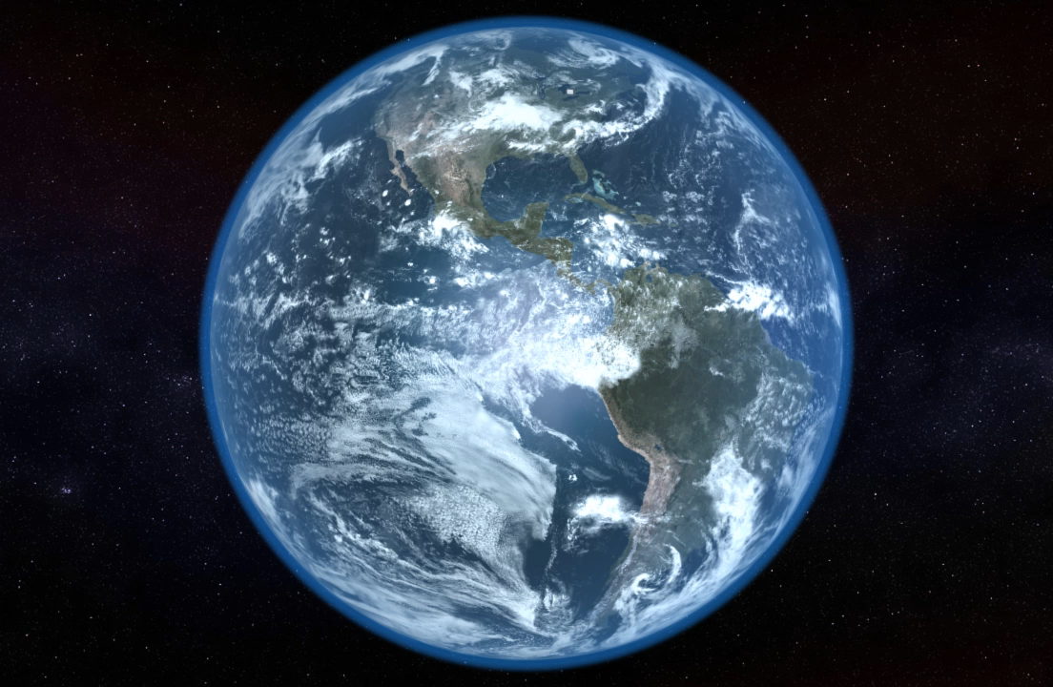
Global
quantum key distribution
Video ©2012 IQC / group of T. Jennewein

Slide 15
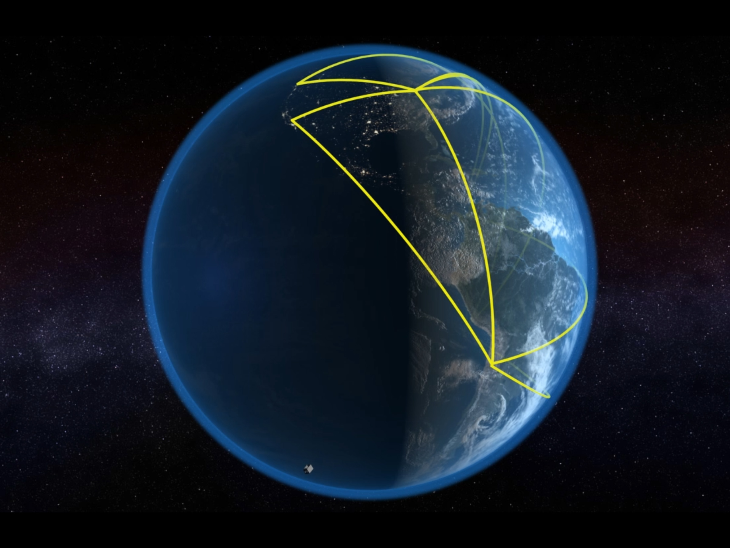
Video ©2012 IQC / group of T. Jennewein

Slide 16
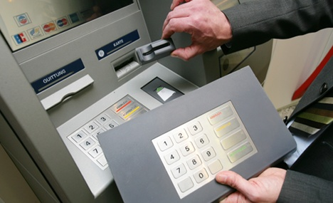
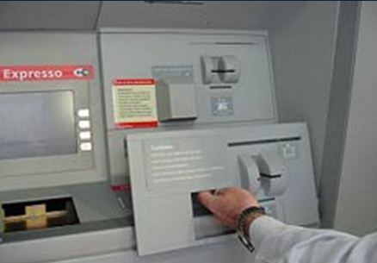
False ATM front

Slide 17
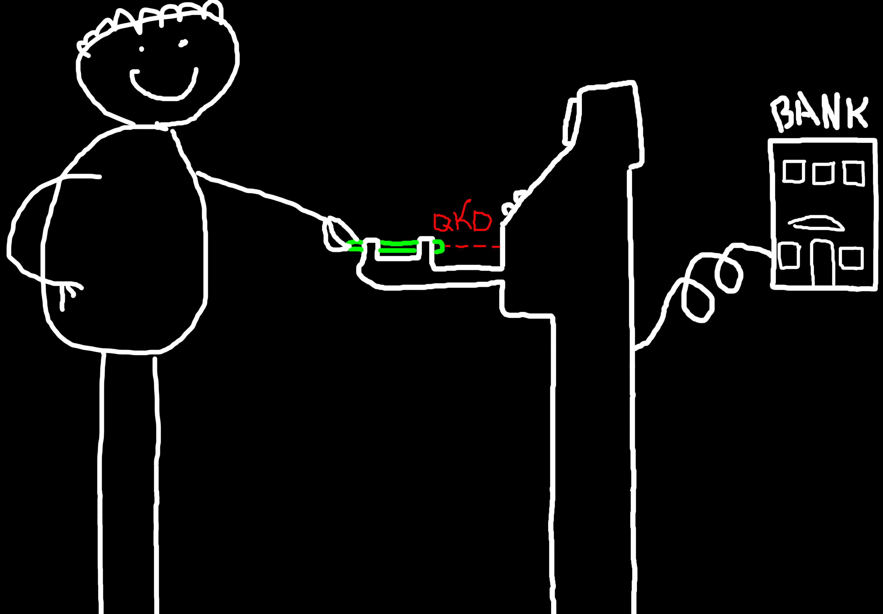
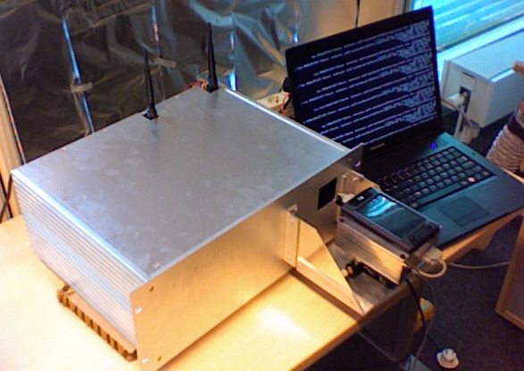
Solution: quantum ATM
J. L. Duligall et al., New J. Phys. 8, 249 (2006)

Slide 18
Solution: quantum ATM
Alice
Bob
Dichroic polarizers
LEDs
Si APDs
Front view
Side view
Diffraction
grating
Key rate: ~4 Kbit/s
J. L. Duligall et al., New J. Phys. 8, 249 (2006)

Slide 19
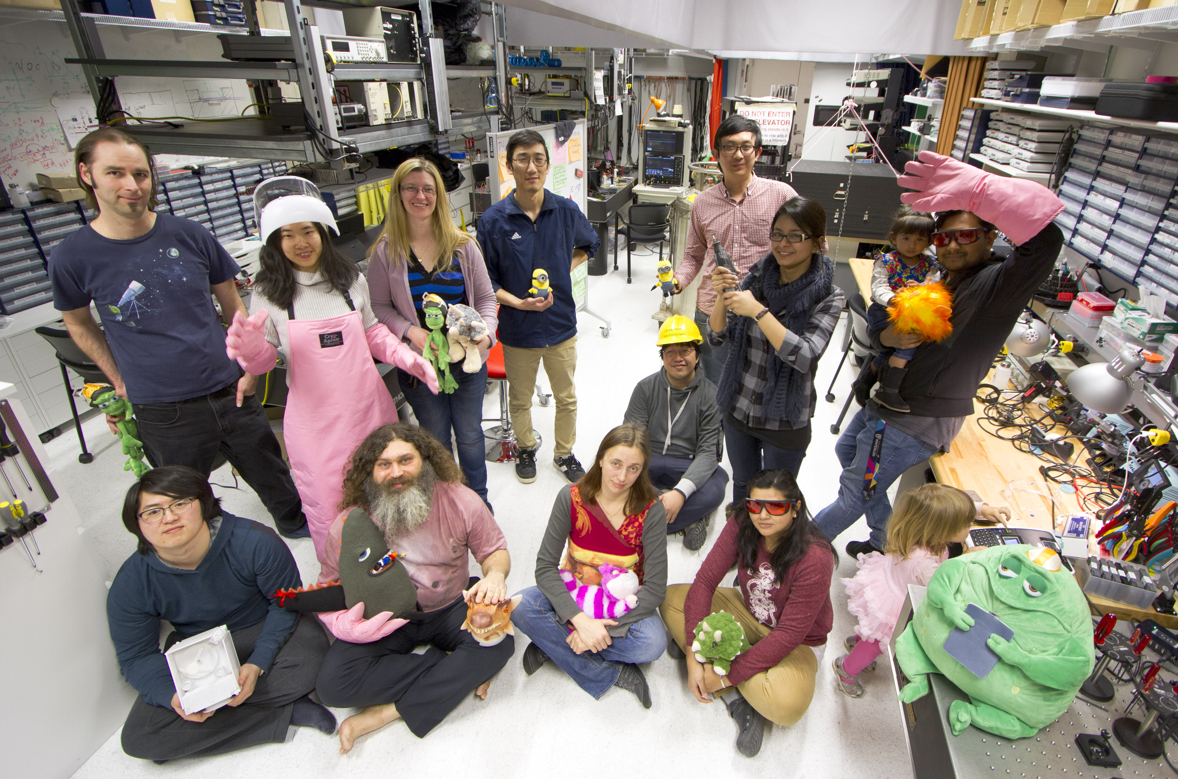
Photo © 2017 Vadim Makarov, Scott McManus / IQC
vad1.com/lab
Quantum hacking lab

Slide 20
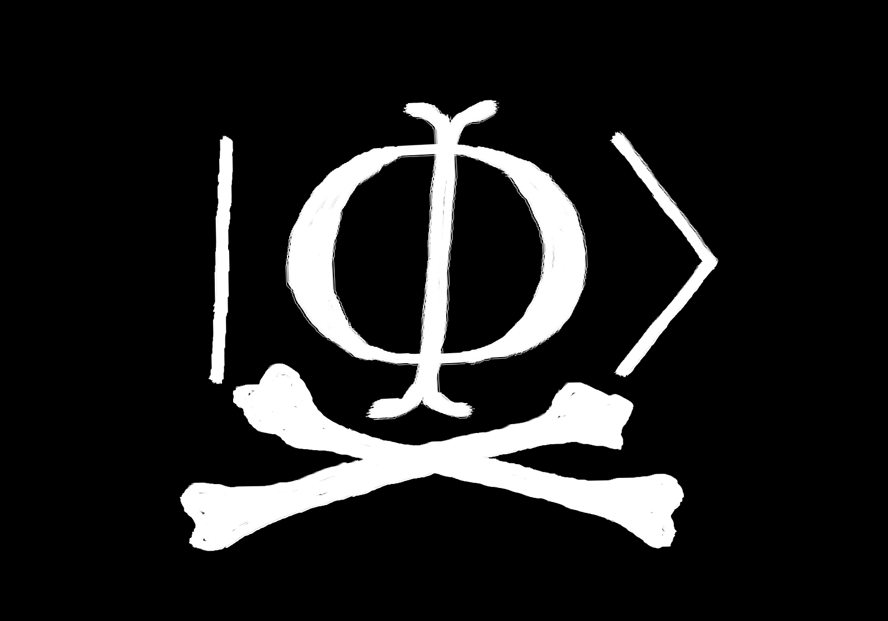
vad1.com/lab
Quantum hacking lab

